Slide 1
Cyclistic Bike-Share Case Study
Jake Isaacs
1/11/2022

Slide 2
Contents
Context
Data Sources
Assumptions
Analysis Findings and Summary of the Data
Conclusion and Recommendations
Visualizations created in RStudio and Tableau

Slide 3
Context
How do annual members and casual riders use Cyclistic bikes differently?
Notes:
Why are we here?
I have been tasked with answering the following question: How do annual members and casual riders use Cyclistic bikes differently?
Now, before moving forward, it is important to note, that due to data-privacy concerns, we do not have access to any sort of personally identifiable information or financial data. So, we are unable to look at this from a monetary lens or from individual users’ perspectives.

Slide 4
Data Sources
Public data set provided by Motivate International Inc.
Data spans December 2020 through November 2021
Each month’s data set contained 100,000+ records
Notes:
The public data provided for this project can be found here: https://divvy-tripdata.s3.amazonaws.com/index.html
The data is made available by Motivate International Inc. under the following license: https://ride.divvybikes.com/data-license-agreement
Data used ranges from December 2020 through November 2021.
Data source description:
Raw data and licensing linked above
Data contains these columns: ride_id, rideable_type, started_at, ended_at, start_station_name, start_station_id, end_station_name, end_station_id, start_lat, start_lng, end_lat, end_lng, member_casual
Data comes from Motivate International Inc., who operates the City of Chicago’s Divvy bicycle sharing service
12 individual files (one for each month of the year)
Each file contains ~100,000+ records

Slide 5
Assumptions
Data does not contain and riders’ personally identifiable information
Most users are local to the Chicago area and use the service frequently
Casual riders use the service for recreational use, and annual members use it more for commuting to work
Notes:
Set by the case study:
Annual members are much more profitable than casual riders
Leadership believes that maximizing the number of annual members will be key to future growth
My assumptions:
Due to data-privacy issues, the public data used for this project does not contain any riders' personally identifiable information, so we must make many assumptions based on individual trip records based on trip time and user type (casual or member)
Most users are local to the Chicago area and use the service fairly regularly
Annual members use the service for commuting to work
Casual riders use the service for recreational use, it's likely this is most frequently on weekends
Single-ride and full-day passes are generally cheaper than an annual membership, but there is a certain frequency of use where the annual membership is the better deal for users while still being the most profitable offering for the company
No financial information or customer/user information is made available for this case study, so many general assumptions were made in the process of completing this project.

Slide 6
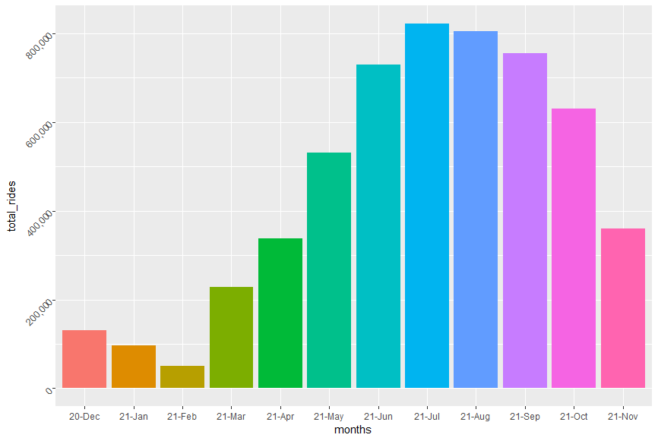
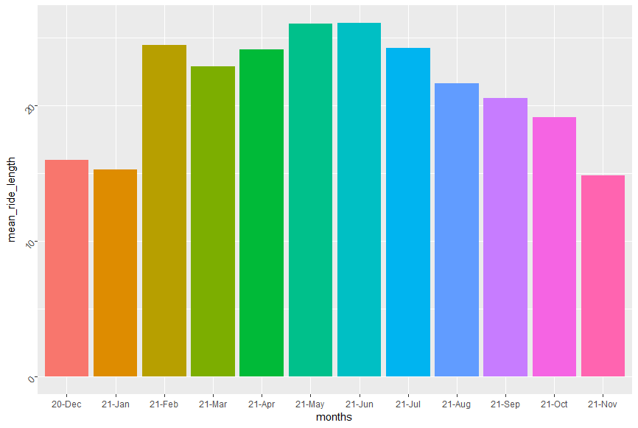
Overview
Total Rides
Average Ride Length (Minutes)
Notes:
To provide a quick overview of the data, first we’ll look at the total rides taken per month and the average ride length per month.
Here we can see that July was the busiest month in terms of the total number of rides taken. May and June are very close as the months with the longest average ride lengths (measured in minutes)
Already, we can see there seems to be some seasonality with the number of rides taken. The summer months are a lot busier than the winter months early in the year.

Slide 7
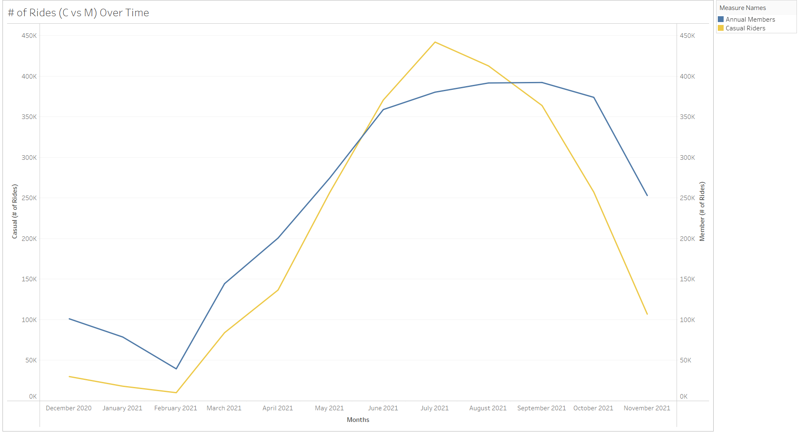
Total Rides
Notes:
Our first comparison of casual riders vs annual members will be the total rides recorded throughout the year.
We can already see the same seasonal pattern as we saw in the previous slide, the summer months tend to be busier with more rides taken by both types of users.
The top month for casual riders was July with 442,056 total trips
The top month for annual members was September with 392,257 total trips

Slide 8
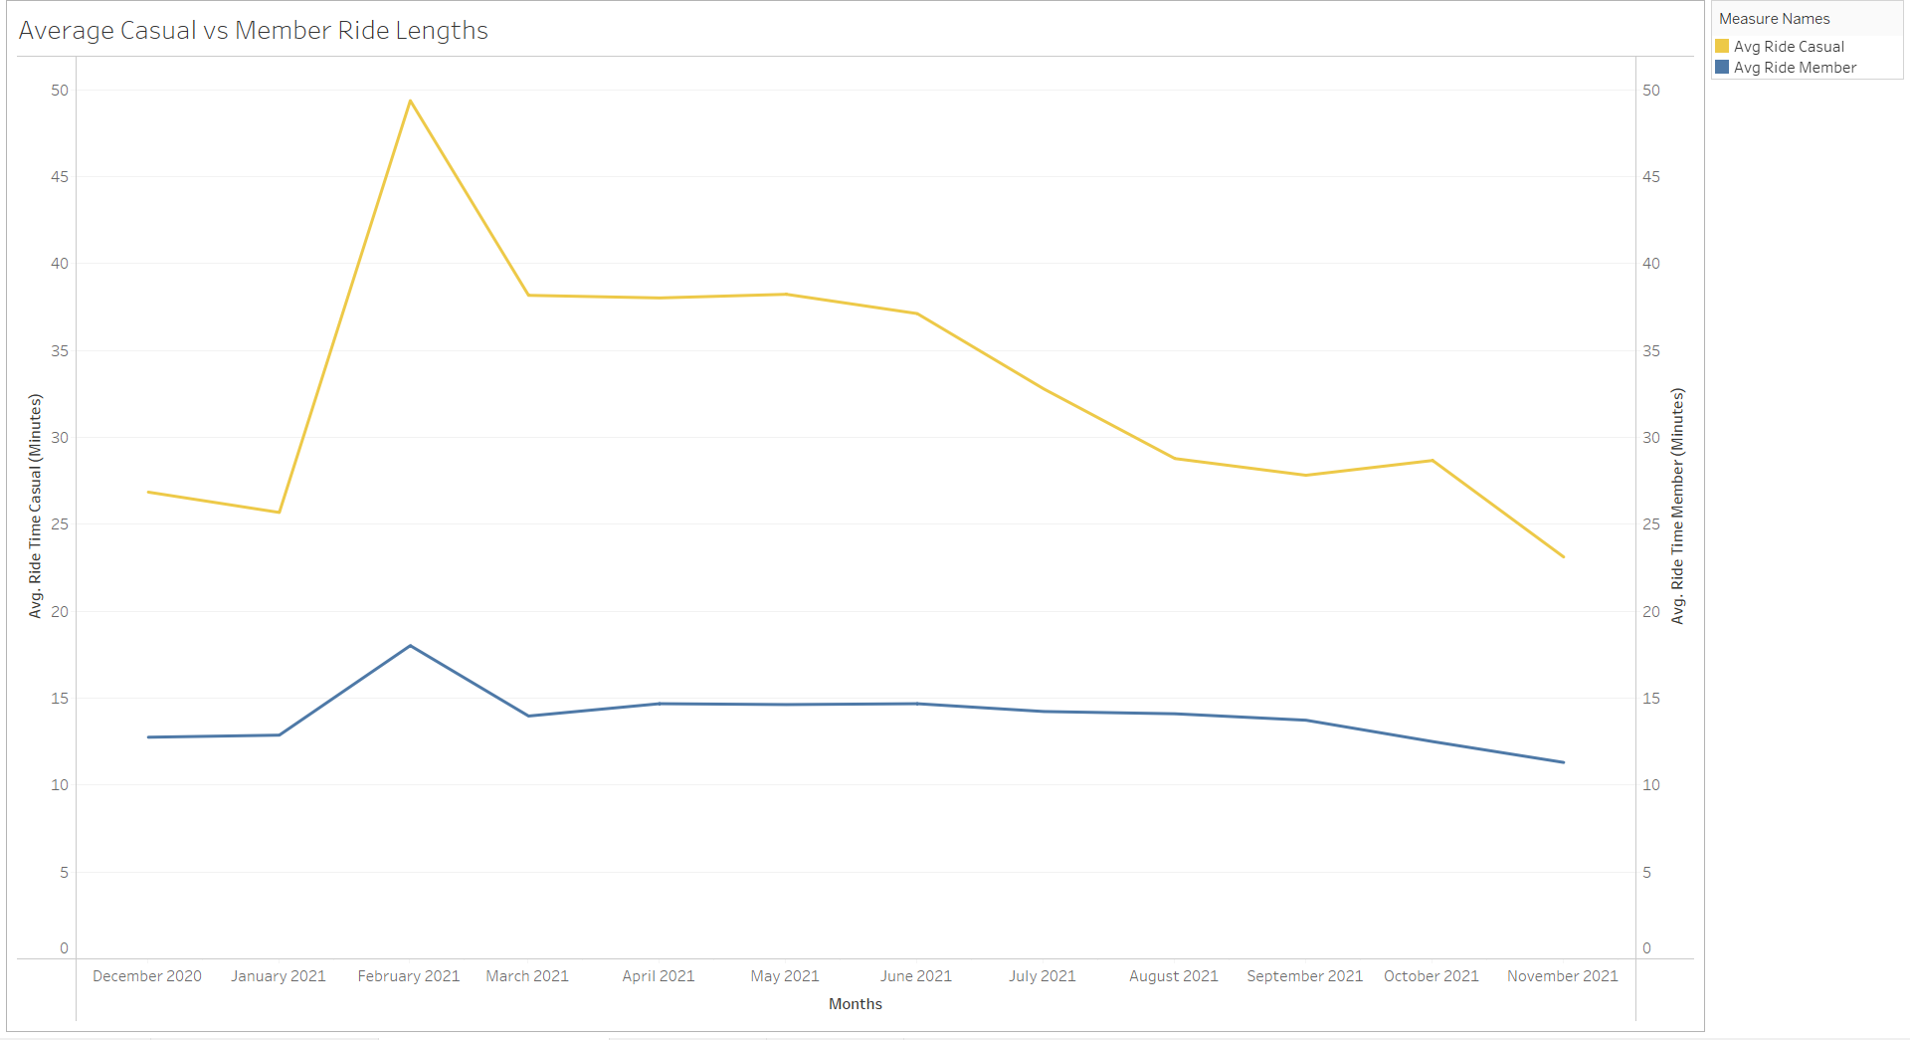
Average Ride Lengths
Notes:
Here we can see casual riders in orange and annual members in blue.
We can clearly see that over the course of the year, casual riders typically had trips that were about 10-15 minutes longer than those of the annual members.
This to me points towards the possibility that casual riders may be using the service for recreational purposes and taking longer rides, while annual members may just be using it for their daily commute to work.
(We’ll see in the next few slides that most rides tend to end not far from their starting positions, possibly pointing towards the use of the service for commuting to work)
Something interesting to point out, we saw in the previous two slides that the summer months were the busiest months; however, we see here that February sees a spike in ride times, and it was the least busy month of the year and had the lowest average ride length.
The increase in rides times may be from poorer weather conditions than other months.

Slide 9
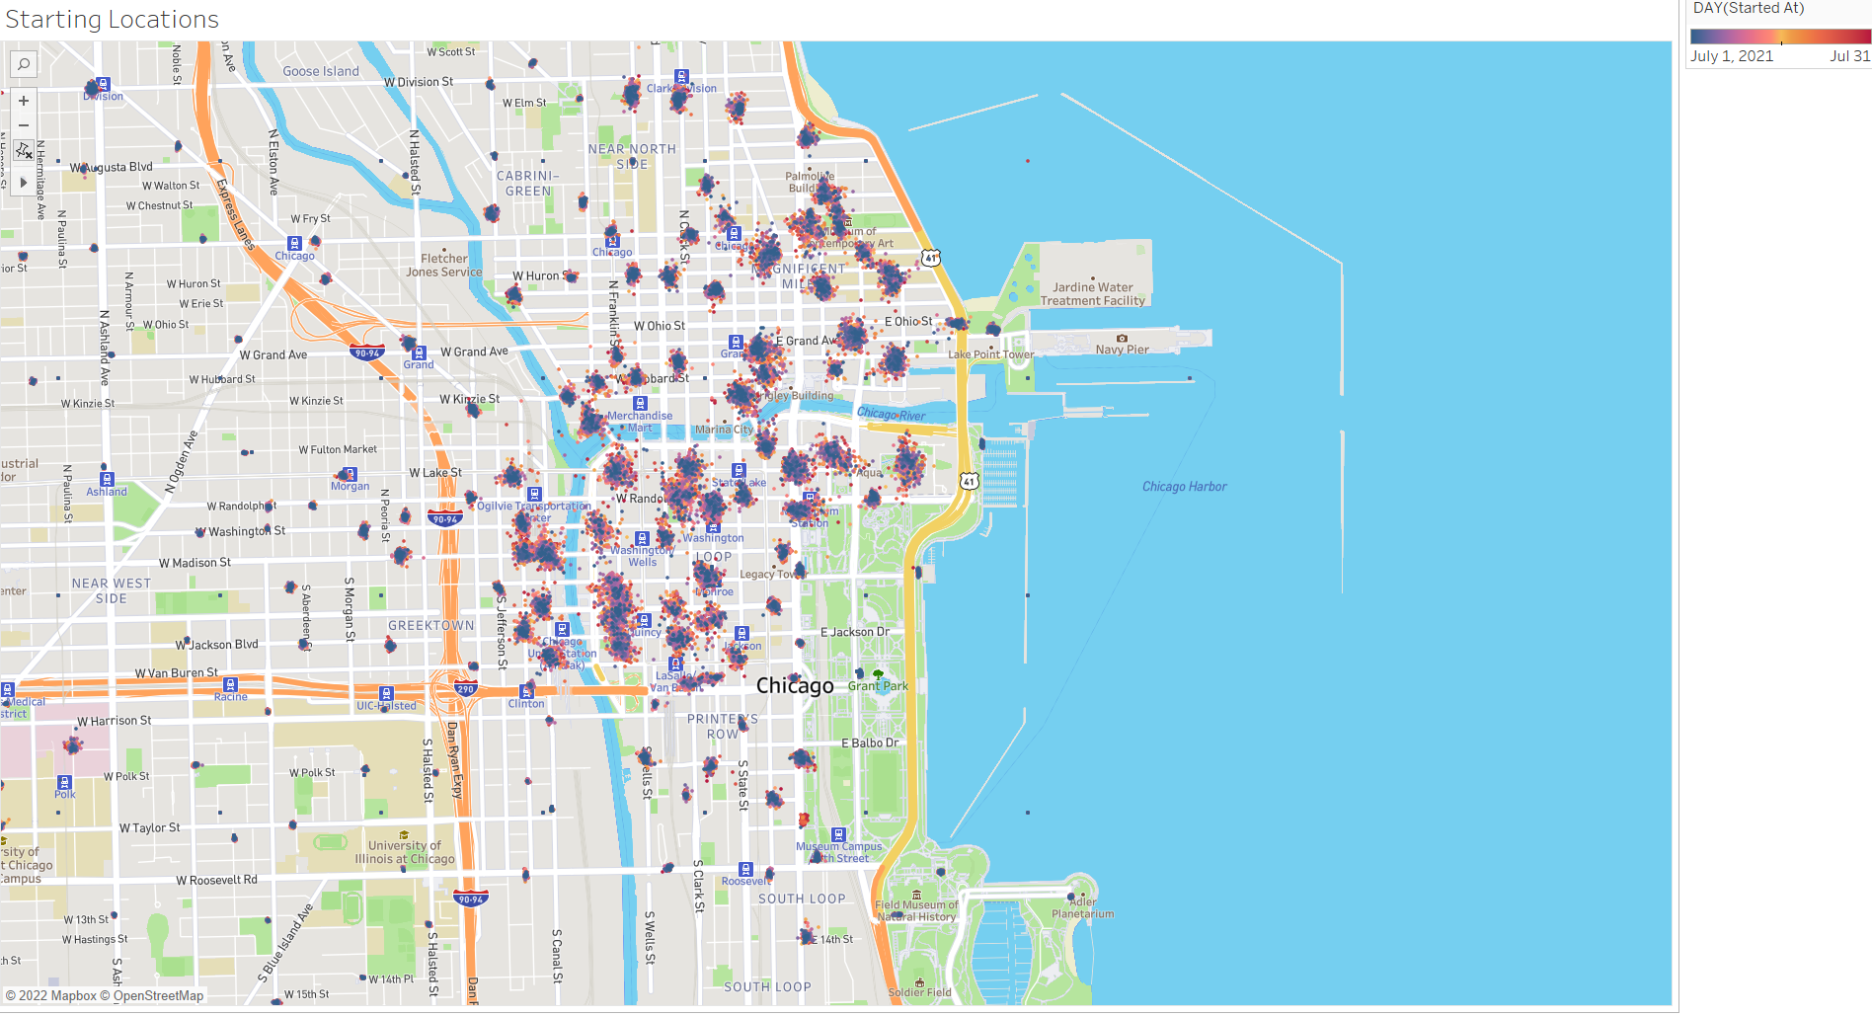
Starting Locations
Notes:
Here I’ve mapped the starting locations for every ride from July 1st through the 31st (July was the busiest month in terms of number of total rides).
Purple dots indicate days towards the beginning of the month and as the color shifts to yellow and into red, we work our way to the end of the month.
In our next slide, we will see how the bikes have been distributed from their starting spots at the end of the ride/trip.
Disclaimer, this map does not contain every single trip taken during the month of July, we are zoomed in on the Chicago city-center to examine the distances traveled during these rides/trips.

Slide 10
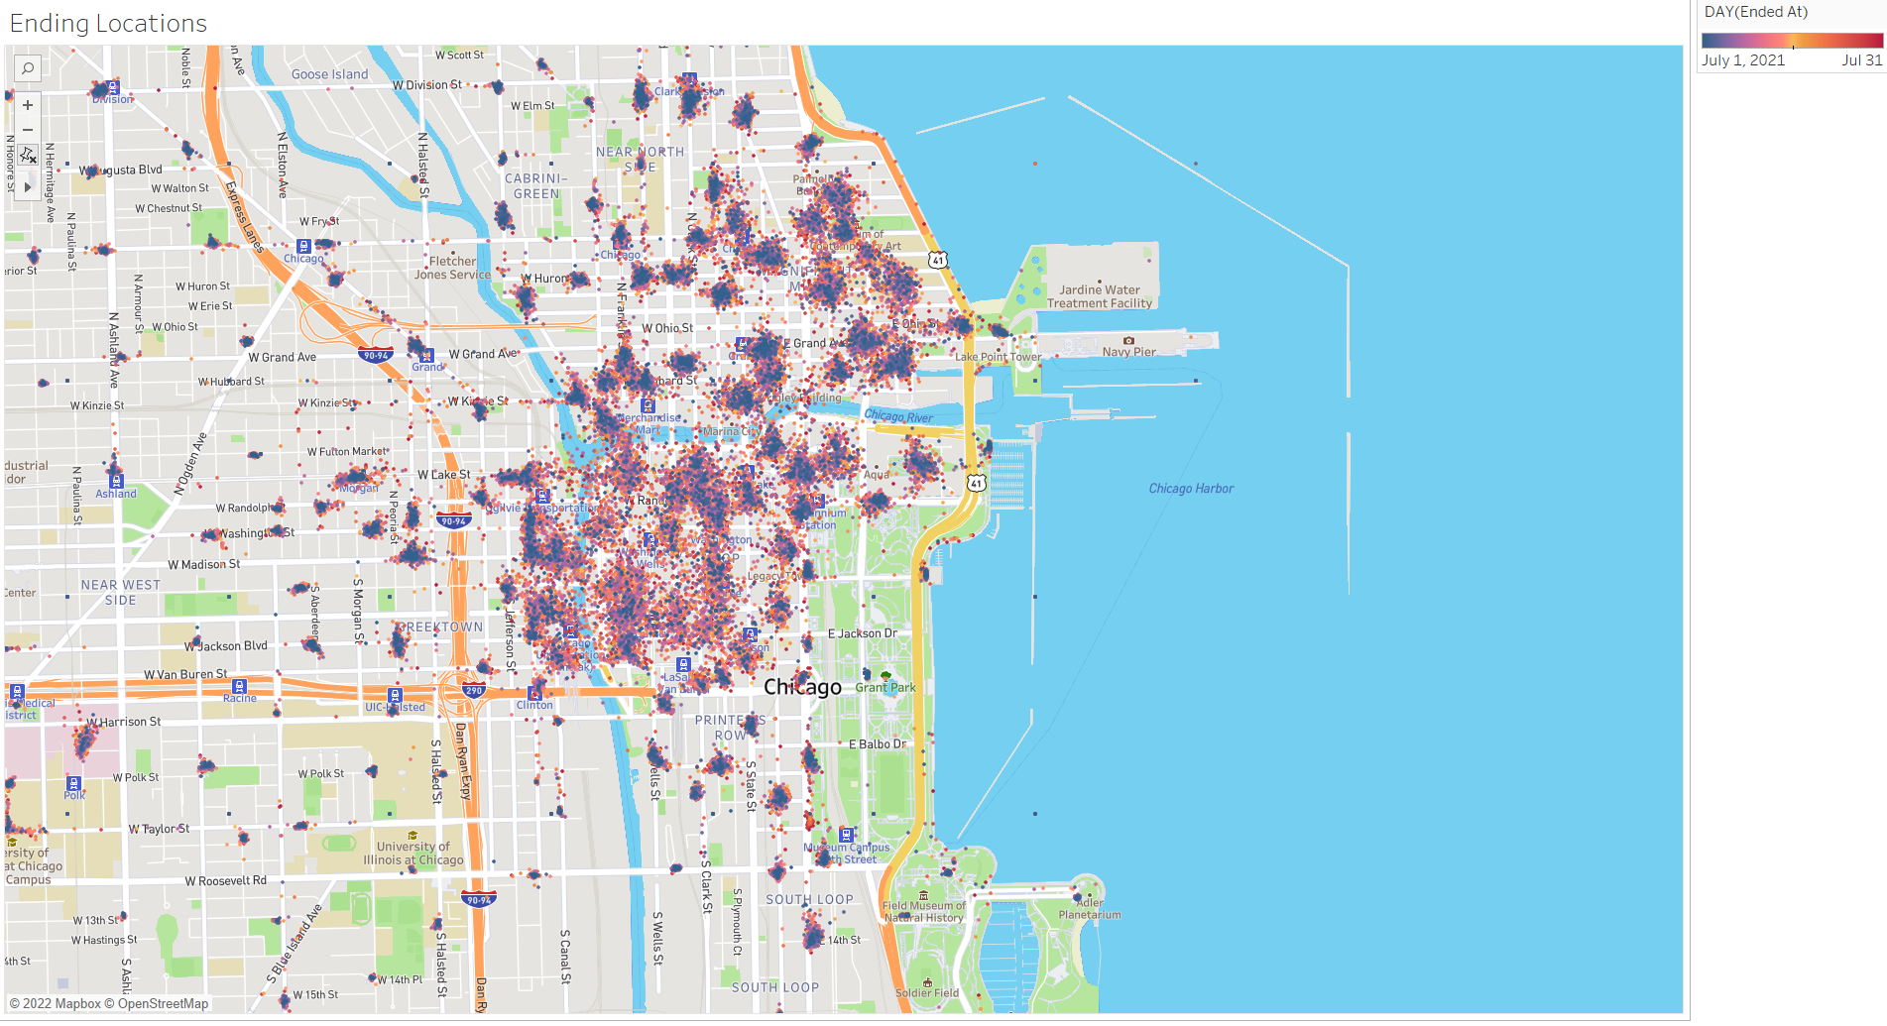
Ending Locations
Notes:
The coloring scale works the same as the previous slide (July 1st being purple, the 31st being red, and so on).
Here we can see that many of the trips taken throughout the month ended relatively close to their starting locations (as indicated by the groupings being slightly more spread-out)
For the purposes of these maps, we are not able to specify which of these are casual riders and which are annual members.
However, due to the relatively small spread from starting to ending locations and the data mentioned previously, I believe that the annual members working downtown primarily use the service in the commute to work, leading to shorter average ride lengths.

Slide 11
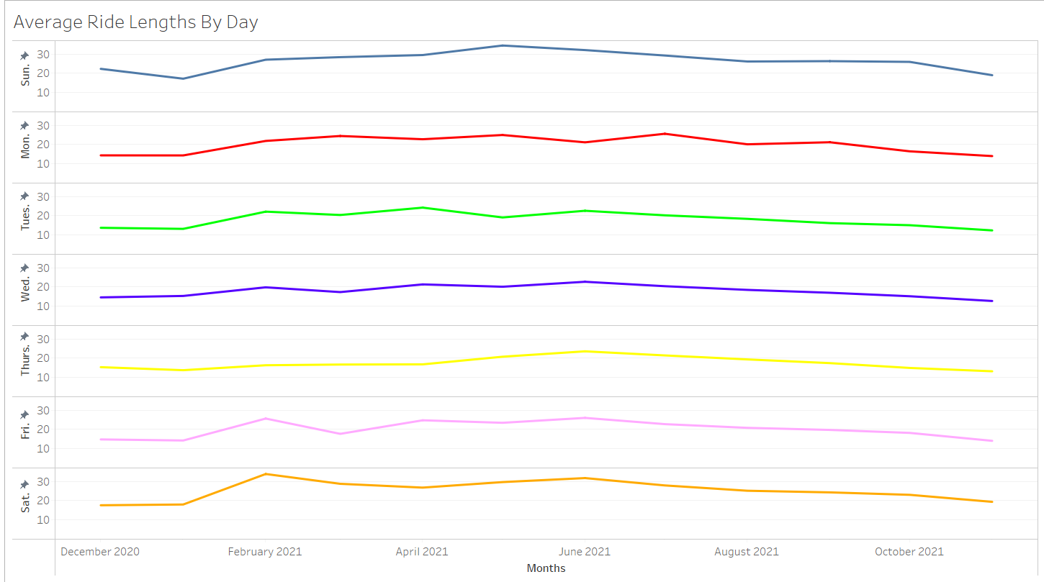
Average Ride Lengths (Sun-Sat)
Notes:
Next, we’ll look at the average ride lengths by day of the week.
I wanted to see if the weekends typically saw longer rides over the weekdays, but there is not much of a noticeable difference across all 7 days throughout the whole year.
There is one pattern that does emerge here though.
(Next slide)

Slide 12
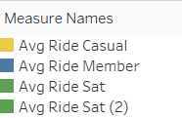
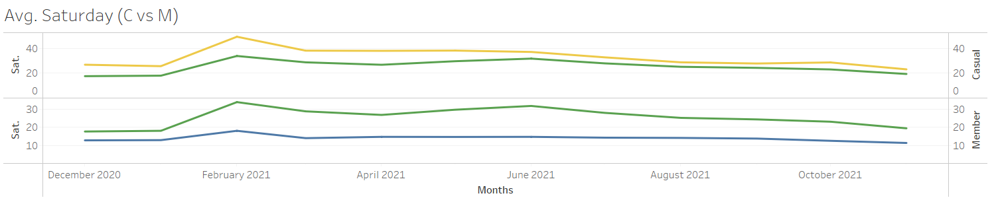
Saturday vs Casual and Member Rides
Notes:
The pattern for the average ride lengths on Saturdays follows the same general pattern of the casual riders and annual members average ride lengths over the course of the year.
We can see that same spike in ride length during February across all three measurements.
One of the other general findings from this project is that Saturdays were the busiest days across each month for the whole year.
(Next slide)

Slide 13
Summary
Notes:
The column I would like to point out here is the “mode_day_of_week” column (towards the middle of the table).
This was created by calculating which day of the week had the largest number of rides/trips in each month.
Each day was assigned a number. Sunday is 1, Monday is 2, and so on through Saturday as 7.
With this, we can see that across the whole year, Saturday was largely the most popular day for the use of the service by all users.
The cells highlighted in green represent the highest measures, while the red highlights represent the lowest measures for their respective categories.

Slide 14
Conclusion
Casual riders tend to take longer rides than annual members
Casual riders may use the service more for recreational use and members more for commuting
July was the busiest month of the year; February was the least busy
Summer months saw the most use of the service
To expand our findings and develop improved recommendations, we will need to gather additional data
Notes:
We set out to answer the following question:
How do annual members and casual riders use Cyclistic bikes differently?
Casual riders tend to take longer rides on average (usually 10-15 minutes longer than their annual member counterparts)
This to me points towards the possibility that casual riders may be using the service for recreational purposes and taking longer rides, while annual members may just be using it for their daily commute to work.
Now, this is an assumption based on the data we do have, but keep in mind, there is a lot of data we do not have access to that would allow us a better understanding of this relationship.
July was the busiest month of the year overall in terms of the largest number of total rides by both types of users.
February was the least busy month; however, we did see that the February had large spikes in average ride lengths for both casual riders and members. This could be due to poorer weather conditions compared to other parts of the year.
We also saw some seasonality along with this, where the summer months had the highest total rides as well as longer average ride lengths.
In order to expand our findings and develop improved recommendations, we will need to gather additional data such as user information, as well as financial data on single-ride and full day passes vs annual memberships, etc.

Slide 15
Recommendations
Market towards the casual riders who have higher than average usage of the service
Run promotional weekend deals during the summer months
Annual member discounts during the winter months
Notes:
If we are wanting to convert more of our casual users into annual members, I recommend the following:
Market towards the casual riders who have higher than average usage of the service.
If we can show that they will get the best deal for their money by becoming an annual member instead, we should be able to make some conversions that way.
Run promotional weekend deals during the summer months.
We saw that Saturdays specifically are busiest days of the month throughout the year, and the summer months were the busiest months.
If we can run a promotional weekend deal on rides for annual members, we could attract more casual riders to the annual membership.
Annual member discounts during the winter months.
Like my second point, the winter months, like we saw with February, have much lower usage of the service.
If we can provide further discounted rides to annual members, we can encourage more usage during these months, as well as potentially attract the casual riders using the service during these months to the annual membership.
Again, in order to expand our findings and develop improved recommendations, we will need to gather additional data such as user information, as well as financial data on single-ride and full day passes vs annual memberships, etc.

Slide 16
Questions?
Thank you!

