Slide 1

Calculating WAR, and looking at the issue with xAVG
By Jake Jensema

Slide 2

Why WAR?
WAR (Wins After Replacement) is a great stat to look at for players to see how much they truly contribute to their team. Looking at a player's WAR gives you a good all around statistics to value a player because it factors in their offensive production, as well as defensive, one important aspect of how WAR is calculated is we value all players position differently, because after all a great shortstop is a lot more valuable than a great first baseman

Slide 3
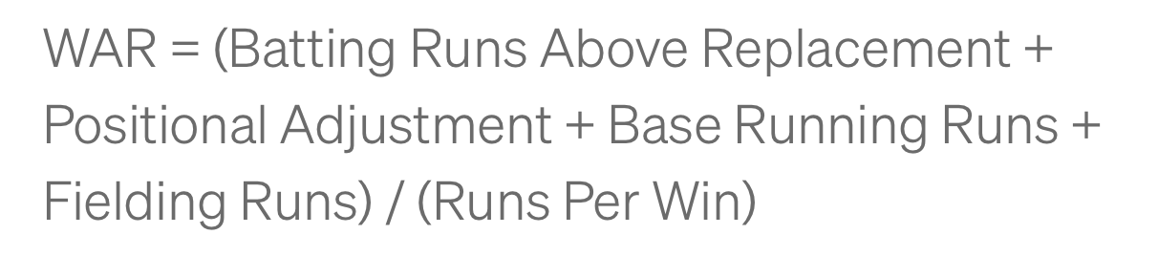
WAR Calculation
Using the following formula, we can calculate how many wins a player adds to their team over a replacement player. A replacement player in terms of the MLB is someone who you could sign for league minimum or a minor league player. For college, we need to think about it in terms of bench players, since college teams do not have a minor league. A bench player that plays in < 5 games is considered a replacement level player.

Slide 4
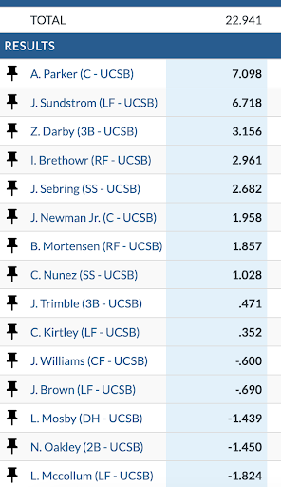
Results
Using Trumedia I did all of these calculations by hand. When looking at the league adjustment, instead of using all of division 1 baseball, I specifically looked at The Big West conference for the calculations. One thing to note is the scale of WAR is not the same as the MLB, in the MLB a position player receiving a WAR of 7 is practically guaranteed the MVP that year, but in this case an MVP candidate sits more around the 9-10 range.
Note: Due to some limitations on Trumedia data, I was not able to calculate WAR for pitchers

Slide 5
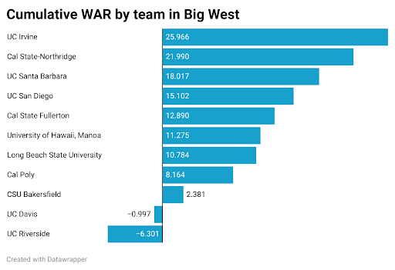
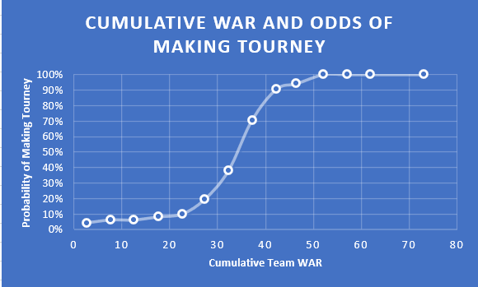
Cumulative team WAR
Looking at a team's cumulative WAR can give a better look as to see how good a team is. Another article I found gives these graphic to see how a team's cumulative war is related to probability of making it to the CBBWS

Slide 6
Looking at xAVG
xAVG is the expected avg of a pitch that is hit. This is basically the probability that the ball that is put in play will result in a hit or not. xAVG is calculated using exit velocity and launch angle, so a ball that is put into play with an xAVG of .700 means that if that same ball was hit with the same exact launch angle and exit velocity, it would result in a hit 70% of the time. This gives a way to see how well a player is putting the ball into play because if a player is batting .247 over the past month but his xAVG is .403 you can see that the player is just hitting the ball right at defense even if he is hitting 105mph line drives.

Slide 7
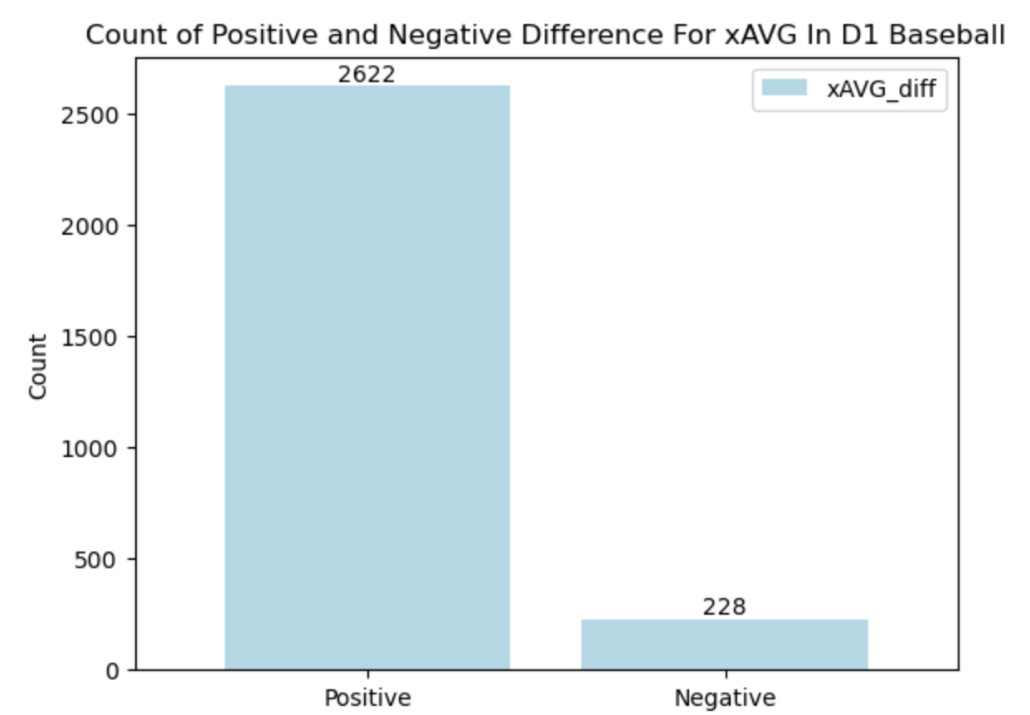
The Problem
When looking at Trumedia I noticed something a little off about the xAVG for players. It was always very low around the .200 and .250 values. This seemed weird, so I did some data exploration to see what was happening.
Looking at player's actual AVG and their xAVG I saw that we see a huge favor of positive values which means that Trumedia’s xAVG stat was lower than the player's actual AVG. The vast difference in positive and negative values made me wonder how could 92% of players in D1 baseball be preforming better than their xAVG.

Slide 8
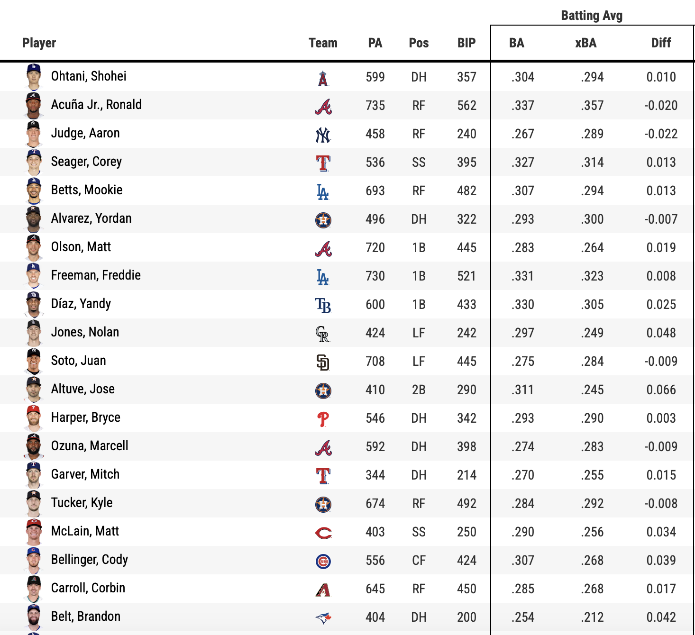
Comparing To MLB
For reference, this is looking at the difference between some of the top players in the MLB’s AVG and xAVG. We see that it’s more evenly distributed as to if players are over or under preforming their xAVG

Slide 9
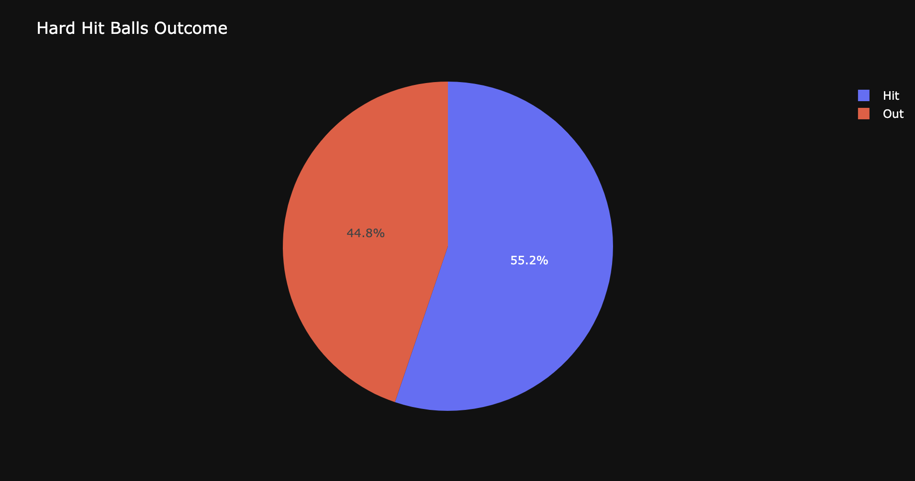
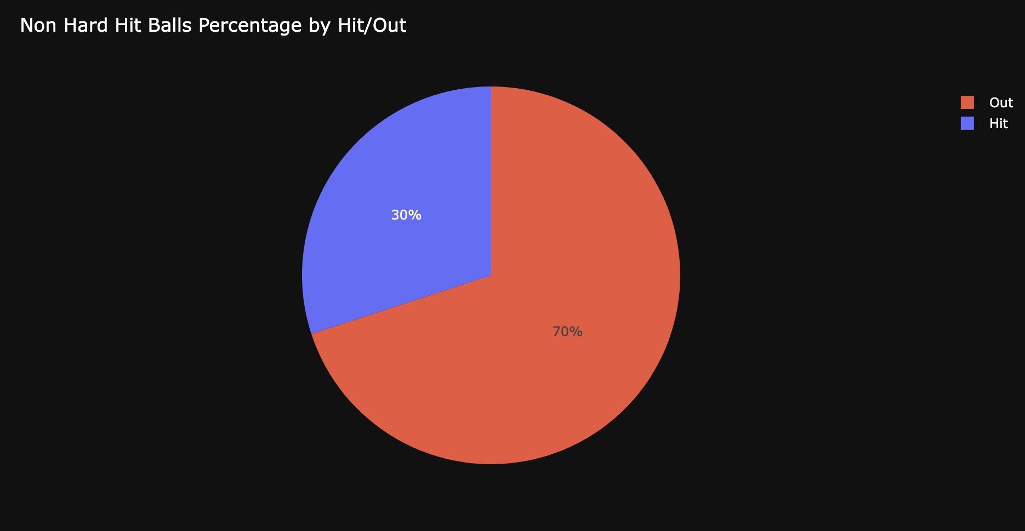
What's wrong with old method?
As we see below, looking at exit velocity, specifically hard hit balls (exit velocity > 95mph) seems to work well at seeing if a ball will result in a hit or not

Slide 10
My Solution
The exact formula for xAVG on Trumedia is not available, but I do know for sure it is solely based on launch angle and exit velocity. My idea was that their calculation was too simple and needed a more sophisticated approach to get a better expected value.
I took on a machine learning approach which involved me using different types of statistical models to predict whether a ball will be classified as a hit or not, and from there looking at the probability that it will be predicted as a hit. This is because xAVG is calculated as the probability of a ball being a hit, so I needed to look at the probability of my model predicting a ball hit in play as a hit or not.
Instead of just using exit velocity and launch angle, I will also be looking at pCallStrike% and Good Pitch

Slide 11
pCallStrike%
pCallStrike% is a variable available on Trumedia which gives the % that the umpire would have called the pitch a strike if the batter did not swing. A low pCallStrike% means that the pitch was on the corner or barely off the plate. A high pCallStrike% means the pitch was distinctly in the middle of the strike zone. Using pCallStrike% allows us to factor in the location of a pitch into whether the probability of the ball being a hit, this is because simply a ball in the corner of the strike zone is harder to hit than a ball right down the middle meaning that the probability you get a hit on a ball put in play in the corner of the strike zone is obviously lower than if the pitch was right down the middle.

Slide 12
Good Pitch
Good Pitch is a variable that I created that labels a pitch thrown as bad, good, or great. The way I decided what to label the pitch as was through looking at the Induced Vertical Break, Vertical Break, Horizontal Break, Velocity, and Spin. First I calculated what the average value for all 5 of these metrics was for each type of pitch and from there I went ahead and labeled a pitch as great if all 5 metrics were > than the average, good if at least 3 were > average and bad otherwise. This gives me a way to add a new encompassing variable that gives our model a way of factoring in that better pitches are harder to get hits on.

Slide 13
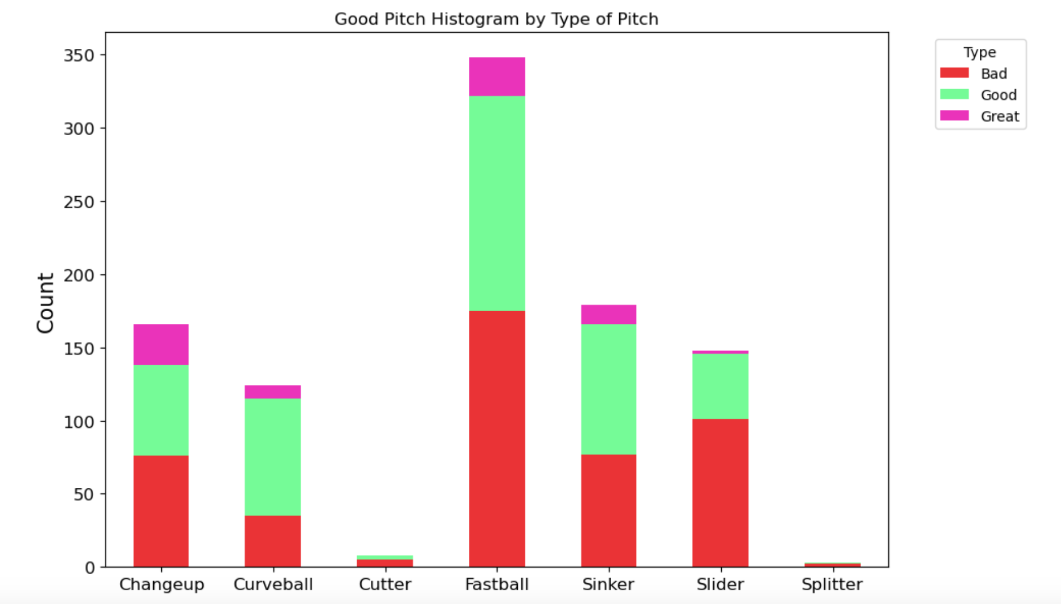
Good Pitch Visualized
Our Good Pitch distribution seems to look as we would expect

Slide 14
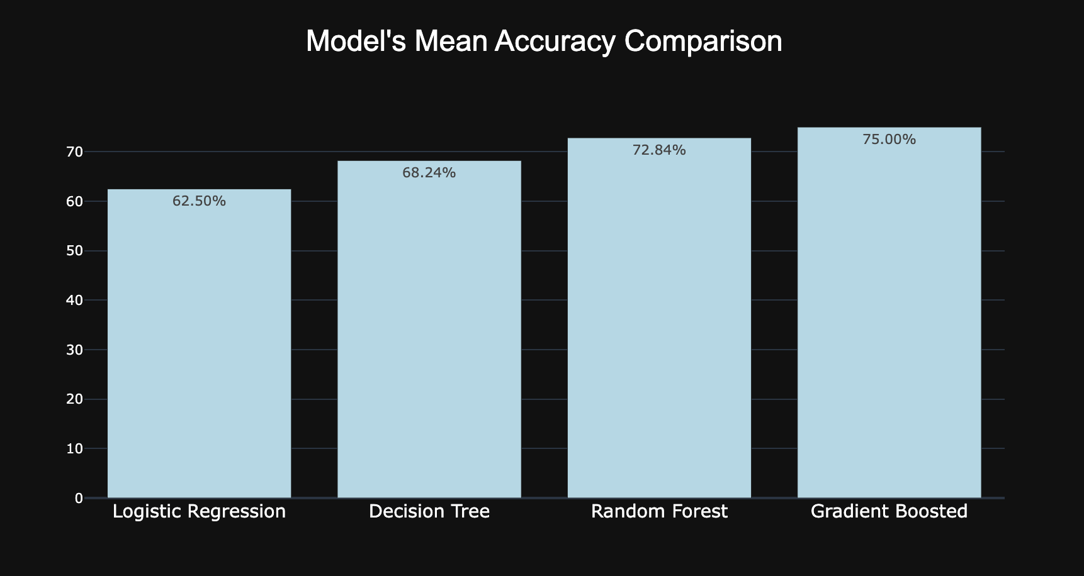
Results
We see that the 4 types of statistical models did pretty well as predicting whether a ball hit would be a hit or not. With our best model scoring 75%

Slide 15
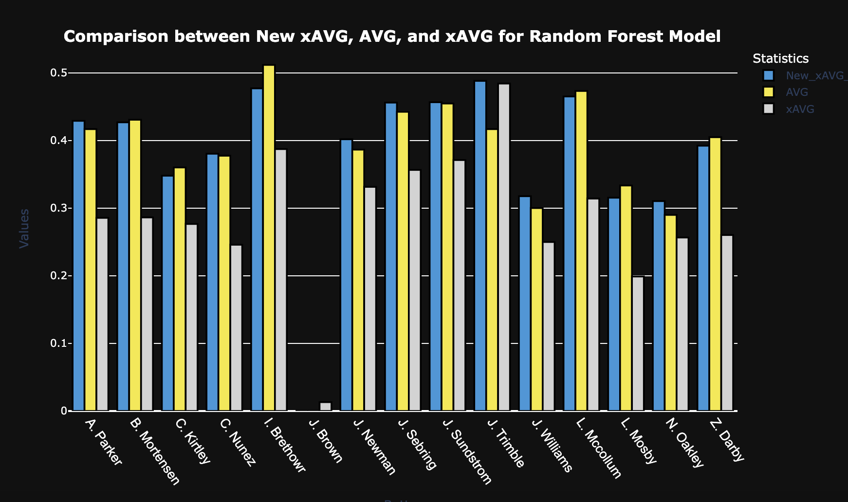
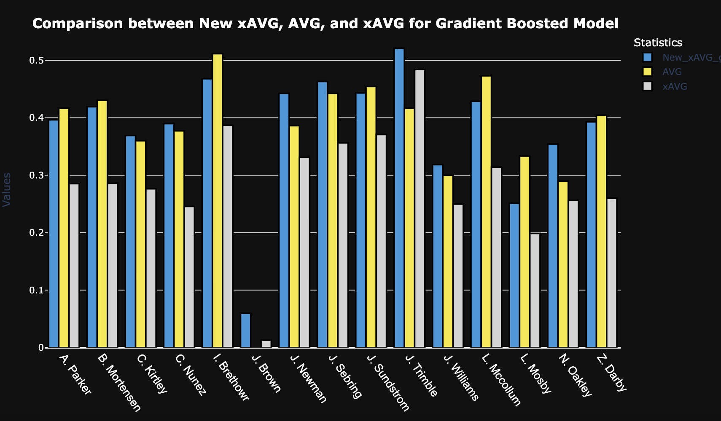
Comparing our New xAVG with old
The light blue value represents our New xAVG, the yellow is the player's actual AVG in our sample data, and the gray is the xAVG on Trumedia. We see our models give a way better estimate on a players xAVG compared to the Trumedias calculation
Note: The reason the player's AVG is so high is because of the limited pitch by pitch data available on Trumedia.

Slide 16
Conclusion
With my new method of calculating xAVG I think that it can be useful to use for future data to give a more accurate method way of seeing how well a batter is putting the ball in play. As noted before, the pitch by pitch data which gives the values for xAVG along with exit velocity for each pitch was limited on Trumedia. Having more data would help the accuracy of my new method of calculating xAVG. Collecting these metrics like exit velocity and launch angle for all games would help for using my model in the future. I hope to go through and continue this project to help fix some other issues I have spotted, similarly xwOBA which is a great metric to look at for players performance is just as skewed on Trumedia. Continuing this project to be able to get a more accurate xwOBA calculation for the team could help immensely.

