Slide 1
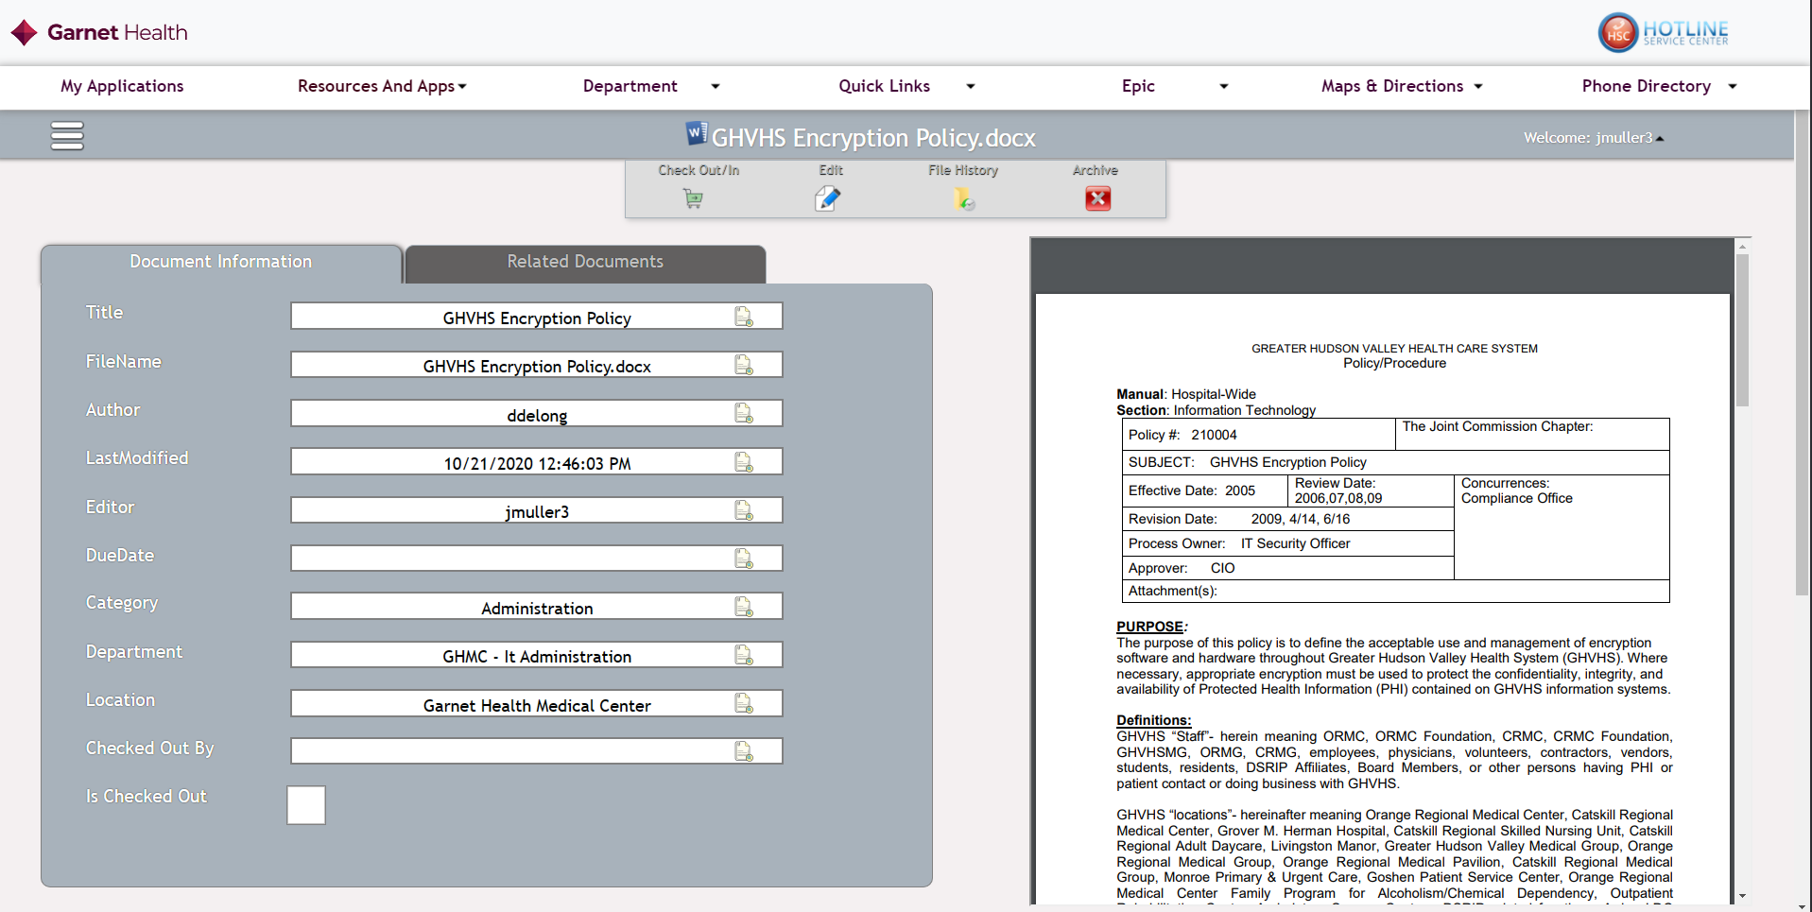
Release Notes for Pnp Site V2.3
Click on user name for master refresh
Now supports clear all people logged into app and refreshes app if level of security is changed ( Approver, Concurrer..etc)
File history
If a policy is checkout and checked back in the old file will be stored in the File history table.
By clicking this all the past versions of one file can be seen and downloaded.

Slide 2
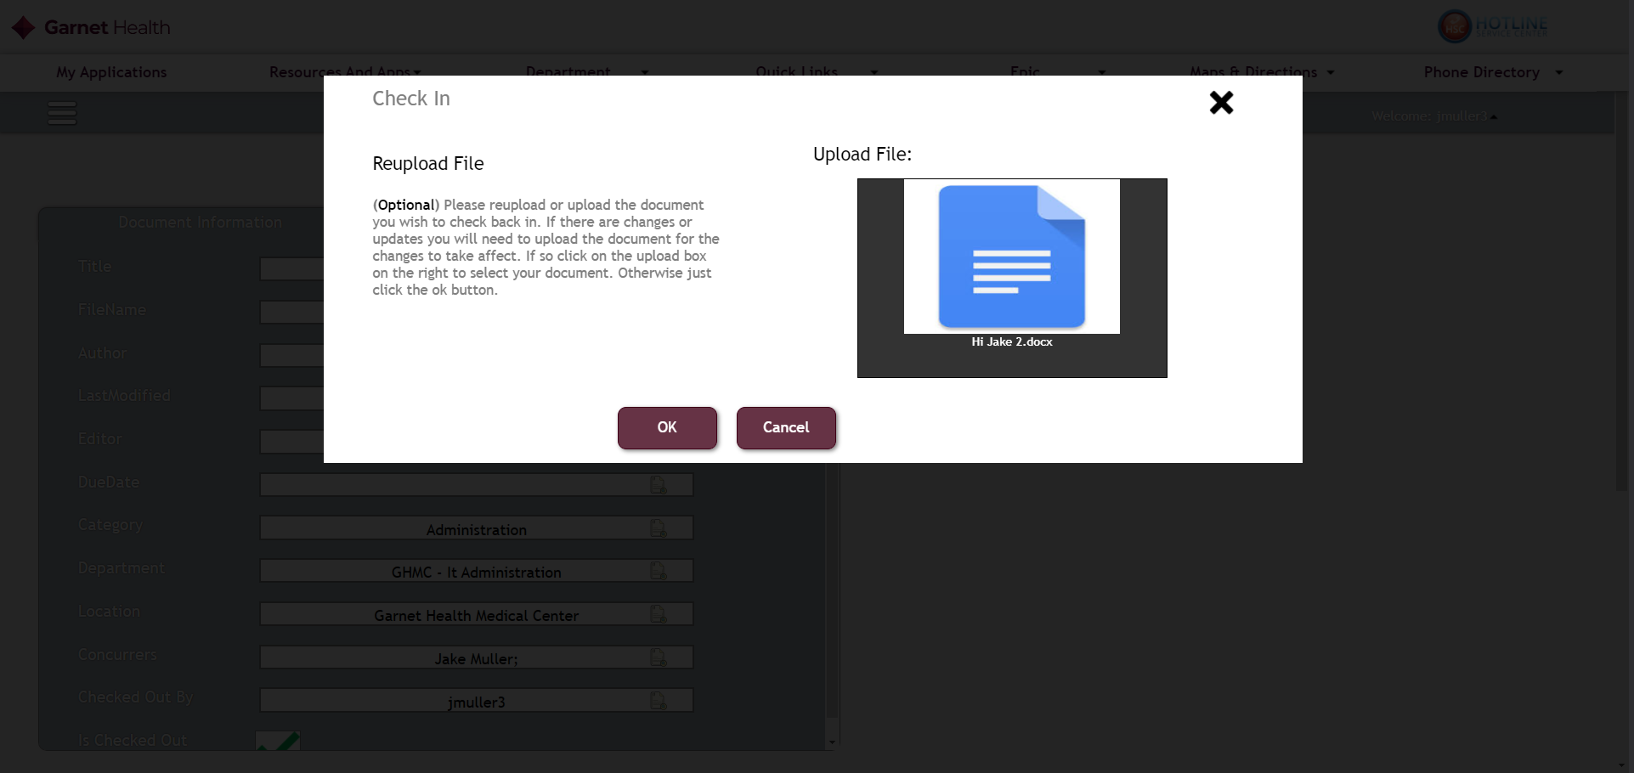
Demonstrating File History
When we check a file back in
The old file will be archived by the server
The New File will now be upload as the file on said policy

Slide 3
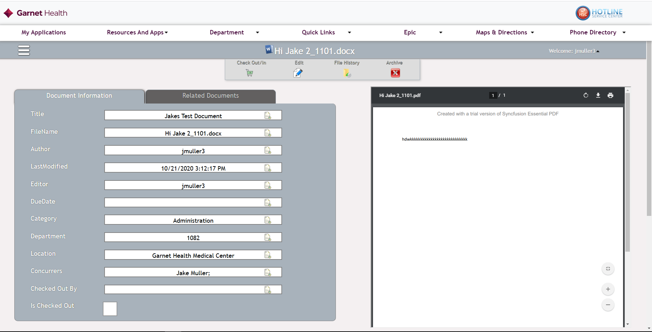
Viewing File History
The file name of the Policy is now updated to what ever the new file name is on the “check in”
Now if we click on the File Icon we can see all the previous file versions of said Policy (See Next Slide)
Now that the new version of the file has been checked back in the pdf now displays the new file contents

Slide 4
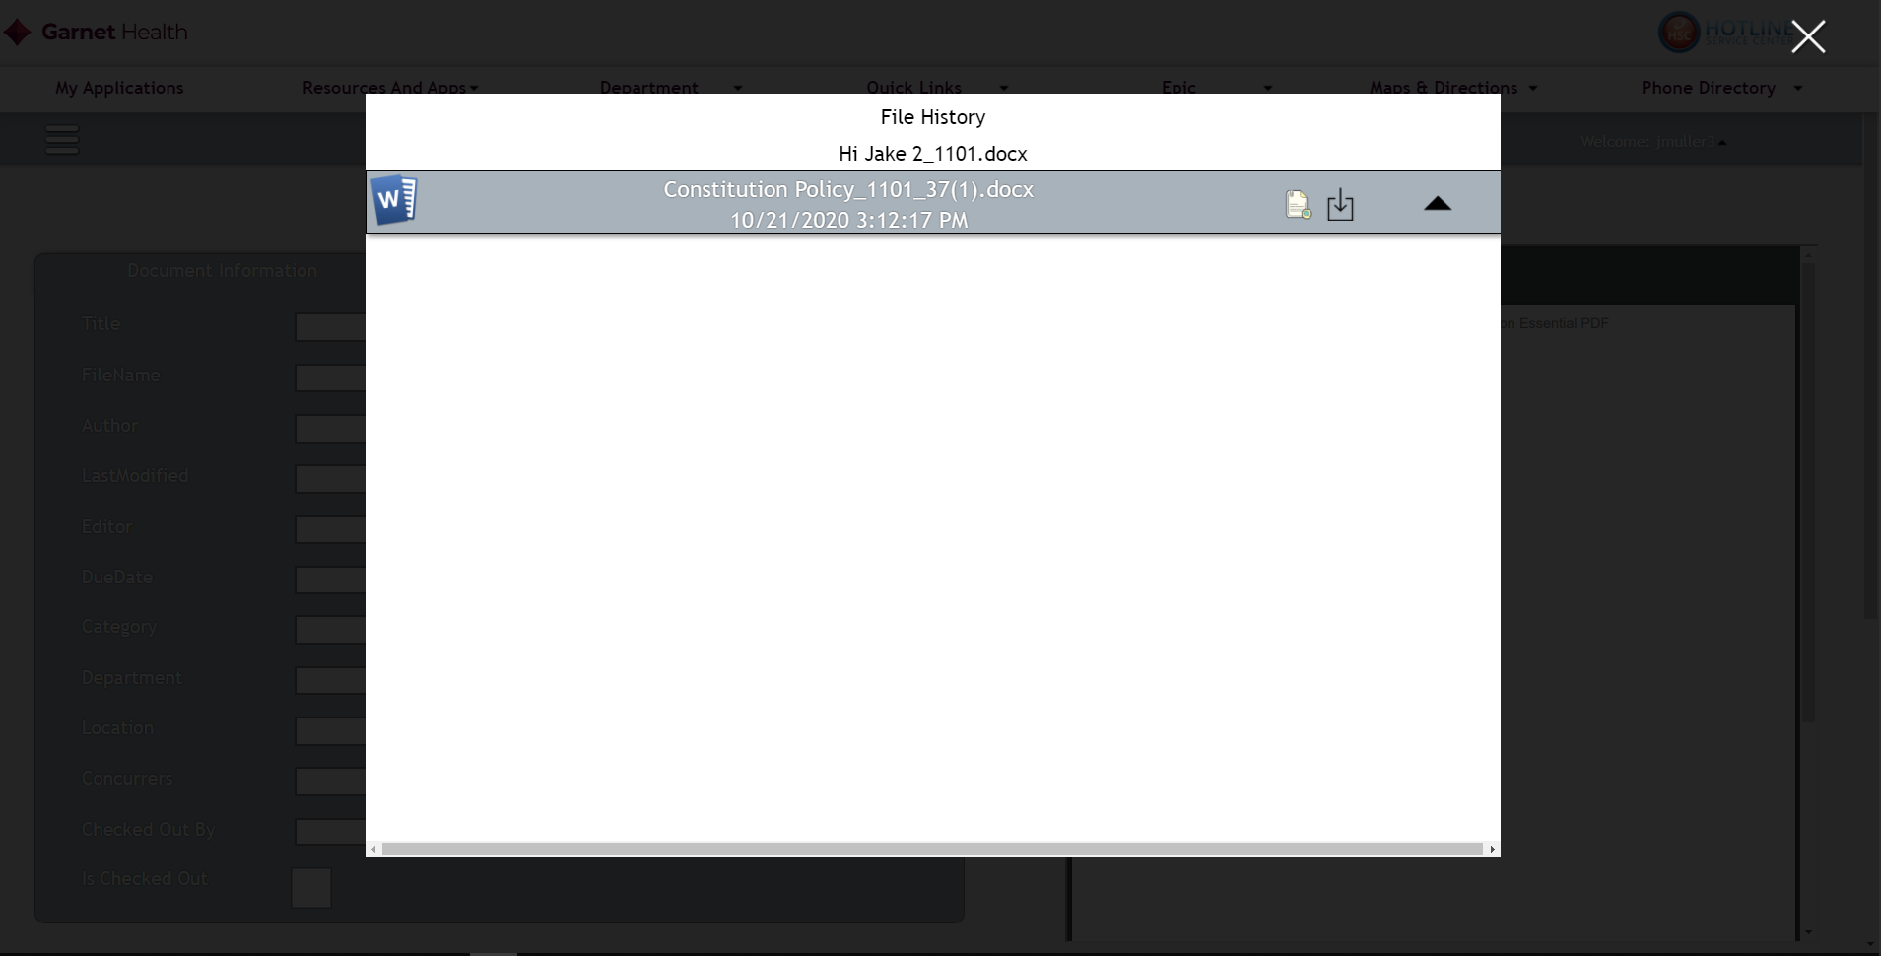
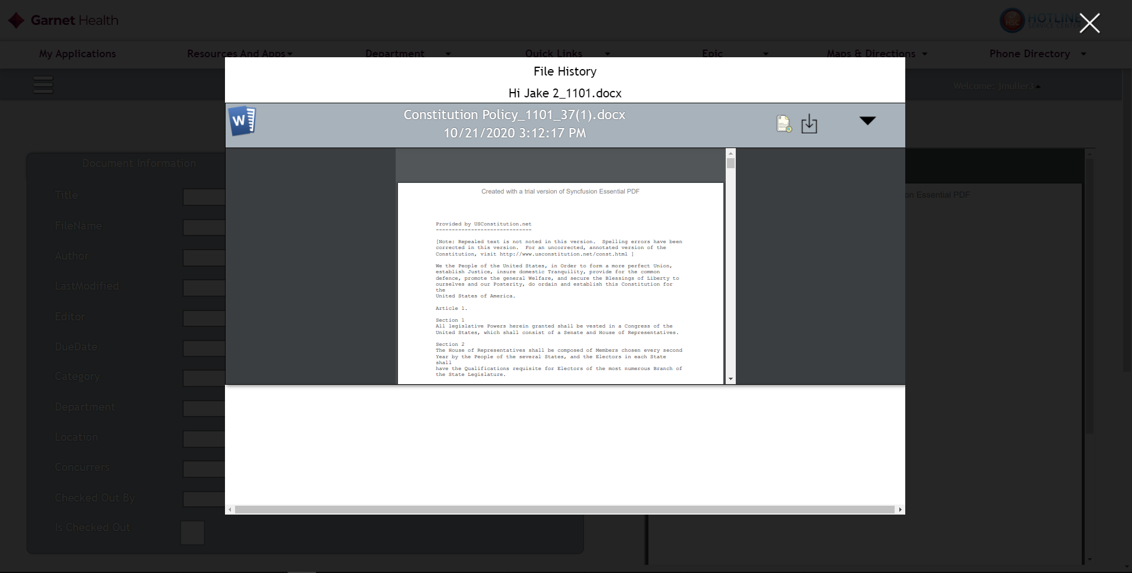
When The File Icon is clicked this will pop up
Clicking on this button will download the file to your computer in the original file
Ex. (.Docx, .doc, etc)
Clicking this button will slide down the pdf version of the file so that it can view before deciding to download or not

Slide 5
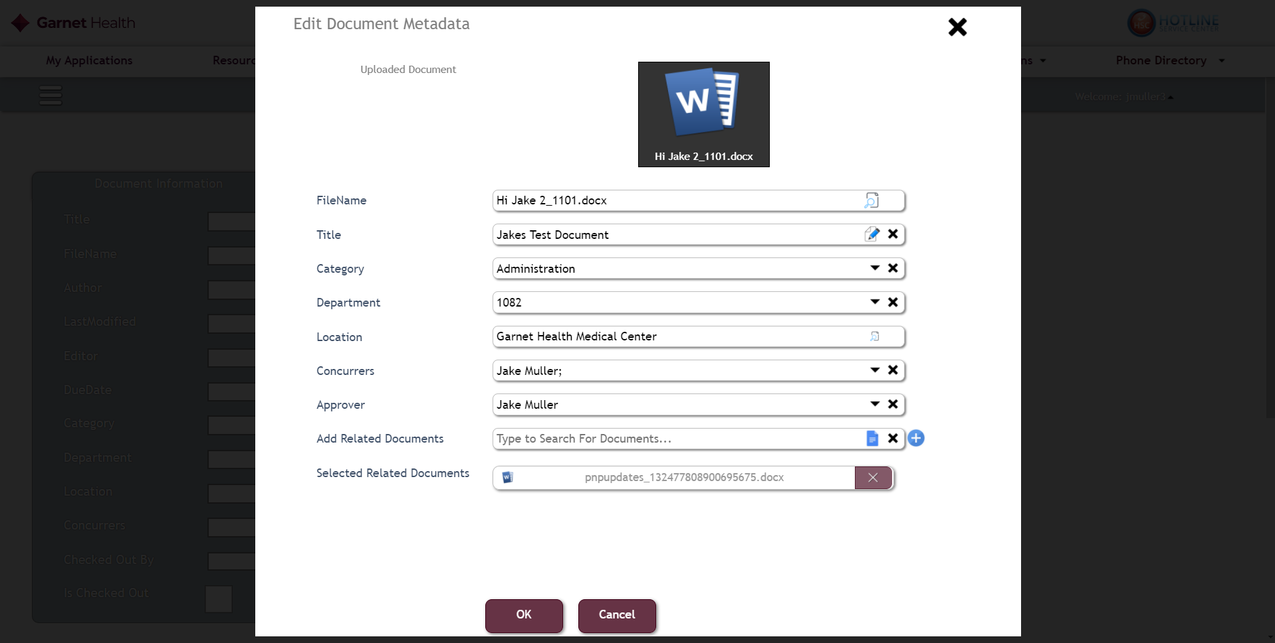
Before this update adding related docs only supported the following file types
Word Documents
Pdf
Text
Which is why you might have seen other file types not showing up
With this new update detailed in this powerpoint the following File types are now Supported.
PowerPoint
Xls
Xslx
Pdf
Word
Text
Any other file type not mentioned in the above list will not show up in the Pnp app
Policies, Not Related Docs only support the following formats
Pdf
Word
Text
Anything else will not show up in the app unless requested to BI Team fir a future update. See Next Slide

Slide 6
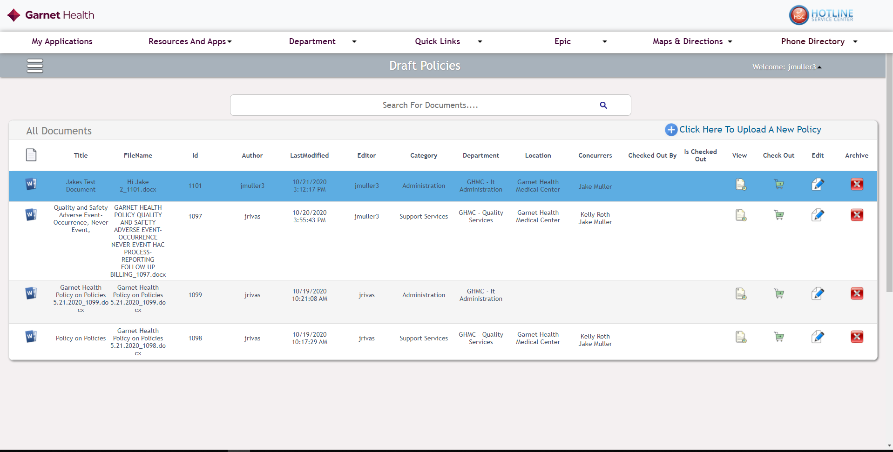
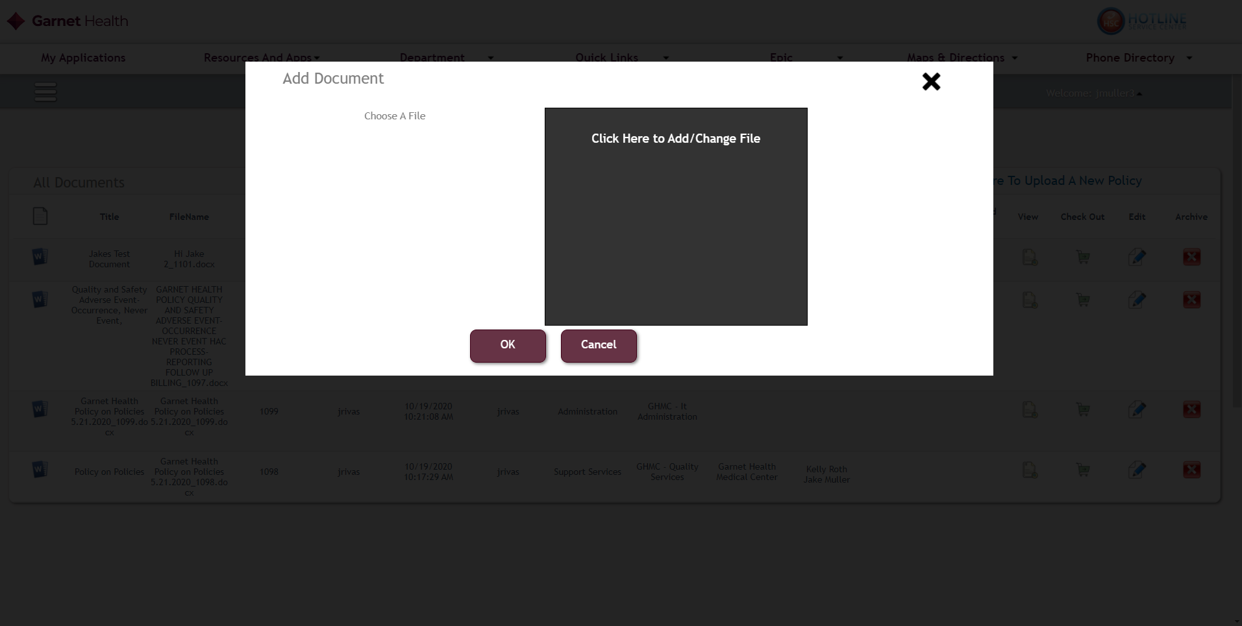
When using this uploader for Policies, it only supports the Following File Types as listing on previous Silde
Word
Text
Pdf

Slide 7
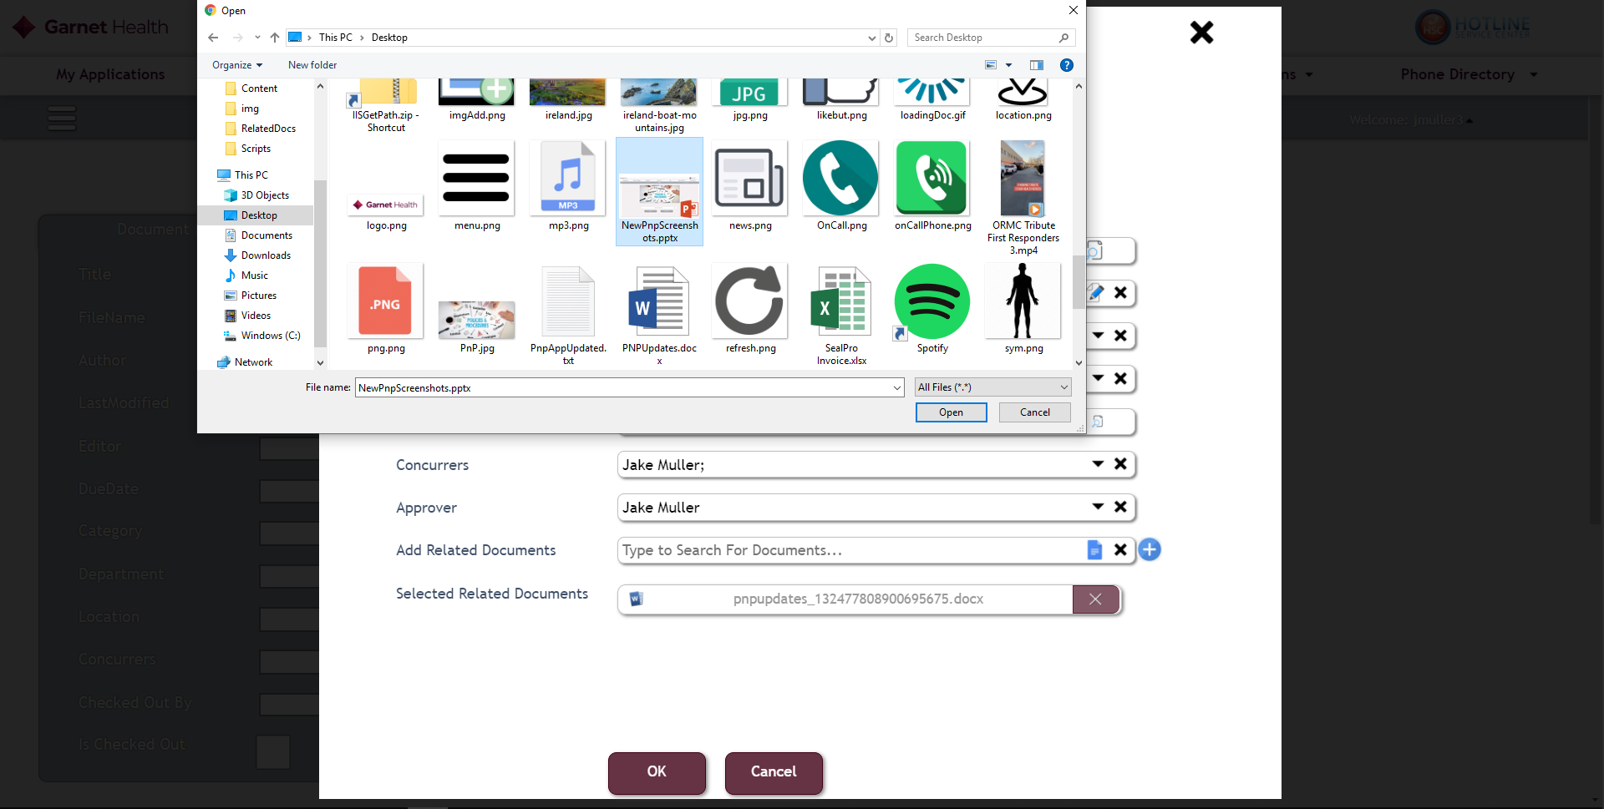
As Described in pervious slides ew file types are now supported for related Docs, This example will demonstrate power point

Slide 8

Upload powerpoint file
Click Save

Slide 9
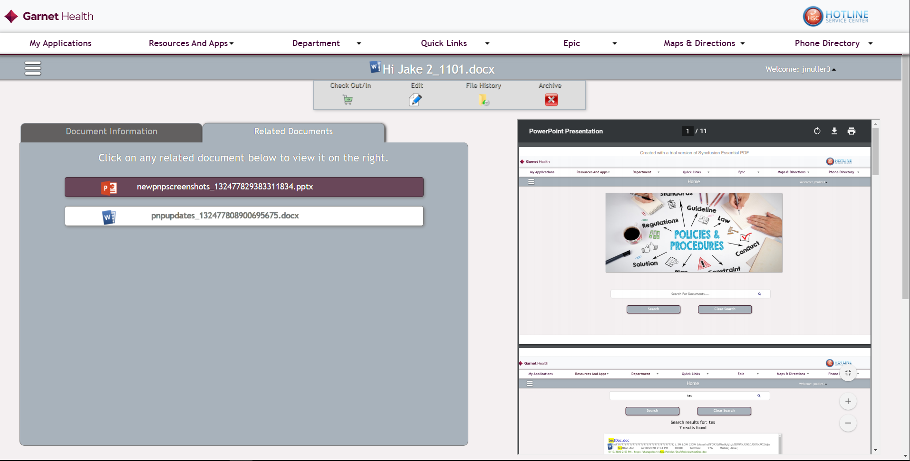
Go to the policy where related doc was added to
Click on upload file to view it on the right
View pdf version of powerpoint

Slide 10
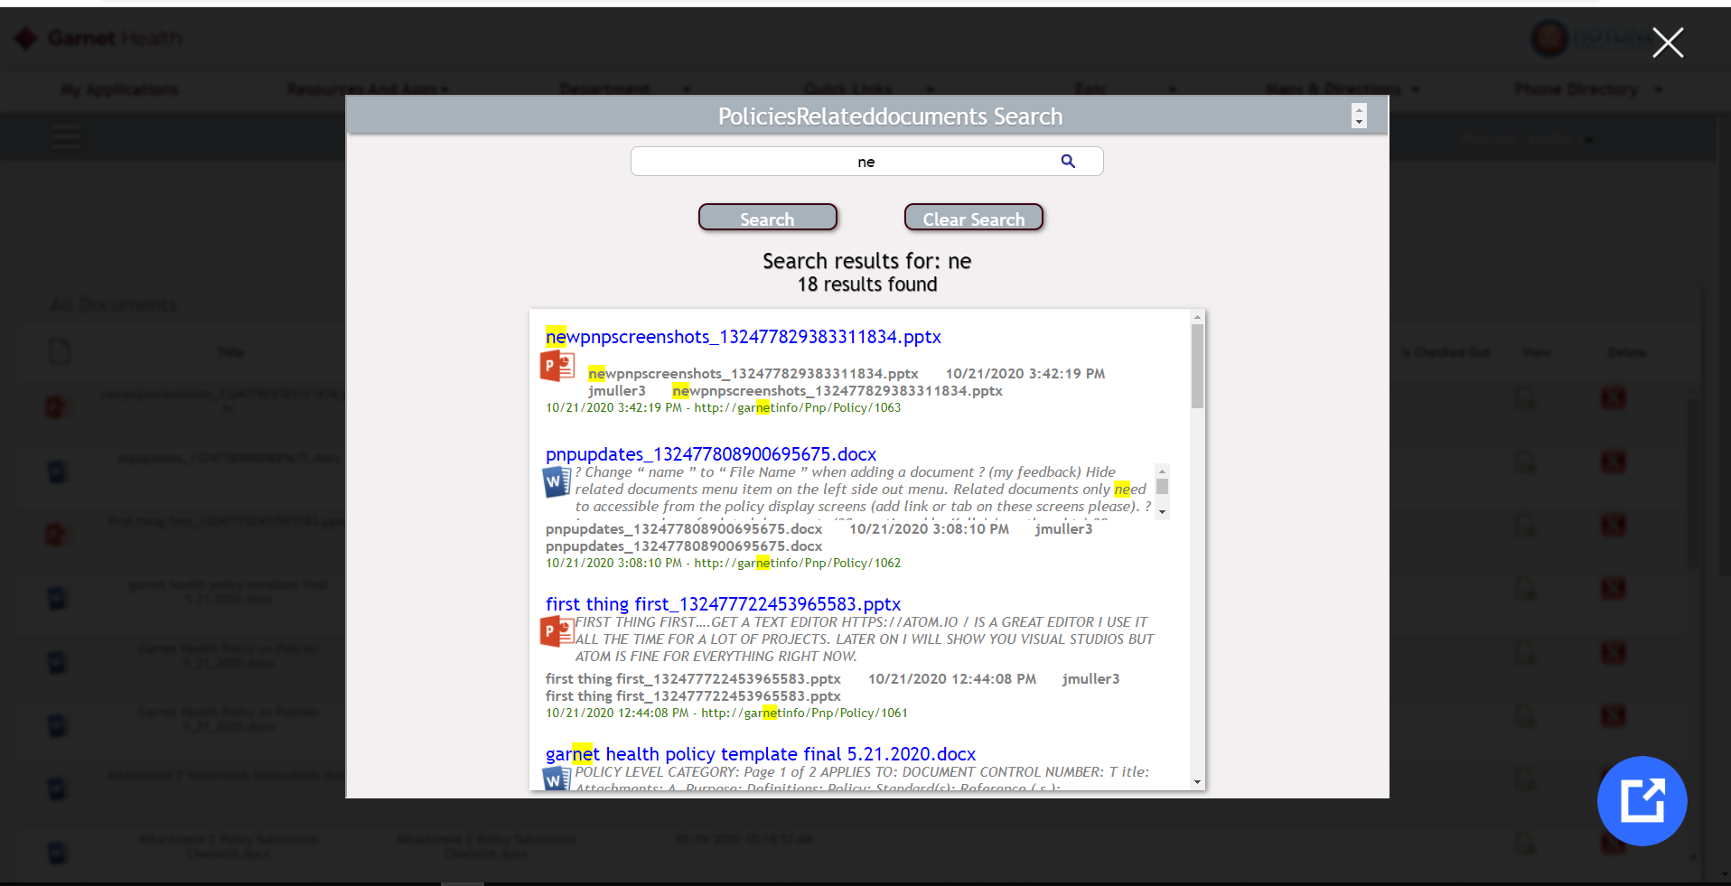
Added functionality to parse words in PowerPoint and excel files to be search able

Slide 11
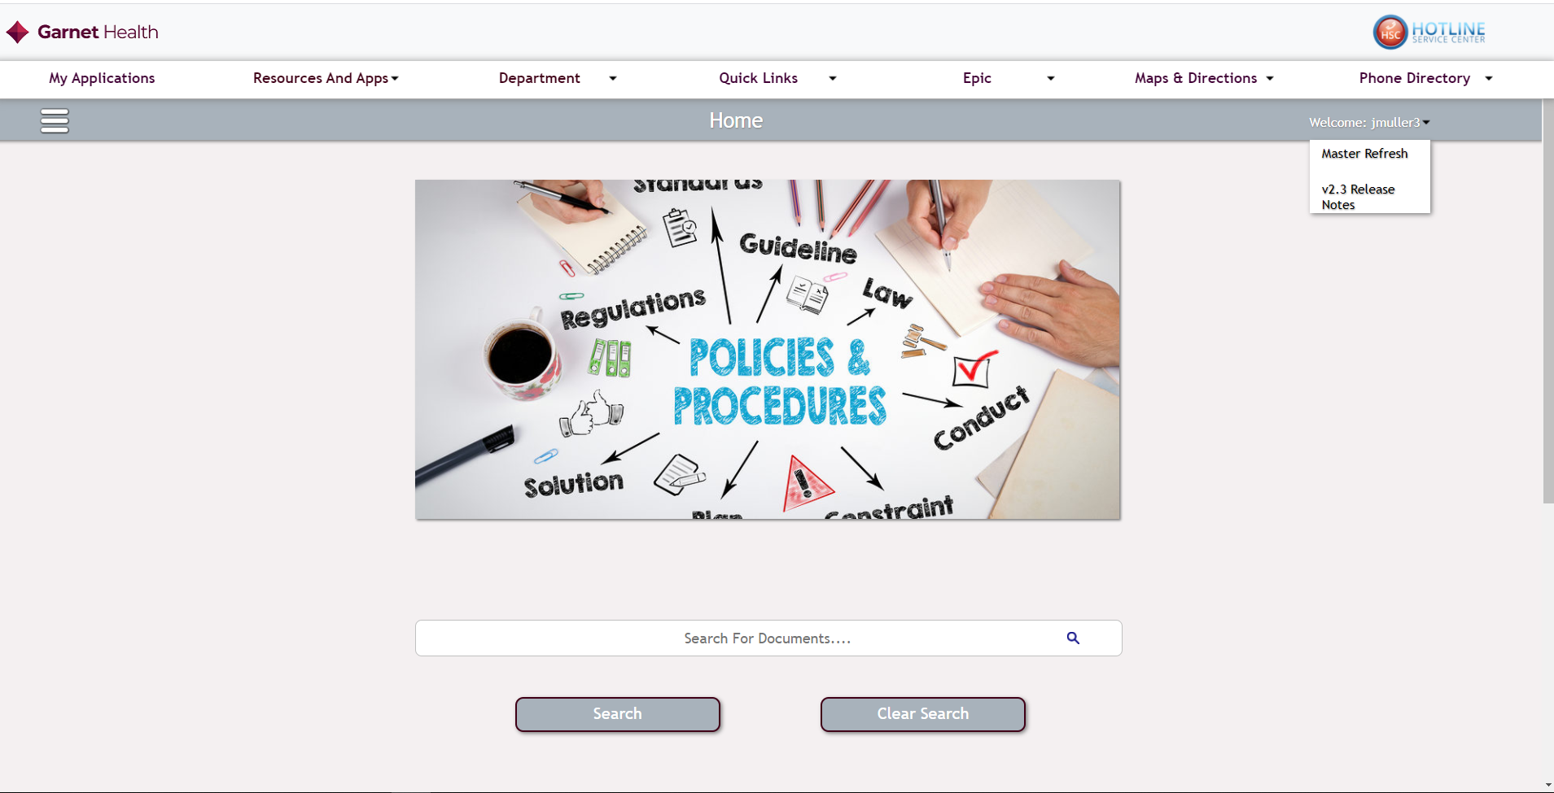
If there is ever any issues with a persons access to site have then click this button
Clicking this will download the current PowerPoint file of new features or bug fixes to be able to be viewed

