Slide 1
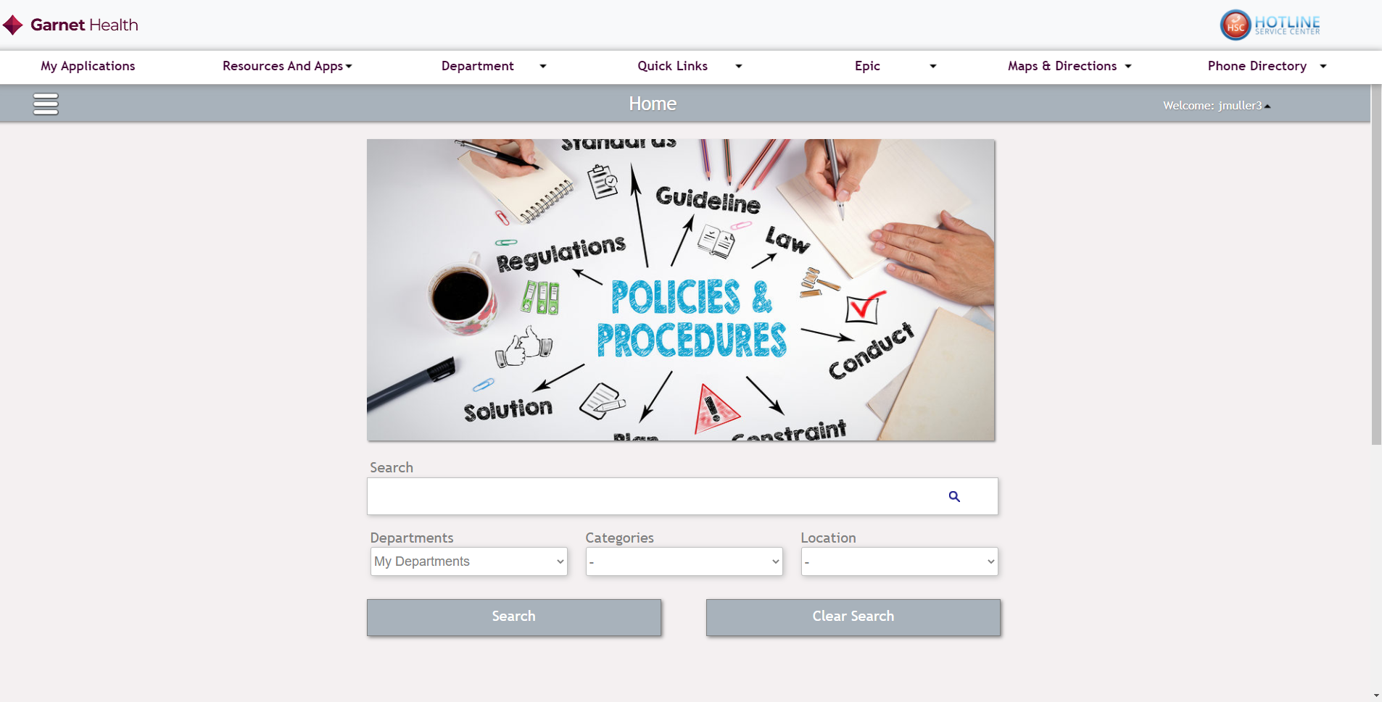
V2.4 PnP Release Notes
All New Search mechanics now built into the search page
Search by department, location and categories
Also search by title and words in the each document

Slide 2
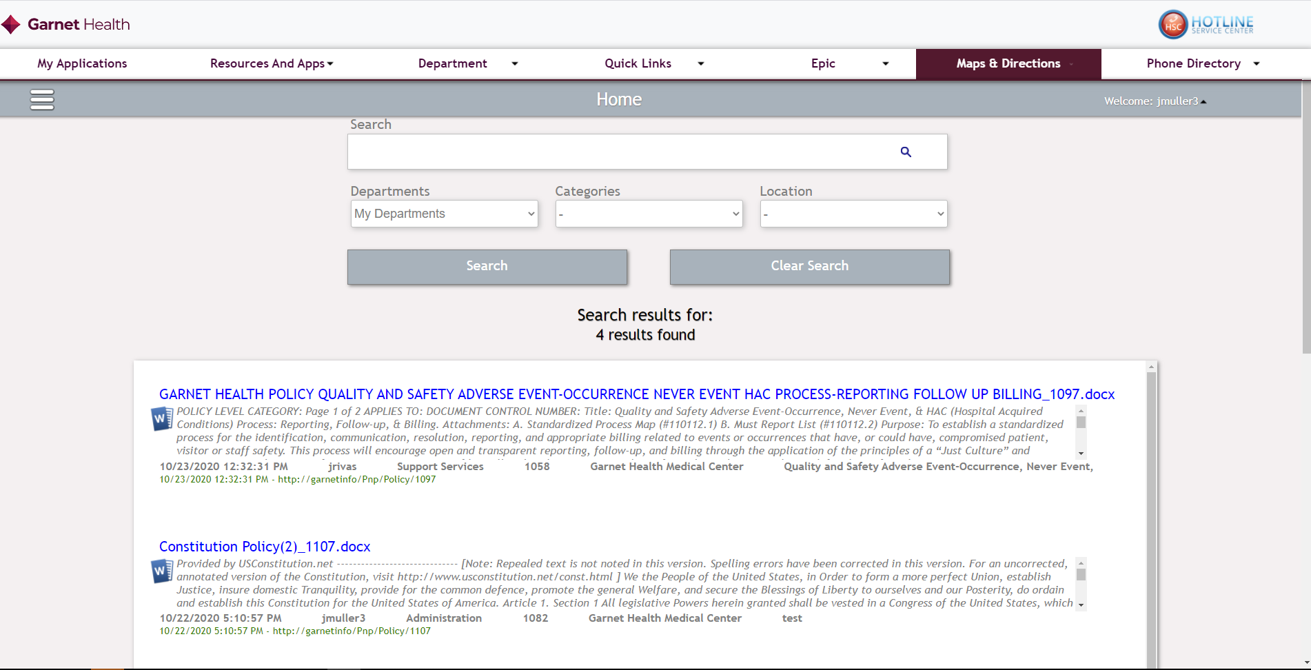
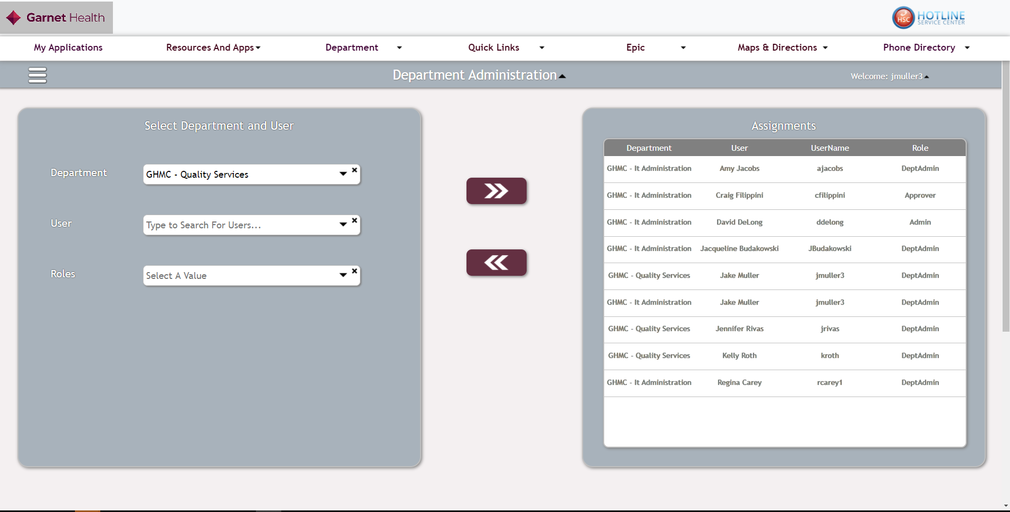
No longer does a user have to enter a words in the search box to be able to execute a search
Any of the drop down selectors can be filed to execute a search
Add the option “My Departments”
This will execute the search for only the policies that the user have full access to

Slide 3
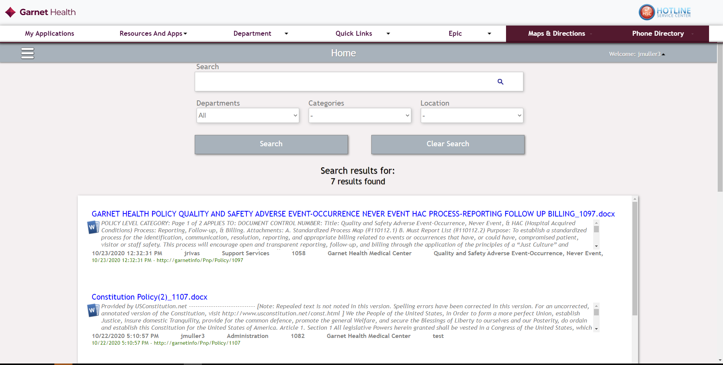
The user can now also search by the “All” keyword to search all for that filter

Slide 4

Leaving a filter or drop down option as “ - ” would indicate that filter doesn’t apply or just like leaving it blank

Slide 5
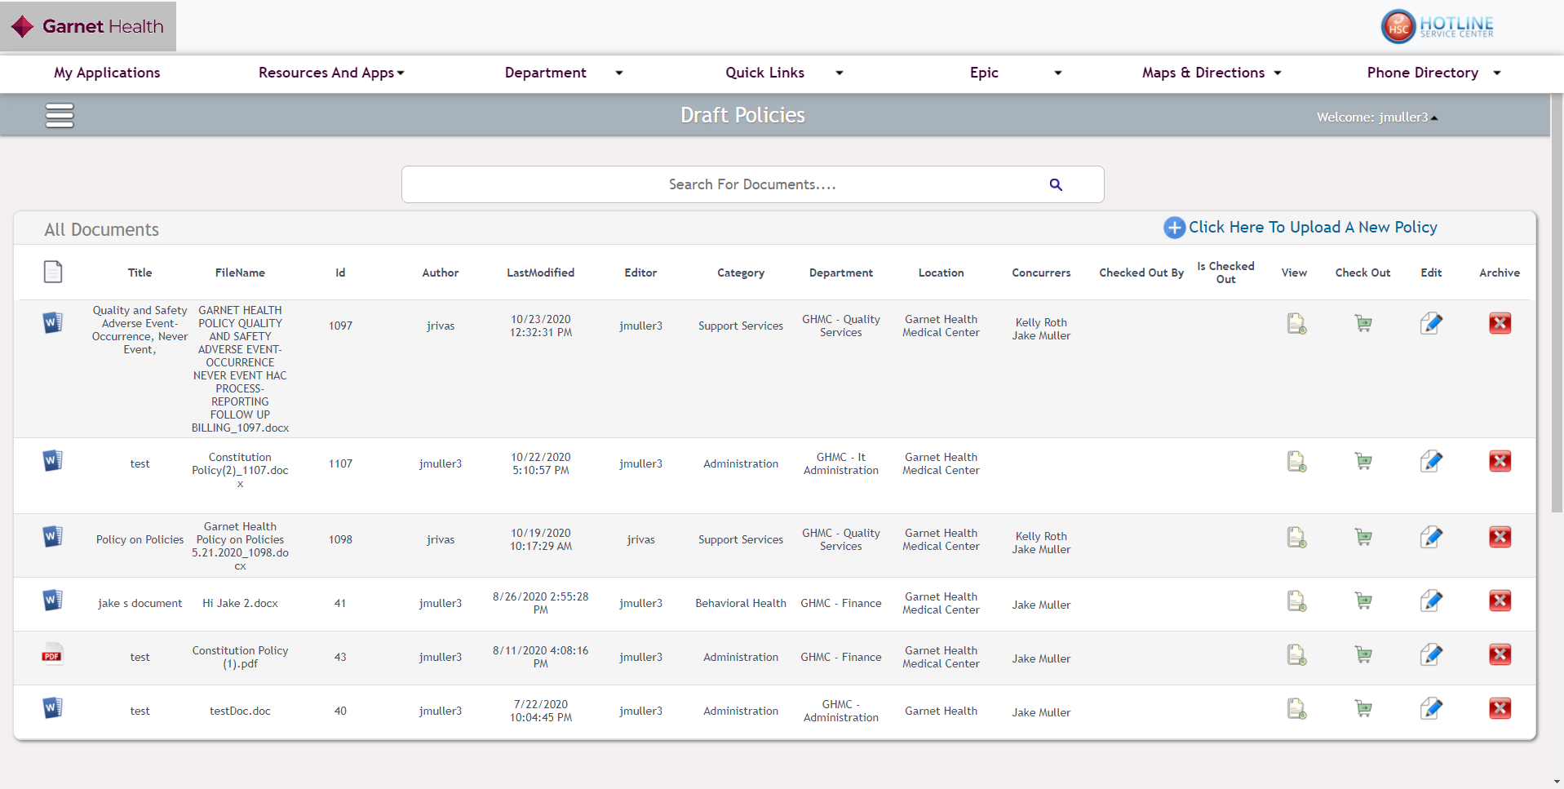
Now the user’s draft policy page is defaulted to be filtered by departments they have access to and any policy they are the author to

Slide 6
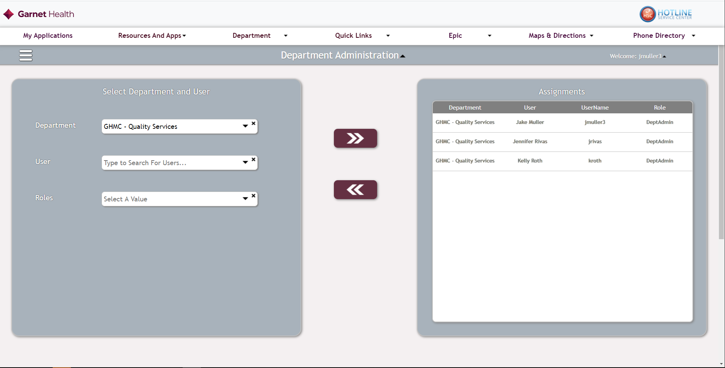
For the sake of this demo I just gave my self access to the quality Services department ( See next slide )

Slide 7
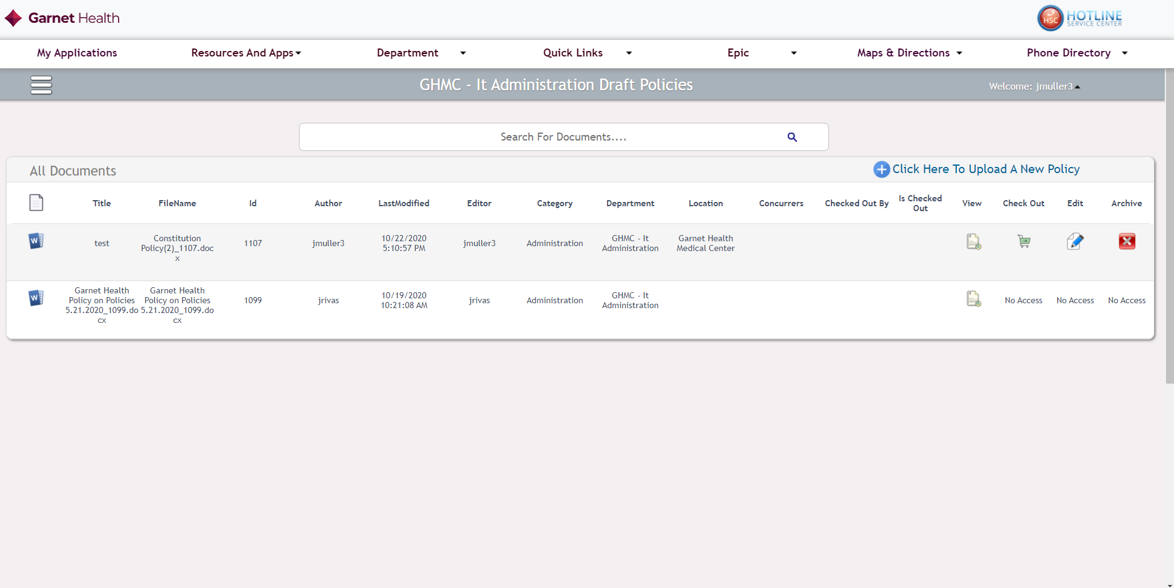
If you look at a department that you don’t have access to the buttons will be hidden with no access, unless you are the author of said policy
If I go to the it administration page
From the last slide I gave my self only access to the quality department
We can see when a user is the author to a policy, they will have access to edit the policy even if that policy in under a department they don’t have access to

