Slide 1

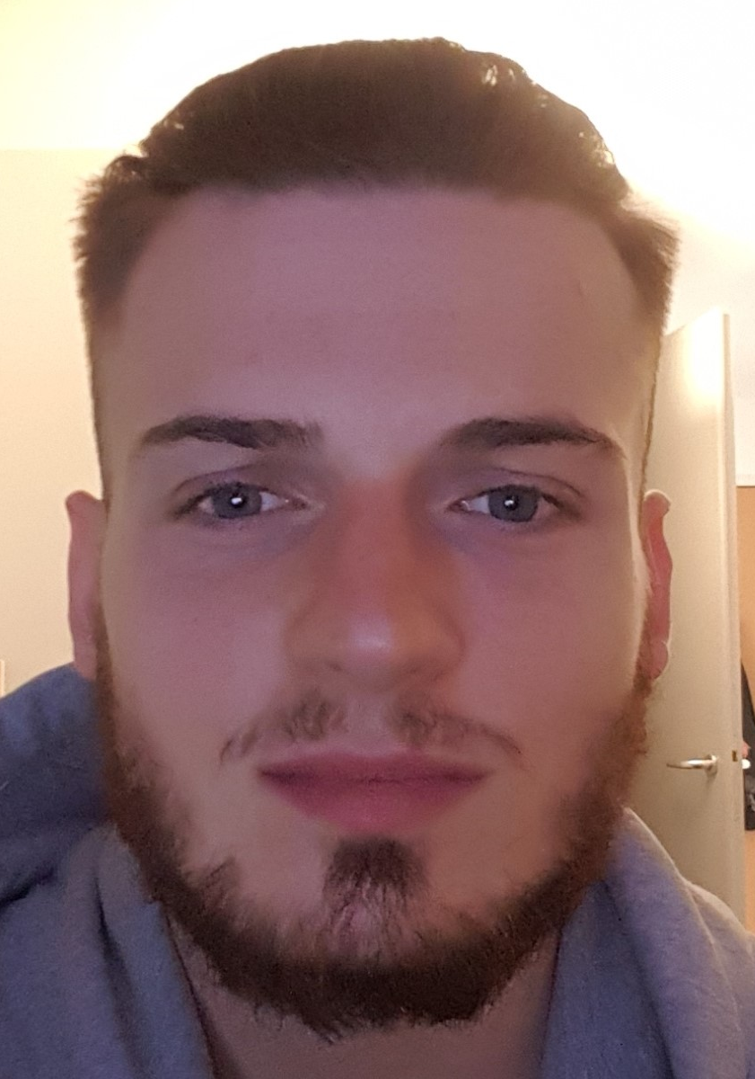
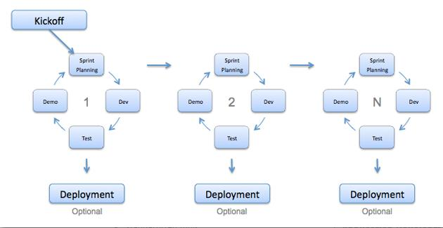
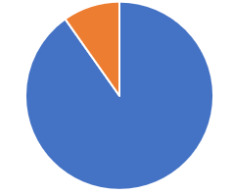
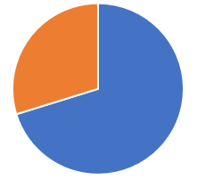

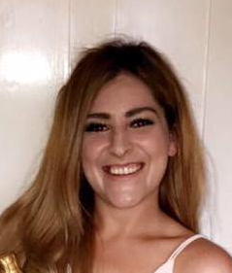
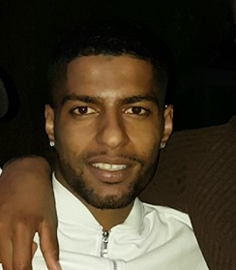

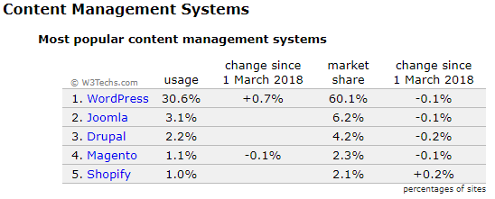




Societies and Sports teams prototype
By Jake Lambert
BSc (Hons) Computing – Third year
Introduction & Background
Agile Process Methodology
Website configuration
Introduction
The purpose of this report is to investigate whether a web presence would help raise the profile of and potentially increase the number of students participating in student societies and sports teams at Solent University. For this project we will create and design a prototype built around these student groups with the aim of connecting students to get them involved with student groups.
Research for amount of students in student groups
With the Agile process our software will be developed in incremental, rapid cycles. This cycle results in small incremental changes with each release being built on the previous functionality. Each release will be tested with the same consistency and thoroughness to maintain software quality. At the end of a sprint retrospective we should have identified and committed to a practical number of process improvement actions that will be undertaken in the next sprint.
SPRINT 1
SPRINT 2
SPRINT 3
Amazon AWS
Southampton Solent University
Kirstie Guildford
10% - 961/9807 students
Full list of all societies and sports teams
8 HRS
Recent news involving the student groups
4 HRS
Detailed info on the student groups i.e. Amount of students & weekly meets
8 HRS
This is the server we host our website on
Setup forum to discuss relevant topics within the student groups
8 HRS
Display results & fixtures for sports teams.
4 HRS
Google map location for each venue a match is played at
4 HRS
Bitnami
This allows us to download, deploy and maintain the WordPress application
Register page to comment on forum
4 HRS
Have league tables update upon updating match results
2 DAYS
University of Southampton
Daniel Thrower
30% - 7000/23500 students
Matches as events displaying all the relevant information
2 DAYS
Only allow users from each team to only update their own data
2 HRS
At least have all the Solent sports team’s members on the website
2 DAYS
WordPress
This s our application to build our website
Agile Participants
Login system to comment or create a topic
4 HRS
Create event page, for training session or social event
2 DAYS
Setup the news page to have publishers write the stories
5 DAYS
MySQL
Features
HTTPD Apache
Chat functionality for each sports team/society
2 DAYS
Have the website fully functional and navigationally-friendly on other devices
5 DAYS
Use an API to retrieve data from third-party websites, implement into website
10 DAYS
Aims & Objectives
Josh Dewitt
Third year
Hockey
Pheobe Pearson
First year
Pole Fitness
Jamal Wiseman
Second year
Football
This is the database to store all of our data
Widgets
Plugins
Our open-source HTTP server for Windows
The aim of this project is to investigate whether we can improve student participation in student societies through a better designed website and online community. The aim of this project is to investigate how many students are currently signed up to student groups and look at how Solent University offers knowledge on these groups to students. This project will address the following specific objectives.
To design a prototype that will be a platform for students view information, sports team performances and socialise with other students building an online community.
Conduct research using interviews of members of staff from the student union and sports centre to gain knowledge on the student groups.
Build an online community with strong foundations.
To use a content management-system to build the website, that can implement all features and functionalities effectively.
Design a sight with the objective to Improve recruitment and retention for participants of all societies and sports teams.
Investigate a variety of features to implement and maintain, select the ones that give the most benefit for the least cost and the least technical skill.
Provide future Recommendations for a full production solution which will be implemented beyond the scope of this project
Estimated time: 5 DAYS
Estimated time: 9 DAYS, 10 HRS
Estimated time: 17 DAYS, 12 HRS
Small blocks that performs a specific function I the website
Tools that help to build our website
System Features
Evaluation of project
Meeting objectives
At the start of this project we set ourselves some objectives to achieve the aims of this project. Throughout the development of this project we managed to achieve our objectives some successfully and some unsuccessfully.
We designed a fully functional prototype and implemented our features to a great standard,
We conducted some great research and interviews with society/sports heads, this was part of our primary research to gain knowledge on these student groups.
We believe we have built a great website to support an online community. We have great features like the forum page where students can air their opinions, the performance page where student can compare themselves to each other, and a news page for all students to keep up to date with.
We used a quality CMS WordPress, this gave us all the tools to implement our features and functionalities.
As we built a prototype there is no way to gage how to improve recruitment and retention to student groups, so this will have to be a done if this project was taken on as a full website.
Plugins are ideal tools for putting together your ideas for website features.
We have provided some great recommendations for further work below.
Societies & Sports teams information and signup
One of our main focuses to our project was to implement an online signup system for student groups in Solent University. On our Home page the users can select their desired student group, where they will be presented with a page with all relevant information, then at the bottom of the page there will be a signup form.
Sports statistics and performance
This section provides to the user statistics and league tables for all sports teams. This is great for people who are following a team, or simply for a current player to look at how well he has been performing.
Student groups blogs and news
We wanted to have a page that just focuses all relevant information and news regarding student groups, this is to give the user interest with what is going on. We provide blogs on sports team progress, society events, and current facilities.
Forum social
We wanted to create a strong online community, by having a forum for students this can give them the feeling of influence, in other words they can have their say to changing the community for the better. This is key focus of ours to maintain this website in the future.
Evaluation of Content Management System
It allows users to customize all aspects of the website from editing the code in a plugin to customizing themes
There are hundreds of tutorials, articles and guides on how to use all themes & plugins, these can help speed up the learning curve.
Even though the user must take security issues into their own hands, they are provided with the tools to do so
We can use more advanced features making our site very complex in functionality.
Although there are a lot of ‘useless’ plugins, we can just ignore them and chose the more high-end plugins. We will know this by looking at the plugin ratings and reviews, if they are usually over 4/5 stars then you know they will be beneficial for you to use. With the abundance of tutorials/videos on the internet you can be sure to pick using theses plugins with ease.
System Management
Evaluation of project
What student groups are available?
I want to see how many people are currently in a student group
I want to sign up to a group
I want to see how my team are performing
When is our next match?
Who is the top goal scorers in the league
I want to post a discussion on a forum
What is the latest news regarding my sport
Fresher Student
Student group’s website
Sports Student
Updating sports results with a mobile application using REST API
Instead of updating results on the website, we can use a mobile application to update results. We can achieve this using the REST API. The recent update to the SportsPress plugin means it’s now compatible with REST API. You will need to install the WP REST API plugin, which gives you instant access to retrieve your data
OpenID login system
Solent University could implement OpenID Connect to allow users logged into the university site to also access this website. OpenID provides an identity layer on top of the OAuth 2.0 protocol, it enables clients to verify the identity of the end user based on the authentication performed by an authorization server
Student custom page
This page will be tailored to the student whom is logged in, it will display what student group they are in and all the details of it. Also it will have a chat function where only student from that group will be able to access, they can use this to arrange social events or extra training session.
What plugins will I need to implement features
How does the site need to be laid out?
What theme should I use?
What is my time frame?
Will the site be easy to maintain after launch?
Central Hub
Do I have enough technical knowledge
Are plugins & themes up to date?
Has the site been backed up?
Is everything running smooth?
Are the layouts still the same?
Website Creator
Maintenance
What do we write?
Are we writing a blog?
What’s the recent news stories?
Is our article interesting to the target audience?
Is our article relevant to student groups?
Are we releasing frequent content?
Is the content relevant?
Do we have a strong social media presence?
Writers
Have we sent our weekly reminder to our writers?
Is the content sent in to a good standard?
Is it relevant?
Will students find an interest in the blog?
What blogs should we post to the site?
Is our password complex enough?
Have we got firewalls to prevent being hacked?
Have we swept our database?
Is our data protected?
Regular website backups
Social media
Head publisher
Security

