Slide 1
Device Locator with Temperature Monitor
Jianqiao Ma

Slide 2
What is this thing?
Get real-time GPS information (latitude and longitude) of this device
Get real-time temperature information

Slide 3
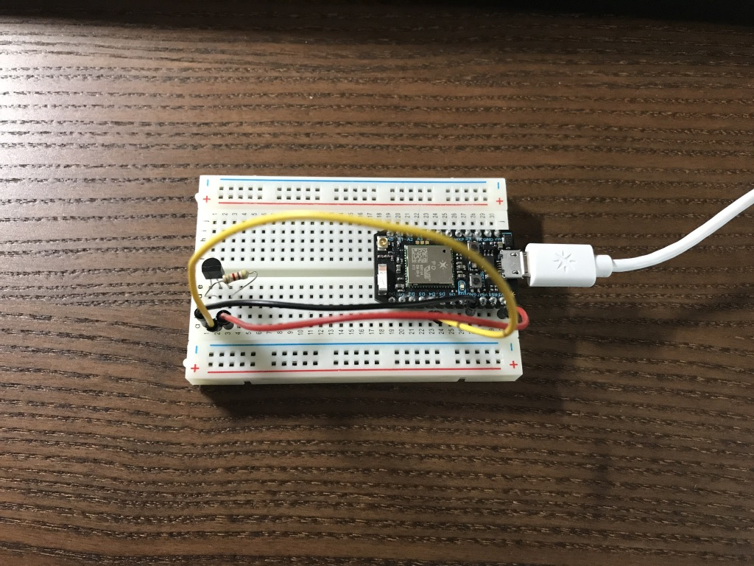

Slide 4
How does it work?
Send location request to Google Maps API
Something look like this: {\"w\":{\"a\":[{\"m\":\"de:5d:df:41:fc:88\",\"s\":-62,\"c\":11},{\"m\":\"7a:40:4e:37:ee:49\",\"s\":-23,\"c\":11},{\"m\":\"d4:5d:df:41:fc:88\",\"s\":-62,\"c\":11},{\"m\":\"fc:2d:5e:2 ………….
Google Maps response with GPS information
Latitude, longitude, uncertainty radius in meters
44.9038179, -93.1699403, 30
Get temperature readings is simple, just read from temperature sensor.

Slide 5
How to visualize these data?
Using IFTTT, every time a new event is published, it adds a new row to my Google Sheet.
From another website: https://www.darrinward.com/lat-long/.
Upload a .csv file and get a map with locations marked on it.

Slide 6
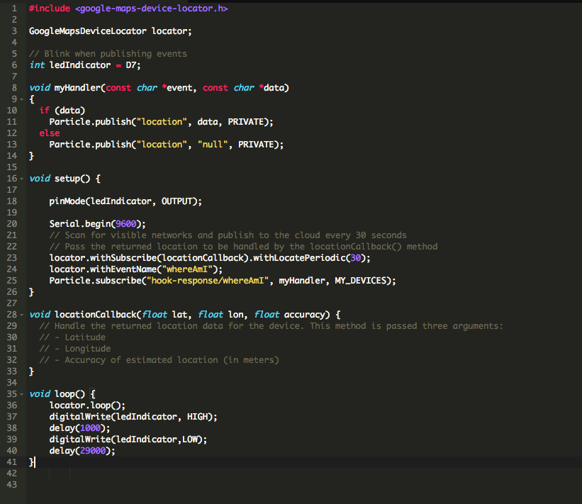

Slide 7
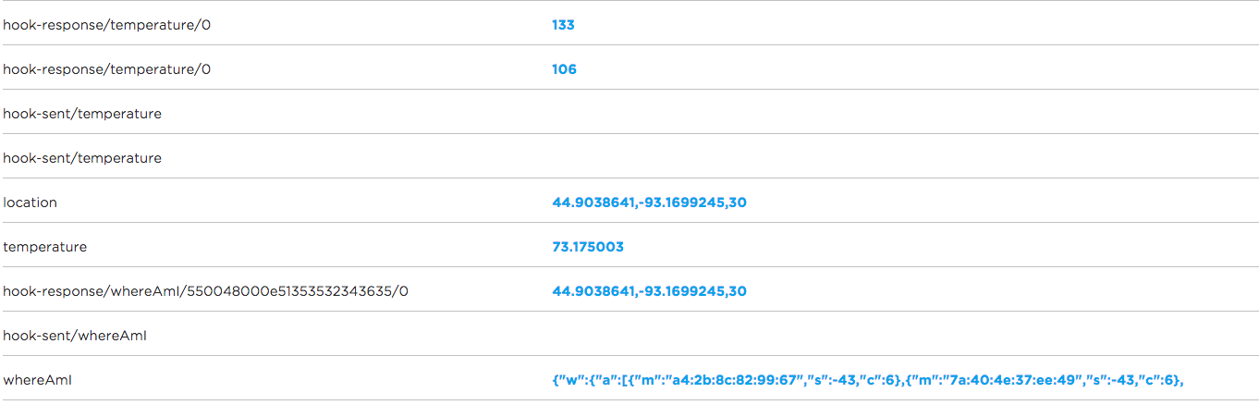

Slide 8
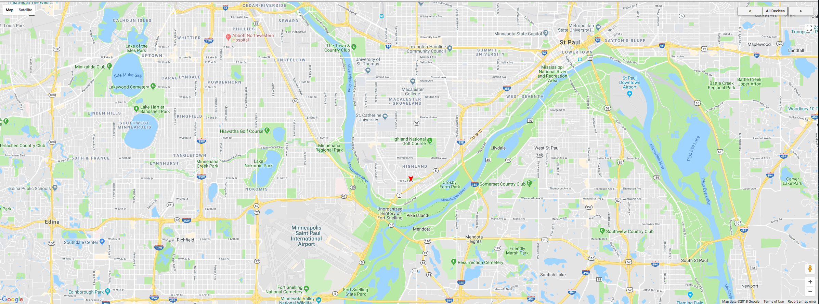

Slide 9
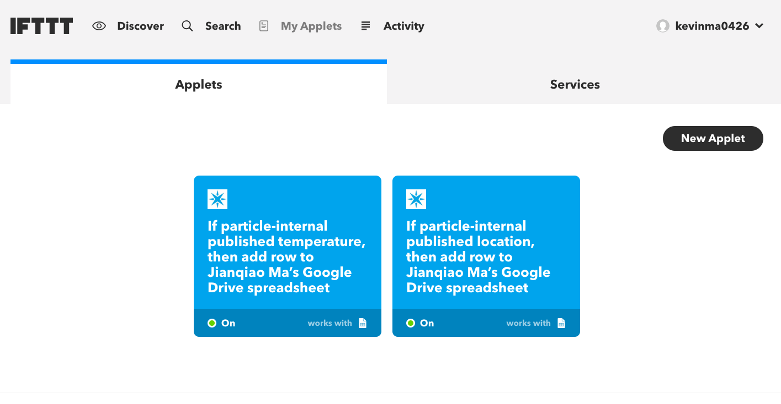

Slide 10
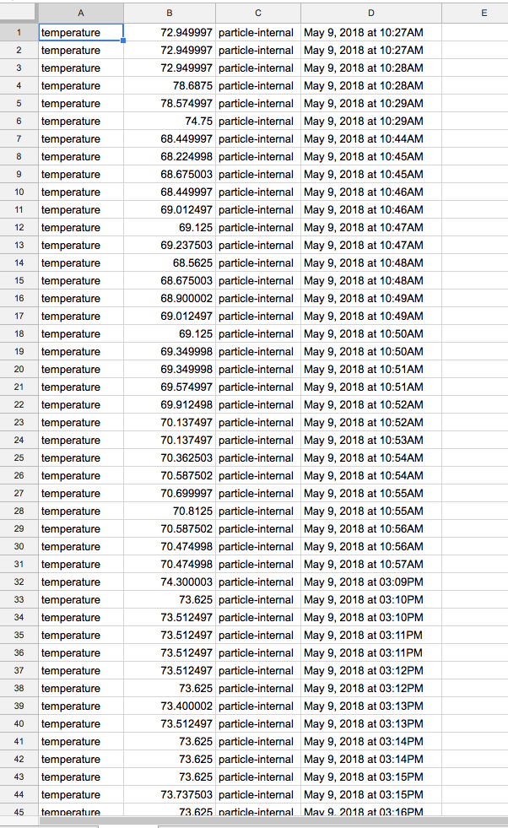
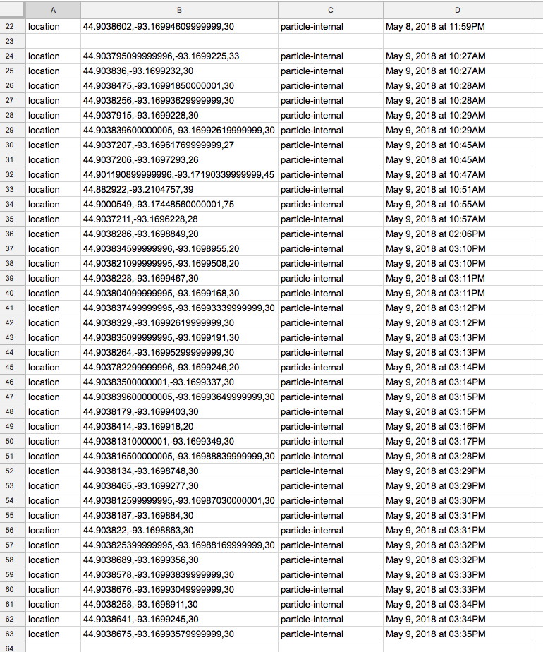

Slide 11
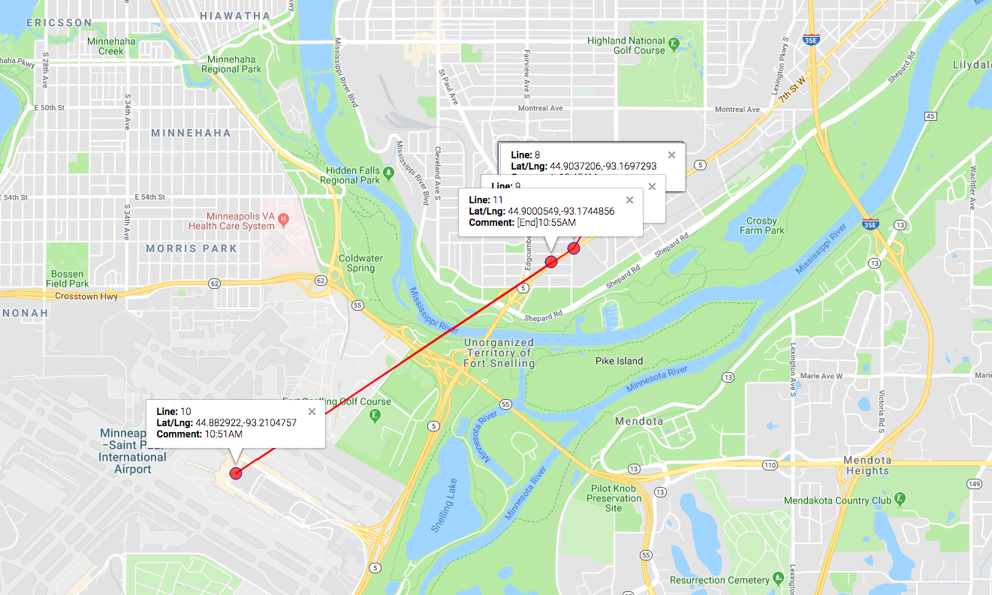

Slide 12
Existing problems
Photon can’t connect to personal hotspot when powering by a car charger
Can’t get readings when driving too fast?

Slide 13
If I have more time
Try different power sources, like a power bank.
Figure out why it can not provide readings when driving on highway.
Use a SIM card to provide internet connection. (Also need more money)

Slide 14
Thank you

