Slide 1
Quantinuum Challenge: InsertPresentationName
InsertTeamName
Grace J. Grace T. Jake M. Misheel O. Theo L.

Slide 2
—InsertSomeoneFamous
“AAAAAAAAAA”

Slide 3
01
Optimization
Improving Quantum Approximate Optimization Algorithm

Slide 4
Approaches
Understanding physical problem → generally successful
Proof of concept by FDSA or gradient descent → successful, got higher result
Used gradient descent and SPSA Optimization → generally successful, still improving understanding
Wrote our own SPSA implementation → successful, got substantially higher results

Slide 5
Quantum Approximate Optimization Algorithm (QAOA)
Several layers of alternating cost and mixer Hamiltonians
Layers are determined by the parameters γ₁, γ₂, … γₚ, β₁, β₂, … βₚ, where 2p is the # of layers
Certain combinations of parameters give good expected energy
Maximize
Farhi, Edward, et al. “A Quantum Approximate Optimization Algorithm.” ArXiv.org, 14 Nov. 2014, https://arxiv.org/abs/1411.4028.

Slide 6
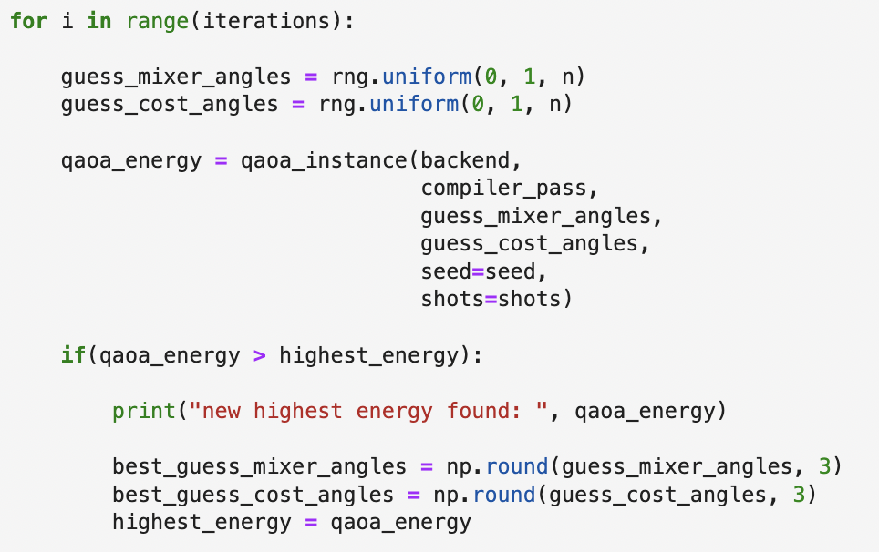
Original Quantinuum Code
Random number guess for angles from uniform distribution between 0 and 1
Keeps choice of angles if it beats all previous choices

Slide 7
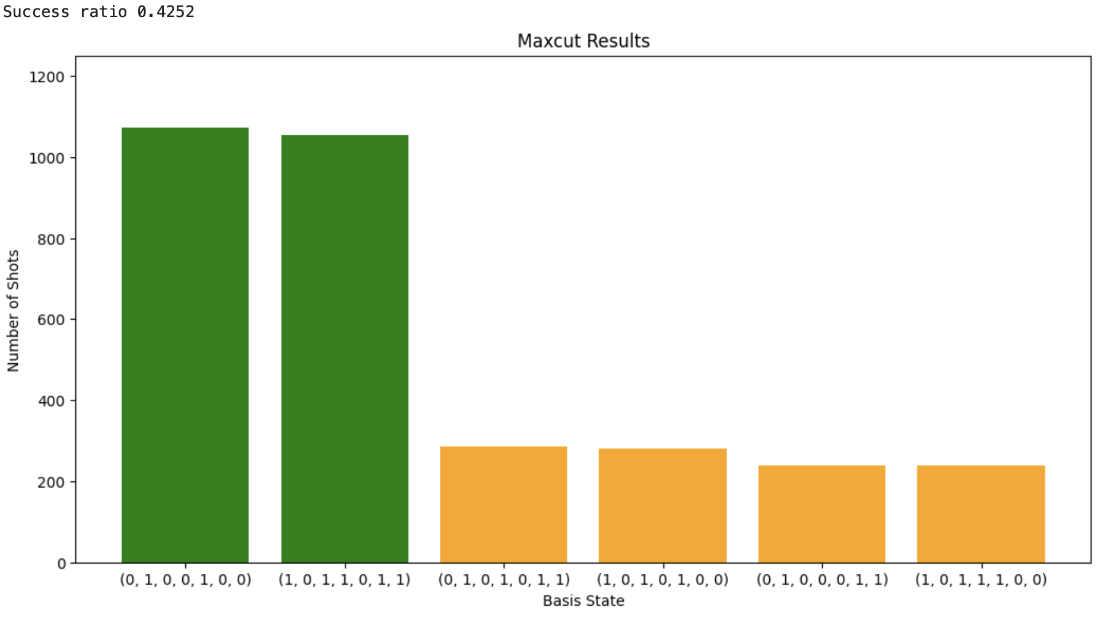
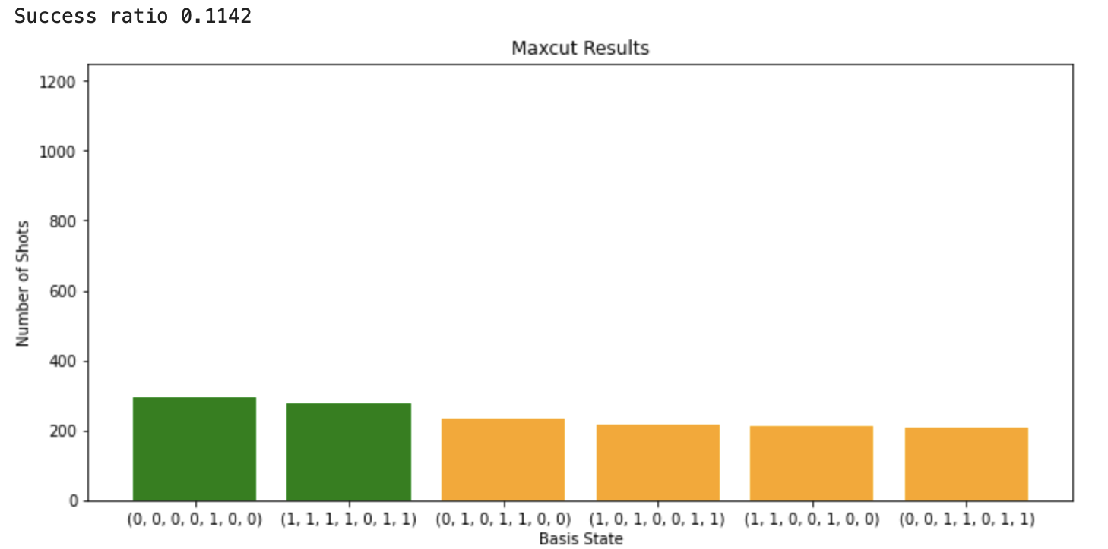
Graphs
Original graph
A weighted graph
(Kind of wrong)
Highest Expected Energy: 4.94
Highest Expected Energy: 9.4

Slide 8
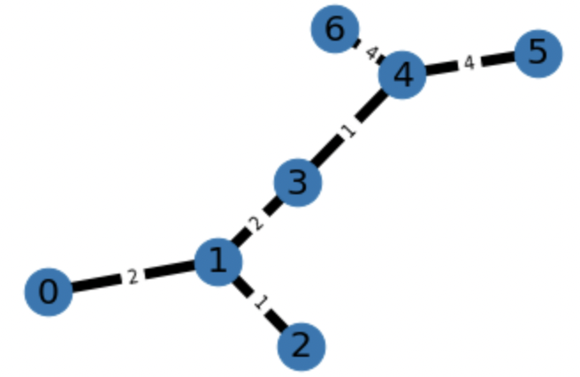

Slide 9
Gradient Descent
Estimate the gradient of the objective function by partial derivative in each variable
Make jumps proportional to the estimated gradient
Pro:
Gets better results than random guesses
Cons:
Complexity increases with number of variables

Slide 10
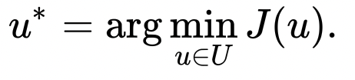
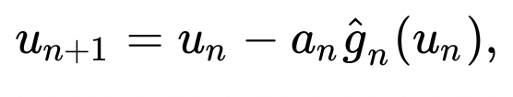
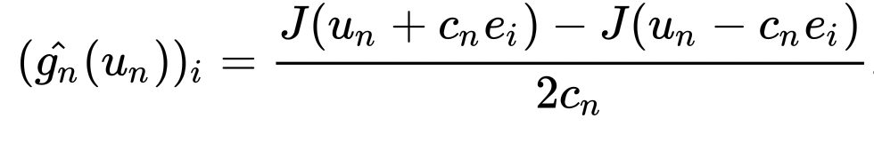
The Math
For Objective function J(u), find
Iterate by moving with gradient,
Estimate gradient by,
“Simultaneous Perturbation Stochastic Approximation.” Wikipedia, Wikimedia Foundation, 3 Jan. 2023, https://en.wikipedia.org/wiki/Simultaneous_perturbation_stochastic_approximation.

Slide 11
Simultaneous Perturbation Stochastic Approximation (SPSA)
Instead of testing each variable direction, tests a random direction twice.
Estimates gradient
Provable that gradient error approaches 0 over iterations
Pro:
Complexity stays the same for more layers
Usually does better than previous approaches
Easy to implement a simple version
Cons:
The pre-existing implementation was confusing and unpredictable

Slide 12
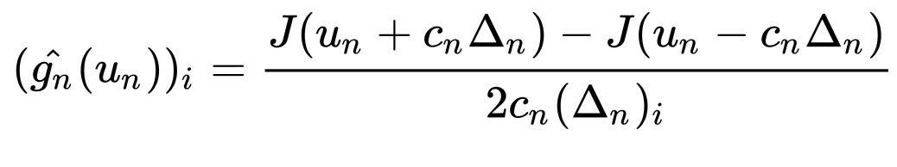
SPSA Math
We estimate the gradient by,
with the 𝚫ₙ drawn from a Rademacher distribution: uniform discrete from {-1, +1}

Slide 13
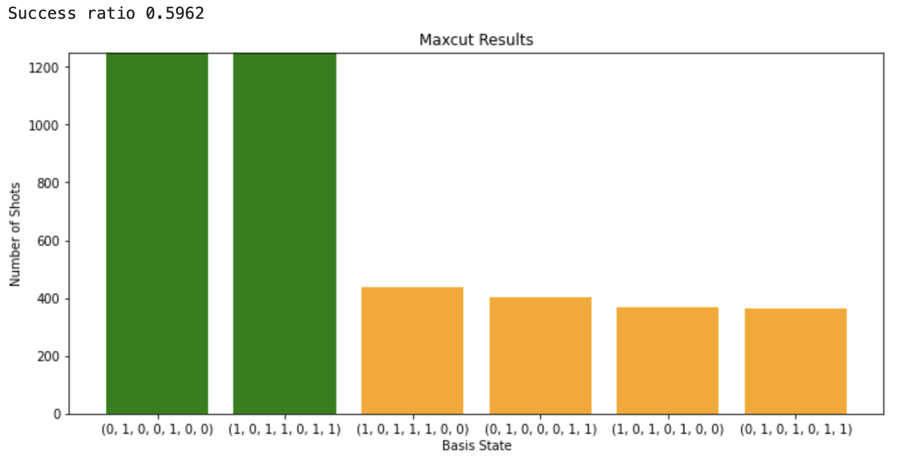
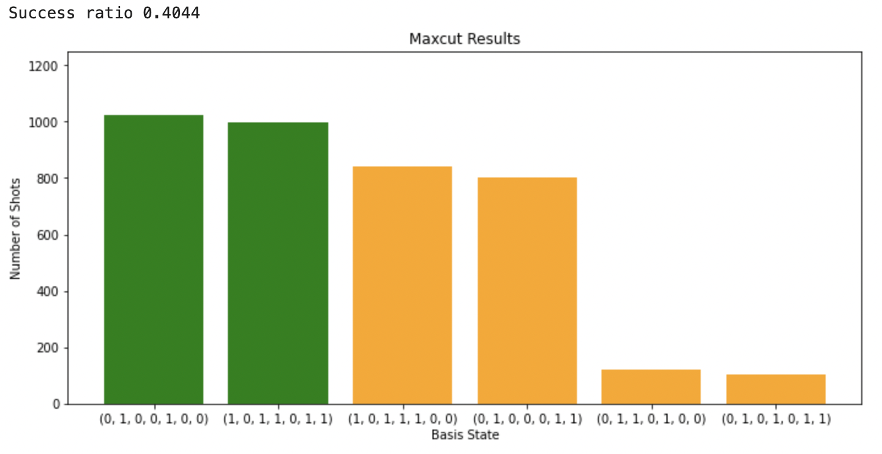
Graphs
Original graph
A weighted graph
Highest Expected Energy: 5.46
Highest Expected Energy: 12.77

Slide 14
02
Further Applications

Slide 15
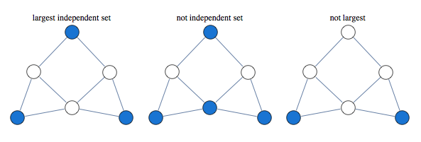
Max Independent Set

Slide 16
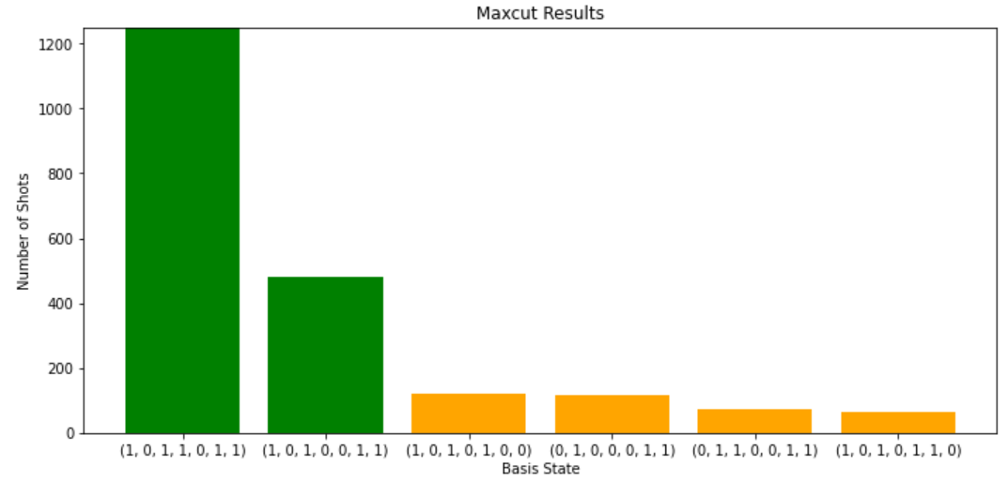
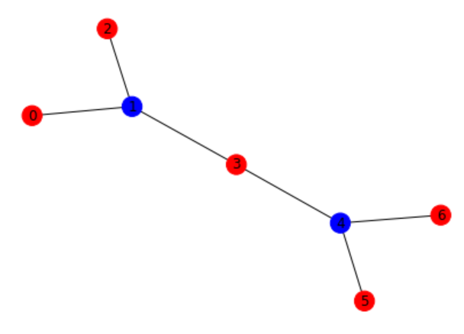
Results
Max Independent Set Results

Slide 17
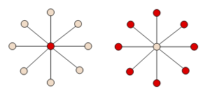
Real-World Applications
Max Independent Set
Corresponds to maximum clique problem on complement graph
Corresponds to minimum vertex cover problem

Slide 18
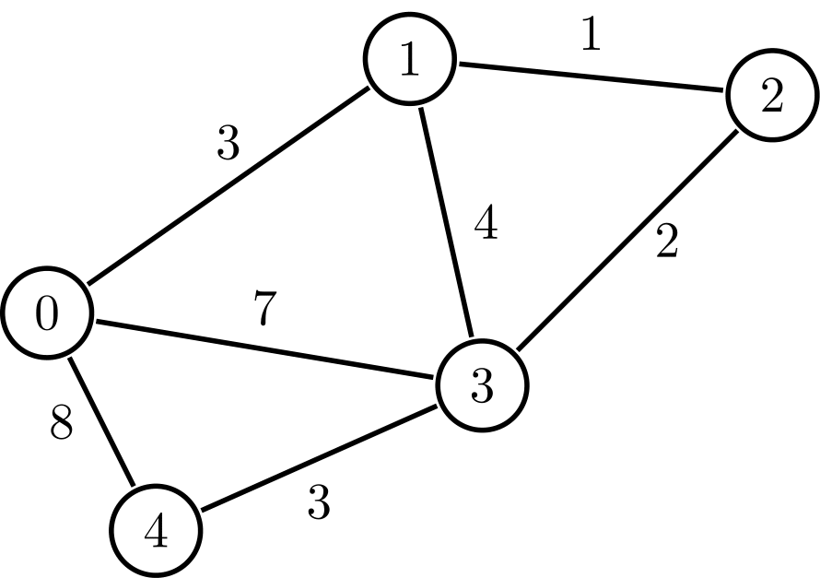
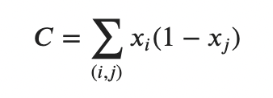
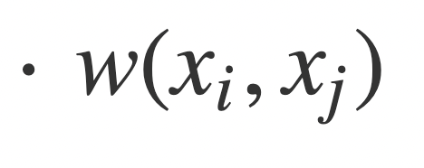
Max Cut for Weighted Graphs
Graph with edges that have weight
Cut across an edge is now worth the edge’s weight, not a default 1

Slide 19

Results

Slide 20
Real-World Applications
Max Cut for Weighted Graphs
Grouping friends together, grouping those who don’t know each other well together
Meal planning from foods in fridge (maximize nutrition)
 | Seal | Monk | Liane
Seal | 1 | 0.4 | 0.7
Monk | 0.4 | 1 | 0.9
Liane | 0.7 | 0.9 | 1

