Slide 1
Maces and Talons
A board game based on Hnefatafl
Jake Mcdonagh (jam93@aber.ac.uk)

Slide 2
Project Aims
Develop a faithful recreation of Maces and Talons.
Based on multiple different board games (Hnefatafl, Risk, Chess).
Develop Game Loop, ruleset, properties of pieces.
Develop on multiple platforms
Windows (Mouse based), Android devices, Microsoft Surface table (Touch screen compatibility).
Develop in-game AI
Alpha-beta pruning.

Slide 3
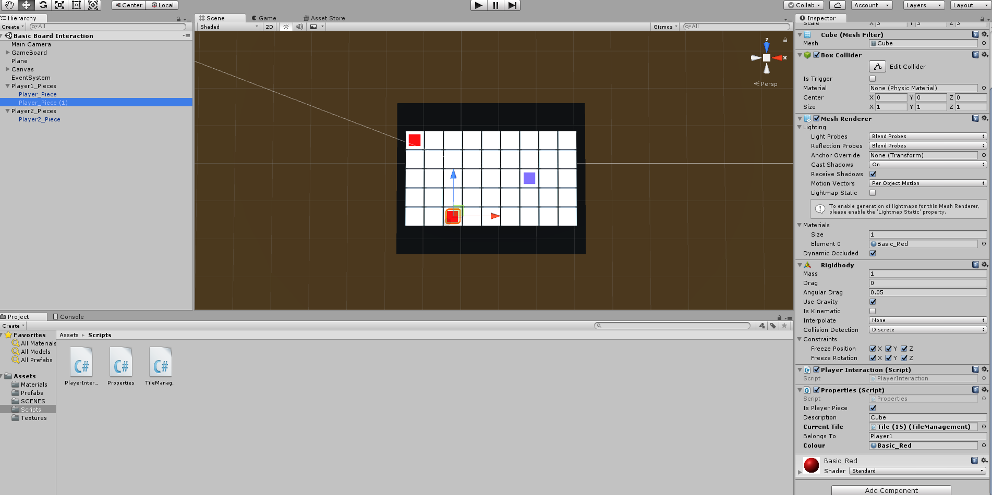
Technical Information
Developed using:
The Unity Engine w/ C#
Game management, Asset management, AI creation
Blender
Model creation

Slide 4
Remaining Work
Finish remaining work for a fully complete game cycle.
Allowing players to add in pieces during their turn.
Develop different properties for different pieces (traitor, hunters, Viking king)
Constant checks to see if player has won.
Develop in-game AI.
To be developed once main game is working.
Graphical overhaul to make application aesthetically pleasing.

