Slide 1
Meals on Wheels Staff and Volunteer Web Portal
Max Patek, Nate Strawser, Josh Santana, Alex Hicks, Kyle Leisure, Michael Benos, Kevin Naddoni

Slide 2
Meals on Wheels -- Requirements Overview
Customers
Receive meals on a delivery route
Volunteers do jobs
Volunteer have recurring jobs (deliver on a route, packing meals, etc)
Volunteer can fill and request substitutions
Staff
Assign jobs to volunteers and coordinate substitutions
Packing and delivering meals
Manage volunteer and customer data (payments, diets, pets)
Generate various reports (billing, daily meal counts, food labels)
(and many more specific requirements)
Notes:
Kyle

Slide 3







Technologies Tools
Django
Python
Docker
Docker-Compose
Bootstrap
Gunicorn
Nginx
Letsencrypt
Postgres
Autoformatters
Google Maps API
Travis CI
Github Actions
Github Issues and Github Projects
Amazon Web Services
Make
Coverage.py
Notes:
Django/Python - project and familiarity - old app
Docker - dev/prod env and setup
AWS - deployment
Letsencrypt - SSL
Github -
Actions - deployment on server
Projects and Issues - keep track of work
12,356 total lines of python
3854 lines of html
322 lines of javascript

Slide 4
What is good?
(wins)

Slide 5
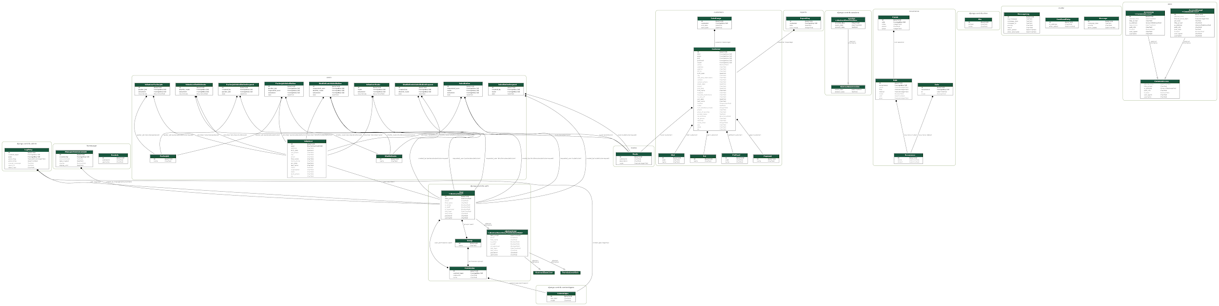
Old Models
Notes:
Max

Slide 6
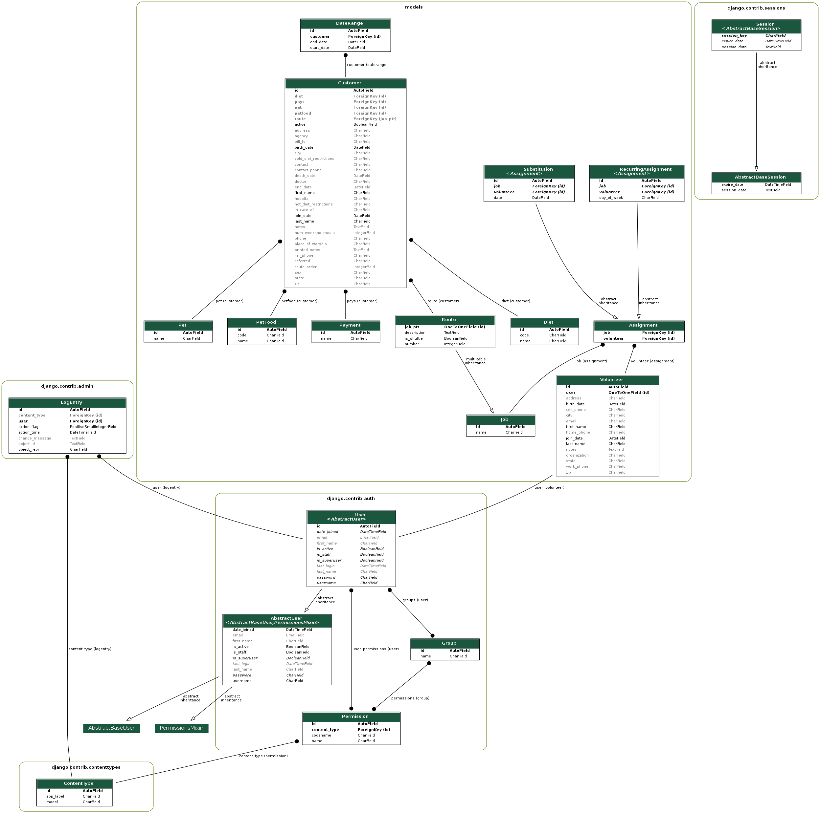
New Models
Resolved Tech Debt
Notes:
Max

Slide 7
Fewer Pages (demo)
More concise models → fewer pages
All job types (route, packer, shuttle) can now be represented on a single “Manage Jobs” page
Substitutions and assignments are more generalized (no separate pages for filled/unfilled, or job types)
Fewer reports for volunteers to generate each day
Site navigation is much easier
Notes:
Josh

Slide 8
Google Maps Integration (demo)
Route Maps
Route manipulation
Directions
Google Maps app support
Addresses
Autocomplete
Notes:
Nate and Michael

Slide 9
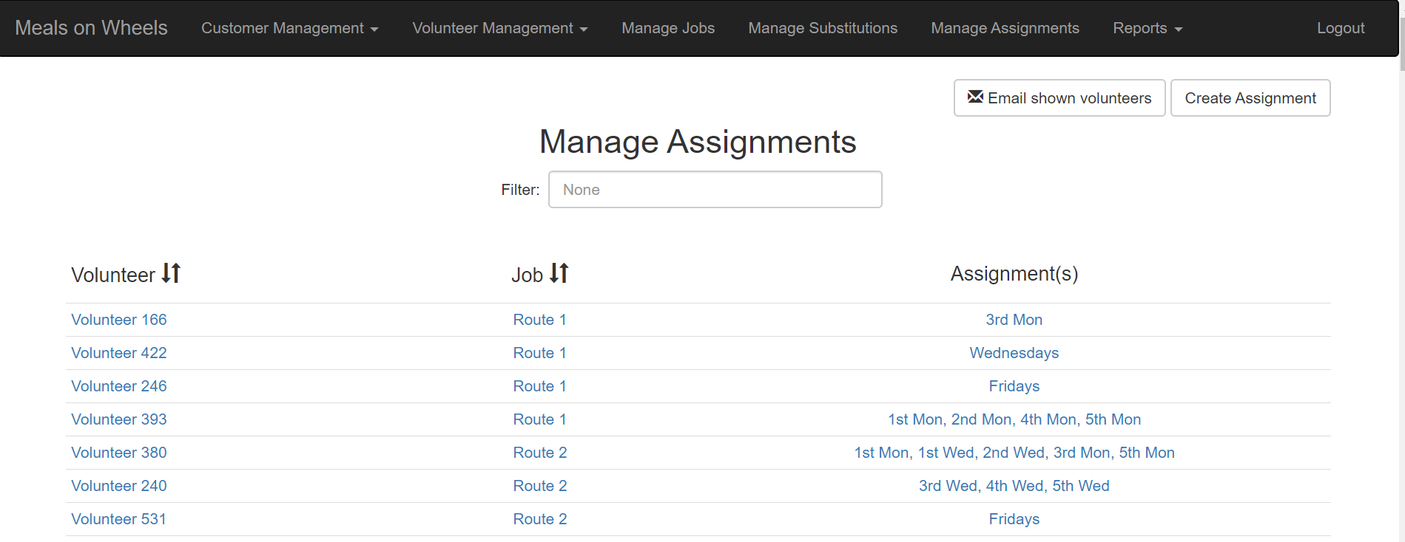
Assignment Management (demo)
Notes:
Kyle
Open demo immediately

Slide 10
Reports (demo)
Hardcopy PDFs
handed to volunteers (food labels, route sheets)
given to the board (billing, daily count)
kept for historical records (job overview)
Hourly cron job creates up-to-date records → guarantees historical accuracy
Faster report generation
Leverage batch processing in cron job
Django’s query aggregation
Notes:
Kevin

Slide 11
What was hard?
(challenges)

Slide 12
Old Portal
Combination of greenfield and brownfield development
Worst of both worlds
Had to understand old codebase while writing our webapp from scratch
12k+ lines of Python
Logistical difficulties of working with an existing live application
Track down old API keys
DNS Records
Data migration
Notes:
Nate

Slide 13
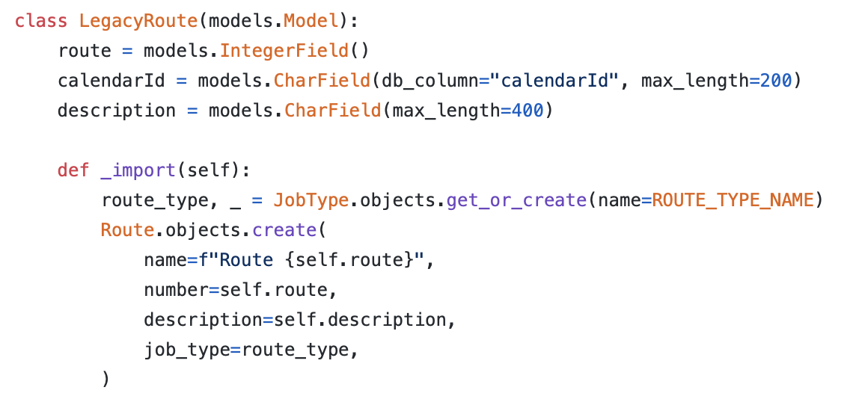
Migrating
Old Data
Fragile server
Risky data dumps
Incompatible Django & fixtures
New Relation Model
Complex migration scripts
Topological sort by foreign keys
Strip Unused Data
Open Route
100,000s rows of outdated data
Migration Utility
python3 manage.py importlegacy --no-coordinates
python3 hack_fixtures.py

Slide 14
Models Changes
Overly optimistic in the very early design predictions
September to October customer meetings → important to learning their system
Understanding MOW users workflow
Customers on specific days
Routes on specific days
Jobs with multiple volunteers
Other exemptions, exceptions that needed to be designed into new system
Proactively incorporated customer input → ultimately not a major development challenge
Notes:
Kevin

Slide 15
Reports Changes
Strict formatting requirements
Labels were printed on a specific sized paper
Working with a new library whtmltopdf
Notes:
Josh

Slide 16
Recurrence Representations
Customers only receive meals sometimes
Active?
DateRange defined?
Recurrence field?
Jobs only run on certain days
Recurrence field?
Anyone actually assigned?
Volunteers only work certain days
Every Monday?
Fourth Monday?
Fifth Monday?
Last Monday?
Existing django packages
No support for restrictions
Not maintained
Conflict with others
Like django-address
Built our own
Use existing for customers
Use existing for routes
Use custom for volunteers
Notes:
Max

Slide 17
What’s next?
Notes:
Michael

Slide 18
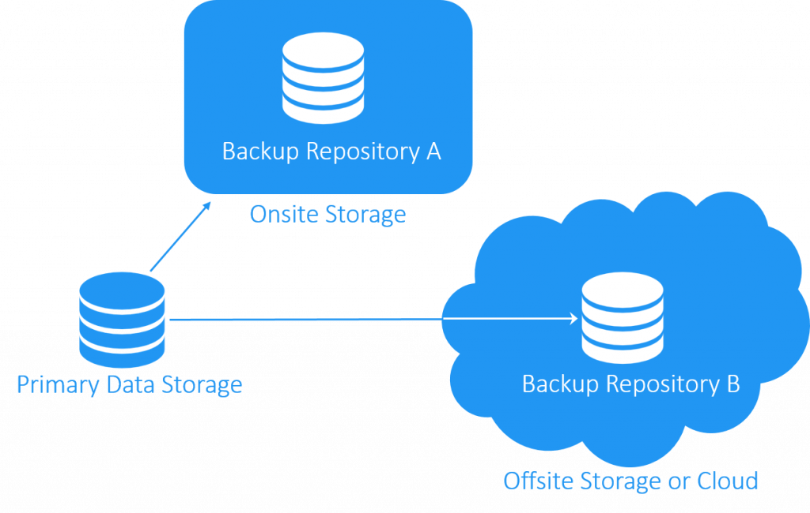


Future Work
Maintainability
Data Security
Mobile friendliness
Functional, but not optimized
Notes:
Michael

Slide 19
Thank you!
We’d like to thank the course staff and the team at Meals on Wheels (specifically Allie and Susan) for all of their help.
Any questions?

