Slide 1
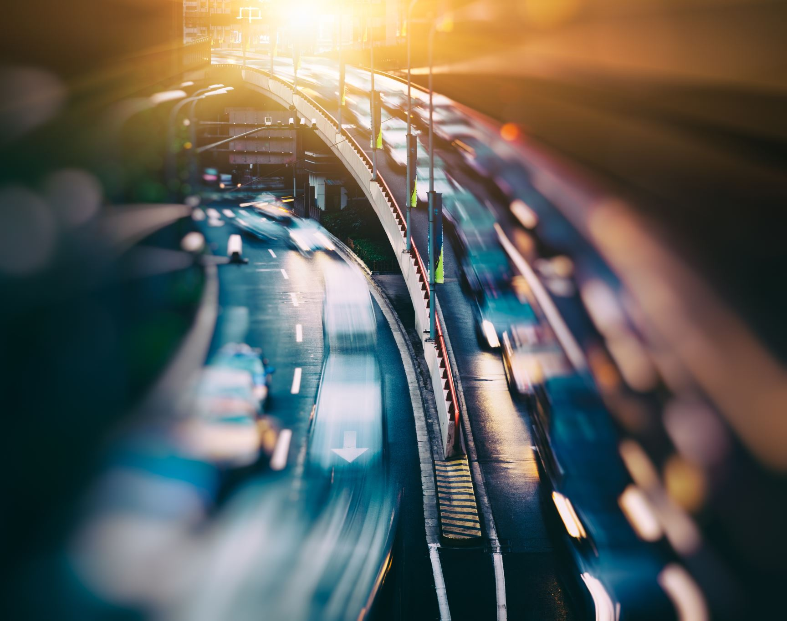
Traffic AI – Pathfinding and LSTM for Traffic Congestion
By: Alina Bangash, Sneha Jacob, Josh Matthew, Jake Schwartz

Slide 2
Traffic Congestion Dataset
Kaggle Dataset based off computer vision model capturing data in urban city.
Columns: {Time , Date, Day of week, Car Count, Bike Count, Bus Count, Truck Count, Total Count, Traffic Situation (Low, Medium, High)}
Data captured from December 1st 2023 - December 31st 2023
Sine and Cosine encoding - time is circular (12 AM is close to 12 PM on a clock). Sine and cosine turn the hour into x and y positions on a circle, so the model understands this cyclical nature.
Dummy Variables for days of week.
Lag Values - previous 3 totals
Breaking data into sequences of 10 time steps

Slide 3
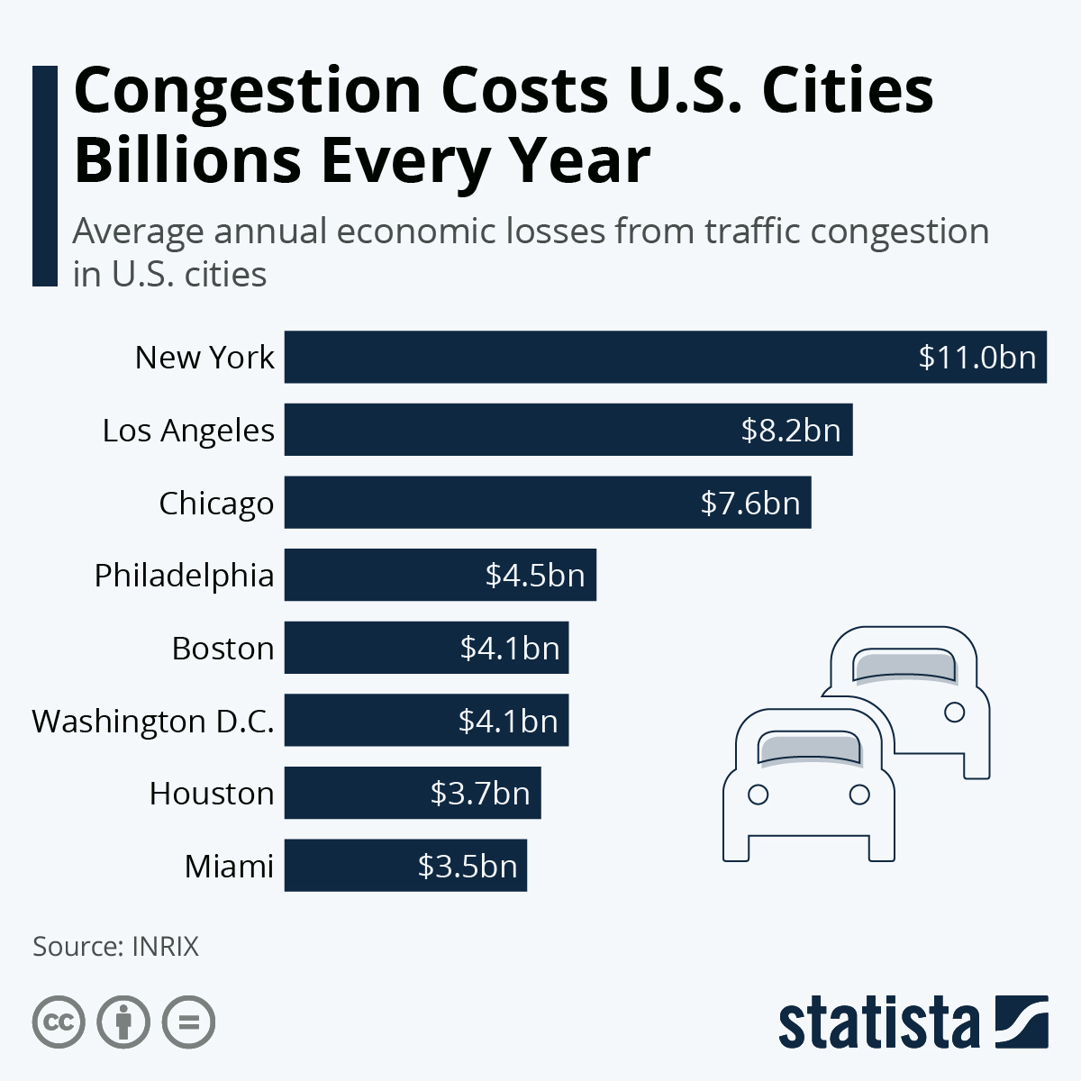
The Impact of Traffic Congestion in Manhattan
Manhattan experiences some of the worst traffic congestion globally, with drivers spending an average of 101 hours in delays annually (INRIX 2023).
Traffic congestion cost NYC an estimated $9 billion in economic losses in 2023 (Bloomberg 2023).

Slide 4
Project Goal

Slide 5





Data and Tools
OSMnx API – OpenStreetMap
Provided city network for pathfinding algorithms.
Kaggle– Traffic congestion prediction dataset
Matplotlib, NumPy, Pandas, Sklearn, TensorFlow

Slide 6
Algorithms and Models
Pathfinding
A*
BFS
DFS
Dijkstra's
Congestion prediction
LSTM
RNN

Slide 7
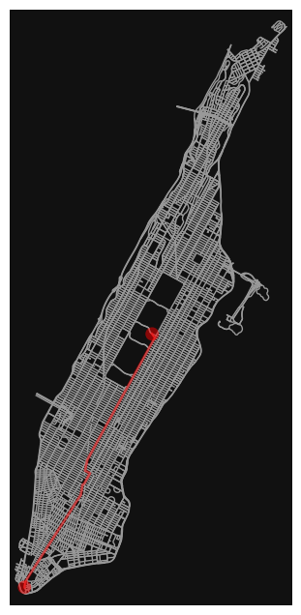
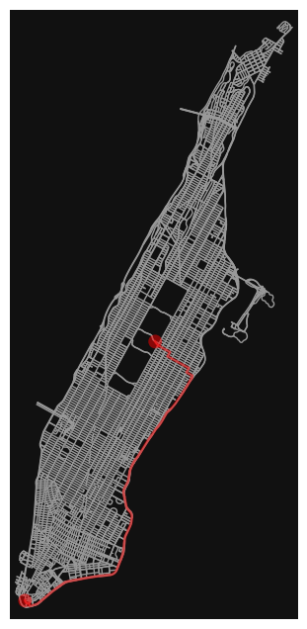
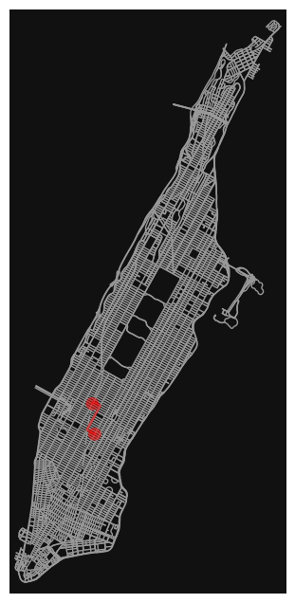
A* Results
Central Park to Battery Park
(Distance)
Central Park to Battery Park
(Distance)
Empire State Building to Times Square (Distance & Time)
Empire State Building to Times Square
1.01 miles
0h 2m 25.84s
Central Park to Battery Park
6.26 miles
0h 13m 55.57s

Slide 8
Dijkstra's Results
Central Park to Battery Park (Distance)
Central Park to Battery Park (Time)
Empire State Building to Times Square (Distance & Time)
Empire State Building to Times Square
1.01 miles
2m 25.84s
Central Park to Battery Park
6.26 miles
13m 55.57s

Slide 9
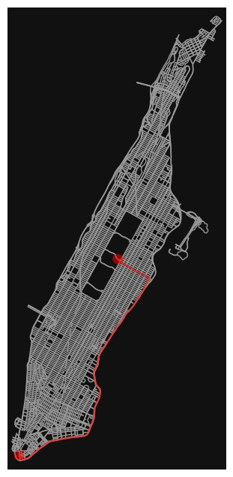

BFS Results
s Square
Central Park to Battery Park (Distance & Time)
Empire State Building to Times Square (Distance & Time)
Empire State Building to Times Square
1.26 miles
0h 3m 0.88s
Central Park to Battery Park
8.05 miles
0h 13m 55.72s

Slide 10
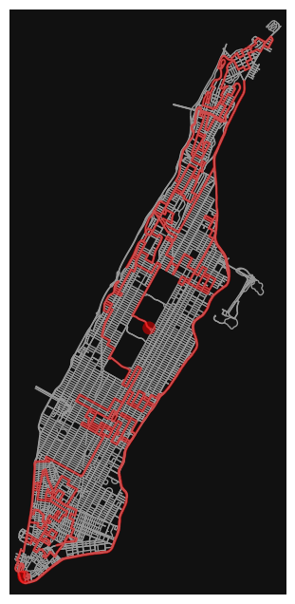
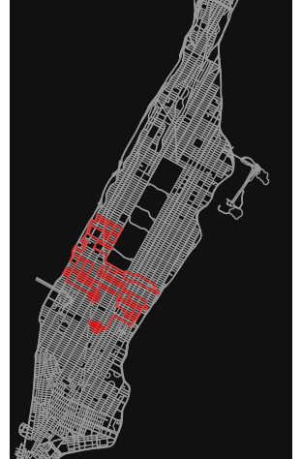
DFS Results
Central Park to Battery Park (Distance & Time)
Empire State Building to Times Square (Distance & Time)
Empire State Building to Times Square (Distance & Time)
Empire State Building to Times Square
24.23 miles
0h 57m 58.28s
Central Park to Battery Park
105.66 miles
3h 55m 40.12s

Slide 11
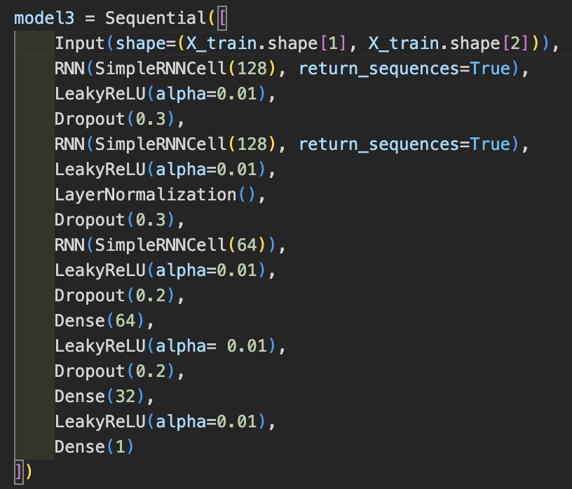
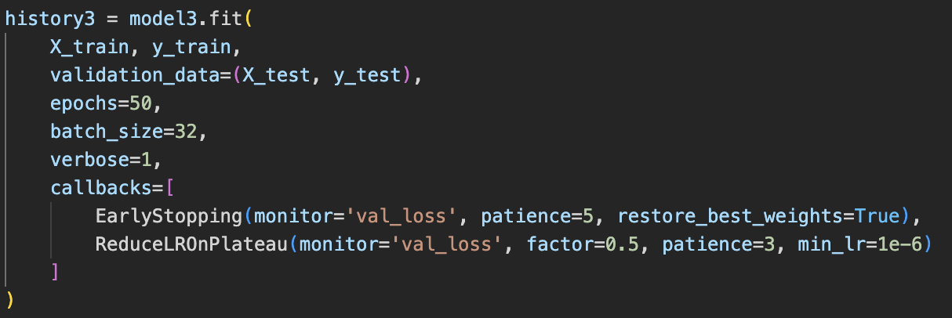
RNN Model
Optimizer: Adam
Loss: MSE

Slide 12
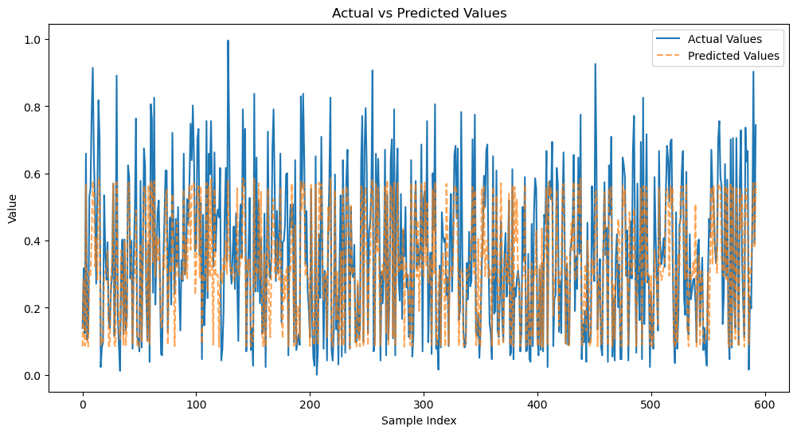
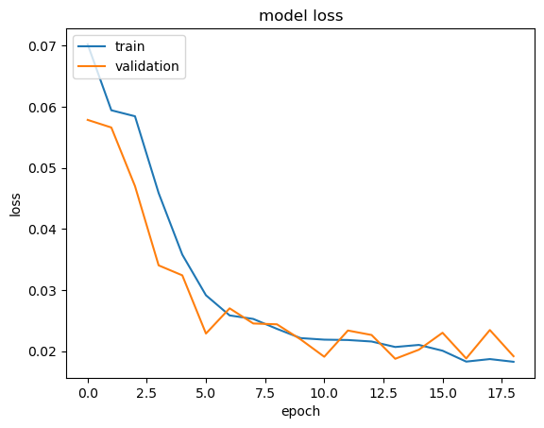
RNN Results
Test MAE: .10327
Loss: .01874

Slide 13
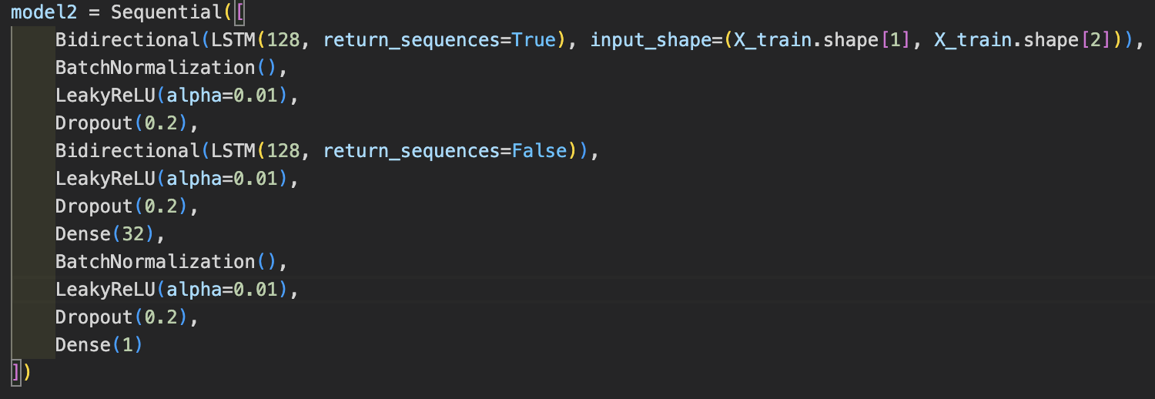
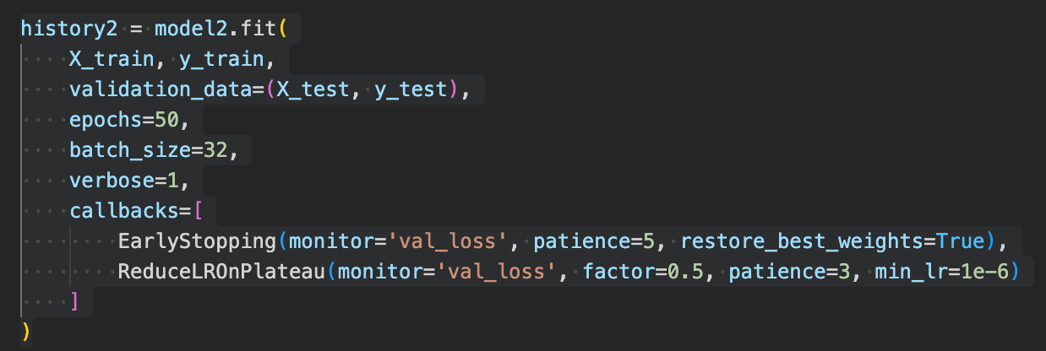
LSTM Model
Optimizer: Adam
Loss: MSE

Slide 14
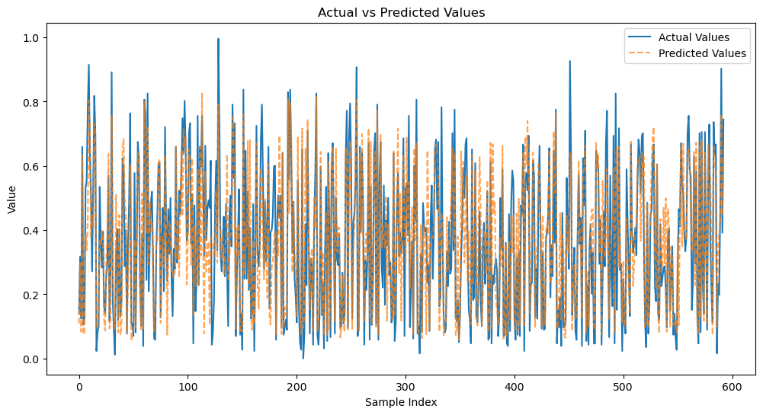
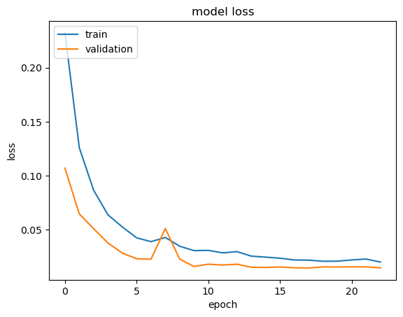
LSTM Results
Test MAE: 0.0894
Loss: 0.0145

