Slide 1
HotelDSl
A DSL for hotel booking analytics

Slide 2
Abstract Syntax – Hotel
Root of the AST
Properties
'name'
Children
A collection of Rooms
A Booking Manager

Slide 3
Abstract Syntax – Room
Children
A collection of 1..* Beds
A collection of 1..* Facilities
Abstract type
Properties
Room number
Price
Capacity
Maximum beds
Maximum facilities
Luxury?

Slide 4
Abstract Syntax – Booking Manager
Allows the state of a Hotel to be easily viewed and queried
Children
A collection of 0..* Bookings

Slide 5
Abstract Syntax – Booking
Reserves a Room for a period of time
Properties
Booking name
Room number
Number of guests
Start and end Date
Constraints
Room can't be double-booked
Room must exist
Number of guests can't exceed Room capacity
Check out can't be before check in

Slide 6
Abstract Syntax – Date
Properties
Day
Month
Year
Constraints
Day between 1 & 31
Month between 1 & 12
Year >= 2019

Slide 7
Abstract Syntax – Standard Room
Subtype of Room
Constraints
Price is mutually exclusive to other Room subtypes
1..2 Beds
Only one Facility
No luxury Beds or Facilities

Slide 8
Abstract Syntax – Studio
Subtype of Room
Constraints
Price is mutually exclusive to other Room subtypes
1..3 Beds
1..3 Facilities
0..1 luxury Bed or Facility

Slide 9
Abstract Syntax – Suite
Subtype of Room
Constraints
Price is mutually exclusive to other Room subtypes
1..4 Beds
1..5 Facilities
0..9 luxury Beds or Facilities

Slide 10
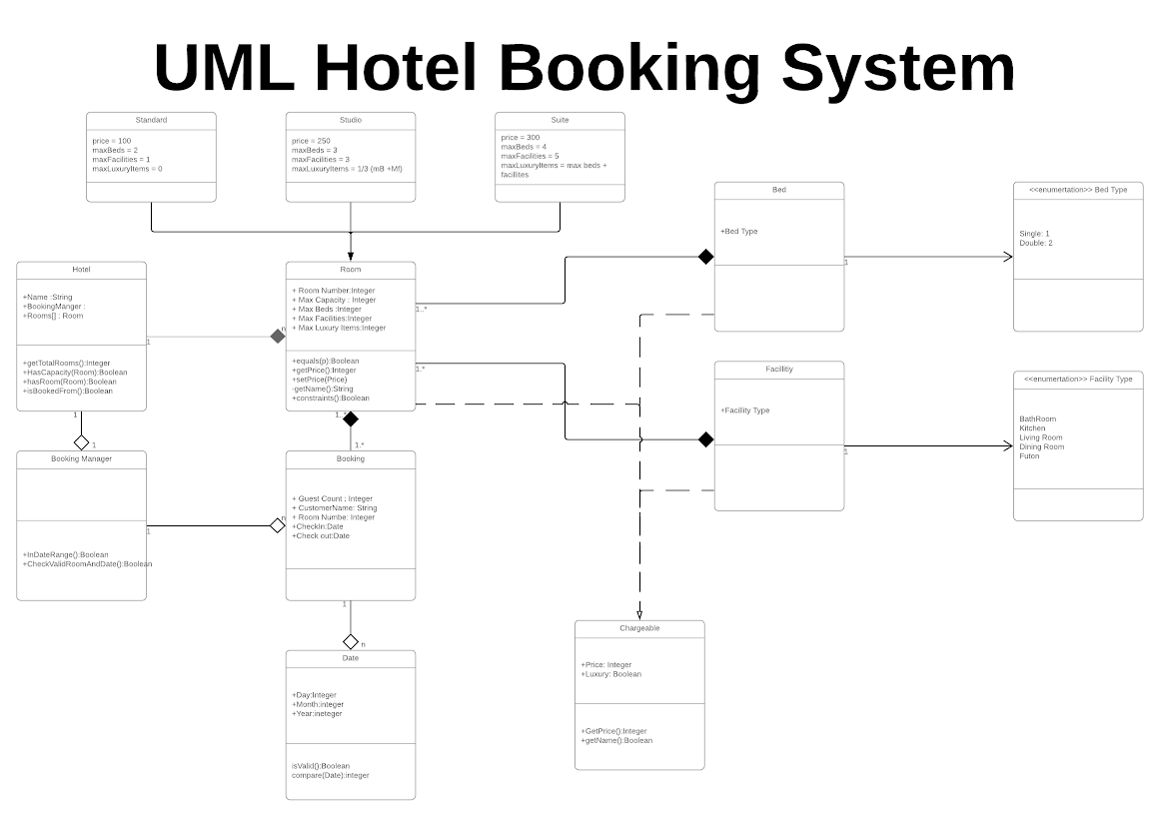

Slide 11
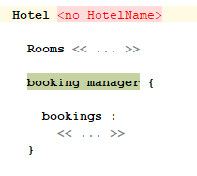
Concrete Syntax - Hotel
Name must be defined
Must have a booking manager instance
Rooms collection can be empty – but not useful!
Enforcing otherwise would have required a default room type

Slide 12
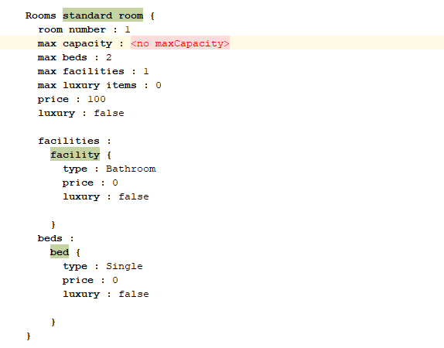
Concrete Syntax – Room
Default values for a Standard Room
Invalid as no capacity defined
Key features
Type declaration for Room
Facility collection
Error if size exceeds max
Bed collection
Error if mismatch with max beds or capacity

Slide 13
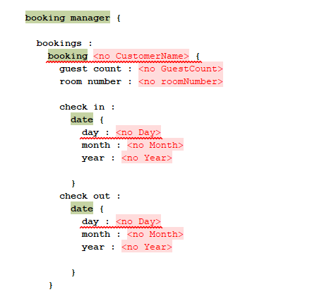
Concrete Syntax – Booking / Date
CustomerName -> object name
Fields
guest count : int
room number : int
check in : Date
check out : Date
Date
Valid day/month/year : int

