Slide 1
Motion and Audio Controlled Smart Lights
Group 4
Jake Roussis, Jarrod Yong, Ben Hodgson

Slide 2
Introduction
Sense
Sound
Motion
Think
User movement
User claps
Act
Triggering the light on or off
Learning behaviours

Slide 3
User Stories
A home owner wants to be able to turn their lights on in their house with ease by clapping their hands.
Wants ease of access with lights
In particular wants to do so by clapping hands
A guest of the house wants to be able to navigate in the dark easily without searching for light switches on walls or needing to carry a torch.
Issues with navigating the dark for light switch.
Wants to resolve issue without the need for secondary devices
A home owner wants to save energy and forgets to turn their lights off often, as a result they want a method of having the lights turn on and off automatically so they are not wasting electricity.
User wants to save energy/electricity due to light usage
Wants Lights to automatically turn on and off
An old person struggles to see at night and uses a walker to get around, as a result they need an easy way for the lights to be triggered on that doesn’t involve looking for a light switch in the dark.
Older Person doesn’t want to go looking for light switch in the dark
Wants a way to turn on lights without looking for switch

Slide 4
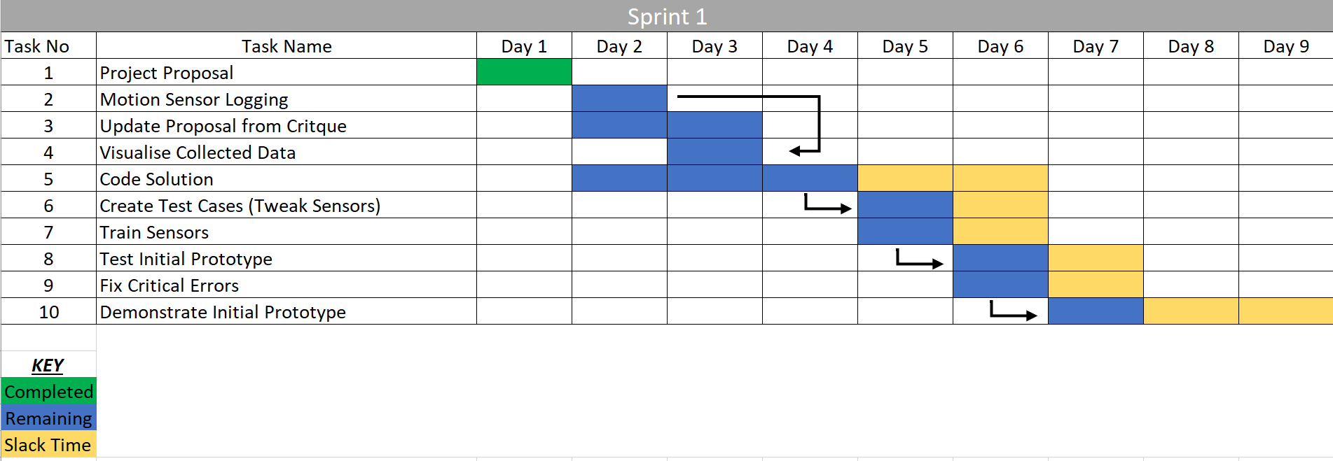
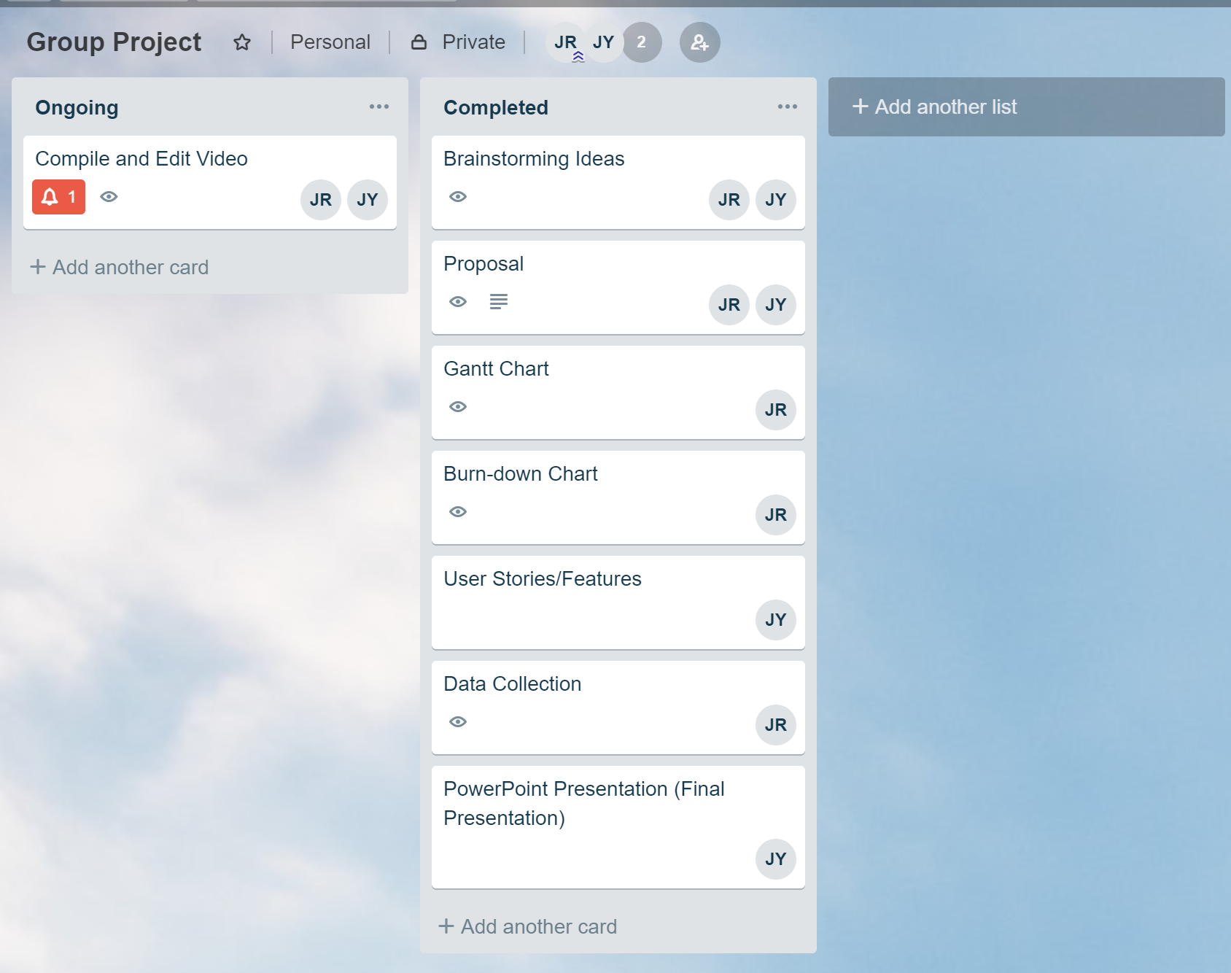
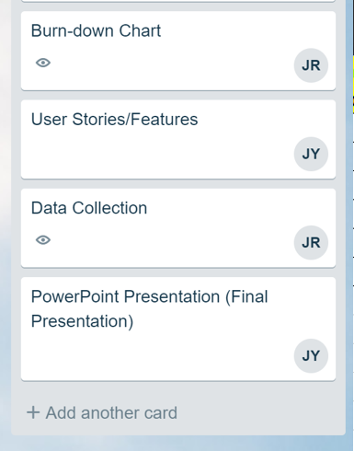
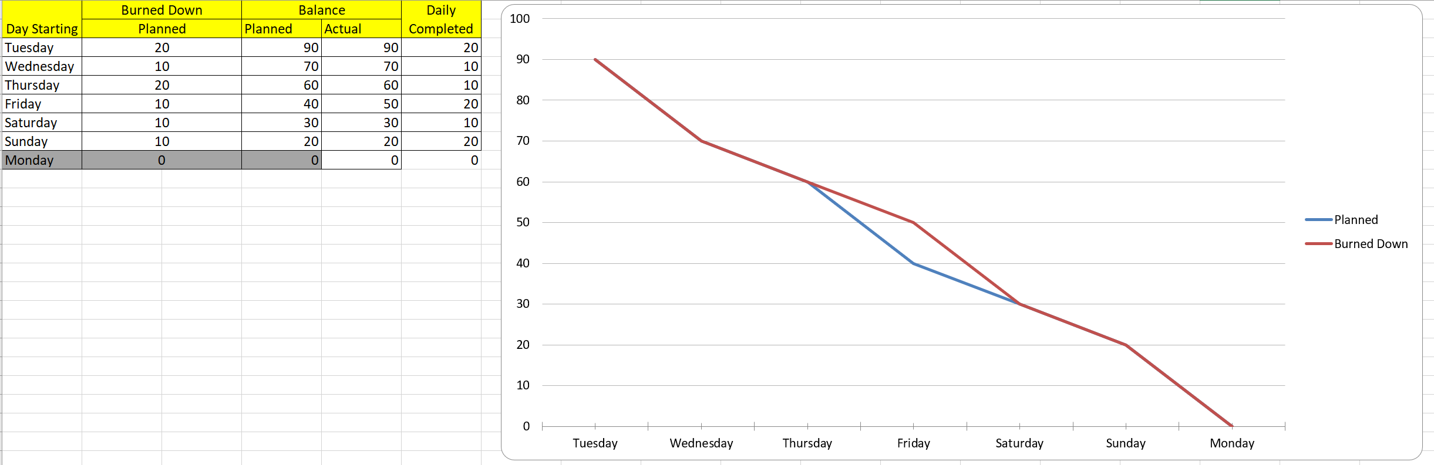
Gantt Chart & Burndown

Slide 5
Code Repositories/Data Collected
Available on GitHub at: https://github.com/JakeRoussis/SmartLights
Contains project code file as ‘.ino’
Contains Excel Spreadsheet with recorded motion data that was analyzed

Slide 6
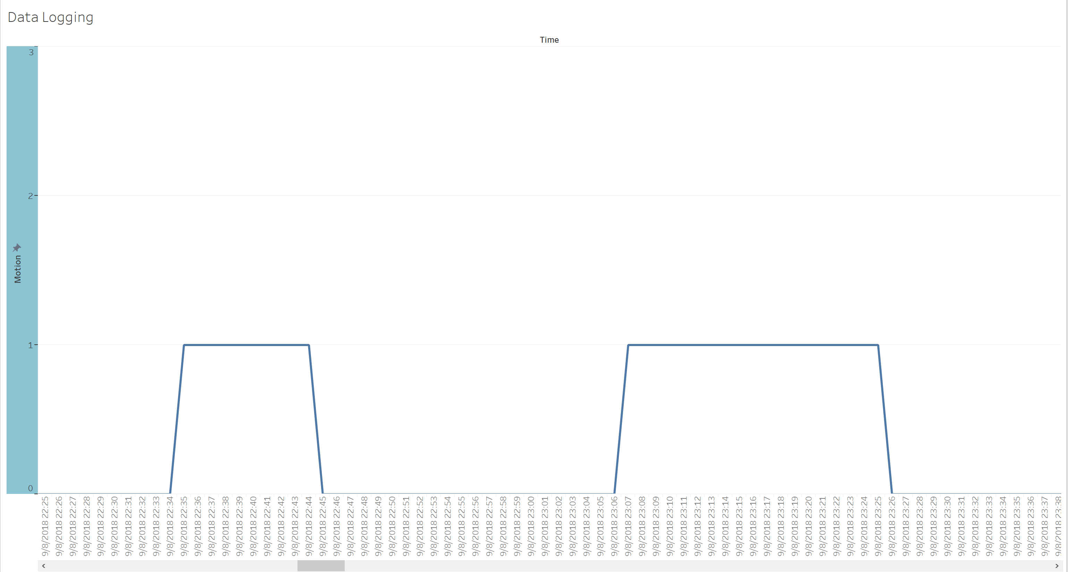
Data Analysis

Slide 7
Demonstration

Slide 8
Challenges
Arduino Identifying the difference between claps and sounds.
Arduino knowing when to use the motion sensor for the lights?
How Arduino would learn time periods to be active and machine-learn?

Slide 9
Plans after completion
To continue fine tuning the project to be optimal for general usage
To determine problems with set up and code
Adding a light sensor to remove/reduce need for time control.

