Slide 1


Data Visual Project – Stand up 4
Group 10
Reliability of Solar Energy in Southeast Asia

Slide 2

Progress since last standup

Slide 3
Progress since last standup
JAKE SIEW JOE KANE
Made improvement on website.
More Singapore data.
made progress on process report.
Desmond foo chi ping
Data cleaning
Made improvement on website??.
finalized on process report.

Slide 4
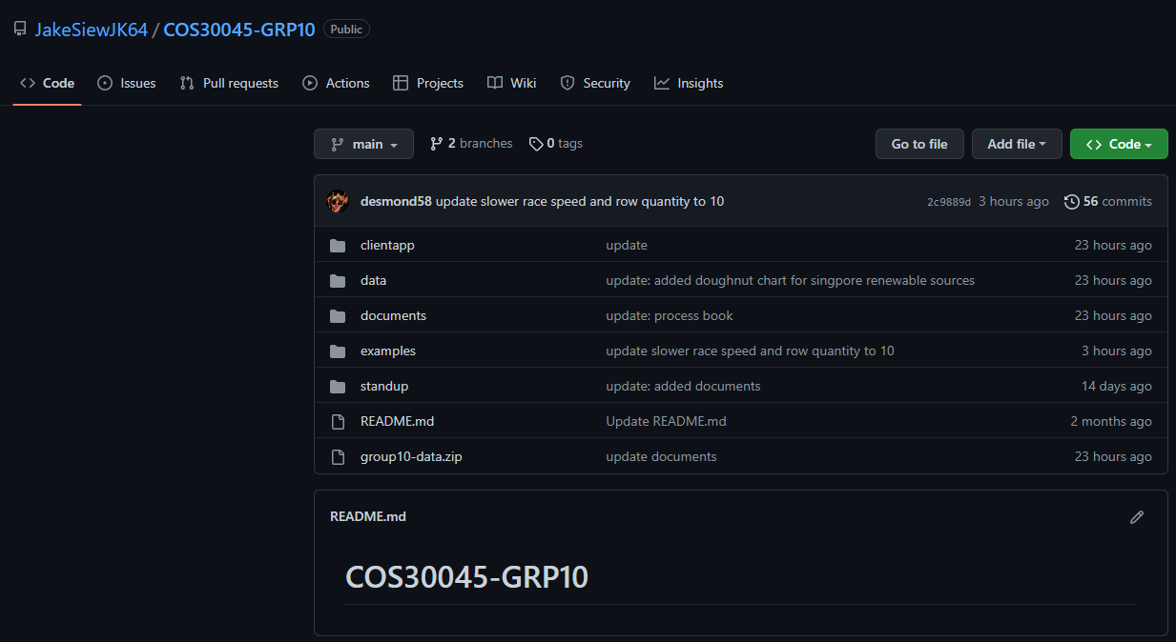
Screenshots
Github status.

Slide 5
What obstacles you are facing in completing your deliverables?

Slide 6
What obstacles you are facing in completing your deliverables?
Data cleaning and formatting to appropriate csv format.
Understanding data and deciding which chart is appropriate.
Higher difficulty chart required much more time to make it work

Slide 7
Website Demonstration…

