Slide 1
Project Planning 1
Group 10
Reliability of Solar Energy in South East Asia

Slide 2
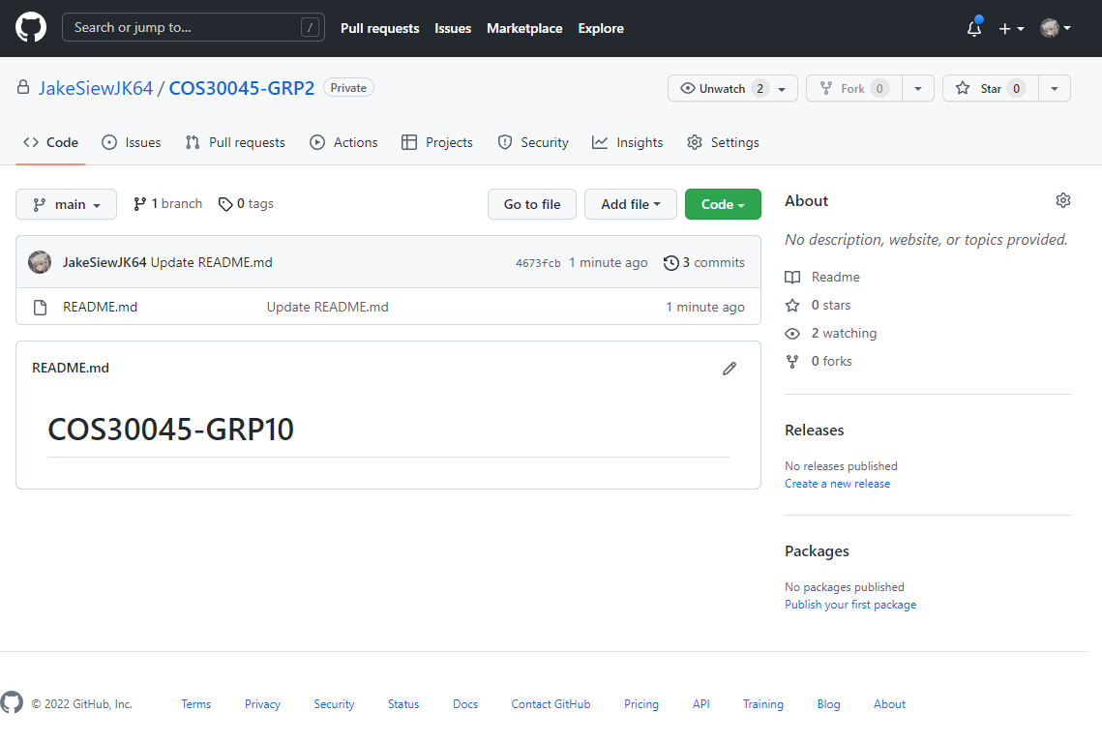
Screenshots
GitHub Repo

Slide 3
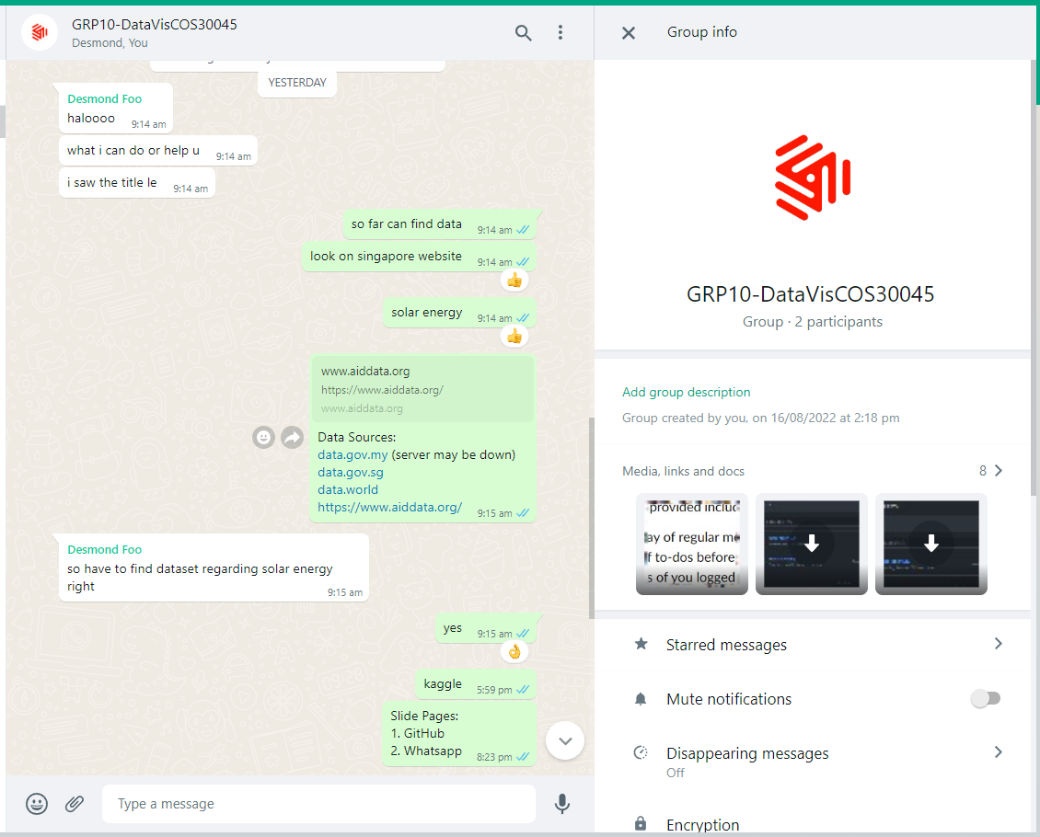
Screenshots
Communication channel

