Slide 1


Data Visual Project – Stand up 2
Group 10
Reliability of Solar Energy in Southeast Asia

Slide 2

Progress since last standup

Slide 3
Progress since last standup
JAKE SIEW JOE KANE
Basic website layout progress.
Singapore data.
made progress on process report.
Desmond foo chi ping
Dataset acquisition.
Low fidelity design of website.
made progress on process report.

Slide 4
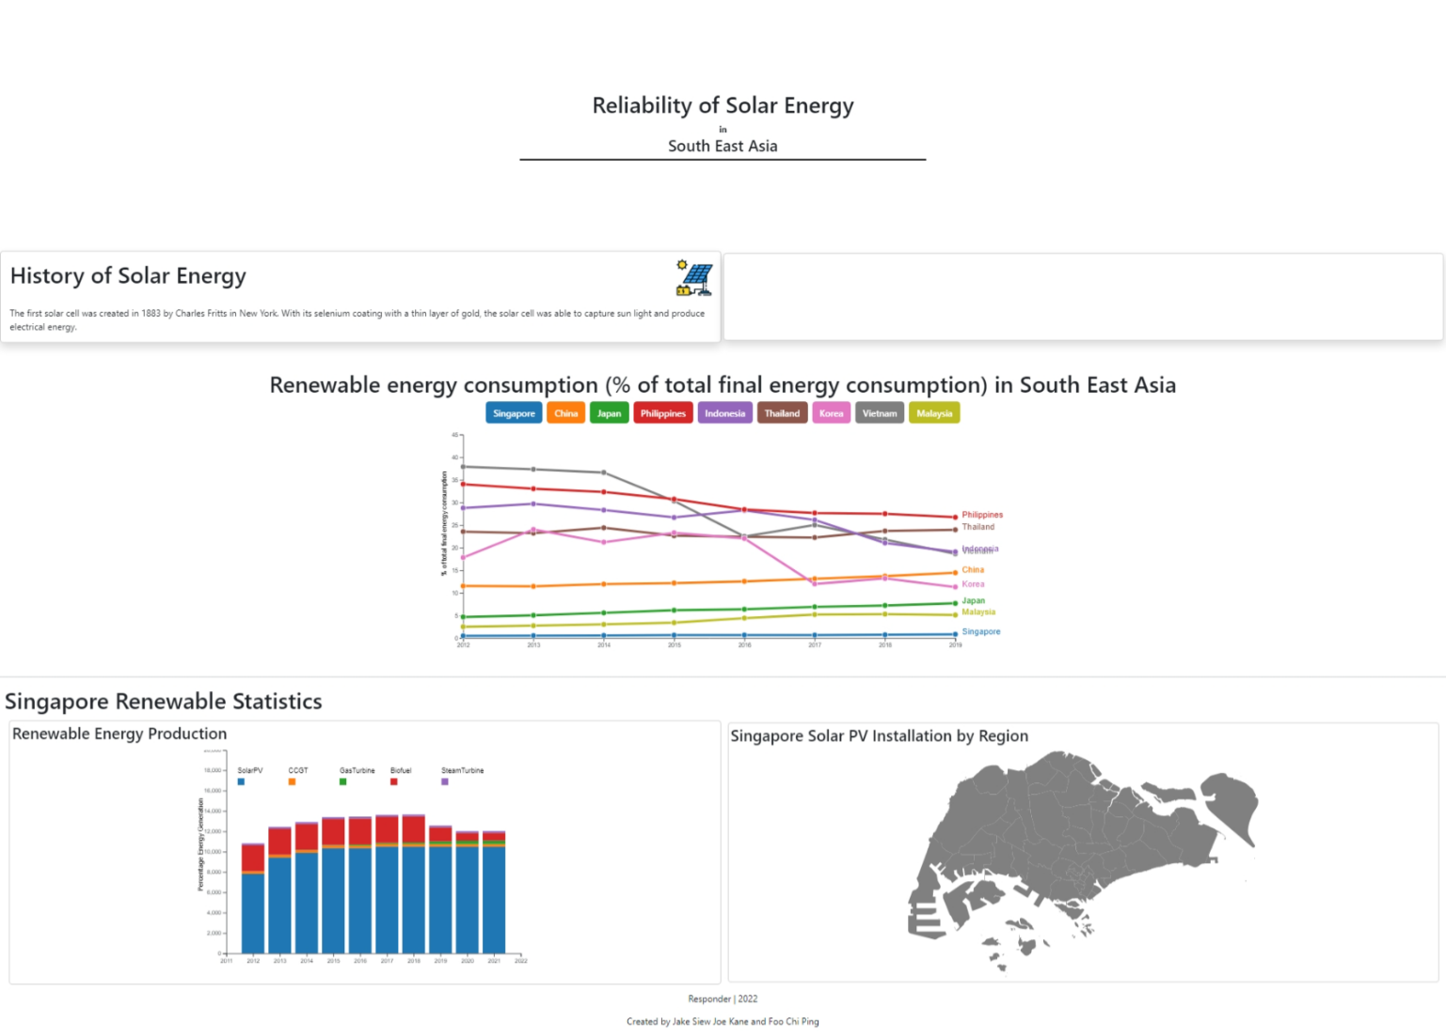
Screenshots
Current website progress.

Slide 5
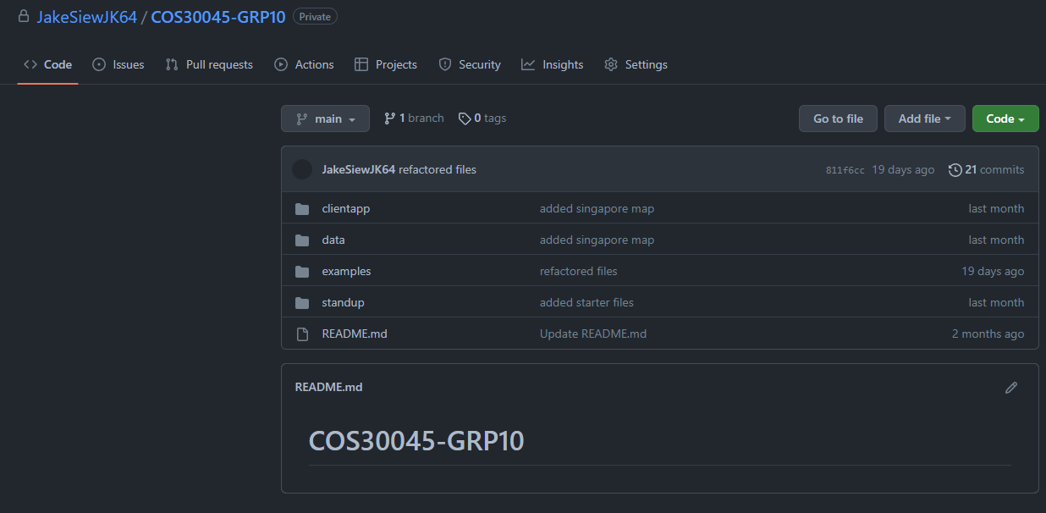
Screenshots
Github status.

Slide 6
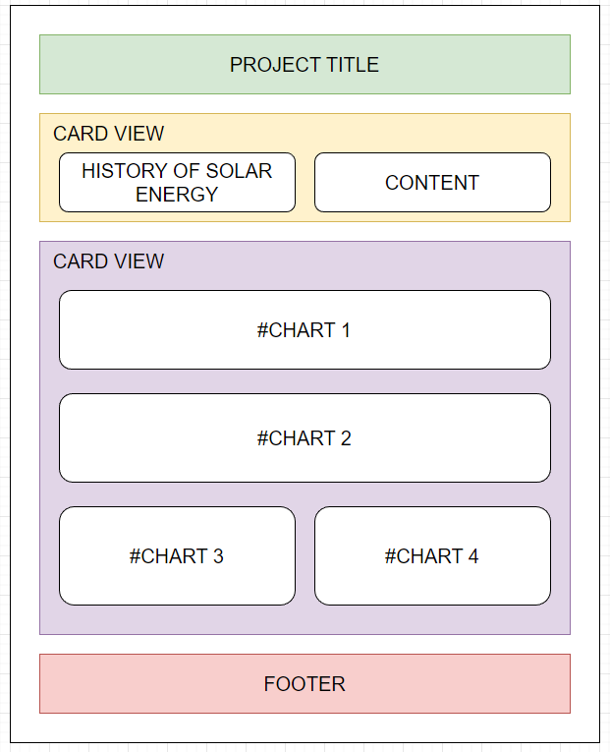
Screenshots
Low fidelity design.
Website

Slide 7
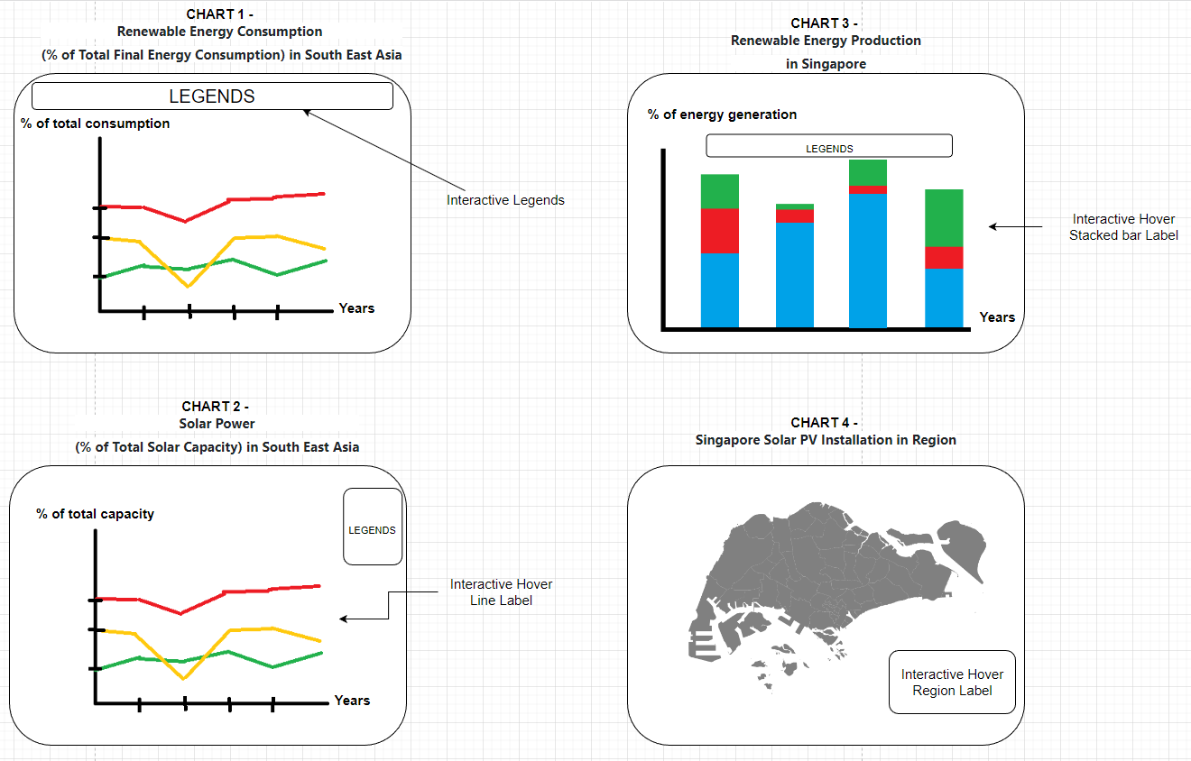
Screenshots
Low fidelity design.
Charts

Slide 8
Things to finish by next stand up.

Slide 9
Things to finish by next stand up.
Improve and add-on to current website progress.
Further data acquisition.

Slide 10
What obstacles you are facing in completing your deliverables?

Slide 11
What obstacles you are facing in completing your deliverables?
Data cleaning and formatting to appropriate csv format.
Understanding data and deciding which chart is appropriate.

