Slide 1


Welcome to Houston TechFest
Thank you for being a part of the
9th Annual Houston TechFest!
Please turn off all electronic devices or set them to vibrate.
If you must take a phone call, please do so in the lobby so as not to disturb others.
Thanks to our Diamond Sponsors:

Slide 3
An Introduction to Node.js on the Raspberry Pi
My Sprinkler Runs Javascript!

Slide 4
Jake Stevenson
Director – Improving Enterprises
.NET Developer by day
Javascript hobbyist by night

Slide 5
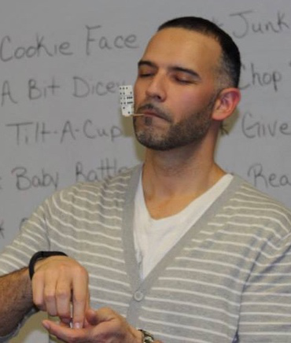
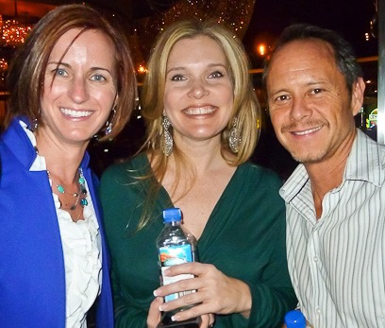
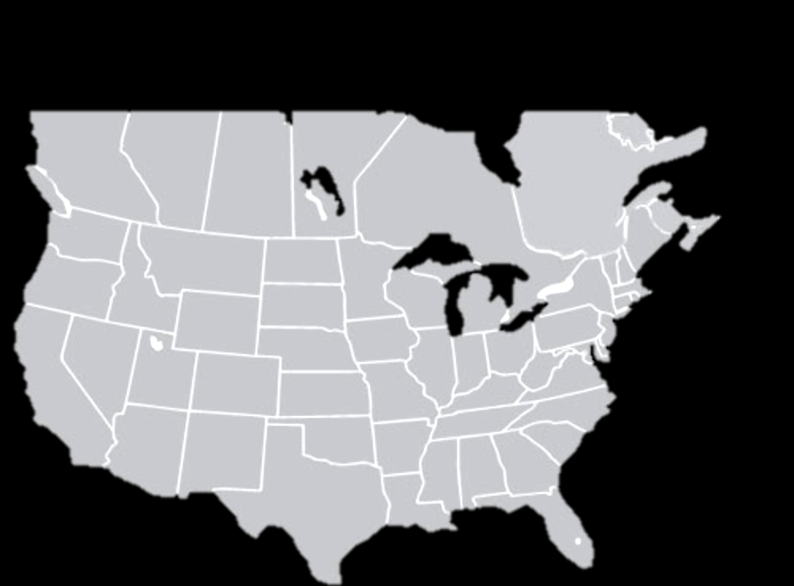
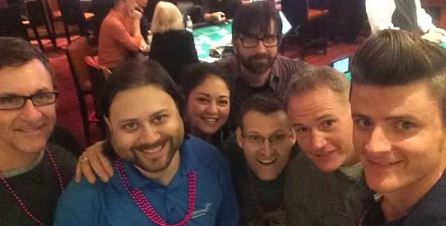

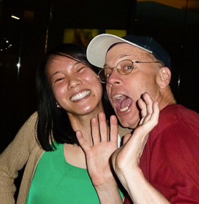
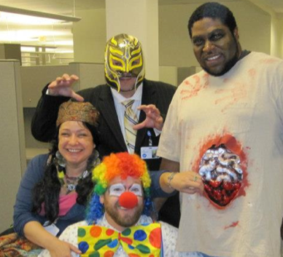
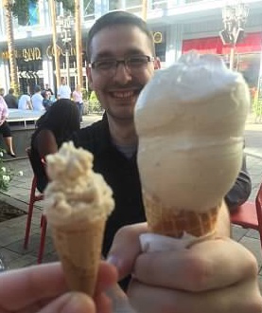
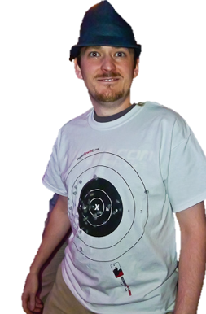

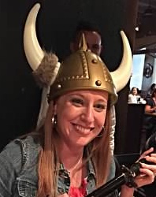

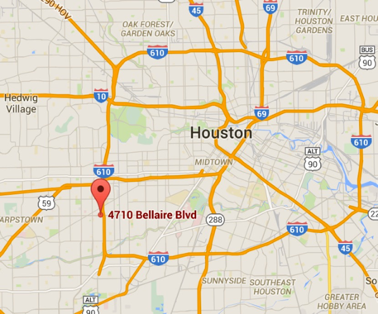
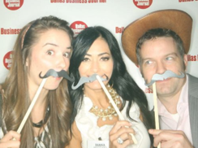
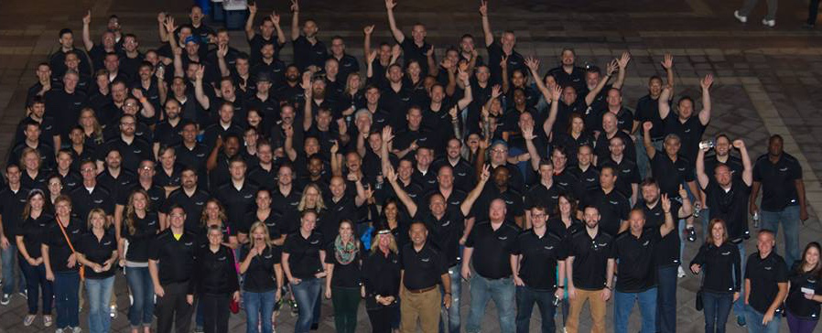
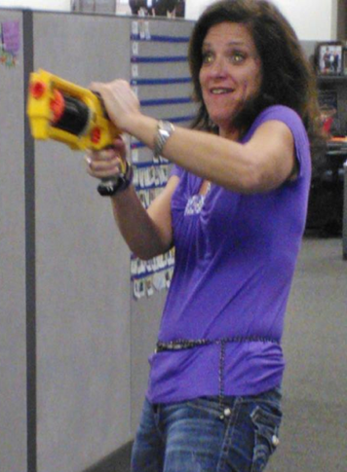
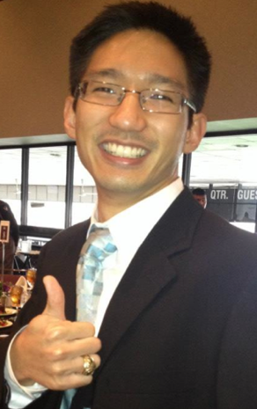



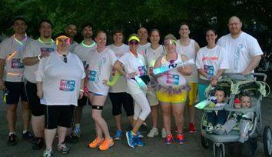
We are:
300+ Improvers
Software Developers
Agilists
Industry Thought Leaders
Education Providers
Centrally located
Four large classrooms
Client project room(s)

Slide 6
Introducing Raspberry Pi Hardware
Many models, A, A+, B, B+, 2, and offshoots
ARM processor
USB, HDMI, Headphone, Network
GPU Capable of 1080p video decoding
SD Card to boot
Micro-USB cable for power
GPIO access

Slide 7
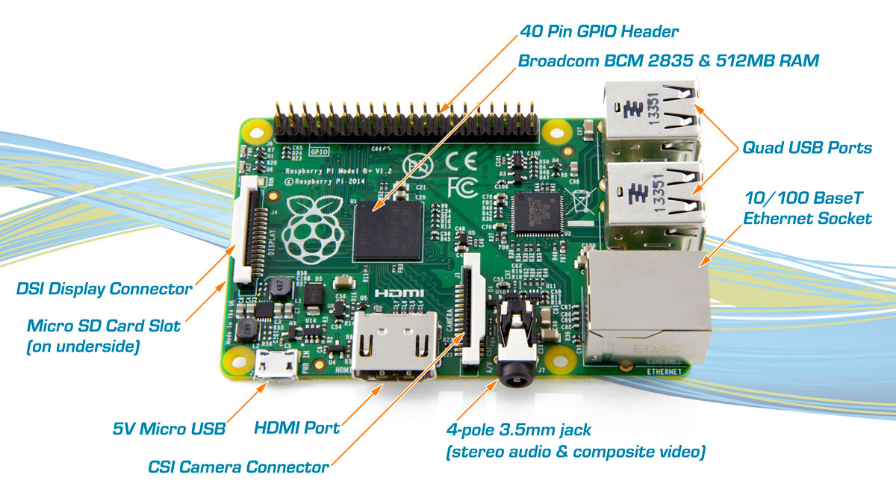
What You Get

Slide 8
Some Downsides
Not as cheap as you would believe
USB Bus can be slow
Newer versions have compatibility issues with older addons

Slide 9
Basic PI Setup – NOOBS
Download the zip file from the internet
Format SD Card as FAT
Copy over files
Boot up and follow instructions!

Slide 10
Raspbian Basics
A debian derivative
Cannot do system modifications without being root
Learn to use the sudo command instead
Apt-get for package management

Slide 11
My First Steps:
Ensure ssh access is on
Create a user and set my password
Change host name
Install tmux + vim
Install avahi-daemon

Slide 12
Install Node.js
Upgrade to Jessie (from Wheezy)
Install NVM and node:
  curl https://raw.githubusercontent.com/creationix/nvm/v0.23.3/install.sh | bash
  nvm install v4.0.0
  nvm alias default v4.0.0

Slide 13
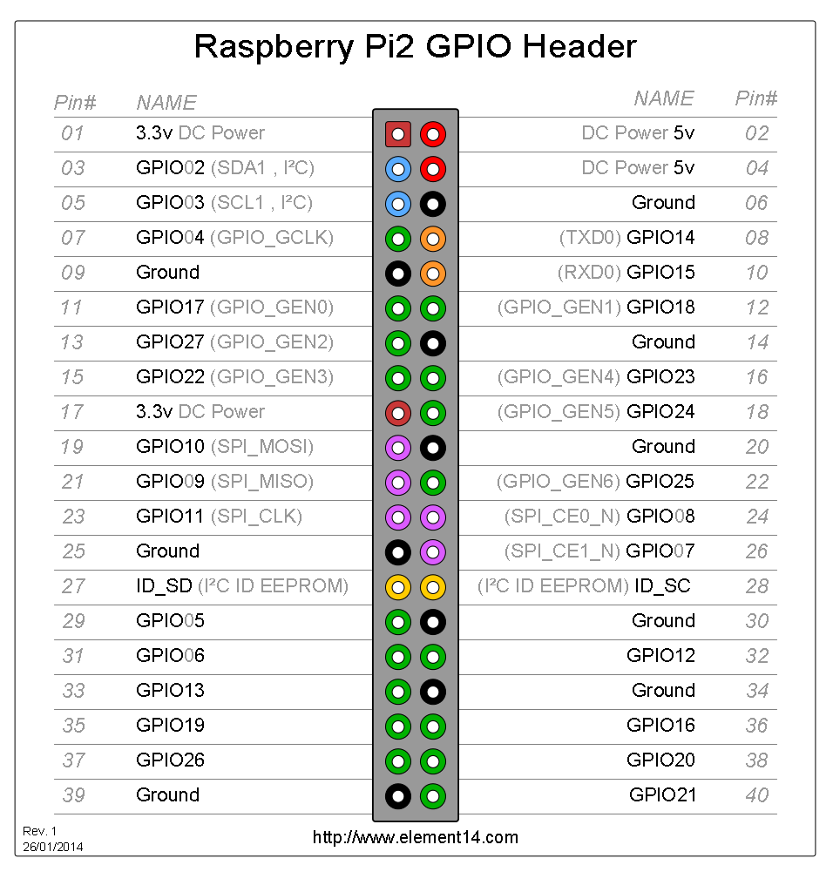
GPIO

Slide 14
Install WiringPi
Easy access to gpio functions
Crazy pin numbers
apt-get install wiringpi

Slide 15
Start a Project With NPM
npm init
npm install *** --save
Edit the index.js

Slide 16
Working with Node
node index.js
Nodemon

Slide 17
Install a package
npm search gpio
We use wp-gpio
Show a basic on/off

Slide 18
That's Enough to Start!
With just these bits you can get things going

Slide 19
Using the Module Pattern
Define our own module just like other NPM modules
Simple Zone class to encapsulate the logic around turning on and off sprinklers

Slide 20
Run in sequence
Callbacks?
Promise chains?

Slide 21
Scheduling
Several packages available – I like later.js

Slide 22
UI
LCD and Buttons
Web-Based on Wifi

Slide 23
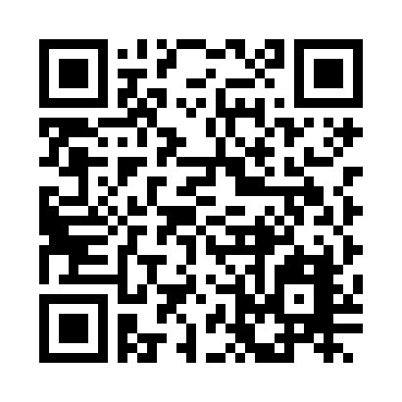
Please Leave Feedback During Q&A
If you leave session feedback and provide contact information in the survey, you will be qualified for a prize
Scan the QR Code to the right or go to http://bit.ly/1K1Hvi5

Slide 24



Thank You!
Jake.Stevenson@ImprovingEnterprises.com
@jakes
Upcoming Houston Classes:
PMP exam prep course, September 21-24.
Professional Scrum Master (PSM), September 22-23.
Professional Scrum Product Owner (PSPO), October 14-15.
Agile Scrum Immersion, October 22-23.
Professional Scrum Master (PSM), November 10-11
Come work for us!
Contact Valerie.Carmona@improvingenterprises.com

Slide 25


Join us for Monday Night Football!
November 16, 2015
Studio Movie Grill
City Centre
improvinghoustonmnf2015.eventbrite.com
Please include that I invited you!

Slide 26












Thanks to all our Sponsors!

