Slide 1

Design Process
Jake Stubbs

Slide 2
Implementation
Developed our own implementation of Eigenfaces written in Python.
To serve as a benchmark for the performance of the algorithm which we will develop.

Slide 3
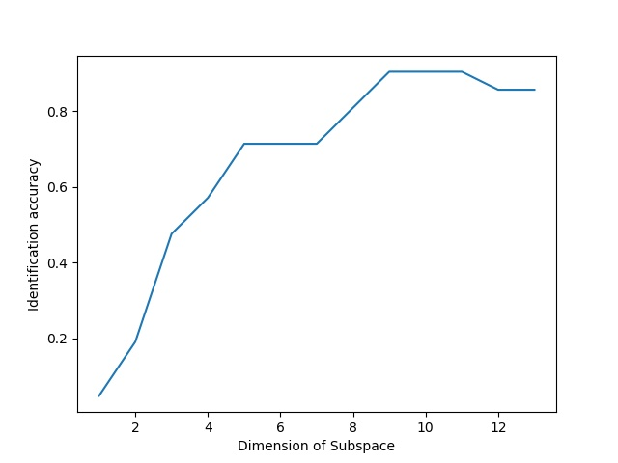
Optimizing Subspace Dimension
- Varying the dimension of the linear subspace, the accuracy of recognition was observed on a fixed set of images.
- An optimal accuracy of approximately 94% occurs with a subspace dimension of 9.
Identification Accuracy
Subspace Dimension

Slide 4
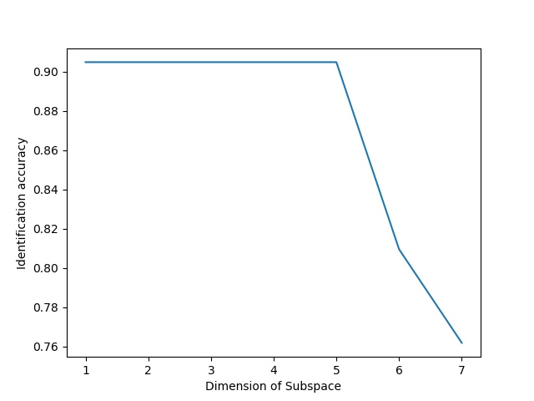
Optimizing K-Nearest Neighbors
With a fixed subspace of dimension 9, K was increased in the KNN algorithm to attempt to increase accuracy.
As seen in the plot, the accuracy was unaffected until K became too large and the accuracy decreased.
Identification Accuracy
Nearest Neighbors Considered

Slide 5
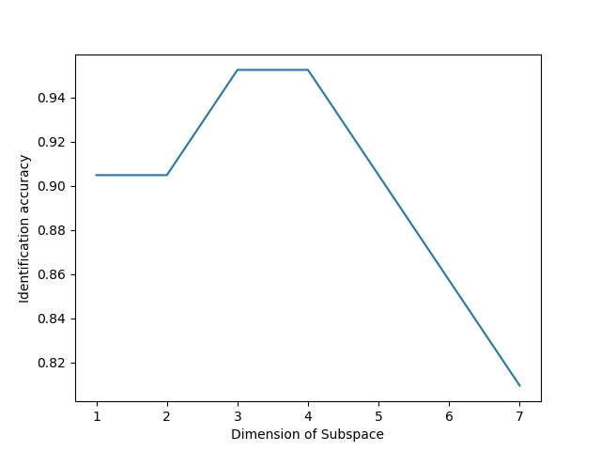
Optimizing K-Nearest Neighbors
By decreasing the subspace to dimension 7, increasing K had a positive effect.
Optimal accuracy was able to be increased to approximately 98% with a dimension 7 subspace and K value of 3.
(Keep in mind that this is a select dataset)
Identification Accuracy
Nearest Neighbors Considered

Slide 6
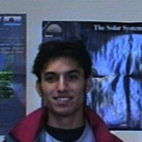
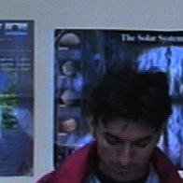
Observed Strengths
Drastically varying the facial expression and positioning.
Image in dataset
Identified Image

Slide 7
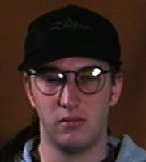
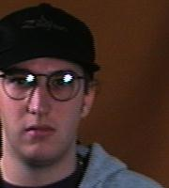
Observed Strengths
Varying the positioning of an individual within the frame.
Image in dataset
Identified Image

Slide 8
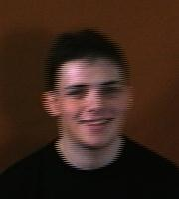
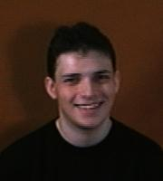
Observed Strengths
Varying image quality.
Image in dataset
Identified Image

Slide 9
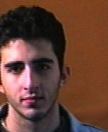

Observed Weaknesses
Shadowing and image brightness.
Image in dataset
Unidentifiable Image

Slide 10
Areas of Potential Improvement
Face images exhibiting the property of Lambertian Reflectance suggests that the same individual under varying lighting conditions should be accurately represented by a low dimensional linear subspace.

