Slide 1
How to react
To React

Slide 2
Before we begin:
Please install node (nodejs.org)
Please clone this project:
Git clone https://github.com/JakeTrevor/react-demo.git
Or you can use “degit” once you have installed node:
npx degit jaketrevor/react-demo
It’s a bit late now, but ideally, make sure you have a code editor installed
I recommend VS Code (https://code.visualstudio.com/)

Slide 3
The 3 Core Web Languages
And their roles

Slide 4
HTML
You know what HTML is;
The purpose of HTML is to add structure to information.
As opposed to CSS: which is to “style” this structure (change how it is displayed).
JavaScript is there to fill other auxiliary functions:
Add interactivity
Dynamically load content (from remote sources)
Perform computation on data in HTML (including form inputs).

Slide 5
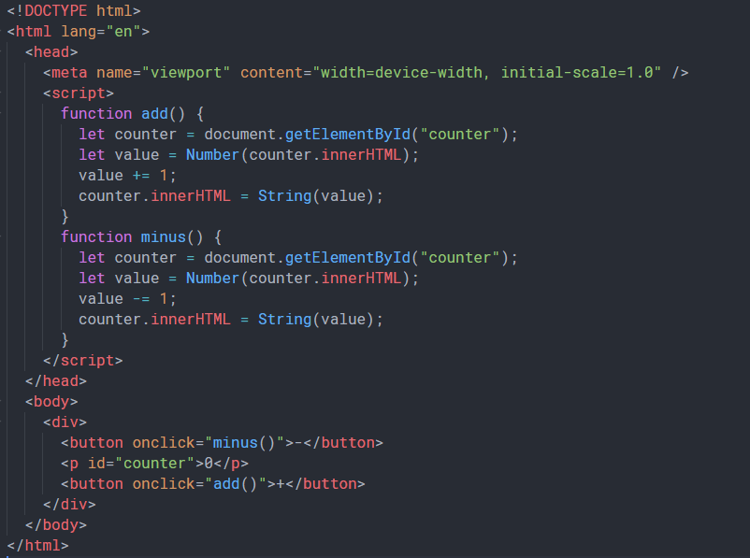
Consider an example
How would you build a “counter” with vanilla JS?
Code would be long, look something like the code in index.html:

Slide 6
These goals have been well separated, but in reality they are closely related.
The problem:

Slide 7
In other words, an inappropriate separation of concerns.

Slide 8
react
React is a JavaScript framework which fulfils two key roles:
Firstly, it integrates the issues of data manipulation (traditional JS task) and the issue of data structure (traditional HTML task) into a single solution.
Secondly, it creates a way to encapsulate such behaviour in a manner which makes such code much more reusable, logical, and readable.

Slide 9
Components
The most important react concept.
Code is split up into components – this is how we encapsulate behavior. We create a component to fulfil a specific task.
Components can be class based or functional.
No one write class based components anymore – they’re annoying
However they can be useful to study to understand the workings of react
We do not have time for that though.

Slide 10
An example
//MyFunComponent.jsx
import React from ‘react’;
Let MyFunComponent = () => {
return <div></div>
}
export default MyFunComponent

Slide 11
How do we use it?
//index.js
Import react from ‘react’;
Import createRoot from ‘react-dom/client’;
Import MyFunComponent from ‘MyFunComponent’
Let container = document.getElementById(“appRoot”)
Let root = createRoot(container)
root.render(<MyFunComponent/>)

Slide 12
This doesn’t seem very great
Let us introduce key feature #2:
State
Interactive apps have state;
React has a special way of managing state, using a hook.

Slide 13
Wait, a what now?
A react hook is a special function that is used in achieving some particular effect.
There are many built in hooks. You can extend their functionality by writing your own
But first, an example on state

Slide 14
A counter example
//MyFunCounter.jsx
import React, { useState } from ‘react’;
Let MyFunCounter = () => {
let [count, setCount] = useState(0)
return (<>
<button onclick={()=>setCount(count-1)}>-</button>
<p>{count}</p>
<button onclick={()=>setCount(count+1)}>+</button>
</>)
}
export default MyFunCounter

Slide 15
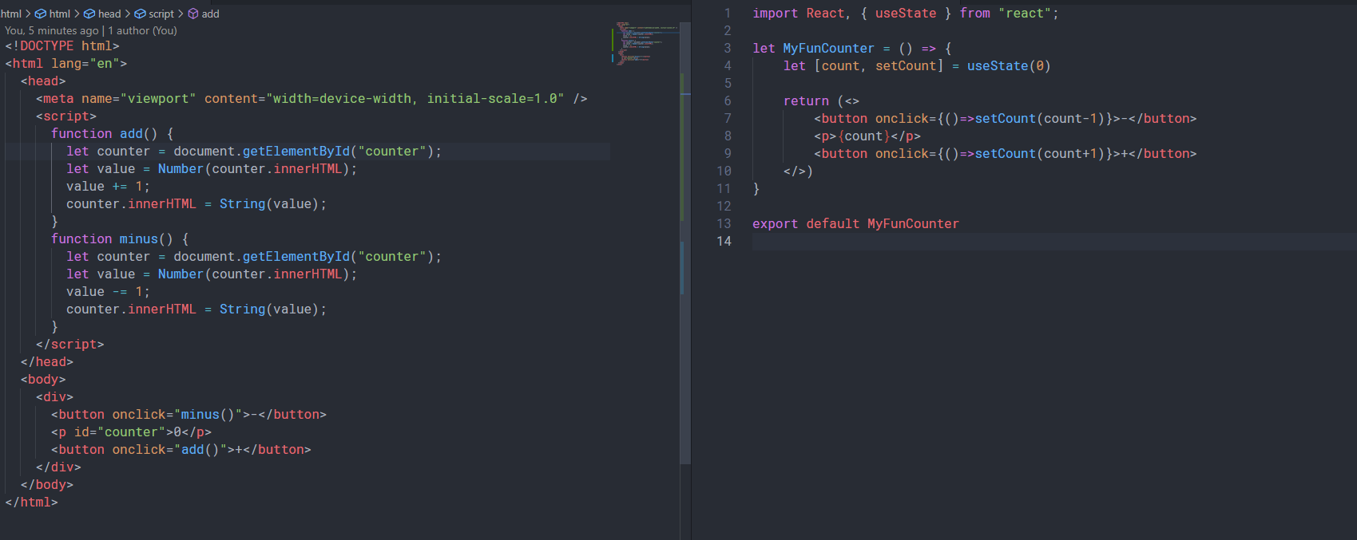
Which do you prefer?

Slide 16
Some useful resources
React hooks docs: (https://reactjs.org/docs/hooks-reference.html)

