Slide 1
How to react
To React

Slide 2
Before we begin:
Please install node (nodejs.org)
Please clone this project:
Git clone https://github.com/JakeTrevor/react-demo.git
Or you can use “degit” once you have installed node:
npx degit jaketrevor/react-demo
It’s a bit late now, but ideally, make sure you have a code editor installed
I recommend VS Code (https://code.visualstudio.com/)

Slide 3
Key Concepts we will cover:
Components (11-12)
Hooks
State
effects
Iteration
Props

Slide 4
I will not be covering:
CSS
JS fundamentals
hopefully you will pick up some as we go
Module bunders (they’re hard)

Slide 5
The 3 Core Web Languages
And their roles

Slide 6
HTML
You know what HTML is;
The purpose of HTML is to add structure to information.
As opposed to CSS: which is to “style” this structure (change how it is displayed).
JavaScript is there to fill other auxiliary functions:
Add interactivity
Dynamically load content (from remote sources)
Perform computation on data in HTML (including form inputs).

Slide 7
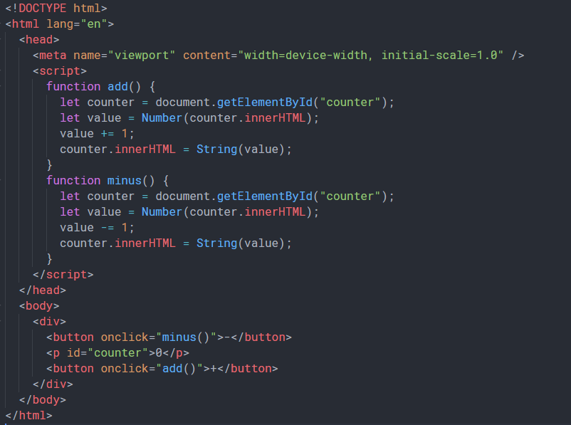
Consider an example
How would you build a “counter” with vanilla JS?
Code would be long, look something like the code in index.html:

Slide 8
These goals have been well separated, but in reality they are closely related.
The problem:

Slide 9
In other words, an inappropriate separation of concerns.

Slide 10
react
React is a JavaScript framework which fulfils two key roles:
Firstly, it integrates the issues of data manipulation (traditional JS task) and the issue of data structure (traditional HTML task) into a single solution.
Secondly, it creates a way to encapsulate such behaviour in a manner which makes such code much more reusable, logical, and readable.

Slide 11
Components

Slide 12
Components
The most important react concept.
Code is split up into components – this is how we encapsulate behavior. We create a component to fulfil a specific task.
Components can be class based or functional.
No one write class based components anymore – they’re annoying
However they can be useful to study to understand the workings of react
We do not have time for that though.

Slide 13
An example
//MyFunComponent.jsx
import React from ‘react’;
Let MyFunComponent = () => {
return <div></div>
}
export default MyFunComponent

Slide 14
How do we use it?
//index.js
Import react from ‘react’;
Import createRoot from ‘react-dom/client’;
Import MyFunComponent from ‘MyFunComponent’
Let container = document.getElementById(“appRoot”)
Let root = createRoot(container)
root.render(<MyFunComponent/>)

Slide 15
Hooks & State
useState

Slide 16
State
React can do more than just render fixed HTML
Interactive apps have state;
React has a special way of managing state, using a hook.

Slide 17
Hooks - Wait, a what now?
A react hook is a special function that is used in achieving some particular effect.
There are many built in hooks. You can extend their functionality by writing your own.
But we will only explore useState (maybe useEffect)
But first, an example on state

Slide 18
A counter example
//MyFunCounter.jsx
import React, { useState } from ‘react’;
Let MyFunCounter = () => {
let [count, setCount] = useState(0)
return (<>
<button onClick={()=>setCount(count-1)}>-</button>
<p>{count}</p>
<button onClick={()=>setCount(count+1)}>+</button>
</>)
}
export default MyFunCounter

Slide 19
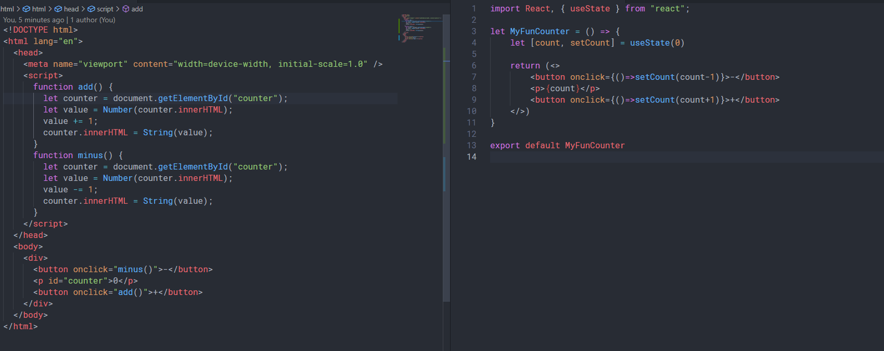
Which do you prefer?

Slide 20
Iteration

Slide 21
Iteration
We just saw how we can use {} to inject JavaScript directly into the HTML
We can use this to do lots of cool things:
Conditional rendering via ternary statement
In-line Variable manipulation
We can also use it to easily add HTML for every item in a list.

Slide 22
Example
//Iteration.jsx
Import react from “react”;
Let Iter = () => {
let data = [“hello”, “this is”, “some data”]
return <ul>
{
data.map(each => <li>{each}</li>)
}
</ul>
}

Slide 23
Props & Sub-components

Slide 24
Sub-components
We saw how useful it was to iterate over a list of data
But what if our data is complex?
It is often cleaner to encapsulate the rendering behaviour for complex data in its own component
We can then use that component in our map function.
But: how do we get the data from one component to the other?

Slide 25
Props
Props allow us to pass data down the component tree.
A parent can give its children props.
They look like HTML attributes:
<Item person={x} />

Slide 26
example
//List.jsx
Import react from “react”
Import Item from “./item”
Let List = () => {
let data = [{name: ”jake”, age:20}]
return <ul>
{data.map(each=><item person={each} /> )}
</ul>
}
Export default list
//Item.jsx
Import react from “react”
Let Item = ({ person:{name, age} }) => {
return <li>
<p>{name} is {age} years old</p>
</li>
}

Slide 27
Note:
Destructuring assignment is key to clean react/JS code
We build components to organize our code; so we may use them in many contexts, not just the list example I just showed you.
Data can (generally) only flow down the component tree (via props).
This brings up the idea of “lifting up” state – but we can talk about that later.

Slide 28
Some useful resources
Practice:
Build a to-do app
like Microsoft to-do
The bundler is already configured
We can work together or individually – but the idea is that you will write some react and get used to it.
React hooks docs: (https://reactjs.org/docs/hooks-reference.html)
MDN JS docs: (https://developer.mozilla.org/en-US/docs/Web/JavaScript/Reference)

Slide 29
Extra reference slides
“How do I X?”

Slide 30
How do I use a text input?
This also works for TextArea elements!
Import react from “react”
Let comp = () => {
let [text, setText] = useState(“”)
return <div>
<input type=“text” value ={text}
onChange={(e) => setText(e.target.value)}
/>
</div>
}
Export default comp
“e” is the change event – a generic event.
MDN docs:
https://developer.mozilla.org/en-US/docs/Web/API/Event
The value of “text” is now bound to the input

