Slide 1

ServiceEngine
Changing the way we use internet tools

Slide 2
The need
All good things start with a story.
  1 hour trying with online services
  2 hours trying with sketchy downloadable services
  ½ hour trying with freeware(vlc)
  15 minutes when asking a friend to do it with ffmpeg

Slide 3

The competition
Many of our peers use online converters
There are tens of online converters, many of which no longer work, work poorly or are infested with ads
Most of these utilities
  Have the same core technology, like ffmpeg
  Are “one-trick-ponies” and you need to have several windows open for different tasks
  Are rate limited and compress or alter your video
  Are slow
From-https://xkcd.com/927/ copyright Randall Munroe

Slide 4
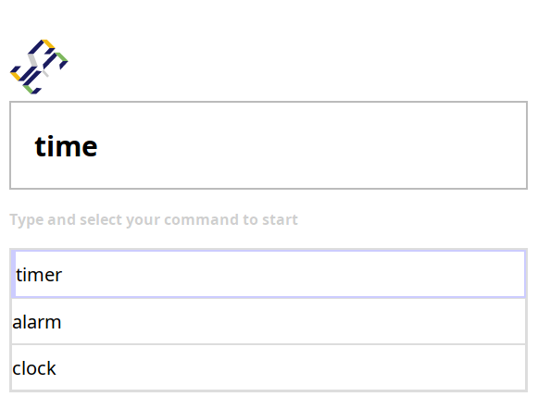
How we address it
ServiceEngine is a search engine of high quality online tools
It…
  allows you to scale from simple to complex tasks
  has a minimal, uncluttered UI
  is built for maximum results from minimal time investment
  allows you to send configurations to friends

Slide 5
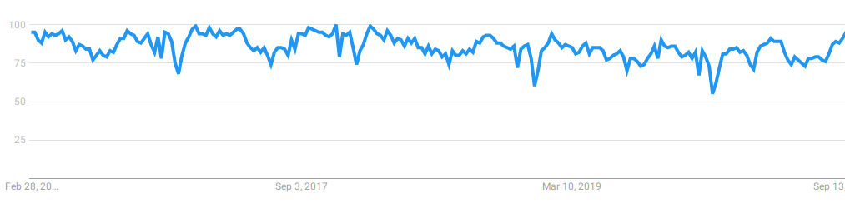
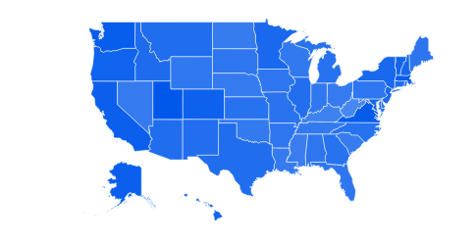
The market
“Numbers represent search interest relative to the highest point on the chart for the given region and time. A value of 100 is the peak popularity for the term.”
File conversion typically hovers between 75-100% interest.
Interest localized in the US
All information on this slide sourced from google trends

Slide 6
Our plan
Use SEO to show up on searches for various utilities
Build a loyal base of people who will associate our utilities with our search engine(like WolframAlpha)
Monetize site with minimalist text ads by carbon and offer a paid tier with more utilities and no ads

