Slide 1

Sengine
Changing the way we use internet tools

Slide 2
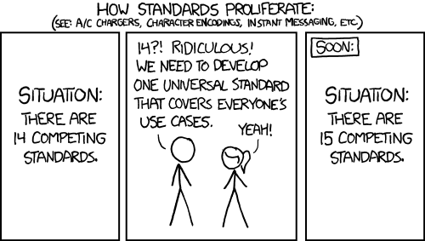
From-https://xkcd.com/927/ copyright Randall Munroe

Slide 3
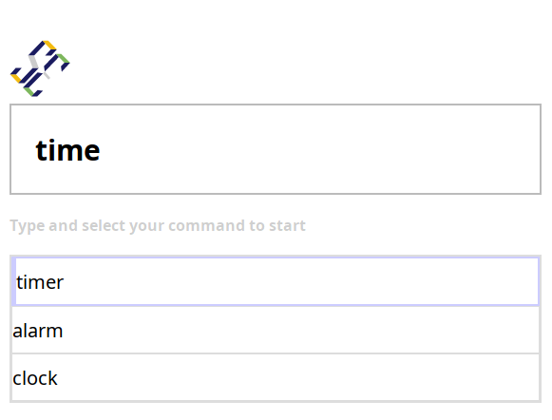
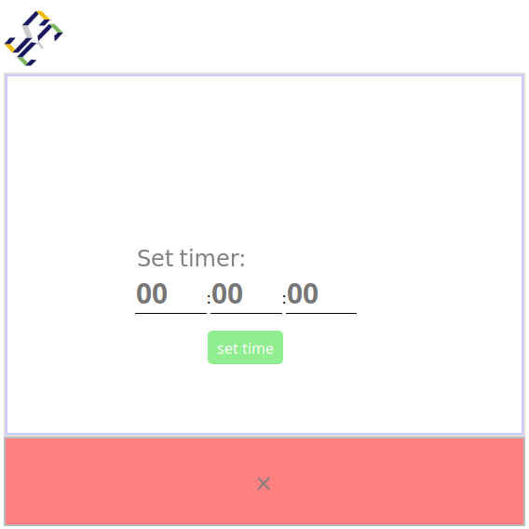
Type query
Get service.

Slide 4
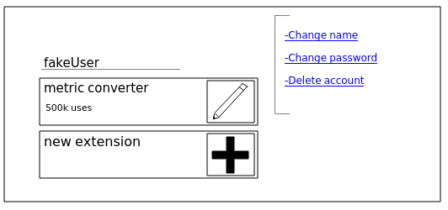
Don’t spin up a server.
Just press plus.

Slide 5
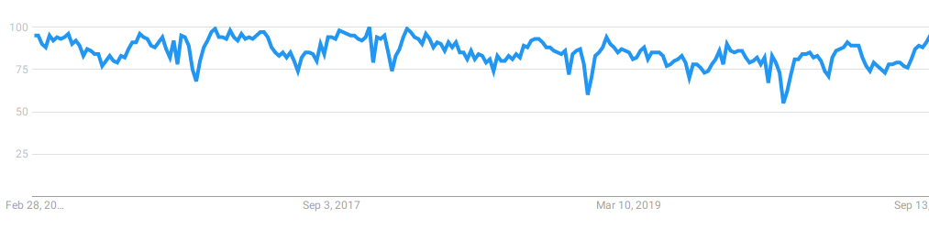
Overall interest
All information on this slide sourced from google trends

Slide 6
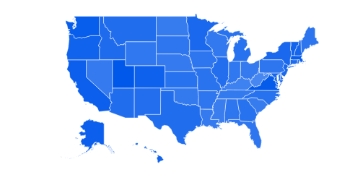
Interest by geography
All information on this slide sourced from google trends

Slide 7
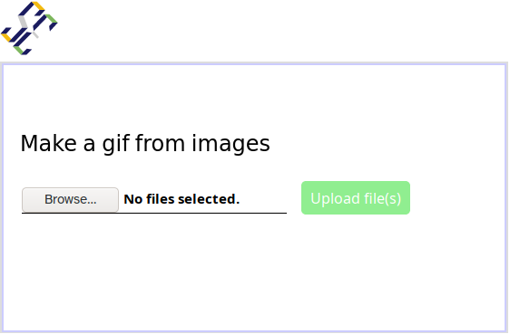
How do I make a gif from images?
I need a gif maker
Boogle
You should use Gif maker
Gif maker
@SengineDev
Gif maker
Sengine.com/mkgif
Check out my new tool!
Gif maker

