Slide 1
JavaScript
By Jake Ward(9800237720)

Slide 2
What is JavaScript?
What is JavaScript?
JavaScript is a Programming/Scripting Language that is primarily used to create interactive effects within web browsers. It should not be confused with Java, they are completely separate. JavaScript is supported in all major browsers.
Object Oriented or Event Driven?
JavaScript is an Object Oriented programming language that is small and lightweight. It is not classed as a “class-based”, but it is classed under the “prototype-based” languages. JavaScript supports a form of Inheritance called “prototypal inheritance” and it supports aggregation and due to its dynamic nature, it can excel at aggregation.
How does it Work?
Values
A Value in JavaScript is just a plain piece of data/a number.
Variables
Variables are containers used for storing variables.
Operators
An Operator is what is used to help assign a value to a variable and allows mathematics to happen.

Slide 3
What is JavaScript?
How is it Implemented?
JavaScript will be activated, via the built in interpreter, as soon as the Web Page loads, however, if the JavaScript is put at the bottom of the code, it will be the last thing to load. The programmer can either put the JavaScript in the main code or can use an external JS file and then reference it in the HTML, both will work.
How Are Decisions Made?
Decisions are made via:
If
The if statement will run the code if a certain condition is met.
If/else
The if/else statement is like the if statement, however if one statement is false then it will move on to the next statement until it gets a statement that is true.
Switch/case
The switch statement evaluates an expression and then the value of that expression is then compared to the values of each case in another statement. If there is a match, the code will be executed. This can be seen as another form of the if/else statement.

Slide 4
What is JavaScript?
Alerts
An Alert is used to make sure that certain information is shown to the user, for example, if the user if filling in a form and they forget to input their email, the JS will realise and then display to the user that they have forgot to input their email when they click submit.
Confirming Choice
A confirming choices “alert” will show an alert and will include an Ok or cancel button. It can be used to verify if the user want to carry on with the process.
Redirecting
Page Re-direction, re-directs the user to another page due to a fault in the page they want or the page no longer exists. It can also be used to redirect to external pages, for example, if a website wants t send the user to an external website, it could send the user to the redirect page on their website and then that page will redirect them else where.
Browser Detection
Browser detection will detect what browser the user is using. Once the browser has been detected, it could then tell the website to run certain features, for example, if the user was using IE then it could run code that makes the experience smoother for the user.
Cookies
Cookies are data that is stored, in small text files, that keeps information about the user as the server loses all information when the user disconnects. Cookies are stored on the users computer and they usually help with the browser choosing what adverts it will show the user.

Slide 5
Scripting Languages
How can Scripting Languages improve the Functionality of the website
Scripting Languages improve the functionality of a website as it allows the user to have a better experience by add elements that are normally available via normal HTML and CSS code. These new elements could include user prompts, navigation assistance and choice confirmations.
Using scripting languages can also help automate a simple task, for example, it could making redirecting a user easier as it would redirect the user as soon as they hit the page, otherwise the user would have wait for the first page to load to then click a button/link to redirect them.
Scripting Languages allows the programmer to add more interactivity as it allows the programmer to add prompts and forms that allows user to interact better with the website.

Slide 6
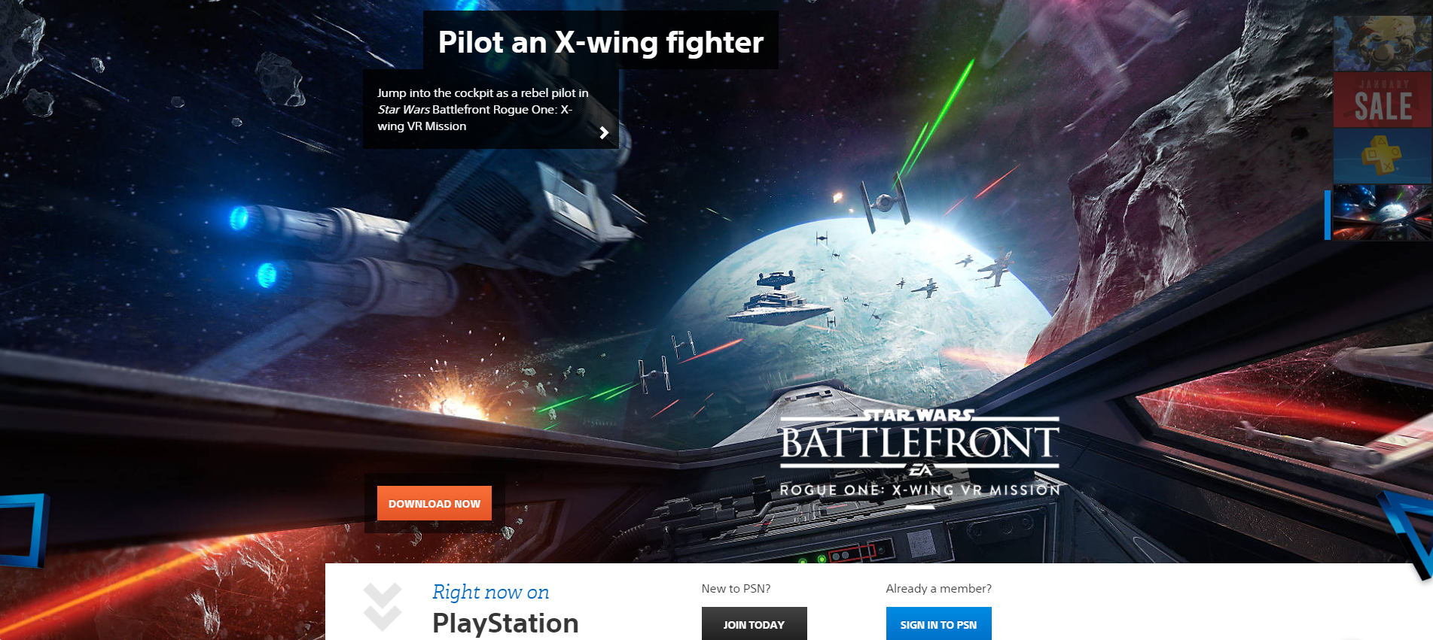

Scripting Languages: Examples
There are many website that use a Scripting Language Effectively. Here is just two:
PlayStation is a good example of a website that effectively uses a scripting language. The website has a slider that scrolls through 4 items on a 5-10 second timer, as seen on the image which will have been made through a scripting language. Another feature that the website has, is that when the user scrolls down the PlayStation symbols will move/fade in and off the screen.
Another website that is a good example of a website that uses a scripting language effectively is the Witcher 3 game website. As soon as the user loads onto the page, they are met with an age verification screen which will redirect the user to another page and declining them access. Another scripting feature that the website uses effectively, is the navigation feature that allows the user to jump to a specific part on the page without having to scroll through the website. Finally, another feature that the website uses, is an interactive world map of the game so the user can see where to go in the game.

Slide 7
Implementation
How Web Pages using scripts are implemented in different browsers
When creating a website, there will be times that the developers will come across browser compatibility issues. These issues could include part of the site not loading possibly due to the limitation of the browser. There are two ways to fix this, or at least make it more viable.:
Browser Detection
Browser Detection is JS script that checks what type of browser and what version of the browser is using, from that information the browser will then be able to load the correct files or adjust to the browser, via separate pieces of code that the user programmer has created.
Object Detection
Object detection allows the programmer to check if an part of the scripting language exists before trying to use it. This allows the script to detect what objects will work in the current browser. This means that Browser detection and Object Detection can work very well together.

Slide 8
Implementation: Browser Detection
Browser detection can send an on-screen alert to the user of an out of date browser, when detected, to tell the user to update to the newest version, so they can get the most use of the website. This allows the developers to focus on working on the newer versions of browsers instead of trying to make their website compatible with older versions and was waste valuable time doing so.
The browser detection helps tell the developer what browser is being used and can also tell the developer what needs to be changed to help the website improve its performance on slower hardware. This will then allow the developer to change the code to fit the hardware and browser that is being used.
Browser detection can tell the browser information about the current system that the user is using and then it will then be able to load the correct files or adjust to the browser, via separate pieces of code that the user programmer has created, if they have decided to implement those features.

Slide 9
Implementation: Object Detection
Object Detection can detect what the user has available in terms of hardware and software and if there is anything that isn’t compatibly with the website, which will then allow the website to change the code accordingly to match the specific requirements; for example, object detection can detect what type of screen the user has and will change the dimensions of the webpage to fit the screen and, if coded correctly, scale all the objects on the screen to the correct ratio as to not look disproportionate with the screen.
Object Detection can also tell the website what browser the user is using and then tell it what scripts to run to make the site work as smooth as possible for that browser and for the hardware the user is using.
SO therefore, Object Detection and Browser Detection work together to help improve the compatibility of the site and the browser that it is run on.

