Slide 1
A general solver for electrochemical
transport–reaction systems
Declare the system; the solver handles the math — demonstrated on ORR selectivity
Jake Weinstein

Slide 2
THE CLASS OF PROBLEM
One framework, many systems
Migration–diffusion–reaction with a structured double layer — the same mathematics across electrochemistry.
ORR
CO₂RR
Electrodeposition
Corrosion
Stern
Electrode
Diffuse layer
Bulk
We'll demonstrate the workflow on ORR.
PNP–BV solver
2

Slide 3
THE IDEA
Two halves of the problem
Model specification
Numerical machinery
the electrochemistry
the solver's job
Species (dynamic & analytic)
Reactions & stoichiometry
Extra physics terms
Boundary conditions
Formulation & log-space
Meshing (1D / 2D)
Continuation & recovery
Robust convergence
→
PNP–BV solver
3

Slide 4
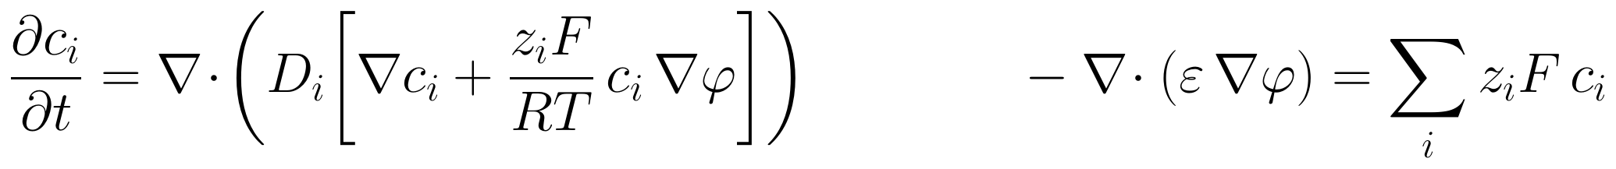
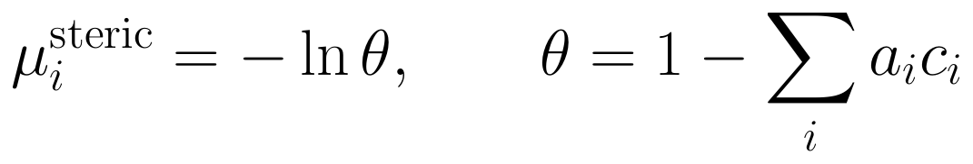
GOVERNING EQUATIONS & TERMS · MENU 1
What you specify
PNP in the diffuse layer — ions diffuse and electromigrate in the field.
Butler–Volmer flux — rate scales with exp(overpotential), tied to the applied voltage.
Steric correction — removes non-physical ion concentrations.
Stern layer — enters as a Robin boundary condition.
PNP–BV solver
4

Slide 5
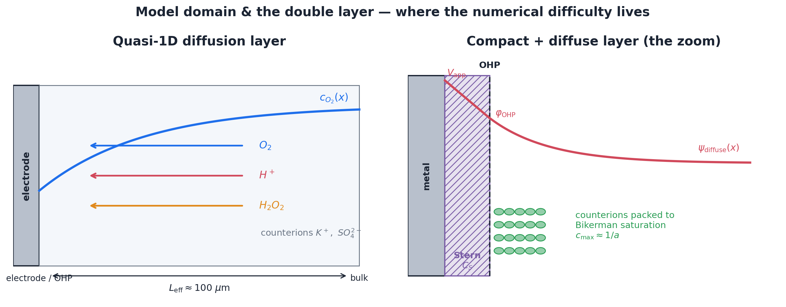
BOUNDARY CONDITIONS · MENU 2
What you specify
Bulk Dirichlet
Butler–Volmer flux
Stern Robin
No-flux
Analytic Bikerman
Mix and match per species, per boundary.
PNP–BV solver
5

Slide 6
REACTIONS & STOICHIOMETRY · MENU 3
What you specify
O₂ + 2 H⁺ + 2 e⁻ → H₂O₂
O₂ + 4 H⁺ + 4 e⁻ → 2 H₂O
E° = 0.695 V · 2e⁻ — the target
E° = 1.23 V · 4e⁻ — the loss
Declare stoichiometry · nₑ · E° · α · k₀ → log-rate Butler–Volmer (parallel or sequential)
Edit a coefficient or append a reaction — the flux re-assembles.
PNP–BV solver
6

Slide 7
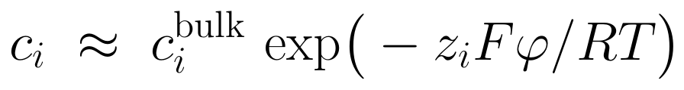
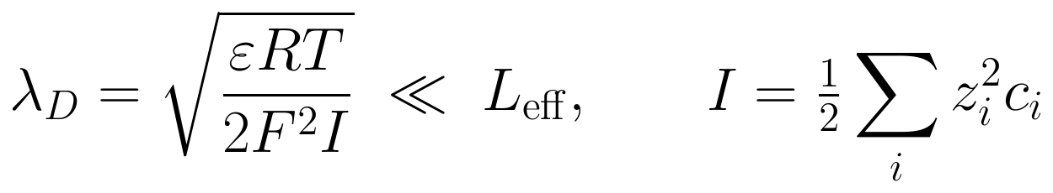
THE DIFFICULTY
Why it's numerically hard
Concentrations span ~10 orders of magnitude across the domain.
The potential varies sharply right at the Stern layer.
The exponential Butler–Volmer term drives steep buildup in c and φ at the boundary.
Diffusion and electromigration act on very different timescales — the system is stiff.
PNP–BV solver
7

Slide 8
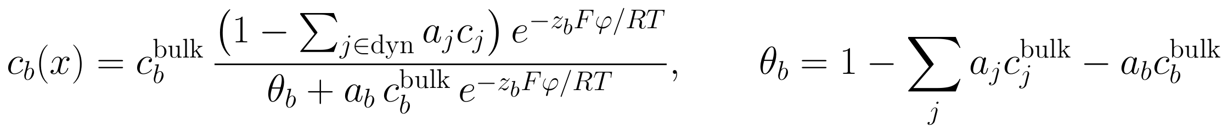
THE SOLVER
How we solve it
1
Solve μ = ln c + z·φ — mirrors the no-flux analytic solution.
2
Log-rate Butler–Volmer — build the rate in log-space, exponentiate once (no overflow).
3
Analytic closure for non-reactive ions.
4
Continuation — never solve the hard problem cold (next slide).
PNP–BV solver
8

Slide 9
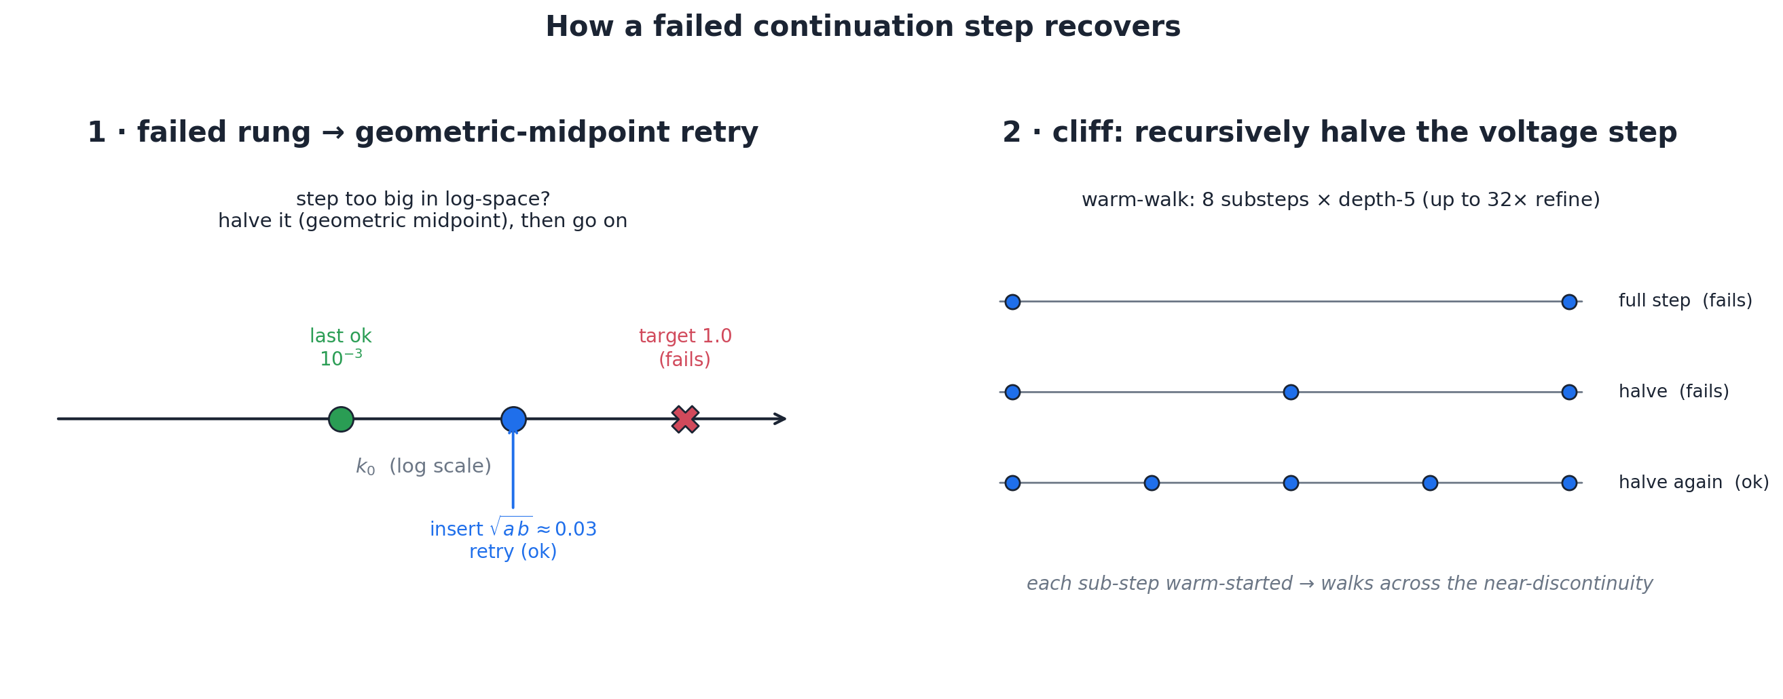
THE SOLVER
Continuation: deform easy → hard
Reaction rate k₀: ramp from ~10⁻¹²× physical up to physical, warm-starting each step.
Stern capacitance: ramp up (stiffer as C_S grows).
Voltage walk: converge near the equilibrium voltage, then step out across the window.
Recursive bisection: insert intermediate steps when one fails — recover, don't restart.
PNP–BV solver
9

Slide 10
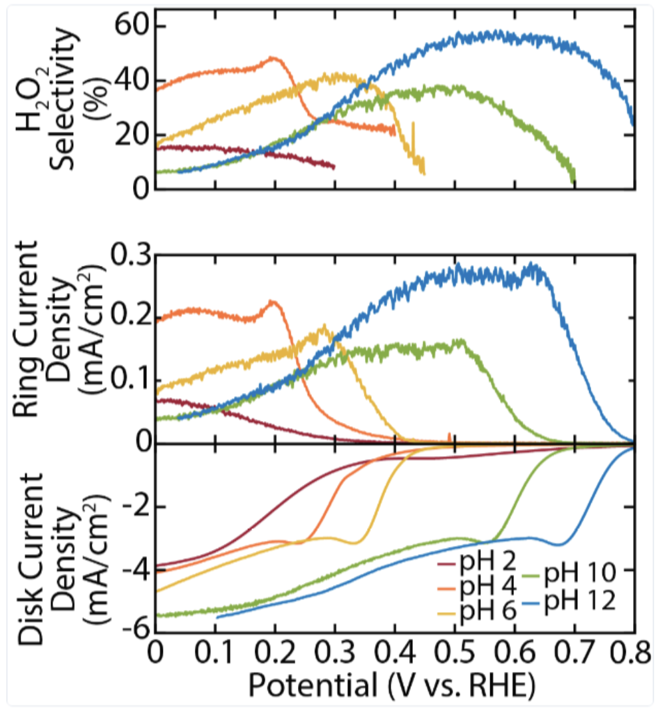
APPLICATION
Proof of concept: ORR selectivity
The system, declared from the menu:
Parallel 2e⁻ (0.695 V) + 4e⁻ (1.23 V)
K⁺ / SO₄²⁻ electrolyte
Finite-size ions (Bikerman)
Stern + Butler–Volmer + bulk BCs
Target: Ruggiero / Seitz–Mangan, pH 2–12
PNP–BV solver
10

Slide 11
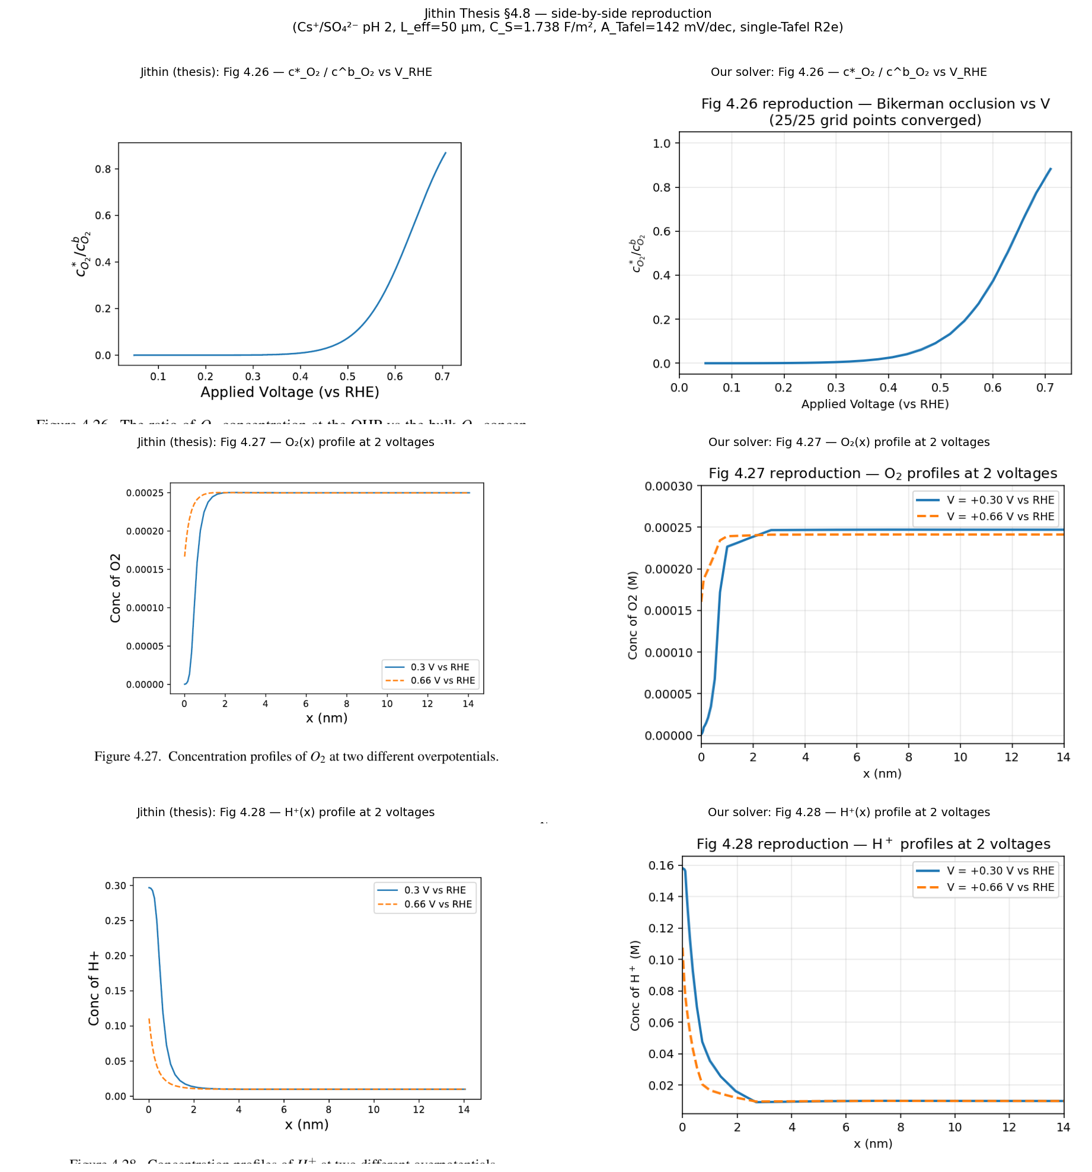
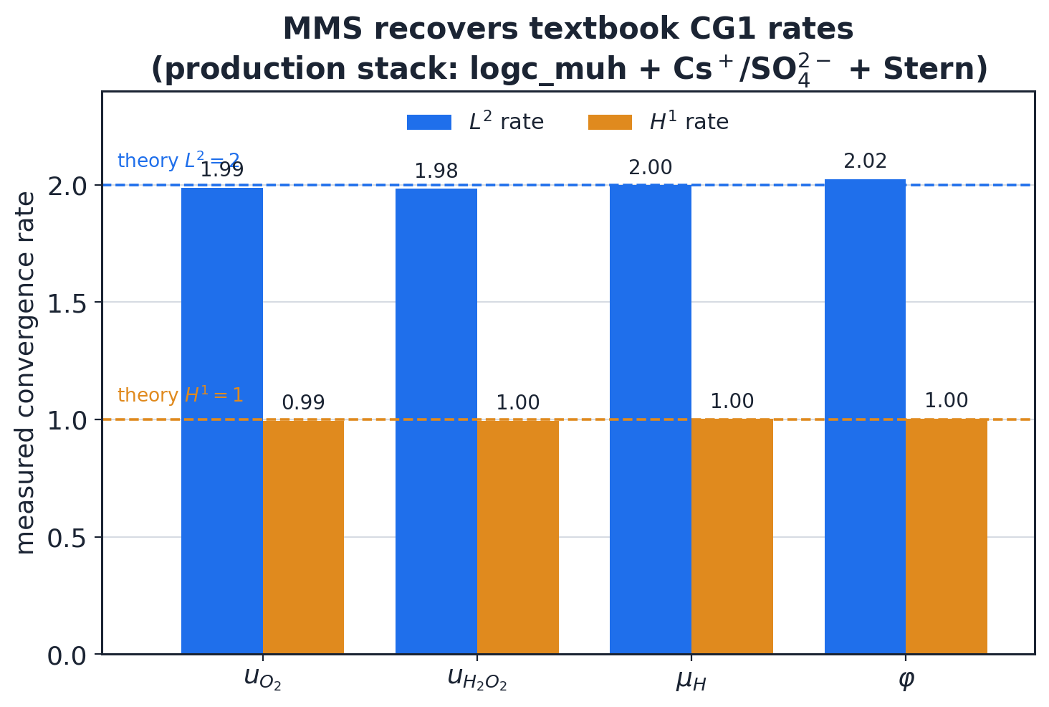
CONFIDENCE
What's proven — and what's left
Reproduces the prior model (~5%)
MMS → textbook convergence
The remaining gap to experiment is model selection — not the solver.
PNP–BV solver
11

Slide 12
FLEXIBILITY
1D and 2D — both today
1D
2D
fast fitting & parameter sweeps
real cell geometry & radial transport
Same governing equations — running in 2D today.
PNP–BV solver
12

Slide 13
VISION — HYPOTHETICAL
Where it's headed: a Python package
import pnpbv as pb
O2 = pb.Species("O2", z=0, D=2.1e-9, c_bulk=1.2e-3)
H = pb.Species("H+", z=+1, D=9.3e-9, c_bulk=1e-4)
K = pb.Species("K+", z=+1, c_bulk=0.2,
analytic=True) # Boltzmann
r2e = pb.BVReaction("ORR_2e",
reactants={O2:1, H:2}, products={H2O2:1},
n_e=2, E_eq=0.695)
prob = pb.Problem(
species=[O2, H2O2, H, K, SO4],
reactions=[r2e, r4e],
electrode=pb.SternElectrode(C_stern=0.20))
sol = pb.Solver(prob).solve_grid(v_rhe=(-0.4, 0.8))
Declare the spec.
It handles meshing,
formulation, solving,
and recovery.
Planned: hyperparameter
autotuning.
Design sketch — not yet built
PNP–BV solver
13

Slide 14
VISION — HYPOTHETICAL
Extend it: add your own term
from pnpbv.formulations import pnp_steric
from ufl import grad, inner
# default PNP + migration + Bikerman steric:
res = pnp_steric(prob)
c, w = res.fields, res.tests # conc + tests
dx = res.dx # 2D bulk measure
# add terms the menu doesn't cover (F = 0):
# peroxide decomposition: H2O2 -> 1/2 O2 + H2O
res.add( -k_d * c["H2O2"] * w["H2O2"] * dx )
res.add( +0.5*k_d * c["H2O2"] * w["O2"] * dx )
# forced convection (RDE):
res.add( inner(u, grad(c["O2"])) * w["O2"] * dx )
# same continuation + failed-step recovery:
sol = pb.Solver.from_weak_form(res).solve_grid(...)
Physics not on the menu?
Import the default residual;
append terms as plain UFL.
One line per term.
The same solver, continuation,
and recovery ride along.
Design sketch — not yet built
PNP–BV solver
14

Slide 15
Roadmap
1
Close the experiment gap by model selection
candidate mechanisms: cation hydrolysis / field-dependent pKa, peroxide reduction, water self-ionization
2
Broaden the menu & add autotuning
more terms, BCs, and reactions; let the solver pick its own settings
3
Lock the API
a reusable predictive simulator for systems in this family
PNP–BV solver
15

