Slide 2
The Credentialing Challenge in AIG
The Traditional Approach: "Blank-page" LLM prompting or rigid templates.
The Result (Focusing on Quantity over Quality):
Superficial paraphrasing (Item Cloning).
Shallow cognitive demand (Testing recall over application).
Too much focus on mass production, leading to poor quality items and non-functioning distractors.
The Core Need: We must explicitly model cognitive operations and content complexity before generating the text of an item.

Slide 3
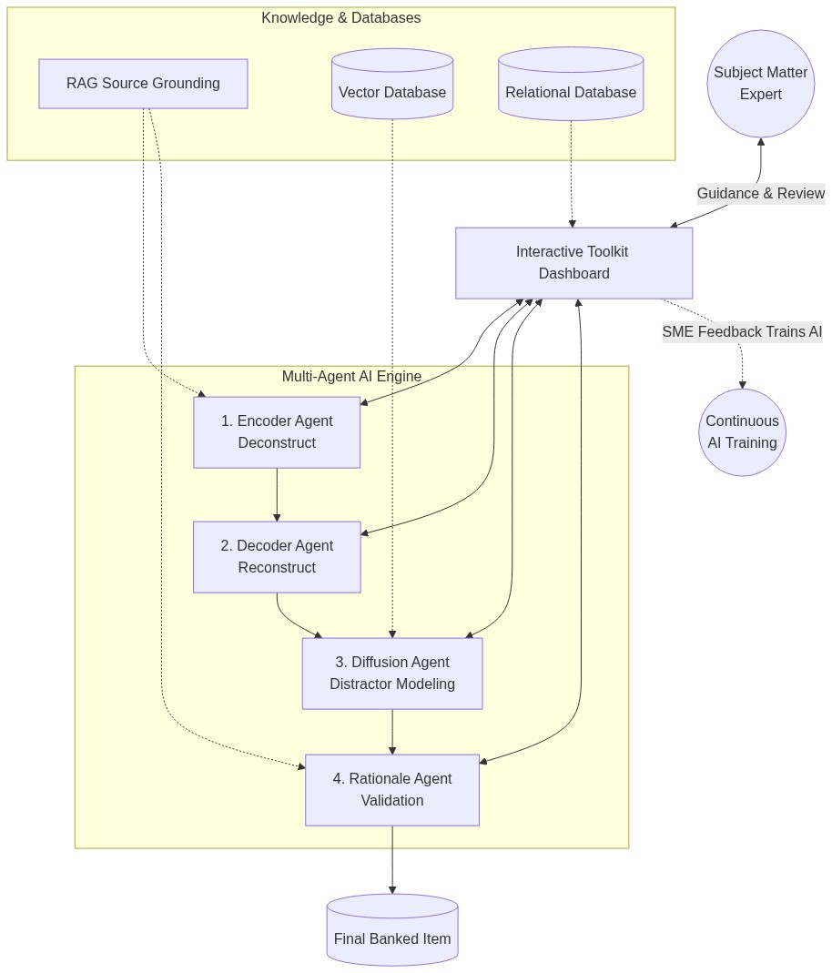
The 4-Agent SME Toolkit Architecture

Slide 4
1. The Encoder Agent: Deconstruction
Purpose: Formulate the precise item model from reference material.
Action: Decomposes source materials and seed items.
Output: A strict cognitive blueprint independent of surface text.
Key Metrics Captured:
Two Main Areas: Domain/Task Knowledge & Cognitive Depth.
Decomposition of core "radical" features from superficial "incident" features.
Target mental operations (e.g., analyze, prioritize).
Identification of potential construct-irrelevant variance.

Slide 5
2. The Decoder Agent: Reconstruction
Purpose: Reconstruct the item model based on the Encoder's blueprint.
Action: Drafts the clinical vignette/scenario and question prompt.
Spaces Created: Establishes the Key Feature Space and Misconception Space to guide expected option generation.
Fidelity: Ensures the generated text maintains absolute fidelity to the intended cognitive construct.
Result: Items that are cognitively isomorphic (identical in difficulty and demand) but deeply diverse in operational presentation.

Slide 6
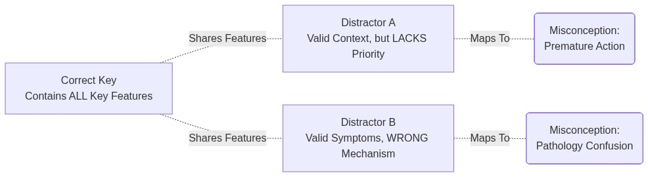
3. The Diffusion Agent: Distractor Modeling
Purpose: Formulate the key and distractors using Cognitive Misconception Mapping (CMM).
Semantic Search: Uses Vector DBs to identify overlapping knowledge concepts.
Context Search: Uses Relational DBs to leverage current item information within the bank.
Plausibility: Validates and confirms the key feature and misconception spaces to formulate functional distractors targeting known errors.

Slide 7
4. The Rationale Agent: Validation & Documentation
Purpose: Validate the generated item and create a comprehensive evidence trace.
RAG Dependency: The RAG system is especially critical for this agent to validate the overall item model and distractors, confirming the strict accuracy of all information.
Multi-tiered Rationales Produced:
1. Candidate-Facing: Simple, teaching-oriented explanations.
2. SME-Facing: Technical explanations referencing required features.
3. Audit-Facing: Evidence trace documenting explicit grounding to sources.

Slide 8
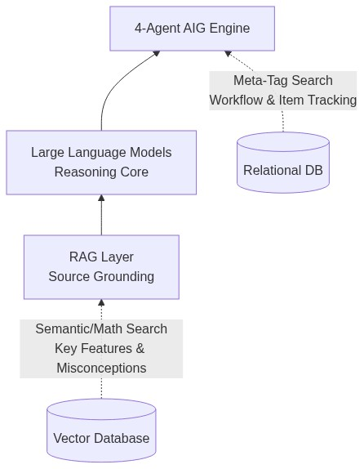
The Complete Technical Foundation

Slide 9
The New Role of the Subject Matter Expert
The SME is no longer facing a blank page. They are an Interactive Partner:
1. Direct the Agents: Set the cognitive target and provide the seed material.
2. Review the Blueprint: Approve the Encoder's deconstruction before drafting begins.
3. Analyze Overlap: Evaluate the Cognitive Misconception Mapping logic of the Diffusion Agent's distractors.
4. Final Approval: Certify the Rationale Agent's evidence trace.
Result: Higher quality items, vastly reduced fatigue, and strictly maintained psychometric integrity.

Slide 10
Conclusion & Q/A
Key Takeaways:
Text generation alone is insufficient for high-stakes credentialing.
The 4-Agent Architecture (Encoder, Decoder, Diffusion, Rationale) guarantees construct alignment.
Advanced infrastructure (RAG, Vector & Relational DBs) grounds generation in truth.
SMEs transition to powerful cognitive architects.
Questions?
[Contact Information / Program details]

