Slide 1
HACKATHON
Cross-Sell Prediction

Slide 2
Problem Statement
Your client is an Insurance company that has provided Health Insurance to its customers now they need your help in building a model to predict whether the policyholders (customers) from past year will also be interested in Vehicle Insurance provided by the company.
Build a model to predict whether a customer would be interested in Vehicle Insurance .

Slide 3
Dataset Column Details
Variable | Definition
id | Unique ID for the customer
Gender | Gender of the customer
Age | Age of the customer
Driving_License | 0 : Customer does not have DL, 1 : Customer already has DL
Region_Code | Unique code for the region of the customer
Previously_Insured | 1 : Customer already has Vehicle Insurance, 0 : Customer doesn't have Vehicle Insurance
Vehicle_Age | Age of the Vehicle
Vehicle_Damage | 1 : Customer got his/her vehicle damaged in the past.
 | 0 : Customer didn't get his/her vehicle damaged in the past.
Annual_Premium | The amount customer needs to pay as premium in the year
Policy_Sales_Channel | Anonymised Code for the channel of outreaching to the customer ie. Different Agents, Over Mail, Over Phone, In Person, etc.
Vintage | Number of Days, Customer has been associated with the company
Response | 1 : Customer is interested, 0 : Customer is not interested

Slide 4
EDA-Observations
Provided Train dataset is an imbalanced one and it has More 0 response(Not interested)
Customer with Driving_license ,Previously_Insured are interested for Vehicle insurance
Most of the Customer with Vehicle age >1 are interested for Vehicle insurance
Almost all the customer with Vehicle Damage are interested for Insurance
Mid-aged customer are more interested for Insurance(Planned to derive new column from Age, but not sure how to create a new column using pipeline. I tried but it errored out)
Vintage column doesn’t have any impact to target variable

Slide 5
Pre-Processing
All the columns in train dataset looks clean, no null value exist
Since the dataset is imbalanced, so went with Oversampling and Undersampling.
Got similar score for both Under and over sampling
In pipeline used SimpleImputer(Mode) , OneHotEncoder for Category columns and SimpleImputer(Mean) and StandardScaler for Integer columns. Though we don’t have NULL values in Train, used SimpleImputer for test datasets

Slide 6
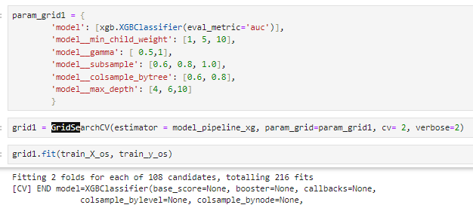
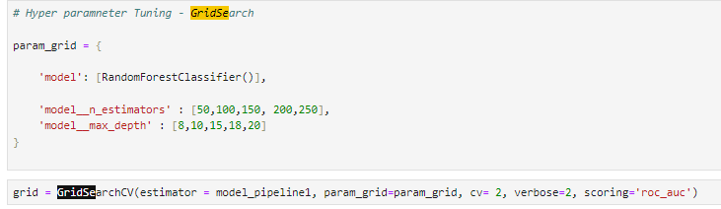
Hyperparameter Tuning
RandomForestClassifier
Used GridSearchCV with different params for tuning hyperparameter for RandomForest and XGBClassifier models.

Slide 7
Models
Tried different Models like LogisticRegression, RandomForestClassifier, AdaBoostClassifier, GradientBoostingClassifier, VotingClassifier and xgboost.
Xgboost and Random forest provided better result with parameter tuning compared to other models. Max-depth parameter played a key role in overcoming overfitting.

Slide 8
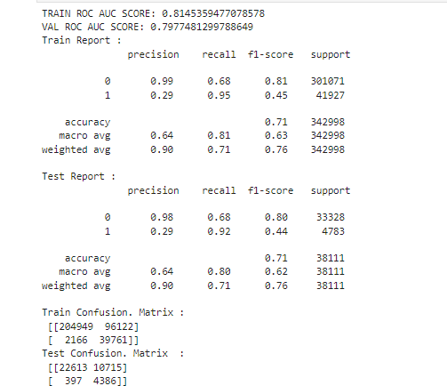
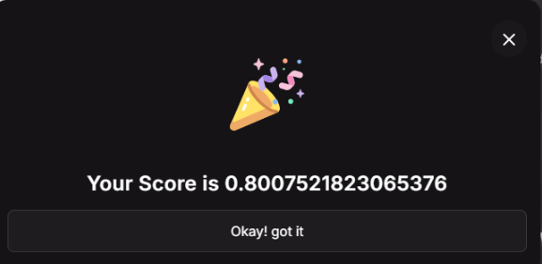
Result

Slide 9
Deployment
Docker:
jakeer4609/stream-hackcrosscellpred1:1.0
jakeer4609/api-hackcrosscellpred1:1.0
AWS:
https://container-service-3.bdg2cyc87fv22.ap-south-1.cs.amazonlightsail.com/docs https://container-service-4.bdg2cyc87fv22.ap-south-1.cs.amazonlightsail.com/

