Slide 1

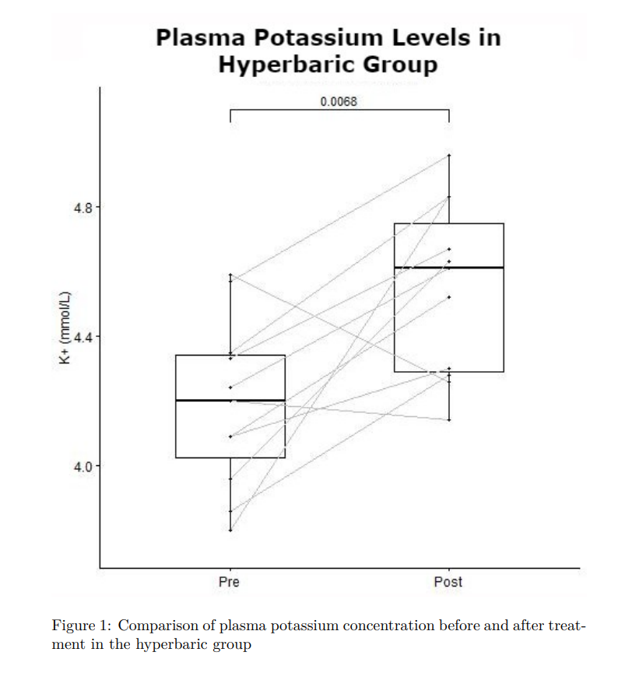
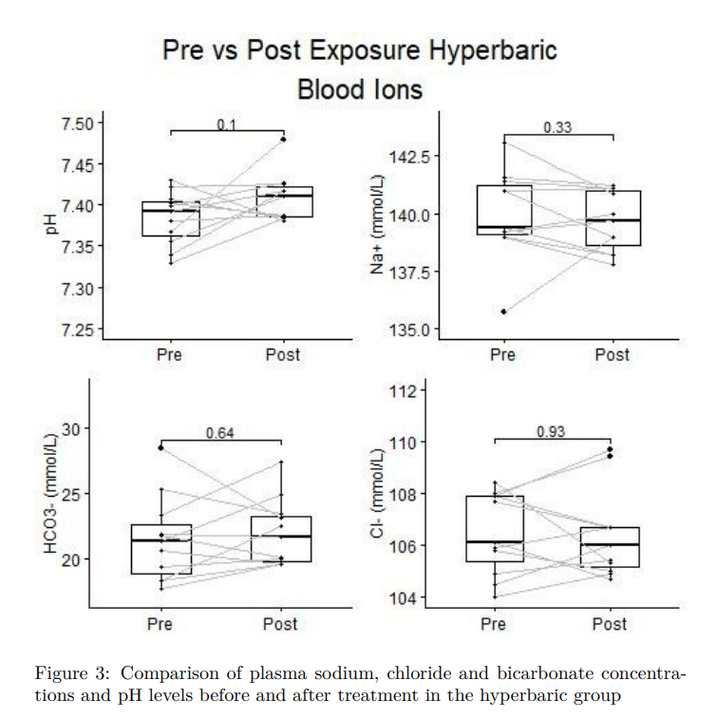
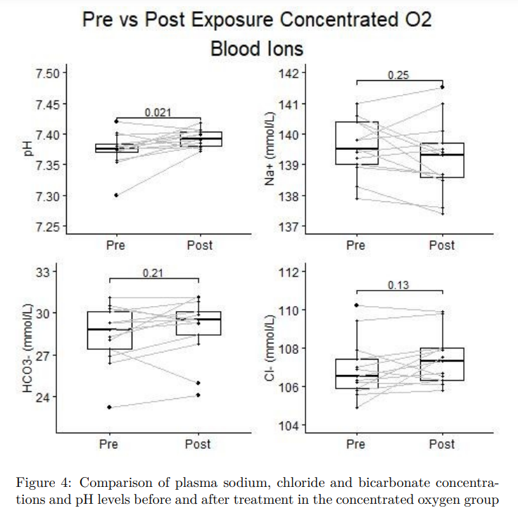
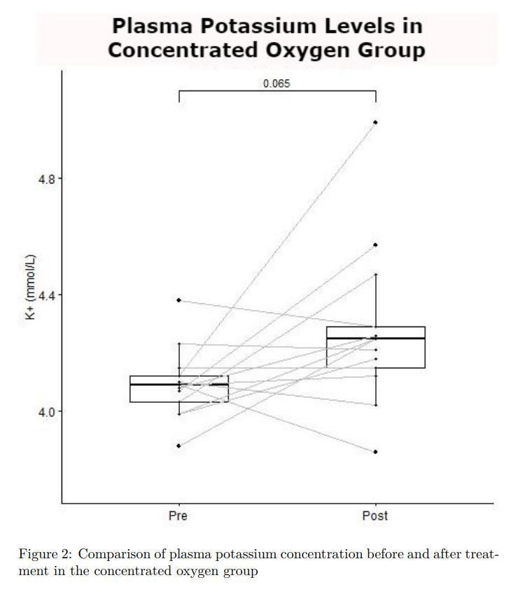
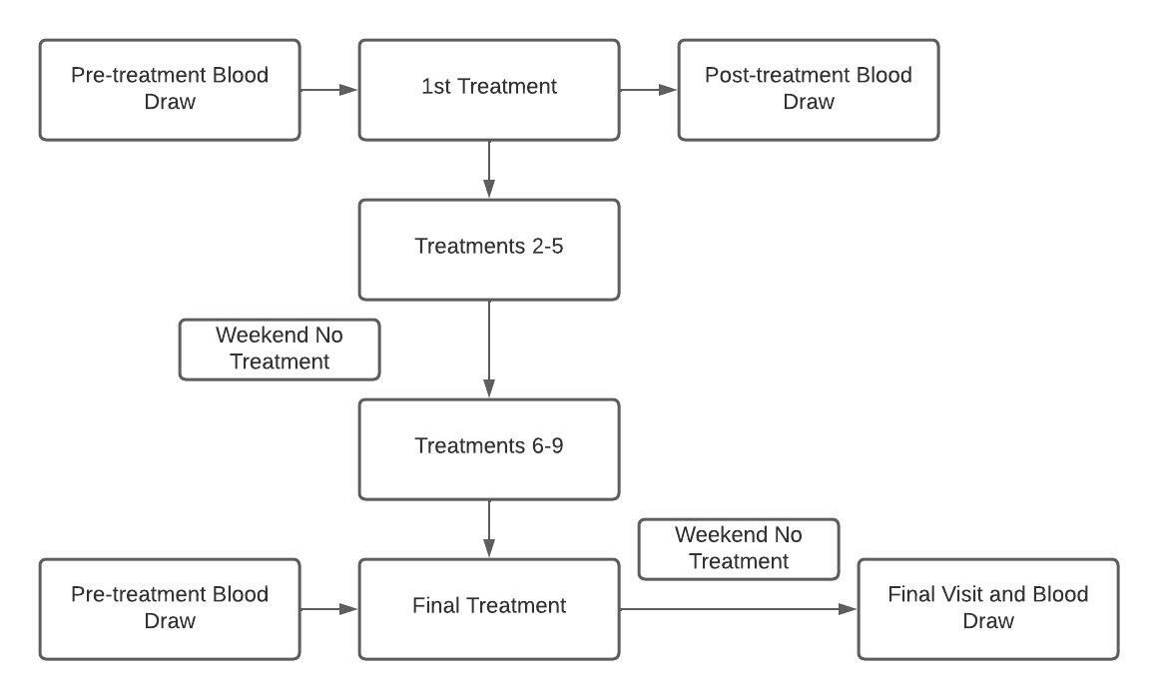


Increase in venous [K+] During Hyperbaric Exposure Independent of Changes in pH or O2 Concentration
Jacob Lamers, Kent MacLaughlin, Matthew Marcou, Rudolf Braun, Marlowe Eldridge
Background
Results
Results (cont.)
Changes in pressure and oxygen concentration can be used to modulate oxygen levels in humans
Hyperoxia has been linked to increases in plasma potassium
Effects of hyperbaria on plasma potassium levels remain understudied
Hypoxia has been linked to changes in plasma potassium levels via HIF-1α pathway
Objective
Determine the effect of hyperbaric treatment and concentrated oxygen on venous metabolites
Methods
Conclusions
Greater increase in plasma potassium in hyperbaric treatment group than concentrated oxygen
Possible explanations
Increase CO2 pressure
Increase N2 pressure
Affects of increased pressure on vasoconstriction
Changes in expression of K+ channels via HIF-1α related response
a
b
c
d
Acknowledgements and Contact
Funding support from the University of Wisconsin – Madison, Department of Pediatrics, and Department of Medicine
Jacob Lamers: jjlamers@wisc.edu
Marlowe Eldridge, MD: meldridge@pediatrics.wisc.edu

