Slide 1

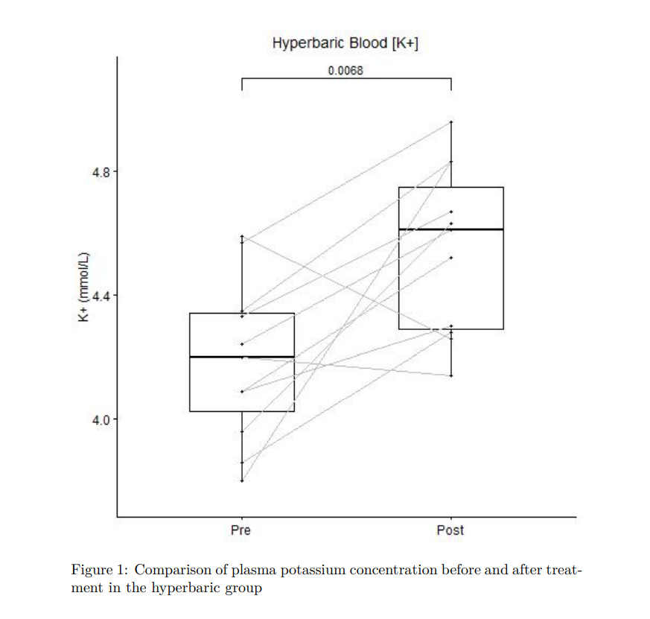
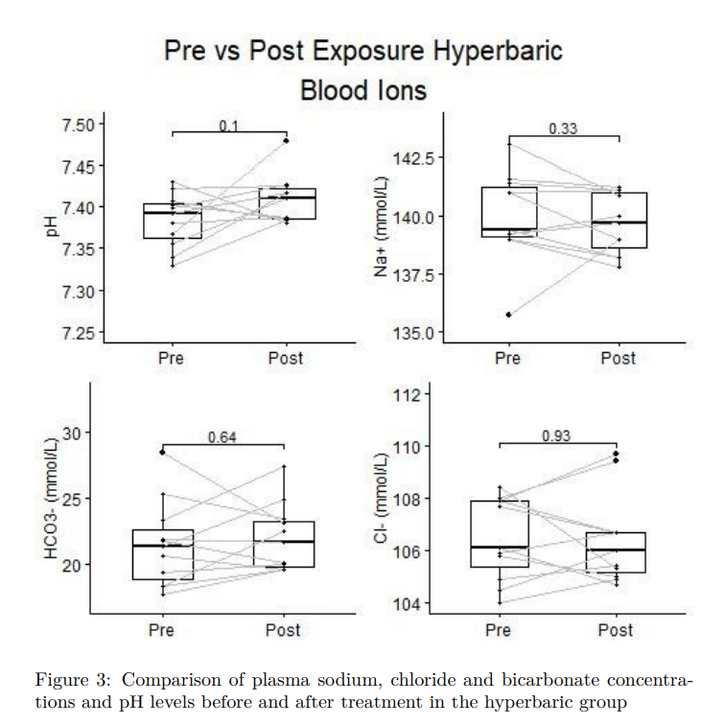
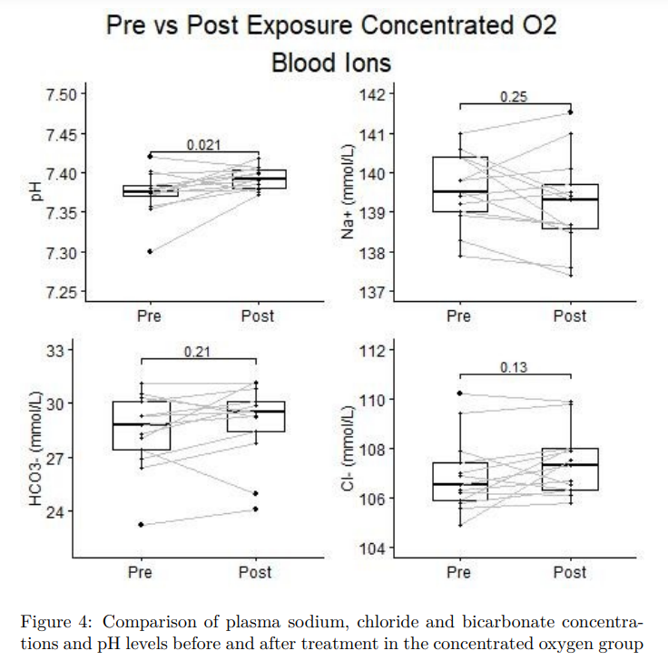
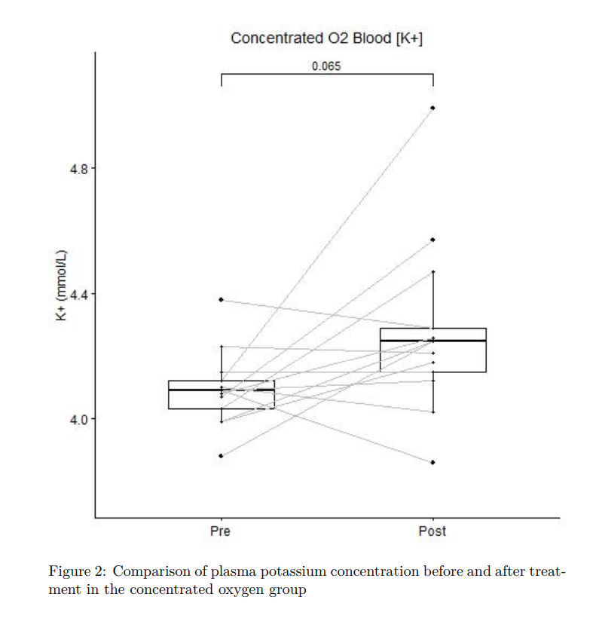
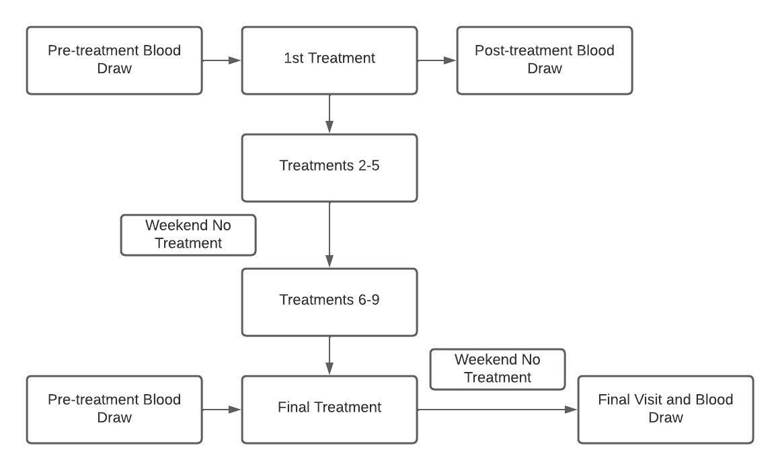


Increase in venous [K+] During Hyperbaric Exposure Independent of Changes in pH or O2 Concentration
Jacob Lamers, Kent MacLaughlin, Matthew Marcou, Rudolf Braun, Marlow Eldridge
Background
Results
Results (cont.)
Changes in pressure and oxygen concentration can be used to modulate oxygen levels in humans
Hyperoxia has been linked to increases in plasma potassium
Effects of hyperbaria on plasma potassium levels remain understudied
Hypoxia has been linked to changes in plasma potassium levels via HIF-1α pathway
Objective
Determine the effect of hyperbaric treatment and concentrated oxygen on venous metabolites
Methods
Conclusions
Greater increase in plasma potassium in hyperbaric treatment group than concentrated oxygen
Possible explanations
Increased CO2/N2 in chamber
Affects of increased pressure on vasoconstriction
Changes in expression of K+ channels
a
b
c
d
Acknowledgements and Contact
Project supported by funding from the National Institutes of Health : RO1 HL086897 (MWE) and RO1 HL38149
Jacob Lamers: jjlamers@wisc.edu
Marlowe Eldridge, MD PhD: meldridge@pediatrics.wisc.edu

