Slide 1

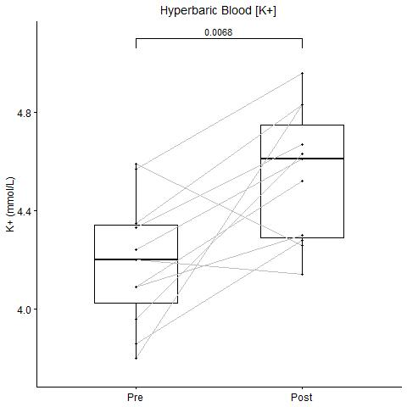
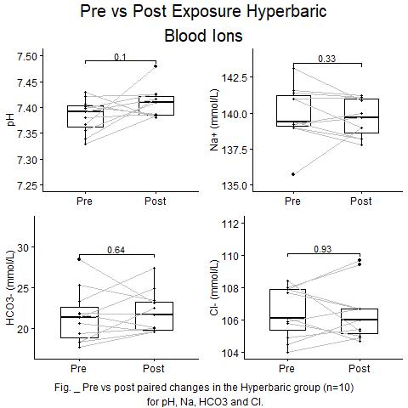
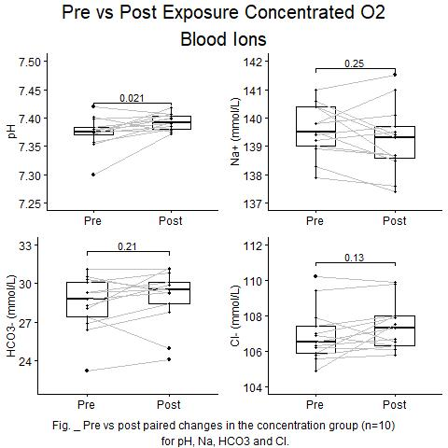
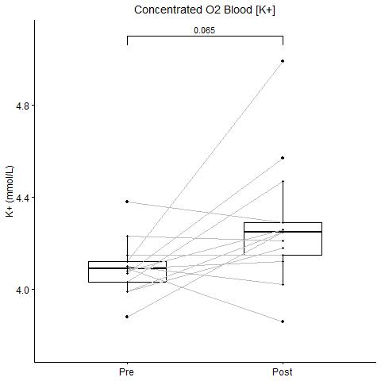
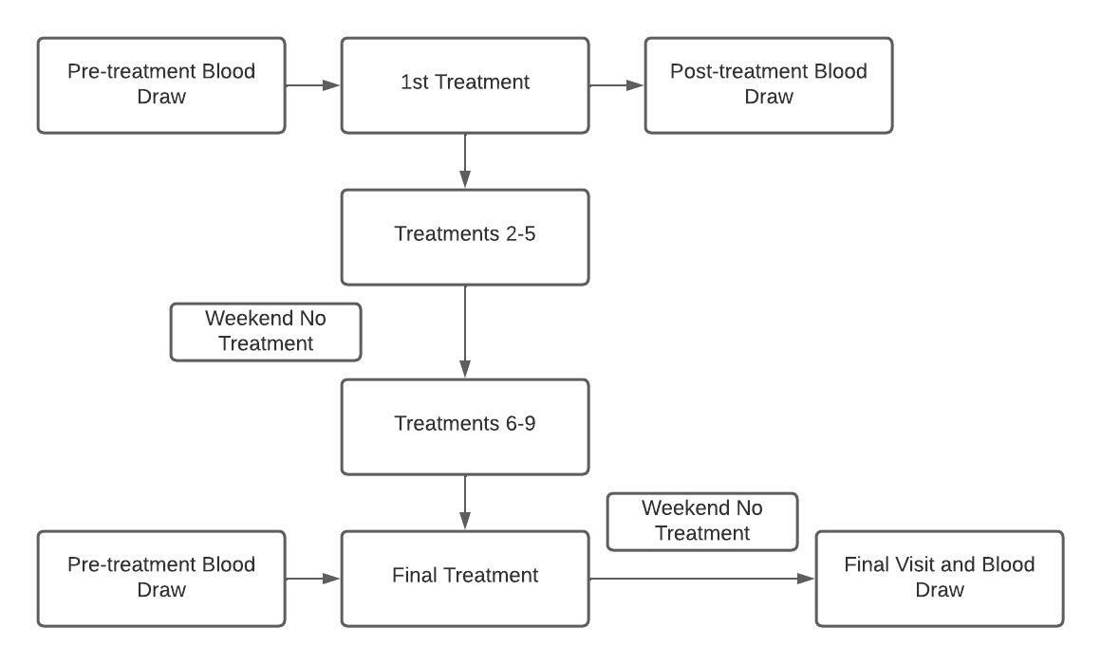


Increase in venous [K+] During Hyperbaric Exposure Independent of Changes in pH or O2 Concentration
Jacob Lamers, Kent MacLaughlin, Matthew Marcou, Rudolf Braun, Marlow Eldridge
Background
Results
Results (cont.)
Objective
Methods
Conclusions
a
b
c
d
Acknowledgements and Contact
Project supported by funding from the National Institutes of Health : RO1 HL086897 (MWE) and RO1 HL38149
Jacob Lamers: jjlamers@wisc.edu
Marlowe Eldridge, MD PhD: meldridge@pediatrics.wisc.edu

