Slide 1

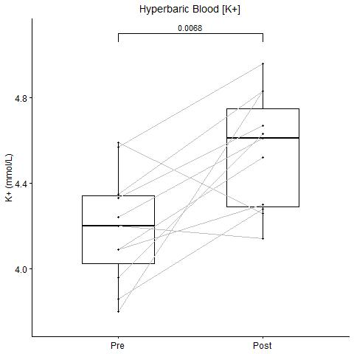
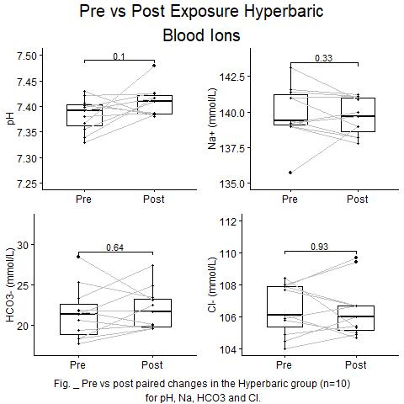
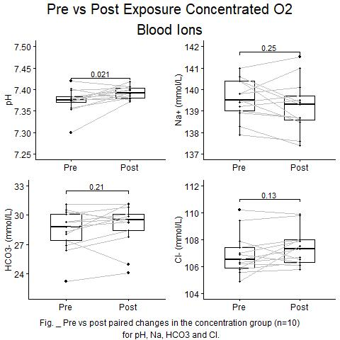
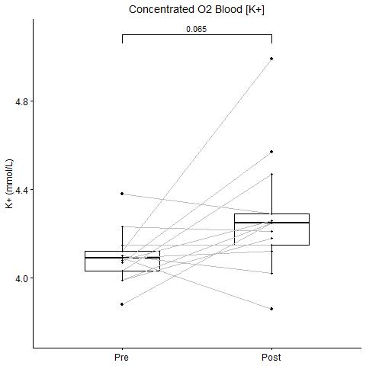
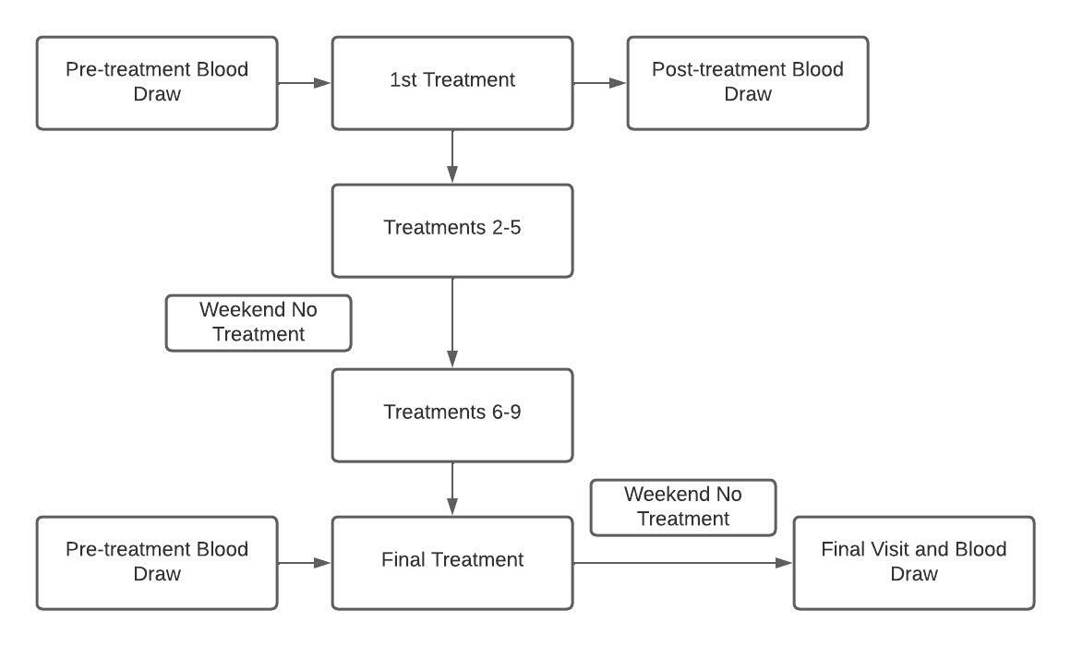


Increase in venous [K+] During Hyperbaric Exposure Independent of Changes in pH or O2 Concentration
Jacob Lamers, Kent MacLaughlin, Matthew Marcou, Rudolf Braun, Marlow Eldridge
Background
Results
Results (cont.)
Objective
Determine the effect of hyperbaric treatment and concentrated oxygen on venous metabolites
Methods
Conclusions
Greater increase in plasma potassium in hyperbaric treatment group than concentrated oxygen
Possible explanations
Lack of dietary restriction
Increased CO2/N2 in chamber
Affects of increased pressure on vasoconstriction
a
b
c
d
Acknowledgements and Contact
Project supported by funding from the National Institutes of Health : RO1 HL086897 (MWE) and RO1 HL38149
Jacob Lamers: jjlamers@wisc.edu
Marlowe Eldridge, MD PhD: meldridge@pediatrics.wisc.edu

