Slide 1
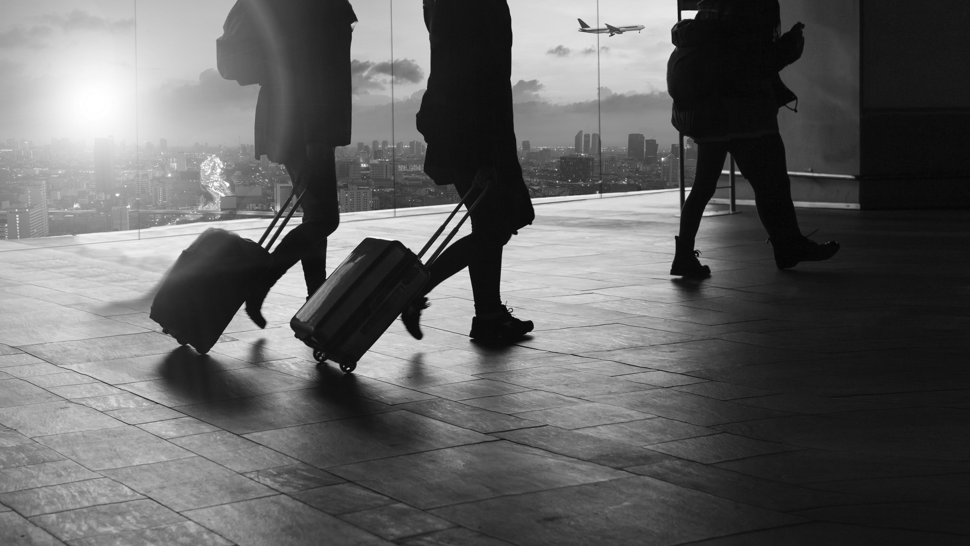
SAFE TRAVELS
Travel safely during COVID-19
Jacob Bartoletta – Chanel Mitchell – Lark Moore – Sarita Thomas

Slide 2
Elevator Pitch

Slide 3
Concept
Description: A site designed to create an experience for travelers to travel safely during COVID-19. Travelers input desired destination, then information about COVID-19, main attractions, and the weather forecast near their destination will be displayed.
Motivation for development?
Nearly 2 years in the pandemic
Travel plans canceled
Having relevant data at your finger-tips to make responsible decisions
User story: We are ready to experience the world beyond our quarantine locations but also want to stay safe while the pandemic rages on. We want to search use an app to quickly view current stats about Covid-19, travel destination, and weather. This information will provide key data for making responsible travel decisions.

Slide 4
Process
Technologies Used
HTML
CSS
JAVASCRIPT
J QUERY
JSON
Pooper JS
Moment JS
Tippy JS
Bootstrap
Google API
OpenWeather API
OpentTripMap API
COVID Act Now API

Slide 5
Process
Breakdown of Tasks and Roles:
Jacob: GitHub; COVID Act Now API calls
Lark: Page layout and functionality; User Story; README;marrying code from each member’s contribution
Chanel: OpenWeather API; Google API; OpenTripMap API calls; marrying code from each member’s contribution
Sarita: Local storage functionality; README; marrying code from each member’s contribution
All team members contributed to the foundation of the app (HTML, CSS, and Script files)

Slide 6
Process
Challenges:
Schedule conflicts and availability
Early agreement on path forward – merging ideas and concepts
Understanding group dynamics within the given timeframe
Successes:
Experience working with talented individuals
Gaining insight on different technologies used by others
Learning experience working with a variety of personalities and preferences

Slide 7
DEMO

Slide 8
Directions for Future Development

Slide 9
Links
Deployed:
https://sdb14.github.io/safe-travels/
GitHub repo:
https://github.com/SDB14/safe-travels
https://github.com/Jakeology/safe-travels/tree/user/sarita

