Slide 1
CGG Ray Tracer – part 1
Dr Leigh McLoughlin
lmcloughlin@bournemouth.ac.uk

Slide 2
Lab Introduction
Tasks Today
Introduction to ray tracing
First steps

Slide 3
Lab Introduction
Ray Tracing Intro
There are two main approaches to rendering:
Rasterisation
Polygons are defined, transformed, converted to pixels, drawn
This is how the graphics card works
We will look at this in the second year
Ray Tracing
Viewing rays shot from camera into scene, each represents a pixel, find if they intersect with geometry, work out each pixel’s colour
Can be used to learn rendering, shading, lighting, shadows, reflections etc
Easier to get things like shadows, reflections than rasterisation

Slide 4
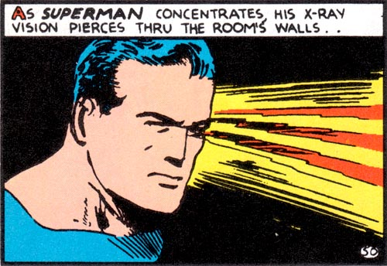
Introduction to Rendering
Ray-Casting

Slide 5
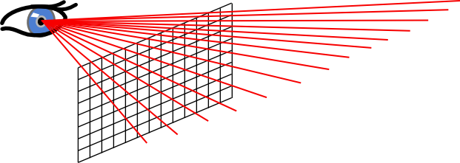
Introduction to Rendering
Ray-Casting
Ray casting is like the first step towards ray tracing
Fire lines, called ‘rays’, from the camera into our scene
Each ray corresponds to a single pixel

Slide 6
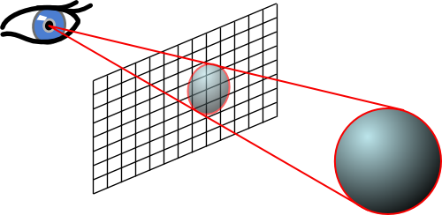
Introduction to Rendering
Ray-Casting
Work out if the rays intersect the geometry of the scene
Working out the colour for the pixel is normally done in a very basic way with ray-casting

Slide 7
Introduction to Rendering
Ray-Tracing
Basically extends the ideas of ray-casting
Once we hit an object, we can then create more rays!
Can trace rays towards light sources to see if we are receiving light or if we’re in shadow
Can trace new rays based on the incoming ray to simulate reflection or refraction
Can trace other rays to consider light bouncing off from other surfaces and objects in the scene

Slide 8
Introduction To Ray Tracing
Overview of How to Build a Ray Tracer
General concept:
We have some way to store / draw every pixel on the screen
We have a virtual camera and virtual objects
For every pixel, we shoot a ray from the camera into the scene
Where this ray hits an object, we work out the colour
We store this as the pixel’s colour in the framebuffer

Slide 9
Lab Introduction
Tasks Today: Ray Tracer First Steps
First step: storing / drawing each pixel on the screen
Two approaches:
Use the CGG Framework from assignment 2
Create a frame buffer system to store and save the image
(can also do both of course!)

Slide 10
Lab Introduction
Tasks Today: Ray Tracer First Steps
First step: storing / drawing each pixel on the screen
Two approaches:
Use the CGG Framework from assignment 2
You should be familiar with this so we’ll concentrate on this method
Create a frame buffer system to store and save the image
I suggest you create a frame buffer class
Use the lodepng library to save the data
(can also do both of course!)

Slide 11
Lab Introduction
Tasks Today: Ray Tracer First Steps
Using the CGG Framework from assignment 2:
Create a loop that goes through every pixel on the screen
You need a point where you have an x and a y coordinate for the pixel you are dealing with

Slide 12
Lab Introduction
Ray Class
Create a class for your ray!
Needs to contain an origin and direction
These should be vectors
(Use the glm maths library)

Slide 13
Lab Introduction
Camera Class
Create a class for your camera!
For now, this should have one function:
This takes a pixel coordinate pair
It returns a ray
We will fill in this function later

Slide 14
Lab Introduction
Tracer Class
Create a class for your ray tracer!
For now, this should have one function to trace a ray:
This function takes a ray
It returns a colour
We will fill in this function later

Slide 15
Lab Introduction
Putting it together
In your main function:
Create a camera object
Where you cycle through each pixel on the screen, use your camera’s function to create a ray for the pixel
Send this ray to your tracer’s trace function, which will return a pixel colour
Draw this pixel colour to the screen!
(nothing will happen yet, we’re just setting up the high-level steps)

