Slide 1
CGG Ray Tracer – part 2
Dr Leigh McLoughlin
lmcloughlin@bournemouth.ac.uk

Slide 2
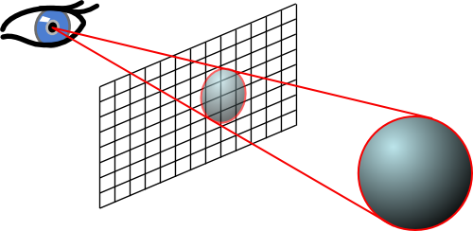
Lab Introduction
Tasks Today
Create a sphere class
Start writing geometry intersection functions
We need to know whether our rays intersect with our objects

Slide 3
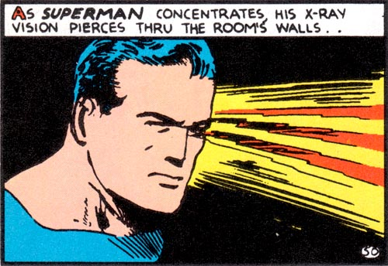
Introduction to Rendering
Ray-Casting

Slide 4
Lab Introduction
Sphere Class
Create a class for your object!
This should have a function to shade a pixel:
This function takes a ray and a vec3 intersection point
It returns a colour
Set this function to return a specific value (e.g. red)
I would suggest you handle colours as between 0-1 in this function and convert to between 0-255 as needed when writing your final pixel colour to screen. It just makes the maths easier when we get to proper shading
We will change this function eventually to perform actual shading

Slide 5
Ray Tracer
Geometry Intersections
You need three functions:
One to get the closest point on a line
Takes a ray, a 3d query point, returns a 3d point
Ray-sphere intersection
Takes a ray, sphere centre and radius, returns whether it hit or not and distance to hit (use a structure or class to combine these if you wish)
One to get the normal of a sphere
Takes a sphere centre and 3d sample point, returns a 3d direction vector

Slide 6
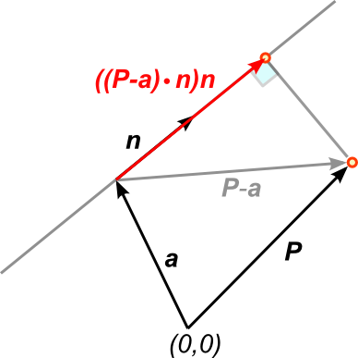

Ray Tracer
Shortest Distance from Point to Line
Remember from the lecture:
We can express the closest point X on the line to a query point P as:
$X=a+\left(\left(P−a\right)⋅n\right)n$
Your ‘get the closest point on a line’
function must implement this
X

