Slide 1
CGG Ray Tracer – part 3
Dr Leigh McLoughlin
lmcloughlin@bournemouth.ac.uk

Slide 2
Lab Introduction
Tasks Today
Introduction to ray tracing
First steps

Slide 3
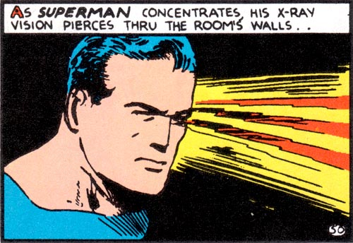
Introduction to Rendering
Ray-Casting

Slide 4
Ray Tracer
Geometry Intersections
You need three functions:
One to get the closest point on a line ← We did this last week
Takes a ray, a 3d query point, returns a 3d point
Ray-sphere intersection
Takes a ray, sphere centre and radius, returns whether it hit or not and distance to hit (use a structure or class to combine these if you wish)
One to get the normal of a sphere
Takes a sphere centre and 3d sample point, returns a 3d direction vector

Slide 5
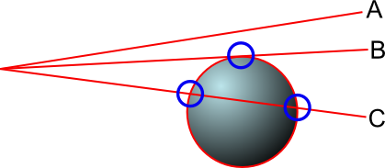
Ray-Sphere Intersection Test
Geometry!
Today we will build on last week’s code
Your task:
Develop a simple function to test for ray-sphere intersections

Slide 6
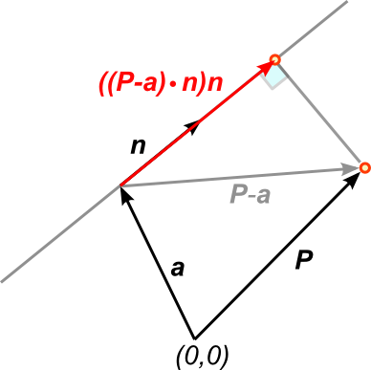

Ray-Sphere Intersection Test
Shortest Distance from Point to Line
Last week we worked on this:
We can express the closest point X on the line to a query point P as:
$X=a+\left(\left(P−a\right)⋅n\right)n$
X

Slide 7
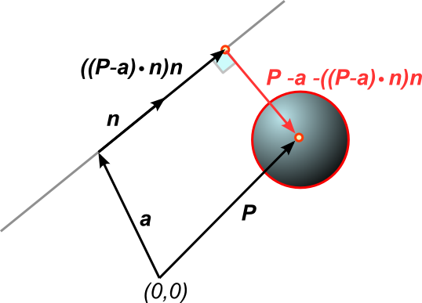

Ray-Sphere Intersection Test
Shortest Distance from Point to Line
The vector from X to P is:
$P−X$
We have the radius R of the sphere
If $\left\|P−X\right\|≤R$
Ray intersects sphere
Else
Ray does not intersect sphere
X

Slide 8
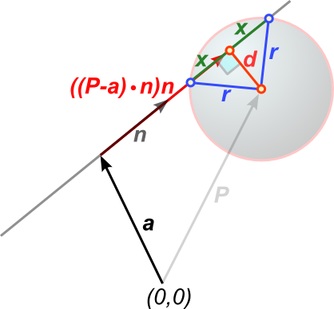

Ray-Sphere Intersection Test
Closest Intersection Point
Your ‘Ray-sphere intersection’
function must implement this:
First intersection should be:
$a+\left(\left(\left(P−a\right)⋅n\right)−x\right)n$
Where: $x=\sqrt{{r^{2}−d}^{2}}$
And:
$d=\left\|P−a−\left(\left(P−a\right)⋅n\right)n\right\|$

Slide 9
Ray-Sphere Intersection Test
What your function needs to do:
First, check if ray origin is inside sphere
If it is, we treat this as an error and will say there is no intersection
Then, find the closest point on the ray to the centre of the sphere
Use your function from last week
Check if the closest point is in front of or behind the ray’s origin / direction
Reject if intersection is behind the ray’s origin and direction points away from it
This prevents us from drawing objects that are behind the camera!
Work out the distance from the closest point on the line to the sphere’s centre
Perform the three checks
Work out and return actual intersection point

