Slide 1
CGG Ray Tracer – part 4
Dr Leigh McLoughlin
lmcloughlin@bournemouth.ac.uk

Slide 2
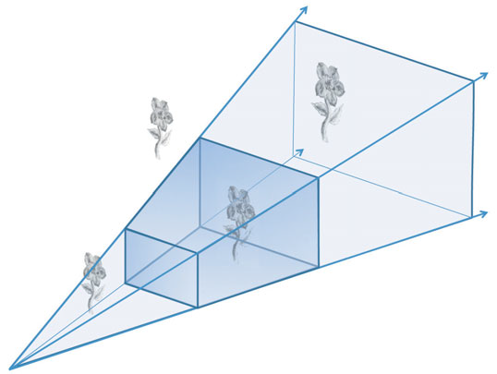
Viewing
Tasks Today
Viewport transformations
Writing the camera’s ‘create ray’ function
Look back at the viewing transformations lecture
We will be going ‘backwards’ through this process

Slide 3
Viewing
Camera Class
Recall your camera class:
For now, this should have one function:
This takes a pixel coordinate pair
It returns a ray
We will fill in this function today

Slide 4
Viewing
Camera Class
Let’s also give the camera class:
A viewing matrix
To represent the camera’s position and orientation
A projection matrix
To act like the camera’s lens

Slide 5
Viewing
Camera’s Create Ray Function
The function:
Takes a pixel coordinate pair
It returns a ray
We must go through a number of steps to create a ray from the input pixel coordinates

Slide 6
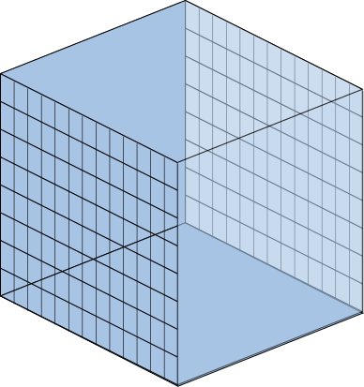
Viewing
Creating Rays
Step 1:
Our journey starts in Normalised Device Coordinates:
Our viewing volume is a cube, from -1 to +1 in each dimension
NDC space is left-handed (a projection matrix converts from right to left handed)
Far Plane
(z = 1)
Near Plane
(z = -1)

Slide 7
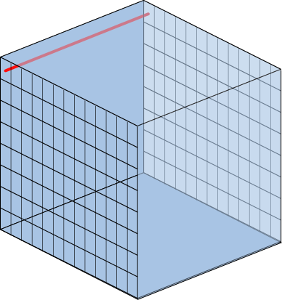
Viewing
Creating Rays
Step 1:
We start in Normalised Device Coordinates:
Our viewing volume is a cube, from -1 to +1 in each dimension
NDC are left-handed (a projection converts from right to left handed)
Generate coordinates for the start and end points of the ray
These go from the near plane (z = -1) to the far plane (z = +1)
Pixel coords (0,0)
Far Plane
(z = 1)
Near Plane
(z = -1)
Pixel coords (640,480)

Slide 8
Viewing
Creating Rays
Step 1:
Pixel coords (0,0) map to NDC (-1,1,1) on far plane
Pixel coords (0,0) map to NDC (-1,1,-1) on near plane
Far Plane
(z = 1)
Near Plane
(z = -1)

Slide 9
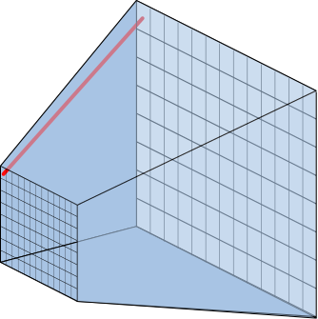
Viewing
Creating Rays
Step 2:
Convert to Eye Space:
Multiply coordinates by inverse projection matrix
This is like distorting the cube into the correct perspective volume
Far Plane
Near Plane

Slide 10
Viewing
Creating Rays
Step 3:
Convert from Left-Handed to Right-Handed coordinate system:
Multiplying by projection matrix gives non-zero w values
Need to divide coordinates by w
Far Plane
(z = -ve)
Near Plane
(z = +ve)

Slide 11
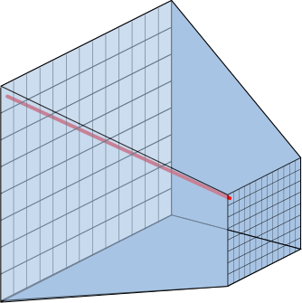
Viewing
Creating Rays
Step 4:
Convert from Eye Space to World Space:
Takes into account camera’s position in the world
Need to multiply coordinates by inverse view matrix

Slide 12
Viewing
Creating Rays
You should then have two coordinates in world space
Use these to define your ray
This is what you return from your function ☺
Note: we will define our sphere objects in world-space to make life easy. If you define other objects and you wish to move them, you will need to multiply any object coordinates defined in a local space by the object’s model matrix to get them into world space

