Slide 1
CGG Ray Tracer – part 5
Dr Leigh McLoughlin
lmcloughlin@bournemouth.ac.uk

Slide 2
Lab Introduction
Tasks Today
Ray Casting: what to do when a ray hits an object
Writing the tracer’s ‘trace’ function

Slide 3
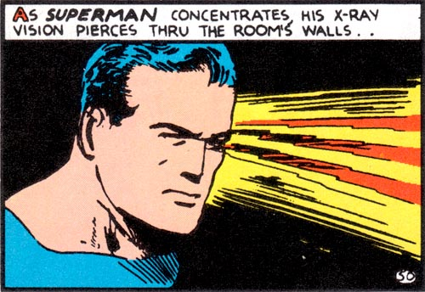
Introduction to Rendering
Ray-Casting

Slide 4
Lab Introduction
Introduction
Recall your ray tracer class
This should have one function to trace a ray:
This function takes a ray
It returns a colour
Today we will fill in this function
We will need to use the geometry functions from previous weeks

Slide 5
Lab Introduction
Scene Definition
The idea is that the ray tracer’s tracing function will test the incoming ray against all objects in our scene
What is a ‘scene’?
We can use a list of objects in the ray tracer class for now

Slide 6
Ray Tracing Function
What your function needs to do:
Find the first object the ray hits
Go through every object in the scene
Call your ray-sphere intersection function
If it hits the object, record the distance from the ray’s origin to the intersection point
The object with the shortest distance is the one we want
If the ray hits an object
Call that object’s shading method (which we created in a previous lab)
Return the pixel colour
If the ray didn’t hit an object
Just return a ‘background’ colour

Slide 7
Ray Tracing Function
Results
If you created a scene with a sphere, you should get a circle showing
This is ray casting ☺

