Slide 1
CGG Ray Tracer – part 6
Dr Leigh McLoughlin
lmcloughlin@bournemouth.ac.uk

Slide 2
Lab Introduction
Tasks Today
Ray Tracing: introducing shading
Writing the object’s shade function

Slide 3
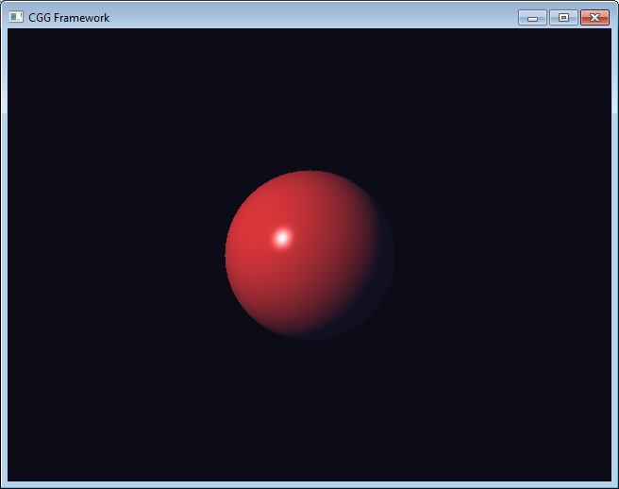
Ray Tracing
Ray Tracing: Shading
Last week we got ray casting working
This time we will add shading!

Slide 4
Ray Tracing
Remember these functions?
You need three geometry functions:
One to get the closest point on a line
Takes a ray, a 3d query point, returns a 3d point
Ray-sphere intersection
Takes a ray, sphere centre and radius, returns whether it hit or not and distance to hit (use a structure or class to combine these if you wish)
One to get the normal of a sphere
Takes a sphere centre and 3d sample point, returns a 3d direction vector

Slide 5
Ray Tracing
Remember these functions?
You need three geometry functions:
One to get the closest point on a line
Takes a ray, a 3d query point, returns a 3d point
Ray-sphere intersection
Takes a ray, sphere centre and radius, returns whether it hit or not and distance to hit (use a structure or class to combine these if you wish)
One to get the normal of a sphere
Takes a sphere centre and 3d sample point, returns a 3d direction vector

Slide 6
Ray Tracing
Surface Normal
For lighting calculations we will need the surface normal
The intersection point is at the surface of the sphere
See if you can figure out how to generate the surface normal at the intersection point

Slide 7
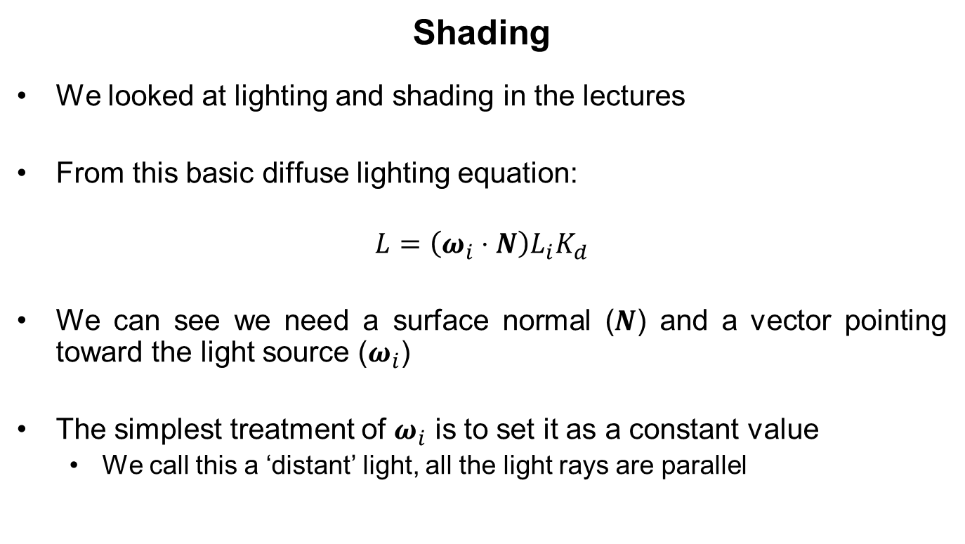
Ray Tracing
Shading
We looked at lighting and shading in the lectures
From this basic diffuse lighting equation:
$$L=\left(ω_{i}⋅N\right)L_{i}K_{d}$$
We can see we need a surface normal ($N$) and a vector pointing toward the light source ($ω_{i}$)
The simplest treatment of $ω_{i}$ is to set it as a constant value
We call this a ‘distant’ light, all the light rays are parallel

Slide 8
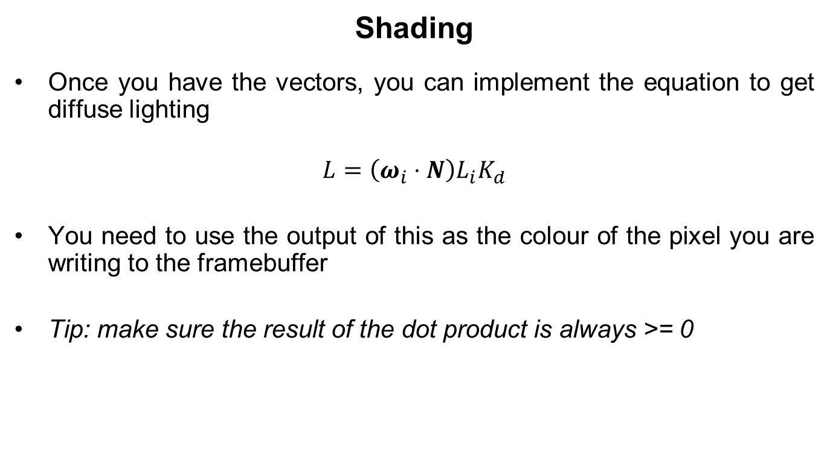
Ray Tracing
Shading
Once you have the vectors, you can implement the equation to get diffuse lighting
$$L=\left(ω_{i}⋅N\right)L_{i}K_{d}$$
You need to use the output of this as the colour of the pixel you are writing to the framebuffer
Tip: make sure the result of the dot product is always >= 0

Slide 9
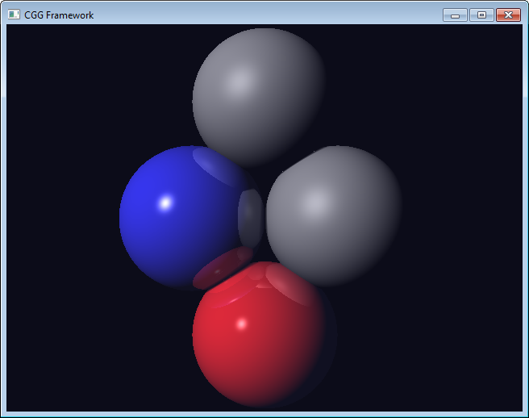
Ray Tracing
Further Directions
Here are some ideas for you to implement next:
Specular shading
Different light types (e.g. point, spot)
Multiple lights
Multiple objects
Reflections

