Slide 1
CGG Raytracer Overview
Dr Leigh McLoughlin
lmcloughlin@bournemouth.ac.uk

Slide 2
Introduction
Overview of How to Build a Ray Tracer
General concept:
We have a framebuffer that represents every pixel on the screen
We have a virtual camera and virtual objects
For every pixel in the framebuffer, we shoot a ray from the camera into the scene
Where this ray hits an object, we work out the colour
We store this as the pixel’s colour in the framebuffer

Slide 3
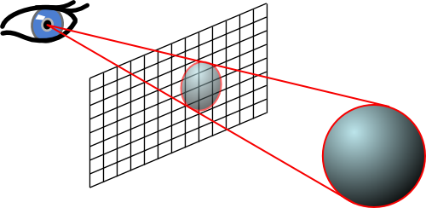
Introduction to Rendering
Creating Rays
Let’s outline two methods
First is simple, rough and ready
Second is more correct / complete

Slide 4
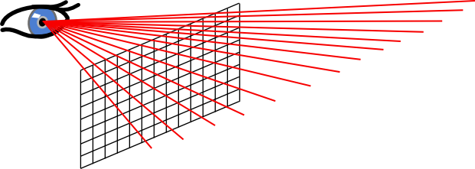
Introduction to Rendering
Creating Rays: Simple Method
Imagine there is a rectangular plane at a fixed distance in front of your camera. This is your framebuffer
Generate rays from the camera position through each pixel
Shoot these into the scene
You can make the camera be at the world origin and define all object positions relative to this

Slide 5
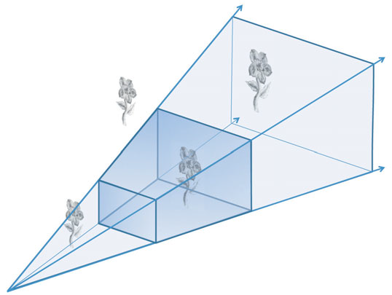
Introduction to Rendering
Creating Rays: Complex (More Complete) Method
Overview:
Define a viewing volume (based on aspect ratio of framebuffer)
Generate rays from the near plane to the far plane

Slide 6
Introduction to Rendering
Creating Rays: Complex (More Complete) Method
We need matrices for each of the following:
The camera’s projection (projection matrix)
The camera’s position relative to the world origin (viewing matrix)
Each object’s position relative to the world origin (model matrix)
Remember that each matrix transforms from one space to another
(This approach is essentially working backwards through the standard method used by OpenGL to render real-time graphics)

Slide 7
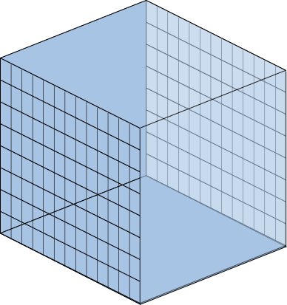
Introduction to Rendering
Creating Rays: Complex (More Complete) Method
Step 1:
We start in Normalised Device Coordinates:
Our viewing volume is a cube, from -1 to +1 in each dimension
NDC space is left-handed (a projection matrix converts from right to left handed)
Far Plane
(z = 1)
Near Plane
(z = -1)

Slide 8
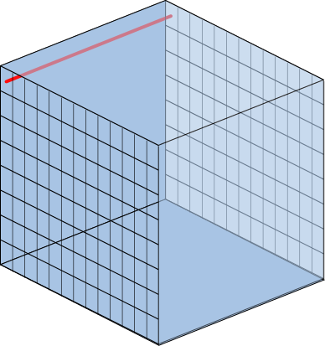
Introduction to Rendering
Creating Rays: Complex (More Complete) Method
Step 1:
We start in Normalised Device Coordinates:
Our viewing volume is a cube, from -1 to +1 in each dimension
NDC are left-handed (a projection converts from right to left handed)
Generate coordinates for the start and end points of each ray
These go from the near plane (z = -1) to the far plane (z = +1)
Far Plane
(z = 1)
Near Plane
(z = -1)

Slide 9
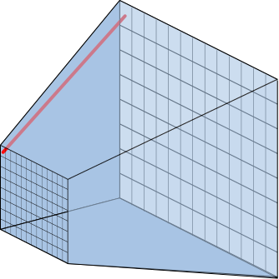
Introduction to Rendering
Creating Rays: Complex (More Complete) Method
Step 2:
Convert to Eye Space:
Multiply coordinates by inverse projection matrix
This is like distorting the cube into the correct perspective volume
Far Plane
Near Plane

Slide 10
Introduction to Rendering
Creating Rays: Complex (More Complete) Method
Step 3:
Convert from Left-Handed to Right-Handed coordinate system:
Multiplying by projection matrix gives non-zero w values
Need to divide coordinates by w
Far Plane
(z = -ve)
Near Plane
(z = +ve)

Slide 11
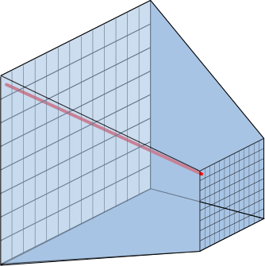
Introduction to Rendering
Creating Rays: Complex (More Complete) Method
Step 4:
Convert from Eye Space to World Space:
Takes into account camera’s position in the world
Need to multiply coordinates by inverse view matrix

Slide 12
Introduction to Rendering
Creating Rays: Complex (More Complete) Method
You should then have two coordinates in world space
Use these to define your ray
Next step is to check if the ray intersects with any objects
Need to multiply any object coordinates defined in a local space by the object’s model matrix to get them into world space

Slide 13
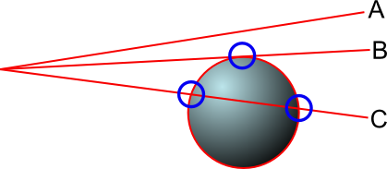
Ray-Sphere Intersection
Closest Intersection Point
We looked at ray-sphere intersections in the lecture
Remember that we have three situations
A: no hit
B: one intersection
C: two intersections – need to find the closest

Slide 14
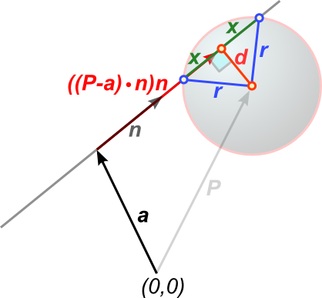

Ray-Sphere Intersection
Closest Intersection Point
Look back at Lecture 9 (Intersections) for the maths
First intersection should be:
$a+\left(\left(\left(P−a\right)⋅n\right)−x\right)n$
Where: $x=\sqrt{{r^{2}−d}^{2}}$
And:
$d=\left\|P−a−\left(\left(P−a\right)⋅n\right)n\right\|$

Slide 15
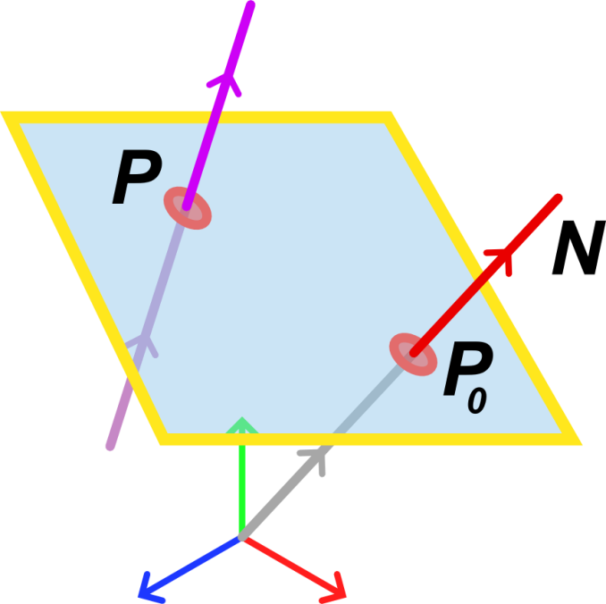
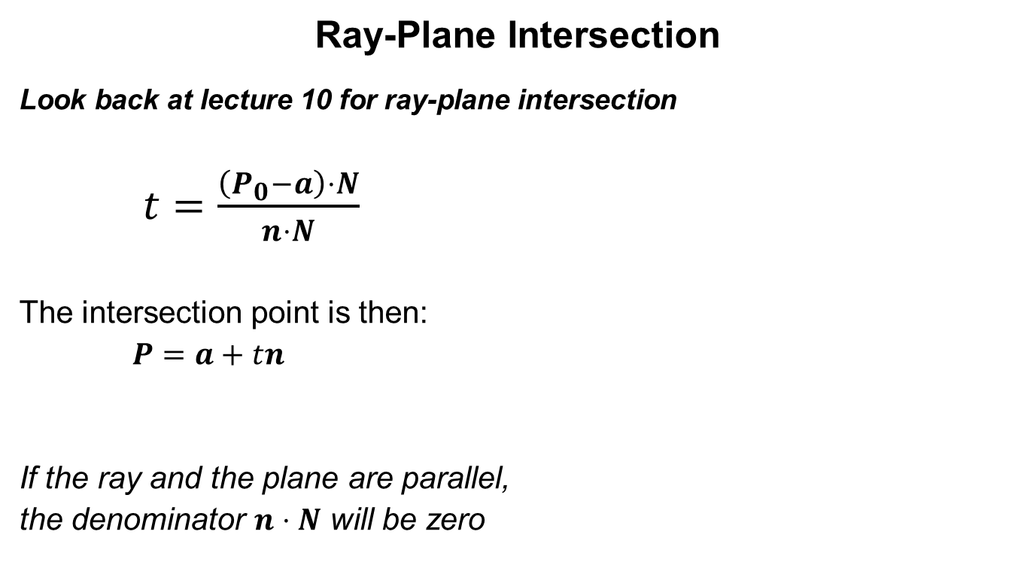
Ray-Plane Intersection
Ray-Plane Intersection
Look back at lecture 10 for ray-plane intersection
$t=\frac{\left(P_{0}−a\right)⋅N}{n⋅N}$
The intersection point is then:
$P=a+tn$
If the ray and the plane are parallel,
the denominator $n⋅N$ will be zero

Slide 16
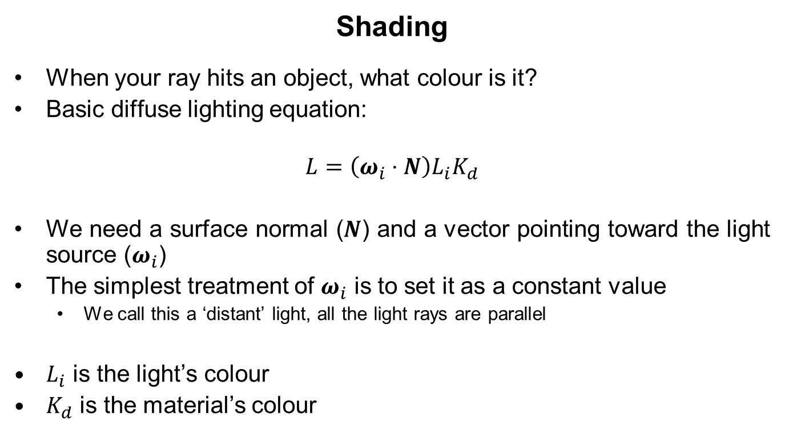
Shading
Shading
When your ray hits an object, what colour is it?
Basic diffuse lighting equation:
$$L=\left(ω_{i}⋅N\right)L_{i}K_{d}$$
We need a surface normal ($N$) and a vector pointing toward the light source ($ω_{i}$)
The simplest treatment of $ω_{i}$ is to set it as a constant value
We call this a ‘distant’ light, all the light rays are parallel
$L_{i}$ is the light’s colour
$K_{d}$ is the material’s colour

