Slide 1

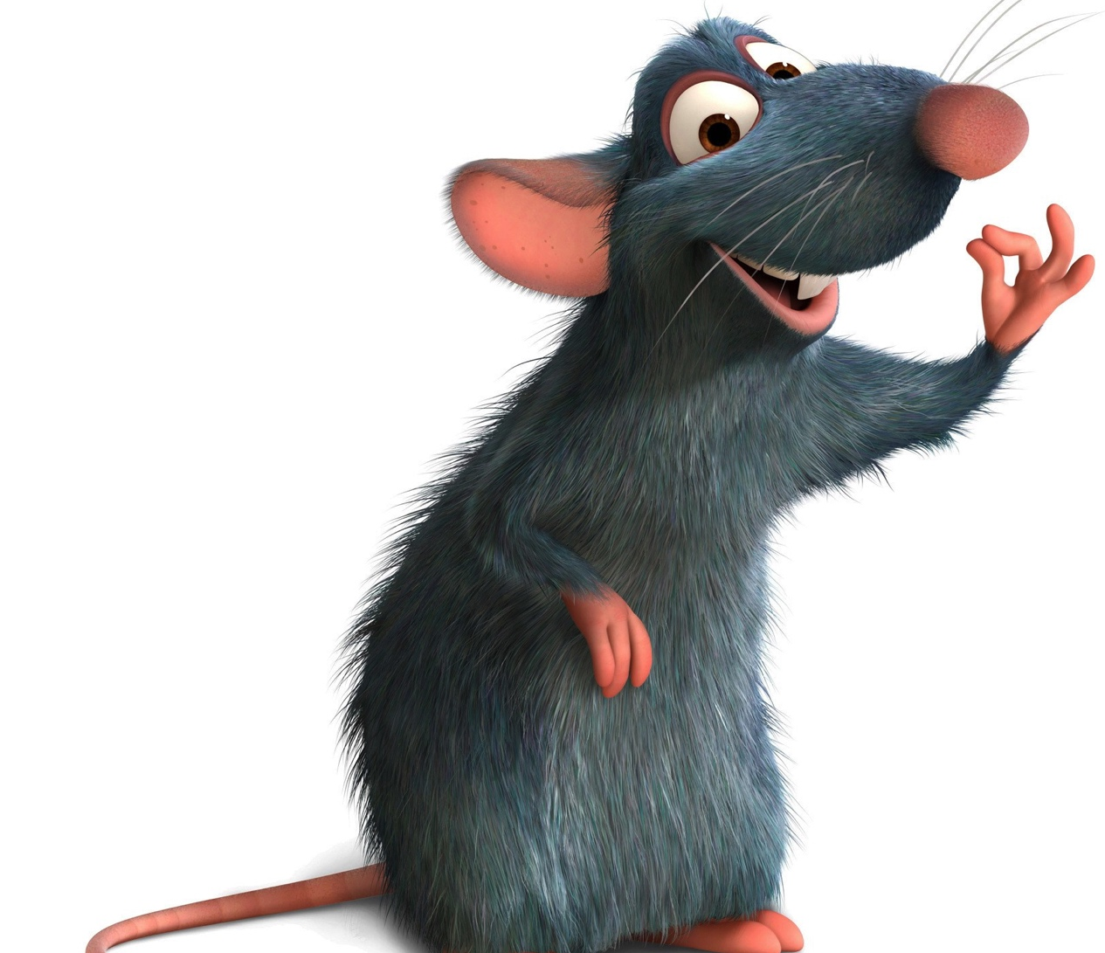
Splat the Rat
Jake Willis Fleming

Slide 2
Structure
Welcome
A few obligatory Puns
Motivations
Preparation
Technical Demonstration
Wins & Tribulations

Slide 3

A few obligatory puns
Rat here, rat now
Ruckus in the Metropolis

Slide 4
Reasons for Killing Rats

Slide 5
Reasons for Killing Rats

Slide 6
Reasons for Killing Rats

Slide 7
Reasons for Killing Rats

Slide 8
Reasons for Killing Rats

Slide 9
Reasons for Killing Rats

