Slide 1

Intro to hypothesis
testing
Statistics
Prof. Anne Roudaut
csxar@bristol.ac.uk

Slide 2
In this deck
Intuition behind hypothesis testing
How stats are used in hypothesis testing
Overview of the different statistical tests
Overview of how to design an experiment

Slide 3
Intuition for hypothesis testing

Slide 4
you own a magic pair of shoes. You have run the 10 meters with it a lot and you have a long log of the time you have run with it.
one day, you come home and it seems like someone has moved your shoes. You get concerned that someone might have taken your (beloved) shoes and instead replaced it with identical looking shoes.
you inspect the shoes long and hard and they look the same. But still worried. How do you verify that they are the same?
<30 sec brainstorming>

Slide 5
let’s start with a contrived example…

Slide 6
ok, so you run the 10 meters with the “questionable” shoes a bunch of times.
here is what you see…

Slide 7
2.5-3s 3-3.5s 3.5-4s 4-4.5s 4.5-5s 5-5.5s
2.5-3s 3-3.5s 3.5-4s 4-4.5s 4.5-5s 5-5.5s
your shoes
questionable shoes

Slide 8
[ ] this is still the original shoes
[ ] someone has replaced my shoes
[ ] could be the original or replacement shoes
your shoes
questionable shoes
x
<let’s vote>

Slide 9
the distribution looks different from the shoes you know
while it is possible that it is the same shoes, it seems somewhat unlikely
your die
questionable die

Slide 10
ok, let’s run some more…
2.5-3s 3-3.5s 3.5-4s 4-4.5s 4.5-5s 5-5.5s
2.5-3s 3-3.5s 3.5-4s 4-4.5s 4.5-5s 5-5.5s
your shoes
questionable shoes

Slide 11
[ ] this is probably still the original shoes
[ ] someone probably has replaced my shoes
[ ] could be the original or replacement shoes
your shoes
questionable shoes
x
x
<let’s vote>

Slide 12
again, the distribution could have happened by chance, but it seems even more unlikely. This is probably not your shoes
your shoes
questionable shoes

Slide 13
again, the distribution could have happened by chance, but it seems even more unlikely. This is probably not your shoes
your shoes
questionable shoes
are you sure this it is not your shoes?

Slide 14
you are not sure.
what can you do to be sure?

Slide 15
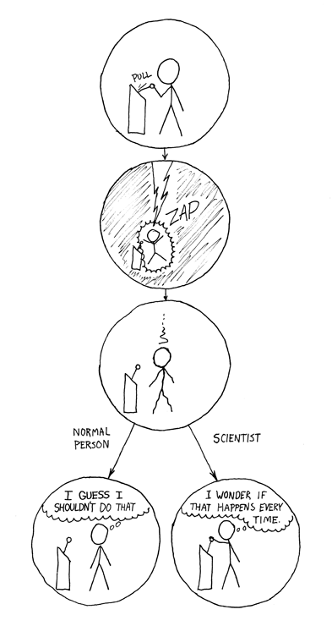
there is nothing you can do, you can never be sure
it is a limitation of science:
no matter how often you pull the lever, it could always be chance

Slide 16
the good news:
the more sample (# of runs), the more your confidence increases
→ you can be arbitrarily sure

Slide 17
let’s do another round

Slide 18
ok, you get your original shoes back
a week later the same thing happens again. again, you run 10 meters a few times with the questionable shoes …

Slide 19
2.5-3s 3-3.5s 3.5-4s 4-4.5s 4.5-5s 5-5.5s
2.5-3s 3-3.5s 3.5-4s 4-4.5s 4.5-5s 5-5.5s
your shoes
questionable shoes

Slide 20
[ ] this is still the original shoes
[ ] someone has replaced my shoes
[ ] could be the original or replacement shoes
your shoes
questionable shoes
<let’s vote>

Slide 21
[ ] this is still the original shoes
[ ] someone has replaced my shoes
[x] could be the original or replacement shoes
your shoes
questionable shoes

Slide 22
it could be your original shoes, or one that just happens to behave the same. a very, very, good copy maybe.
your shoes
questionable shoes

Slide 23
what are the odds of this being a different shoes?
your shoes
questionable shoes

Slide 24
you cannot compute the odds.
that’s strange! why not?

Slide 25
in both cases, there are two explanations
same shoes
different shoes
your shoes
questionable shoes
this seems unlikely…
…thus this must be true
…now, in the other case

Slide 26
in both cases, there are two explanations
same shoes
different shoes
your shoes
questionable shoes
this does seem not unlikely…
we still have two possible explanations
→ we cannot conclude anything
no thus
…thus…

Slide 27
let’s use stats

Slide 28
statistical significance ::
a result is called statistically significant if it is unlikely to have occurred by chance

Slide 29
significance level ::
If a statistical test of significance gives a p-value lower than the significance level, such results are informally referred to as 'statistically significant’.
Popular levels of significance are 10% (0.1), 5% (0.05), 1% (0.01), 0.5% (0.005), and 0.1% (0.001).

Slide 30
i.e., oddly, when we want to prove that they are different, we ask whether they are the same…

Slide 31
2.5-3s 3-3.5s 3.5-4s 4-4.5s 4.5-5s 5-5.5s
vs
2.5-3s 3-3.5s 3.5-4s 4-4.5s 4.5-5s 5-5.5s
null hypothesis: both data sets are from same mechanism

Slide 32
we are running stats in the hope that we will be able to reject the null hypothesis (and we can reject it if our p-value is below our significance level, e.g. 0.05)

Slide 33
→ if comparison of two groups reveals no statistically significant difference between the two, it does not mean that there is no difference in reality.
It only means that there is not enough evidence to reject the null hypothesis (it fails to reject the null hypothesis).

Slide 34
in both cases, there are two explanations
same shoes
different shoes
your shoes
questionable shoes
this seems unlikely…
…thus this must be true
…now, in the other case

Slide 35
in both cases, there are two explanations
same shoes
different shoes
your shoes
questionable shoes
this does seem not unlikely…
we still have two possible explanations
→ we cannot conclude anything
no thus
…thus…

Slide 36
so how do you prove that two mechanisms are the same?

Slide 37
in both cases, there are two explanations
same shoes
different shoes
your shoes
questionable shoes
this does seem not unlikely…
no thus
…thus…
you cannot

Slide 38
how to report non-significant results:
“our test did not find a significant difference”

Slide 39
Is it that easy?

Slide 40
Yes and no.
It turns out not all data works with the same tests because certain conditions must be met.

Slide 41
scale independent variable
What type of data?
categorical independent variable
Is it normal?
scale dependent variable
categorical dependent variable
scale dependent variable
categorical dependent variable
>50
Komogorov-smirnov
<50
Shapiro-wilks
regressions
logistic
regressions
normally distributed
skewed
2 grp
>2 grp
2 grp
>2 grp
2 grp
>2 grp
Non paired
paired
Non paired
paired
Non paired
paired
Non paired
paired
Counts >= 5 in >= 75% cells
Counts >= 5 in < 75% cells
T-test
ANOVA
Mann-Whitney Utest
Wilcoxon signed rank test
Kruskall-Wallis test
Chi-square test
Fisher’s exact test
Chi-square test
Paired-t-test
Friiedman test
McNemar’s test
Levens test for homogenity
Bonferoni correction: if testing n hypothesis test against 0.05/n

Slide 42
and arguably running the test is the easy bit … the hardest things is to plan your experiment
this is what we call experimental design

Slide 43
1
5
research question / hypothesis?
look at raw data
2
6
in(dependant) variables?
look at distributions
3a
within or between subjects?
7a
check for normality
3b
counterbalancing?
7b
run some stats
4
8
how many repetitions/trials?
conclude

Slide 44
The goal of this statistic part is to teach you how to design an experiment and to figure out which statistical tests to use and use it
The exam won’t ask you to do any of those tests by hand

Slide 45
end

