Slide 1
HTML AND CSS

Slide 2
HyperText Markup Language (HTML)
The notation used to describe web pages
We will have different start tags and end tags
Tags enclosed in angle brackets <> indicate the parts of the web page
In the 90's web browsers interpreted HTML pretty differently
Much much much more consistent these days

Slide 3
Example
<!DOCTYPE html>
<html>
<h1>Welcome!</h1>
<p>I am ….</p>
</html>

Slide 4
Activity
Open up any text editor on your computer.
Create a new HTML file example.html and add content from above example.
Open the html file in a browser of your choice by right click -> open with

Slide 5
HTML is so easy
It’s really easy right..
HTML is easy to get started, However mastering it requires a lot of practice.

Slide 6
What happened?
Browser will take your HTML document and parse tags in it to elements.
You can look these parsed elements in your Browser.
Open the example.html in your browser
Open the developer tools by right-click->inspect
These developer tools are really great!

Slide 7
HTML pointers
HTML documents are required to start with a document type declaration.
The original purpose of the doctype was to enable parsing and validation of HTML documents by SGML tools based on the Document Type Definition.
In HTML4, we required DTD and document type declaration is as follows
<!DOCTYPE HTML PUBLIC "-//W3C//DTD HTML 4.01//EN" "https://www.w3.org/TR/html4/strict.dtd">

Slide 8
What is SGML and DTD?
HTML5 does not define a DTD; therefore, in HTML5 the doctype declaration is simpler and shorter. (We are currently in version 5)
<!DOCTYPE html>
SGML(Standard Generalized Markup Language): A standard for defining markup languages( Put simply, some rules how a document should be).
DTD (Document type definition): DTD defines these markup languages’ declarations.

Slide 9
HTML pointers
Default characteristics for every item of HTML markup are defined in the browser, and these characteristics can be altered or enhanced by the web page designer's additional use of CSS.
Not case sensitive (<!DOCTYPE html> is case-insensitive)
Most of the time you must include "end tags"
Use indentation and blank lines to enhance readability, like any programming language

Slide 10
Not sure about title
Great!
We have created our first web page!
Let’s show this to the world!
Let’s put it in THE WEB!

Slide 11
Publishing HTML on a server
Install & start Filezilla Client https://filezilla-project.org/
Log into flip.engr.oregonstate.edu port 22
On right side, go into public_html folder
Drag your ”example.html" to the remote folder
View your page (e.g., http://web.engr.oregonstate.edu/~shaikj/jaki)
Mac - scp ./example.html <ONID>@flip.engr.oregonstate.edu:~/public_html/
http://web.engr.oregonstate.edu/~<onid>/example.html

Slide 12
Activity
Publish your first web page

Slide 13
Some common tags
<h1>REALLY big text</h1>
<h2>Big text</h2>
<h3>Kind of big text</h3>
<em>emphasis</em>
<p>paragraph</p>
<div>a division, like a paragraph but usually without spacing around it</div>
<span>a span, ie a part of a division</span>

Slide 14
Making lists of stuff
<ul>
<li>item A</li>
<li>item B</li>
<li>item C</li>
</ul>
<ol>
<li>item one</li>
<li>item two</li>
<li>item three</li>
</ol>

Slide 15
Laying out tables
<table>
<tr><td>row 1, col 1</td>
<td>row 1, col 2</td></tr>
<tr><td>row 2, col 1</td>
<td>row 2, col 2</td></tr>
<tr><td colspan="2">row 3, cols 1-2</td>
</tr>
</table>
There's also a th you can use instead of td if the cell is basically a header. Read more online if you like at W3 Schools.

Slide 16
Hyperlinks
Links (or hyperlink, or Web link), the basic hypertext construct. The key feature which separates HTML (HypertextTML) from other conventional markup languages.
Linking a page to other content in a different location (within the same site or elsewhere on the internet) is fundamental.
The default behavior associated with a link is the retrieval of another Web resource.

Slide 17
Hyperlinks
A link has two ends -- called anchors -- and a direction.
The link starts at the "source" anchor and points to the "destination" anchor, which may be any Web resource (e.g., an image, a video clip, a sound bite, a program, an HTML document, an element within an HTML document, etc.).
We use an anchor tag <a> to link to another place. The href attribute tells the browser where to link to: <a href="https://www.google.com">Here’s a link to Google</a>

Slide 18
Navigating within same page.
We can have bookmarks with in a webpage
<!DOCTYPE html>
<html>
<body>
<p><a href="#js">Go to Javascript</a></p>
<h2 id=”js”>Javascript</h2>

Slide 19
Navigating to other page in your directory
<!DOCTYPE html>
<html>
<body>
<a>Contact</a>
<a href=”./otherfile.html">Coursework</a>
<a href="#news">Projects</a>
</body>
</html>

Slide 20
Creating a navbar
Just put all the the anchor tags in one div block, you will get a plain HTML nav bar with out any styles.
<!DOCTYPE html>
<html>
<body>
<div>
<a class="active" href="#home">Contact</a>
<a href=” other_page_in_your_directory.html">Coursework</a>
<a href="#news">Projects</a>
<a class="name" href=”other_page_in_your_directory.html">Your name</a>
</div>
</body>
</html>

Slide 21
Navigation-External website
Provide the URL to which you want to redirect.
<a href="https://www.google.com">Here’s a link to Google</a>

Slide 22
Navigation-conclusion
By specifying one extra attribute ”target”, We can specify where to open our new page.
Eg: <a href=https://www.google.com target=“_blank”>Here’s a link to Google</a>

Slide 23
Inserting images
<img src="myimage1.jpg">
<img src="subfolder/anotherimage.gif">
Images can be in folders.
Widely-supported image formats
gif (good for logos)
jpg (good for photos)
png (general-purpose)

Slide 24
Inserting other pages (IFRAME)
Blah blah blah
<iframe src="otherpage.htm"></iframe>
bottom of my page

Slide 25
Inserting videos
<video width="400" height="300" controls>
<source src="http://blahblah.com/videofile.mp4"
type='video/mp4; codecs="avc1.42E01E, mp4a.40.2"'>
<source src="http://blahblah.com/videofile.ogv"
type='video/ogg; codecs="theora, vorbis"'>
</video>
This is the standard HTML version 5 way of inserting videos. Older browsers do not support this tag, FYI. You need to create both mp4 and ogv formats to insert videos this way.

Slide 26
FYI about videos
A video file is like a zip file or a package file
It essentially has several streams or files "inside" it
Some of the streams are for video, others for audio
Each of these is encoded and/or compressed
The encoding/compression algorithm is called a codec
There are lots of possible codecs
Your browser reads, decodes, expands, plays all of these streams in parallel
Assuming the codecs are installed on your computer and properly configured for your browser!

Slide 27
Much simpler approach
Post the video to YouTube or Vimeo
Let their server figure out how to convert
Use "share" and "embed" to get HTML
These instructions may not sound sophisticated, but they will enable you to "keep up with the times" as new standards come along!

Slide 28
Example of HTML to embed video
<iframe width="420" height="315" src="http://www.youtube.com/embed/YwlVgpXXJS0" frameborder="0" allowfullscreen></iframe>
Basically, you're putting a little YouTube page inside your own.
Note: You have to put /embed before the hash of the video.
You might not be able to play some times because of domain restrictions.

Slide 29
The Document Object Model (DOM)
The Document Object Model, or DOM, is a representation of an entire HTML page as a tree structure. It is also an API for interacting with that HTML page.
The DOM is the representation of HTML stored in memory after parsing.

Slide 30
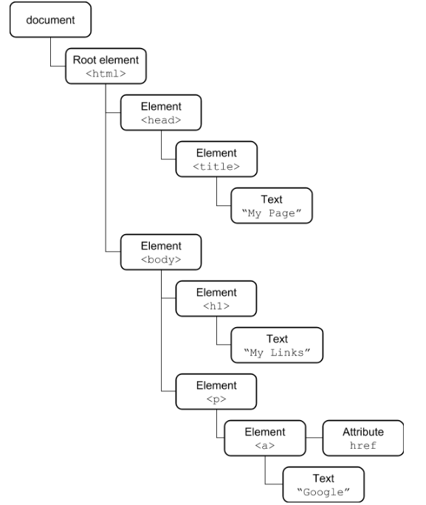
The Document Object Model (DOM)
Here is one sample HTML and its DOM.
<html> <head> <title>My Page</title> </head> <body> <h1>My Links</h1> <p> <a href=”http://google.com”>Google</a> </p> </body> </html>

Slide 31
HEAD versus BODY
Sometimes you want to put invisible stuff on the page that gets loaded before the visible stuff
Examples: style information, scripts, etc
This goes in the HEAD
Everything else goes in the BODY

Slide 32
HEAD vs BODY example
<html><head><title>My page title</title>
</head><body>
<h1>Visible content starts here</h1>
And <em>fine</em> content it is, too!
</body></html>

Slide 33
Activity
Post a web page that has the following:
A <head> containing a <title> with your name
A <body> containing a <main> containing a <p> containing one sentence describing what you want to do after you graduate

Slide 34
Handy tags for organizing content
<main>…</main> for your main content
Usually contains some sections
<section>…</section> for a section
Omit if there's really just one section
Usually contains several <p> or <div> tags, maybe a low-level heading such as <h3>
<nav>…</nav> for navigation
Usually contains a list of links

Slide 35
Cascading Style Sheets (CSS)
So named because CSS gives your web pages some style!
Cascading because style rules override each other
Great tool for making web-pages more usable.

Slide 36
Simple example of CSS
<table>
<tr><td>text in black and</td></tr>
<tr><td style="color:#0000FF">blue</td></tr>
</table>

Slide 37
Changing the colors
Colors are (usually) written as six hexadecimal digits indicating the amount of red, the amount of green, and the amount of blue (on a scale of 0 through 255, or 00 through FF).
So #FFA030 would mean:
Maximum red (FF)
A fair amount of green (A0)
A dash of blue (30)
The result is an orange color.

Slide 38
Changing background colors
Text in black and
<span style="color:#0000FF;background-color:#FFa030">blue</span>
<div style="background-color:#ff0000">for comparison</div>
You can set lots of style attributes; just separate them with semicolons. Notice how the div tag is a block all the way across from left to right.

Slide 39
Changing the font
Ugly old-school newspaper font
<span style="font-family:sans-serif">vs more web-friendly sans-serif font</span>
Set the font family to sans-serif to get rid of that horribly ugly font (usually Times Roman) in most browsers.
"Serifs" are those little curly cues on the letters of Times New Roman. They are supposed to help people read large amounts of text. Most web pages use sans-serif fonts.

Slide 40
Bolding text, controlling size
<div style="font-family:sans-serif; font-weight:bold; font-size: 16pt">Big 'n bold</div>
These days, most reputable web developers prefer CSS "font-weight:bold" instead of <b>.Tags like <b>, <strong> are used to show the importance of a word in a sentence.

Slide 41
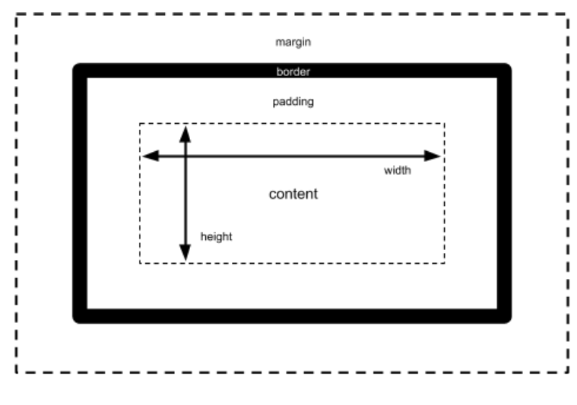
The box model
Every element in an HTML document is structured as a many-layered box:

Slide 42
Changing the border
<div style="border: 2px solid #00FF00">Text with a border</div>
You can draw a border around elements, also. Experiment. See what happens when you change "2px" to "5px". Then see what happens if you change your 5px border from "solid" to "inset" or "outset".
Tip: You can edit the HTML in the browser. Right-click->inspect->right-click on Elements->Edit as HTML

Slide 43
Changing the padding
<div style="border: 2px solid #00FF00; padding: 20px 10px 5px 0px">Text with a border</div>
This pads 20px of space above the text but inside the border, 10px of space to the right inside the border, 5px of space below the text inside the border, and 0px of space to the left.

Slide 44
Changing the margins
<div style="border: 2px solid #00FF00; margin: 20px 10px 5px 0px">Text with a border</div>
This adds 20px of space above the text and outside the border, 10px of space to the right outside the border, 5px of space below the text outside the border, and 0px of space to the left.
(Margin does not work well with span. Span is not a block. It's just a little region of text.)

Slide 45
You can style just about any tag
<table style="border: 1px solid black; background-color:#ffffaa">
<tr><td style="font-weight:bold">Name</td>
<td style="font-weight:bold">Children</td></tr>
<tr><td>Eddie</td><td><ul>
<li style="color:#808080">Alice</li>
<li style="color:#808080">Bob</li>
</ul></td></tr>
<tr><td>Esteban</td><td><ul>
<li style="color:#808080">Carmen</li>
<li style="color:#808080">Daniela</li>
</tr>
</table>

Slide 46
That gets wordy if we have many rows
You can assign a certain style to many elements all at the same time.
Just give them a "class" attribute
And create a <style> tag telling what style to apply to elements of that class
<style>.myclassname {color:#f03366;font-family:Arial}</style>

Slide 47
No need to repeatedly type font-weight: bold and color:#808080
<style>
.hdr { font-weight: bold; }
.kid { color: #808080; }
</style>
<table style="border: 1px solid black; background-color:#ffffaa">
<tr><td class="hdr">Name</td>
<td class="hdr">Children</td></tr>
<tr><td>Eddie</td><td><ul>
<li class="kid">Alice</li>
<li class="kid">Bob</li>
</ul></td></tr>
<tr><td>Esteban</td><td><ul>
<li class="kid">Carmen</li>
<li class="kid">Daniela</li>
</tr>
</table>

Slide 48
Or you can select based on tag name
<style>
table {border: 1px solid black; background-color:#ffffaa;}
th { font-weight: bold; }
li { color: #808080; }
</style>
<table>
<tr><th>Name</th> <th>Children</th></tr>
<tr><td>Eddie</td><td><ul>
<li>Alice</li>
<li>Bob</li>
</ul></td></tr>
<tr><td>Esteban</td><td><ul>
<li>Carmen</li>
<li>Daniela</li>
</tr>
</table>

Slide 49
You can modify a few selected tags at once
<style>
body, th, td, li { font-family: sans-serif }
table {border: 1px solid black; background-color:#ffffaa;}
th { font-weight: bold; }
li { color: #808080; }
</style>
<table>
<tr><th>Name</th> <th>Children</th></tr>
<tr><td>Eddie</td><td><ul>
<li>Alice</li>
<li>Bob</li>
</ul></td></tr>
<tr><td>Esteban</td><td><ul>
<li>Carmen</li>
<li>Daniela</li>
</tr>
</table>

Slide 50
You can select tags based on nesting
<style>
body, th, td, li { font-family: sans-serif }
table {border: 1px solid black; background-color:#ffffaa;}
th { font-weight: bold; }
table tr li { color: #808080; }
</style>
<table>
<tr><th>Name</th> <th>Children</th></tr>
<tr><td>Eddie</td><td><ul>
<li>Alice</li>
<li>Bob</li>
</ul></td></tr>
<tr><td>Esteban</td><td><ul>
<li>Carmen</li>
<li>Daniela</li>
</tr>
</table>

Slide 51
ID Selectors
You can also apply an id attribute to any HTML element and then use it in CSS selectors.
The id value is used in a selector by prepending a #.
Here’s an example of an id being used to style an element: <div id="main-content"> ... </div> #main-content { margin: 20px; }

Slide 52
Combinators
There are few different ways where we can combine elements to apply style:
AB – any element matching both A and B at the same time, e.g.:
p.user-address
A B – any element matching B that is a descendent of an element matching A, e.g.:
p em
A > B – any element matching B that is a direct child of an element matching A, e.g.:
ul > li
A + B – any element matching B that is the next sibling of an element matching A, e.g.:
.nav-header + .nav-item

Slide 53
You can even reuse CSS across files
body, th, td, li { font-family: sans-serif }
table {border: 1px solid black; background-color:#ffffaa;}
th { font-weight: bold; }
table tr li { color: #808080; }
#thiskidisbadnews {color: #FF0000; font-size: 16pt;}
Put this in style.css
<html>
<head>
<link rel="stylesheet" type="text/css" href="style.css">
</head>
</html>
Put this in your HTML file

Slide 54
Positioning
We can control the position of an HTML element using the CSS position property.
position lets us control the type of positioning.
The top, right, bottom, and left properties let us specify the actual position.
We refer to an element as positioned if its position property value is relative, absolute, or fixed.

Slide 55
Activity
Open up the directory where you have created navbar HTML file.
Let’s add CSS to it from the styles.css on Canvas

Slide 56
Cascading rules: very complicated
In general…
Later rules overrule earlier rules
So rules in the HTML file override rules in the <style> tags
And rules in the <style> tags override rules in the linked stylesheet file
And stylesheet files specified later in the HEAD will override those specified earlier in the HEAD
And rules associated with id override rules associated with class
And rules associated with class override rules associated with tags
And some rules (though not all) are inherited by default depending on how tags are nested inside one another
And that's not even taking into account advanced CSS rules such as media selectors and @import, which we won't cover in this course

Slide 57
Yikes!
First of all, as much as possible, keep it simple.
Try to use only a single .css file
Try to select based on tag name and class name instead of selecting based on id
Try not to put style into tags directly
Second, test your page in a browser that can explain to you how rules override each other.
Such as Google Chrome

Slide 58
Responsive layouts
Internet usage on mobiles is growing very rapidly.
More than 50% of web traffic is on mobiles worldwide.
To make our apps more usable across mobile devices we should make our apps adaptable as per the device screen.
Responsive web design is a great tool to achieve this using HTML and CSS.
https://www.statista.com/statistics/306528/share-of-mobile-internet-traffic-in-global-regions/

Slide 59
What is Responsive Web Design?
Responsive web design is to make our app respond to needs of the user and device they are using HTML and CSS.
A meta viewport tag gives the browser instructions on how to control the page's dimensions and scaling.
<meta name="viewport" content="width=device-width, initial-scale=1”>
Include width=device-width to match the screen's width in device-independent pixels.
Include initial-scale=1 to establish a 1:1 relationship between CSS pixels and device-independent pixels.

Slide 60
Responsive layouts – Media queries
A full exploration of responsive layouts is beyond the scope of this course, but one essential thing to be aware of when implementing responsive layouts is the CSS @media rule.
The @media rule allows you to apply different blocks of CSS rules when the device/viewport on which the user is viewing your site meets certain conditions.
One simple way to use @media is to apply different CSS rules at different viewport widths.

Slide 61
Media queries - Example
This set of @media rules would color the background of the header differently as the viewport was resized from 400 pixels to above 1200 pixels:
@media(max-width: 400px) { header { background-color: green; } } @media(max-width: 800px) { header { background-color: red; } } @media(max-width: 1200px) { header { background-color: blue; } }

Slide 62
Bootstrap
Bootstrap is a front-end framework to apply CSS styles ( and also some HTML, JS features)
Creates responsive web pages
Most used framework with lot of designs and templates

Slide 63
Bootstrap - Example
<link rel="stylesheet" href="https://maxcdn.bootstrapcdn.com/bootstrap/3.3.7/css/bootstrap.min.css">
Bootstrap is hosted on MaxCDN.
We just have to include the link in our HTML page.

Slide 64
Bootstrap - Jumbotron
Bootstrap has lot of templates to use. We will go through some useful ones.
Jumbtron:
A jubmbotron is used when we want a block on the page to be highlighted.
Eg. Jumbotron.html

Slide 65
Bootstrap – Navigation Bar
Commonly used template to navigate between different pages of the website.
User friendly.
We can create navigation bar with bootstrap very easily.
Can add dropdowns and invert the color of the navigation bar.

Slide 66
Bootstrap
Modal
Tooltip
Carousel
Forms
Lots of other features, Great tool!!

