Slide 1
HTTP with Node
To serve/make HTTP requests, we have a lot of libraries available in NodeJS. Some of them are below.
http
Express
Axios
Superagent

Slide 2
‘http’
The built-in http module allows Node.js to transfer data over the Hyper Text Transfer Protocol (HTTP).
To use the HTTP module, use the require() method
var http = require(‘http’);
The HTTP module can create an HTTP server that listens to server ports and gives a response back to the client.

Slide 3
‘http’ - Example
Create a new js file in your directory, add the following content.
Example:
var http = require('http'); //create a server object: http.createServer(function (req, res) { res.write('Hello World!'); //write a response to the client res.end(); //end the response }).listen(8080); //the server object listens on port 8080
Run the js file using node <file_name>.js
https://www.w3schools.com/nodejs/nodejs_http.asp

Slide 4
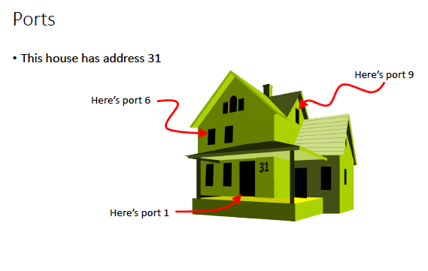
What are these ports?
OSU-CS344

Slide 5
ports
Ports are used to reach a specific process on a machine
Each process listens on a unique port - similar to a unique entrance into a house
So a complete address that can be used in a socket is an IP
address combined with a port number:
43.144.31.223:80
80 is default port number for HTTP.

Slide 6
‘http’ - Example
The function passed into the http.createServer() method, will be executed when someone tries to access the computer on port 8080
Let’s add a Header to the response

Slide 7
‘http’ example
Example:
var http = require('http'); http.createServer(function (req, res) { res.writeHead(200, {'Content-Type': 'text/html'}); res.write('Hello World!'); res.end(); }).listen(8080);
The first argument of the res.writeHead() method is the status code, 200 means that all is OK, the second argument is an object containing the response headers.

Slide 8
‘http’ - Example
Lets serve a webpage from our server
Create a sample.html file in your local directory and add some html.
Create a js file and add the following code.
var http = require('http');
var fs = require('fs');
http.createServer(function (req, res) {
fs.readFile('sample.html',function (err, data){
res.writeHead(200, {'Content-Type': 'text/html','Content-Length':data.length});
res.write(data);
res.end(); //end the response
})
}).listen(8080); //the server object listens on port 8080

Slide 9
‘http’
As you can obserce, it’s a hassle to serve with http library.
Express makes implementing web servers much more easier for us.
We will come to Express in later classes

Slide 10
Axios
Axios is one of many available libraries we use to get data from web services.
Axios is a promise based library
To use axios in our application, we have to install it as a dependency using npm.
In your directory, run ‘npm install axios’
Note: For the purpose of this example, I created one simple web-service which return cs290 course information. That may not be available later

Slide 11
Axios example
var axios = require('axios');
axios.get('http://flip1.engr.oregonstate.edu:2438/cs290info')
.then(response => {
console.log(response.data);
console.log(response.data.Course);
console.log(response.data.Credits);
console.log(response.data.location);
})
.catch(error => {
console.log(error);
});

Slide 12
Axios - example
The above example makes a http GET request to the web service hosted on flip1 at the URL 2438:/cs290info.
The API returns data in following JSON format
{ Course: 'CS290', Credits: 4, location: 'KEC1003' }
If you are succesfully able to get data from the API, then() of promise will be called and we will print the data to the console.
Else, Error will be printed out to the console.

