Slide 1
HTTP
Hypertext Transfer Protocol (HTTP) is an application layer protocol for transmitting hypermedia documents, such as HTML.
It was designed for communication between web browsers and web servers, but it can also be used for other purposes.
HTTP is a stateless protocol, meaning that the server does not keep any data (state) between two requests.

Slide 2
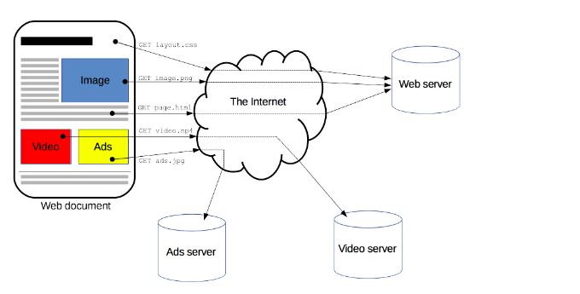
HTTP
HTTP follows a classical client-server model, with a client opening a connection to make a request, then waiting until it receives a response.
https://developer.mozilla.org/en-US/docs/Web/HTTP/Overview

Slide 3
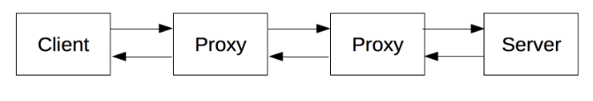
HTTP
Clients and servers communicate by exchanging individual messages (as opposed to a stream of data). The messages sent by the client, usually a Web browser, are called requests and the messages sent by the server as an answer are called responses.
A HTTP client can be anything:
Most of the time the user-agent is a Web browser, but it can be anything, for example a robot that crawls the Web to populate and maintain a search engine index.

Slide 4
Proxies
Between the Web browser and the server, numerous computers and machines relay the HTTP messages, generally called proxies.
These can be transparent, or not (changing requests going through them), and may perform numerous functions:
caching (the cache can be public or private, like the browser cache)
filtering (like an antivirus scan, parental controls, …)
load balancing (to allow multiple servers to serve the different requests)
authentication (to control access to different resources)

Slide 5
HTTP flow
Client initiates a connection
Server accepts a connection
Client sends a HTTP request
Server sends the respons (often documents like HTML forms)
Close or reuse the connection

Slide 6

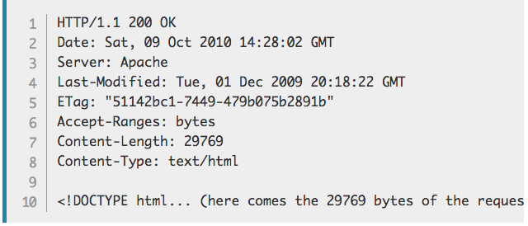
HTTP request and response
Example request and response:
Request:
Response:

Slide 7
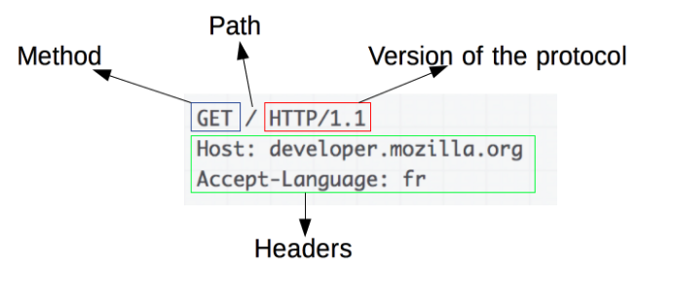
HTTP Messages

Slide 8
HTTP Messages
An HTTP method, usually a verb like GET, POST or a noun like OPTIONS or HEAD that defines the operation the client wants to perform. Typically, a client wants to fetch a resource (using GET) or post the value of an HTML form (using POST)
The path of the resource to fetch; the URL of the resource stripped from elements that are obvious from the context, for example without the protocol (http://), the domain (here developer.mozilla.org), or the TCP port (here 80).
The version of the HTTP protocol.
Optional headers that convey additional information for the servers.
Or a body, for some methods like POST, similar to those in responses, which contain the resource sent.

Slide 9
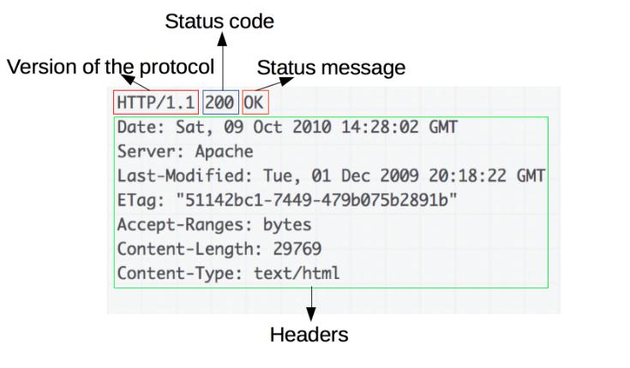
HTTP Response

Slide 10
HTTP response
Responses consist of the following elements:
The version of the HTTP protocol they follow.
A status code, indicating if the request has been successful, or not, and why.
A status message, a non-authoritative short description of the status code.
HTTP headers, like those for requests.
Optionally, a body containing the fetched resource.

Slide 11
HTTP request methods
We have different HTTP request methods that client can initiate
CONNECT
DELETE
GET
HEAD
OPTIONS
PATCH
POST
PUT
TRACE

Slide 12
HTTP methods
The HTTP GET method requests a representation of the specified resource. Requests using GET should only retrieve data.
The HTTP POST method sends data to the server. A POST request is typically sent via an HTML form and results in a change on the server.
The HTTP PUT request method creates a new resource or replaces a representation of the target resource with the request payload.
The HTTP DELETE request method deletes the specified resource.

Slide 13
HTTP response codes
The response from the server often contains a response code.
These response code indicates what happened with our request.
Eg:
200 : OK
302 : found
404 : Not found
304: Not modified

Slide 14
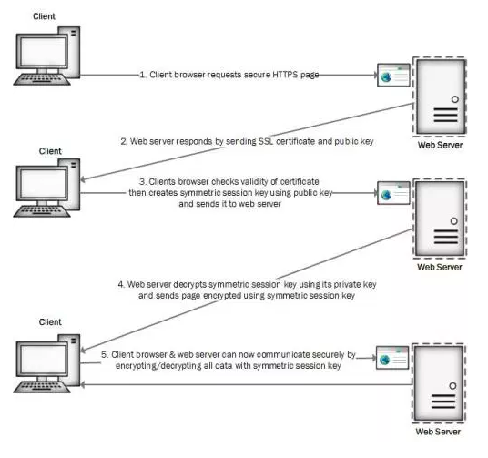
HTTPS
HTTP Secure (HTTPS) is an extension of the HTTP.
It usually uses SSL or TLS to encrypt all communication between a client and a server.
https://gurunguns.wordpress.com/2017/10/10/how-does-https-works/

Slide 15
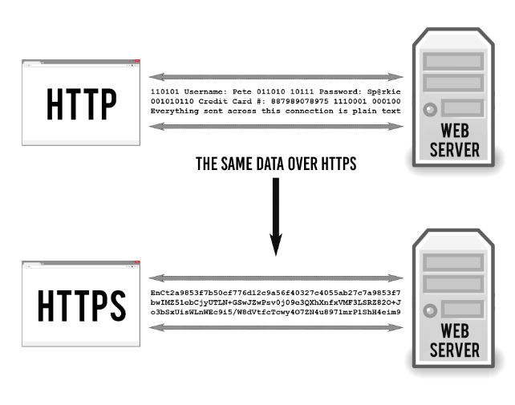
HTTPS
https://tiptopsecurity.com/how-does-https-work-rsa-encryption-explained/

