Slide 1
Objects
We have seen two types creating an object. These are called object literals
1. var p = { }; p.prop = “val1”
2. var p = { prop: ”val1” };
We also have another method.
First create a constructor function and then instantiate an object invoking that function in conjunction with the ”new”operator.

Slide 2
Creating object with constructor
This process has two steps
Define the object type by writing a constructor function. There is a strong convention, with good reason, to use a capital initial letter.
Create an instance of the object with new.
Take our assignment-2 question.
Automobile() – constructor function
new Automobile(1995, "Honda", "Accord", "Sedan") is instance of the object

Slide 3
Which way should I chose?
Initialize by using a function if you want to create several similar objects. In our example, Automobile is called the constructor function. This is similar to classes in other OO languages.
Use object literals if you only need one object of a kind.

Slide 4
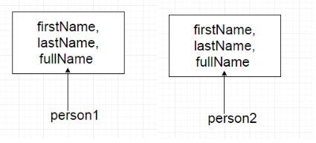
prototype
When we use a constructor function, for each object we create, we get a new copy of that constructor function with the values of that object.
If we have a Person constructor function, and we have create two objects using that. Then they will be created like this.

Slide 5
Prototype contd..
If we have a function as a member of that object as in the example below.
function Person(firstName, lastName) = { this.firstName = firstName, this.lastName = lastName, this.getFullName = function () { return this.firstName + " " + this.lastName; } };

Slide 6
Prototype contd…
The getFullName() which is a function will be the same for any number of objects that we create.
So we are just having redundant copies of the same function.
This is where we have prototypes of great use.
https://hackernoon.com/prototypes-in-javascript-5bba2990e04b

Slide 7
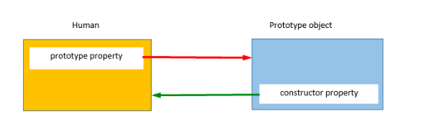
Prototype
When a function is created in JS, JS engine adds a prototype property to the function. This prototype property is an object (called as prototype object) has a constructor property by default. constructor property points back to the function on which prototype object is a property. We can access the function’s prototype property using the syntax functionName.prototype.

Slide 8
Prototype
We can modify the code above using prototype as below.
Person.prototype.getFullName = function () {
return this.firstName + " " + this.lastName; }
}
This will only create one copy of the function, But we get same behaviour.

