Slide 1
Pug - Syntax
In pug templates we will not have any closing tags
It uses indentation to determine the nesting of the tags
Adding attributes(Eg: href for <a> tag, or giving a id to an element in HTML) can be added inside parenthesis.
Eg: div(class="movie-card", id="oceans-11")
The above line can also be written as ‘div.movie-card#oceans-11’
Simplifies code a lot

Slide 2
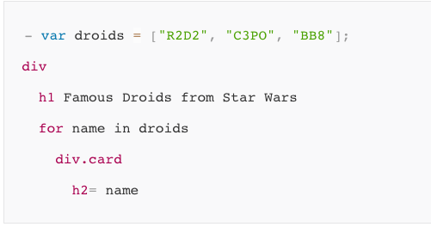
Pug Loops
Loops:
Pug have some standard for loops. We don’t have to use Javascript in every case.
Eg:

Slide 3
Pug
Interpolation: Using the values that you retrieved from your router can be interpreted easily using pug.
Eg: p Hi there, #{profileName}.
Mixins: Mixins are like functions. They take parameters as input and give markup(HTML code) as output. Mixins are defined using the mixin keyword.

Slide 4
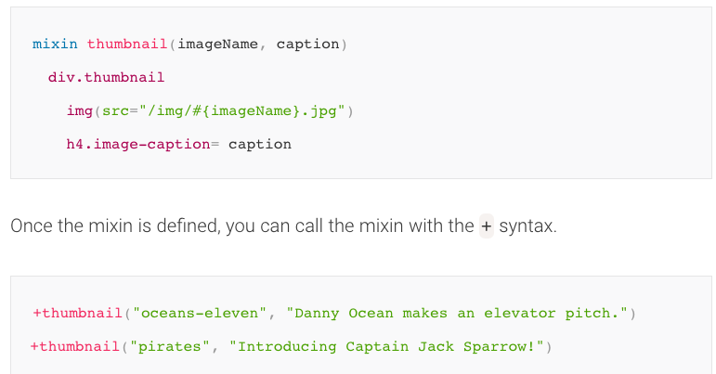
Pug - Mixins

Slide 5
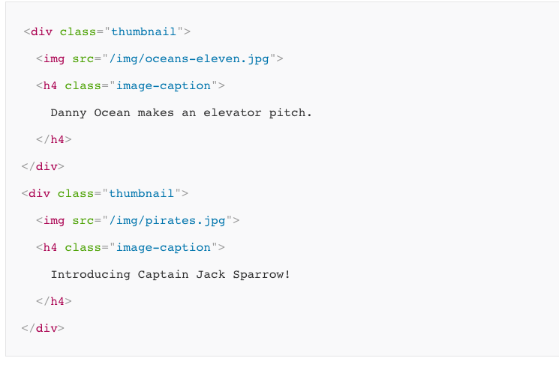
Pug - Mixins
Above mixin calling will produce this result.

Slide 6
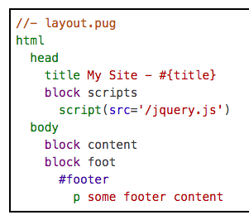
Template inheritance
Pug supports template inheritance. Template inheritance works via the block and extends keywords.
In a template, a block is simply a “block” of Pug that a child template may replace. This process is recursive.
Let’s say we have a layout.pug

Slide 7
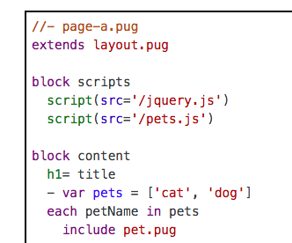
Template inheritance
To extend this layout, create a new file and use the extends directive with a path to the parent template. (If no file extension is given, .pug is automatically appended to the file name.) Then, define one or more blocks to override the parent block content.

Slide 8
Adding styles to pug templates
We can add styles similar to how we added styles to our HTML pages. We have to import all the styles in pug template using script or link.
These are imported usually in layout.pug and we extend the layout.pug in all the other pug files.
If we have any custom CSS styles we want to write, we will add them to Stylesheets folder in public/ of our project

Slide 9
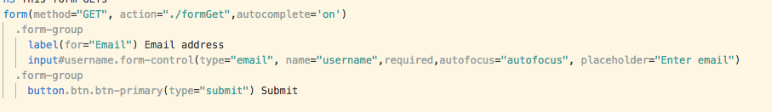
GET requests
In your router js file, you can handle the get request with this code.
router.get('/formGet',function(req,res){
console.log(req.query);
res.render('getInfo');
});

Slide 10
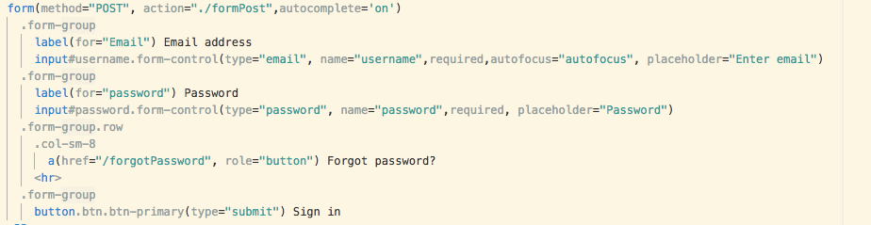
POST request
We can handle the post request in JS file using this code
router.post('/formPost',function(req,res){
console.log(req.body);
res.render('postInfo');
});

Slide 11
Pug styles
We can observe properties like, .form-group in above pug code.
This is nothing but our css class name.
Using this method we can add styles and we have to include CSS files in layout.pug

Slide 12
API requests
The term web service is either a service offered by an electronic device to another electronic device, communicating with each other via the World Wide Web, or a web service implemented in the particular technology or brand.
Let’s make api calls to openweathemap

Slide 13
OpenWeatherMap
OpenWeatherMap is one API which provides information about weather of a location.
Create an account and get a API key
We need app ID to recognize our application.
This will let us make api requests to the openweatherMap api
More instructions here: https://openweathermap.org/appid
API documentation: https://openweathermap.org/current

