Slide 1
Templating libraries
Putting hardcoded HTML in your controller is awful
Terrible impact on quality attributes
Maintainability: Now you have to read that garbage
Security: So many opportunities for massive security holes
Usability: No room in your controller for all the little touches that make webpages more usable
Templating libraries to the rescue
For example, Pug (formerly known as Jade)
Simple library focused on the structure of the HTML
Supports code reuse (through shared headers/footers/etc)

Slide 2
Example – Passing data to the pug template
Example...
In your router, pass some data to the template...
router.get('/demo', function (req, res, next) {
users = [1,2,3,4]
res.render('demo.pug', { myusers: users, title: "Happy, happy!" });
});
In your template (./views/demo.pug), reference the data...
- for (var i = 0; i < myusers.length; i++) {
- if (myusers[i])
a(href=('edit?id='+i))= myusers[i]
<BR>
- }
a(href='edit') (Add New)

Slide 3
Example – Passing data to the pug template
Example... Let’s add some more data to the same route
In your router, pass some data to the template...
router.get('/demo', function (req, res, next) {
users = [1,2,3,4]
usersJson = {'name':'John','id':'1'}
res.render('demo.pug', { myusers: users,myusersJson: usersJson, title: "Happy, happy!" });
});
In your template (./views/demo.pug), reference the data...
- for (var i = 0; i < myusers.length; i++) {
- if (myusers[i])
a(href=('edit?id='+i))= myusers[i]
<BR>
- }
a(href='edit') (Add New)
<BR>
h3 JSON data is
p name is #{myusersJson.name}
p id is #{myusersJson.id}

Slide 4
Embedding JS in PUG/Jade
Lines starting with hyphen - are treated as JavaScript
You can write any JS you like
Remember to close your brackets, braces and parentheses
You don't have to use JavaScript to iterate (there's a pug syntax)
The equals = symbol indicates a computed output
Notice, for example, how we set the href attribute of each a tag to be equal to a string concatenated with an integer
Pay attention to your indentation (which controls HTML tag nesting)
To access properties of a JSON object use #{<JSON object name>}, See the above example where I accessed properties of myUserJson using #{}

Slide 5
Exercise
Create a new express application
When the user navigates to the URL localhost:3000/details display the details of the user which are in following JSON format.
userDetails = {‘name’:’Dave’,’course’:’CS290’,’id’:5}

Slide 6
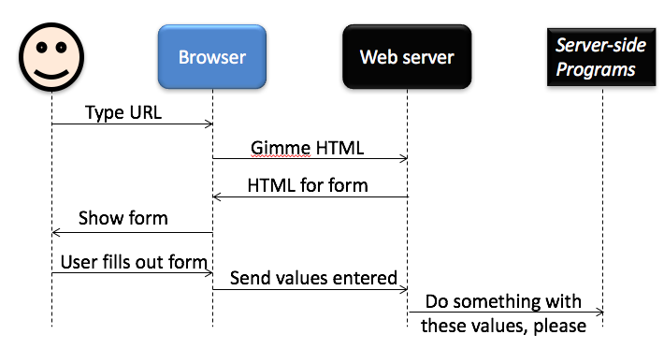
HTML Forms
HTML forms enable your web application to collect information from your users

Slide 7
Forms - GET
<form action="http://web.engr.oregonstate.edu/~scaffidc/formrepeater.php" method="GET">
<input type="text" name="myfield">
<input type="submit">
</form>
When your user types a value and hits submit, the form sends the value of myfield to the server. Notice the value appears on the URL.
Note: the URL above might break some day. In that case, search online for the URL of a "form tester" that can replace the URL shown above.

Slide 8
Forms - Post
<form action="http://web.engr.oregonstate.edu/~scaffidc/formrepeater.php" method="POST">
<input type="text" name="myfield">
<input type="submit">
</form>
Now the value is not shown on the URL. This helps to keep it secret.

Slide 9
Password fields
<form action="http://web.engr.oregonstate.edu/~scaffidc/formrepeater.php" method="POST">
<input type="text" name="myfield">
<input type="password" name="mypasswordfield">
<input type="submit">
</form>
The value of the password field is also kept hidden on the screen when the user types it. NEVER EVER transmit passwords via GET.

Slide 10
Form methods (GET vs POST)
So what's the deal with GET vs POST?
Difference in purpose
GET is for retrieving data from the server (or any other purpose that can safely be repeated an arbitrary number of times)
POST is for making changes to the server (or any other purpose that cannot be safely repeated an arbitrary number of times)

Slide 11
So GET can be called arbitrary times
GET can be called…
1 time when 1 user wants data
1 time when 2 users want data
1 time when 300 users want data
Many times when 0 users want data (preemptive caching)
0 times when 1 user wants data (if it was cached)
Many times when search engines want data

Slide 12
POST is not allowed to be cached
A proxy server will always forward the POST request exactly 1 time when each user's browser tries to POST.
A proxy server may not cache POST data.
So if you send passwords via POST, proxy servers are not allowed to keep copies of passwords going by!
And search engines are also not supposed to automatically perform POST operations, either.

Slide 13
Examples of good ways to use GET
Retrieving an HTML table or list
Retrieving a form
Checking to see if the page still exists
Checking to see if the server has crashed
Checking to see fast the server is today
All of these can safely be repeated lots of times. Repeating these won't mess up the server.
These are called "idempotent operations."

Slide 14
Examples of bad ways to use GET. For these, use POST instead.
Deleting data from the server
Updating data on the server
Logging in (changes state on the server)
Logging out (ditto)
Each of these changes the state of the server, so repeating them an arbitrary number of times could mess up the server.

