Slide 1
Team Project(Team 7) DeAnza Student Database

Slide 2
Main Purpose
Sort student IDs and Names in two Different BSTs. Used for searching, inserting, and deleting.
Put student objects to HashTable according to student IDs, establish efficient searching.
Examine different Hash Functions and observe the differences.

Slide 3
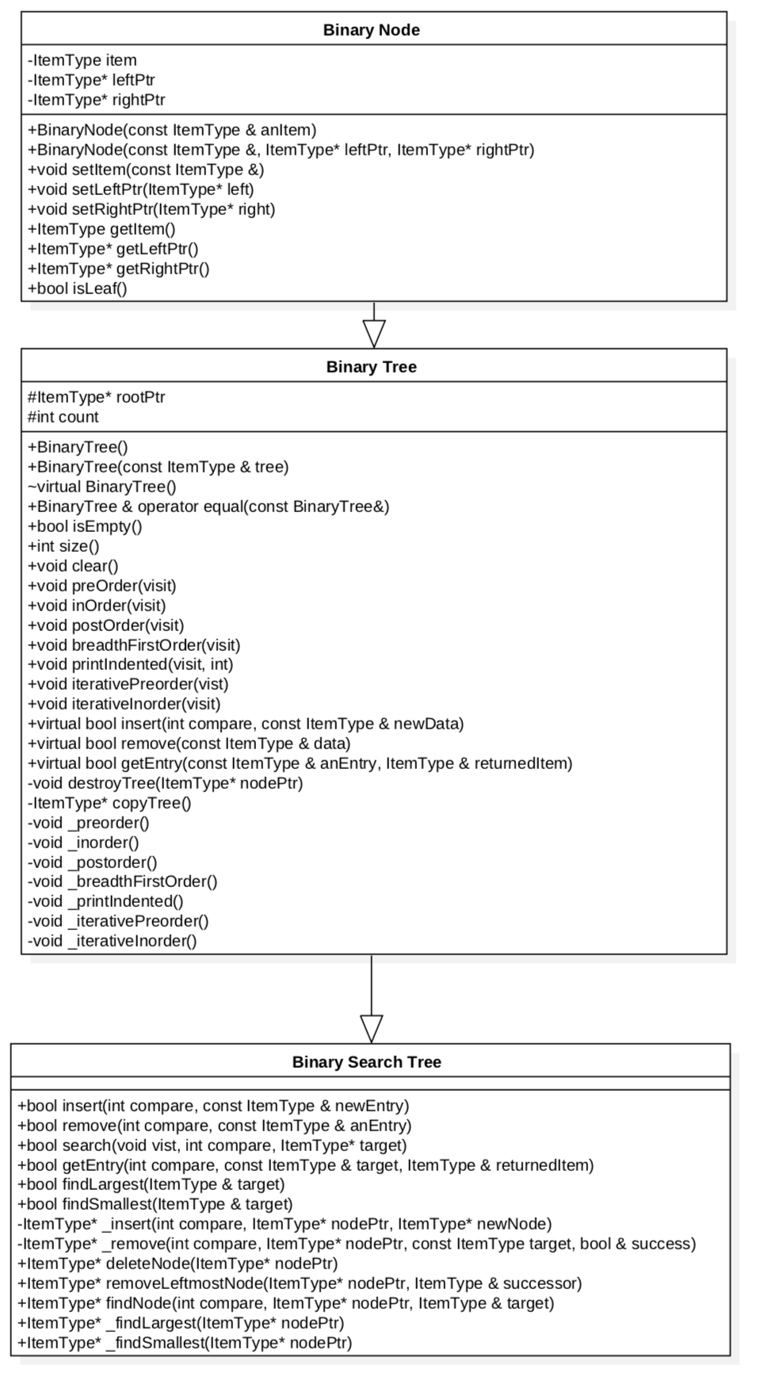
UML

Slide 4
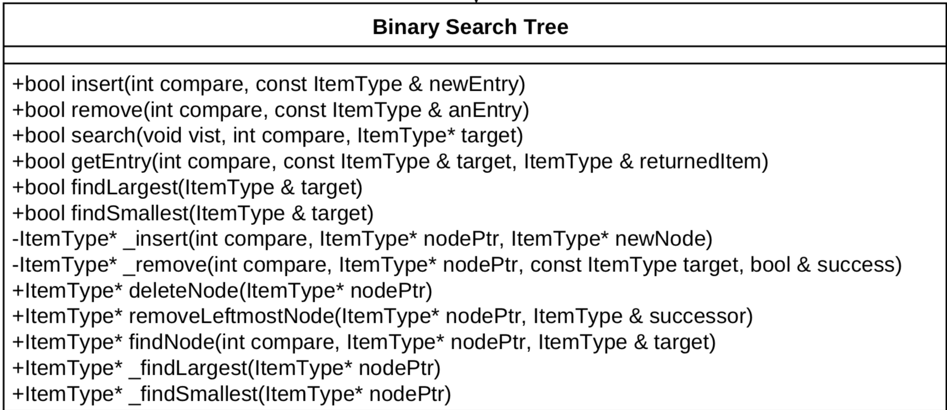
BST

Slide 5
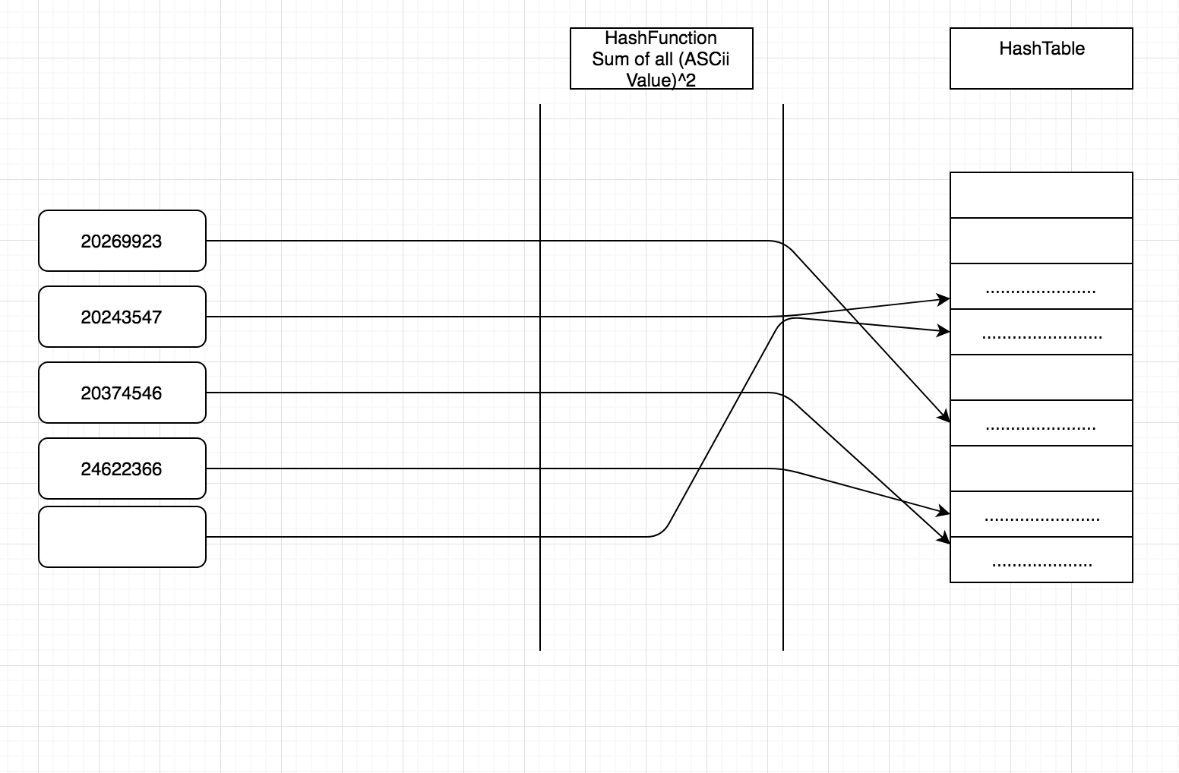
Data Structure Hash List

Slide 6
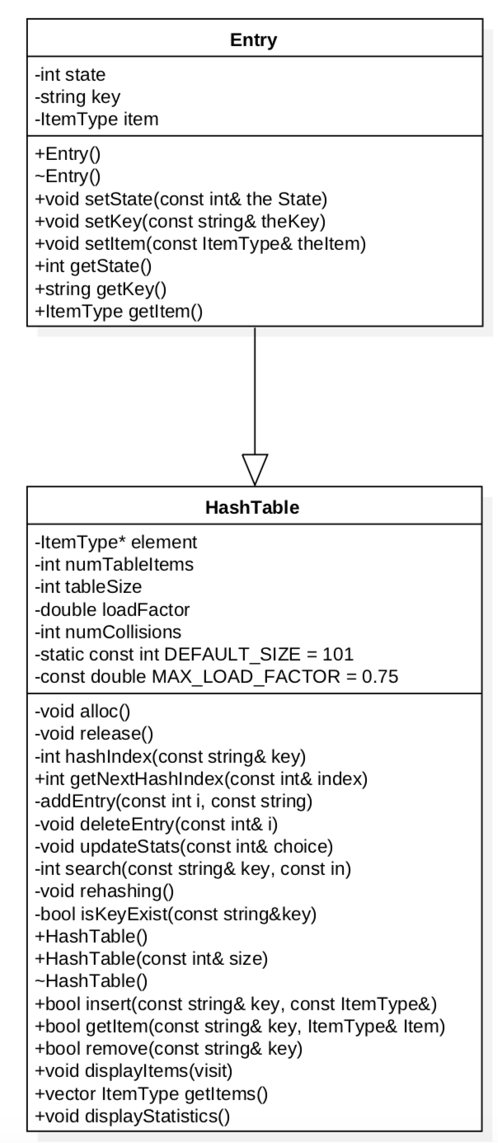
UML

Slide 7
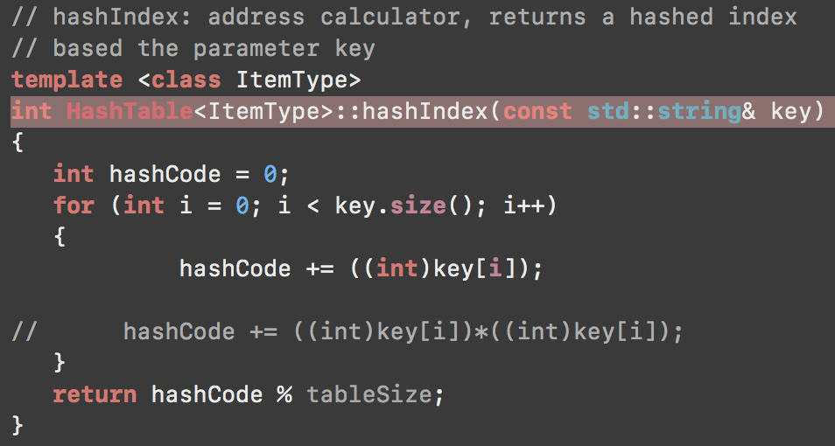
Hash Function

Slide 8
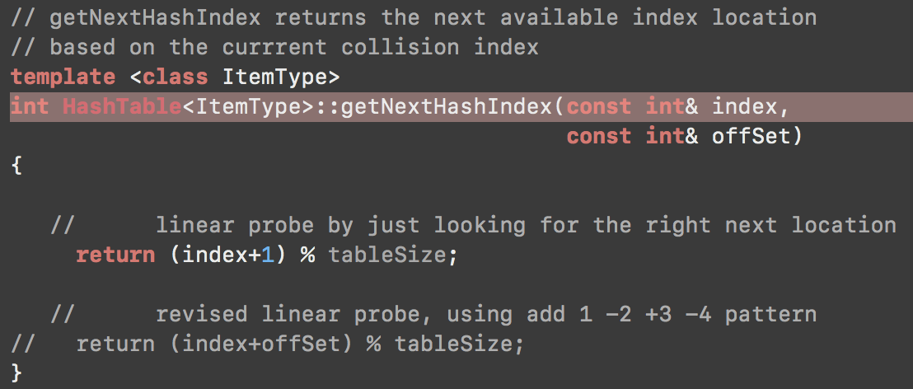
Collision Resolution Function

Slide 9
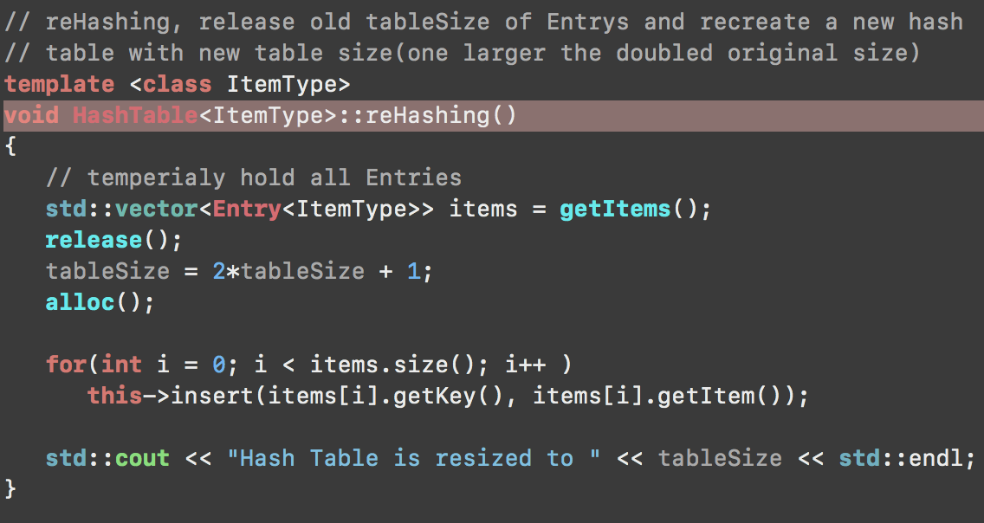
Rehashing Function

Slide 10
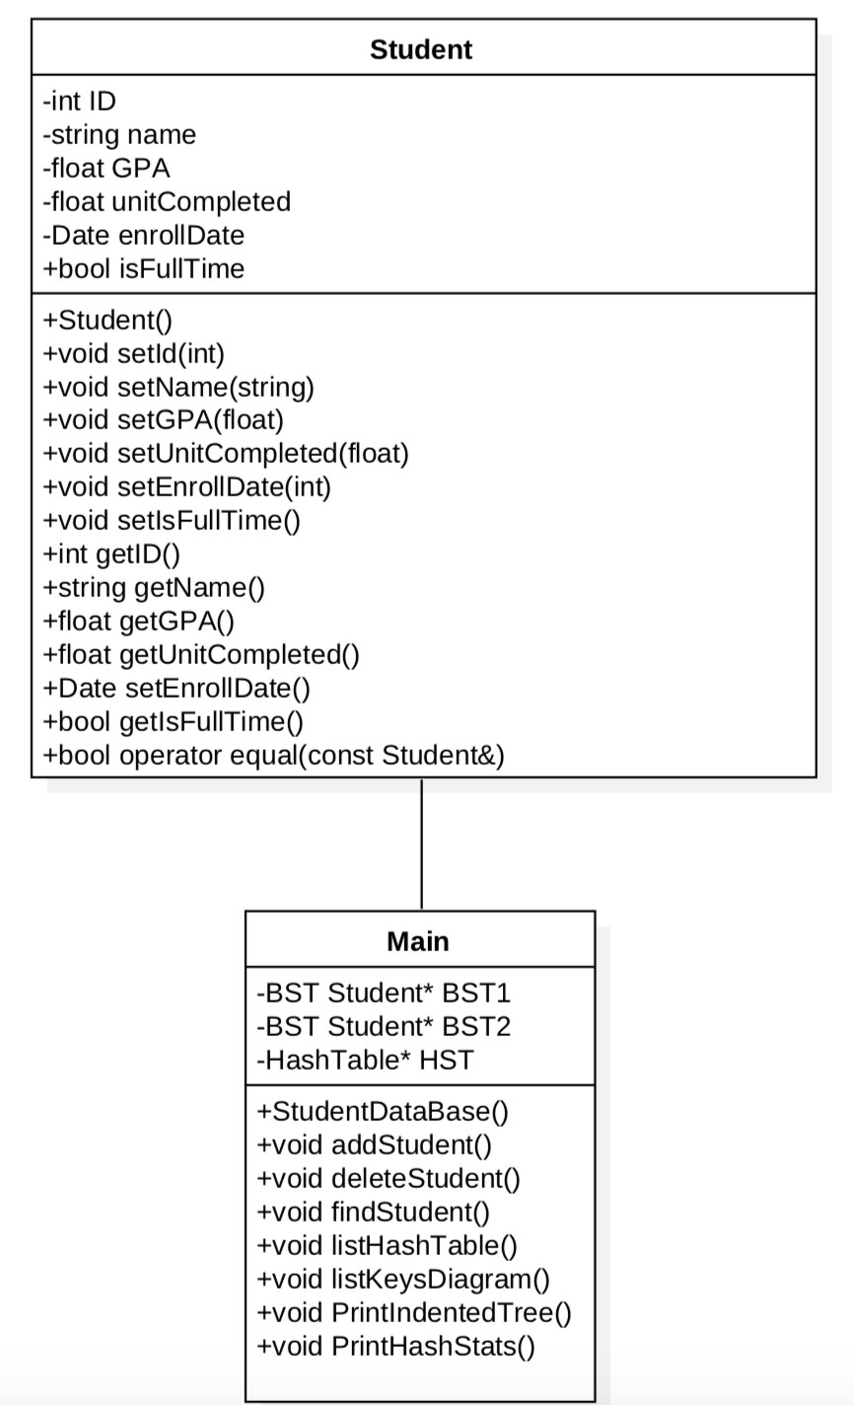
UML

Slide 11
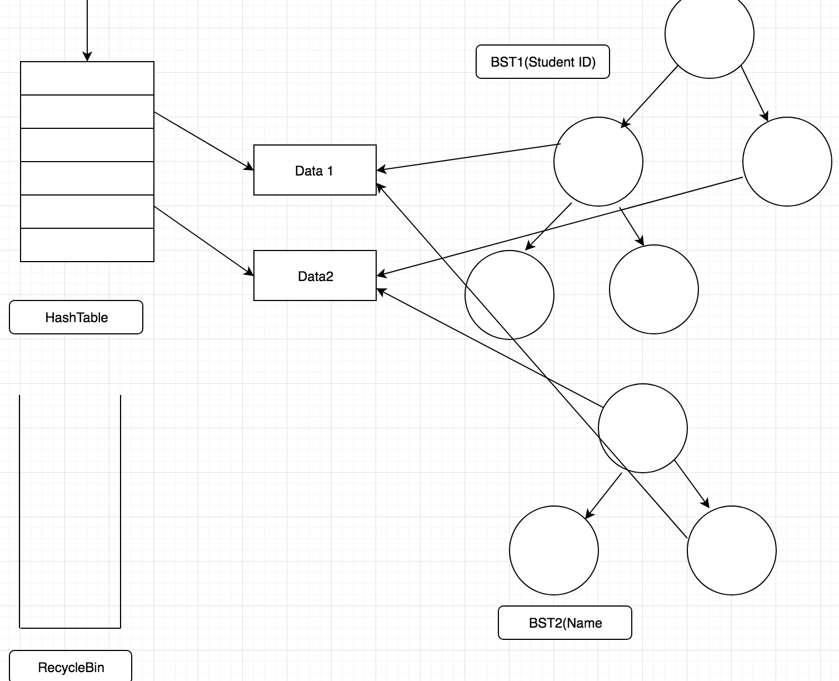
Data Structure

Slide 12
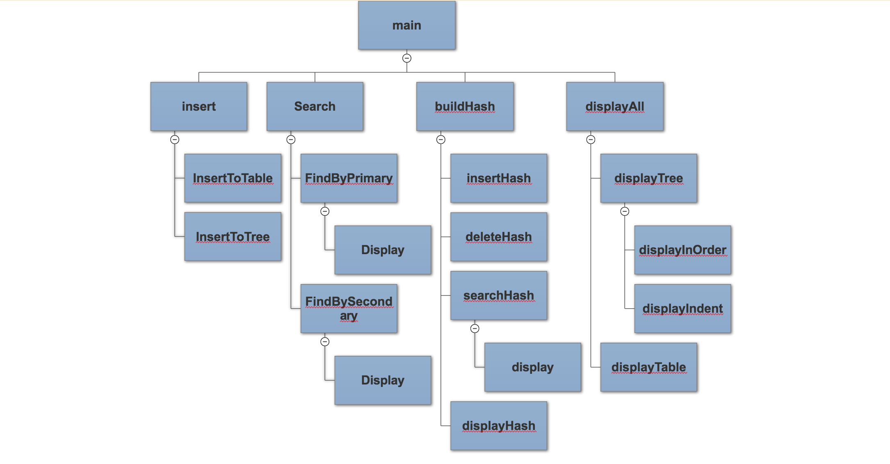
Structure Chart

Slide 13
Code Demonstration

Slide 14
Q & A

