Slide 1
Team Project(Team 7) DeAnza Student Database

Slide 2
Main Purpose
Sort student IDs and Names in two Different BSTs. Used for searching, inserting, and deleting.
Put student objects to HashTable according to student IDs, establish efficient searching.
Examine different Hash Functions and observe the differences.

Slide 3
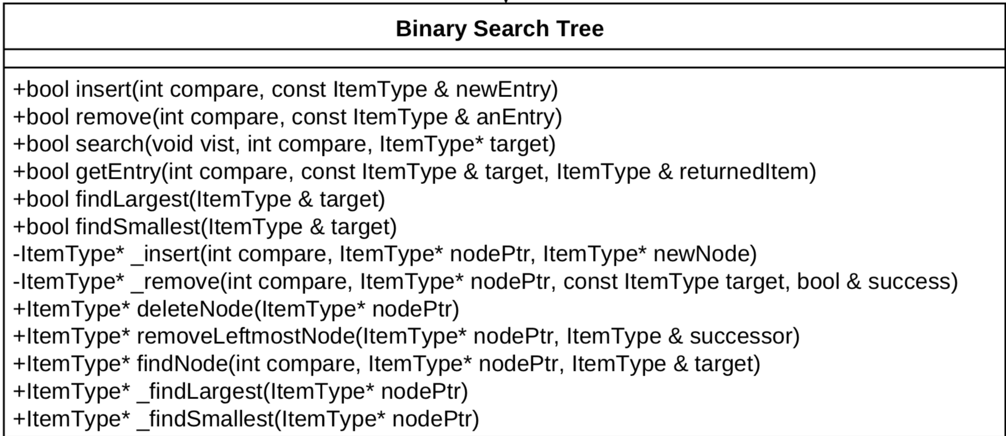
BST

Slide 4
HashTable

Slide 5
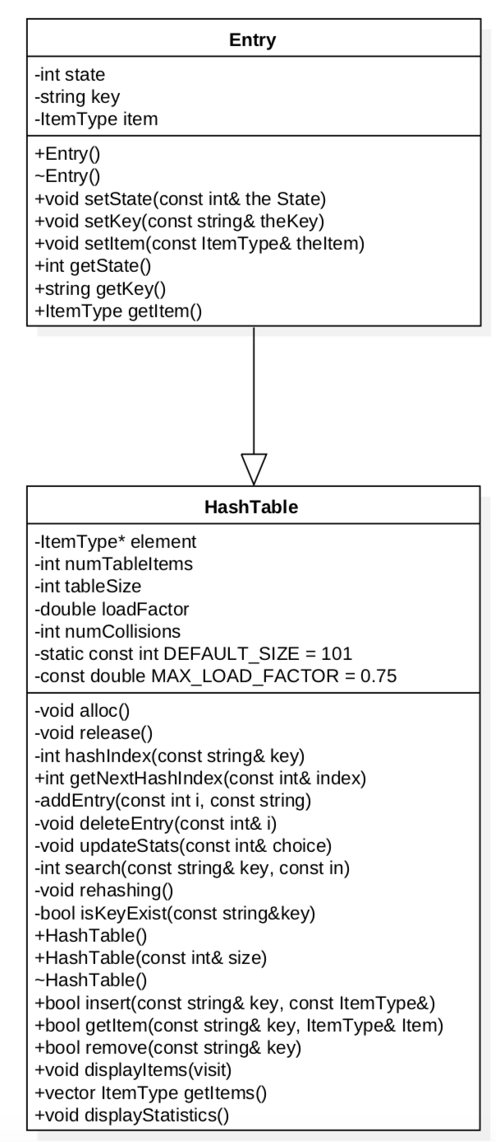
UML

Slide 6
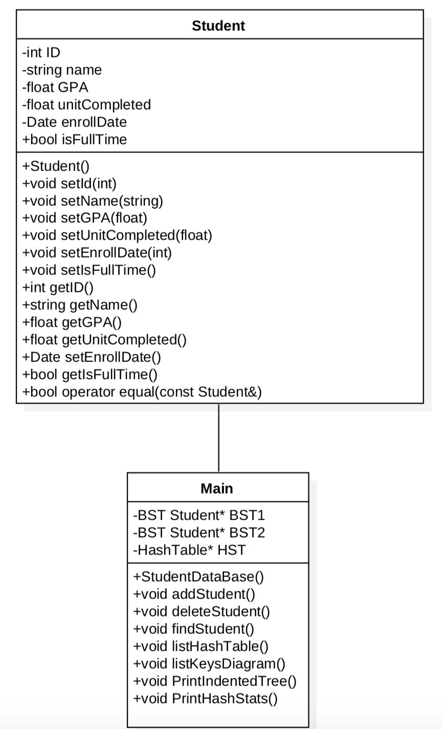
UML

Slide 7
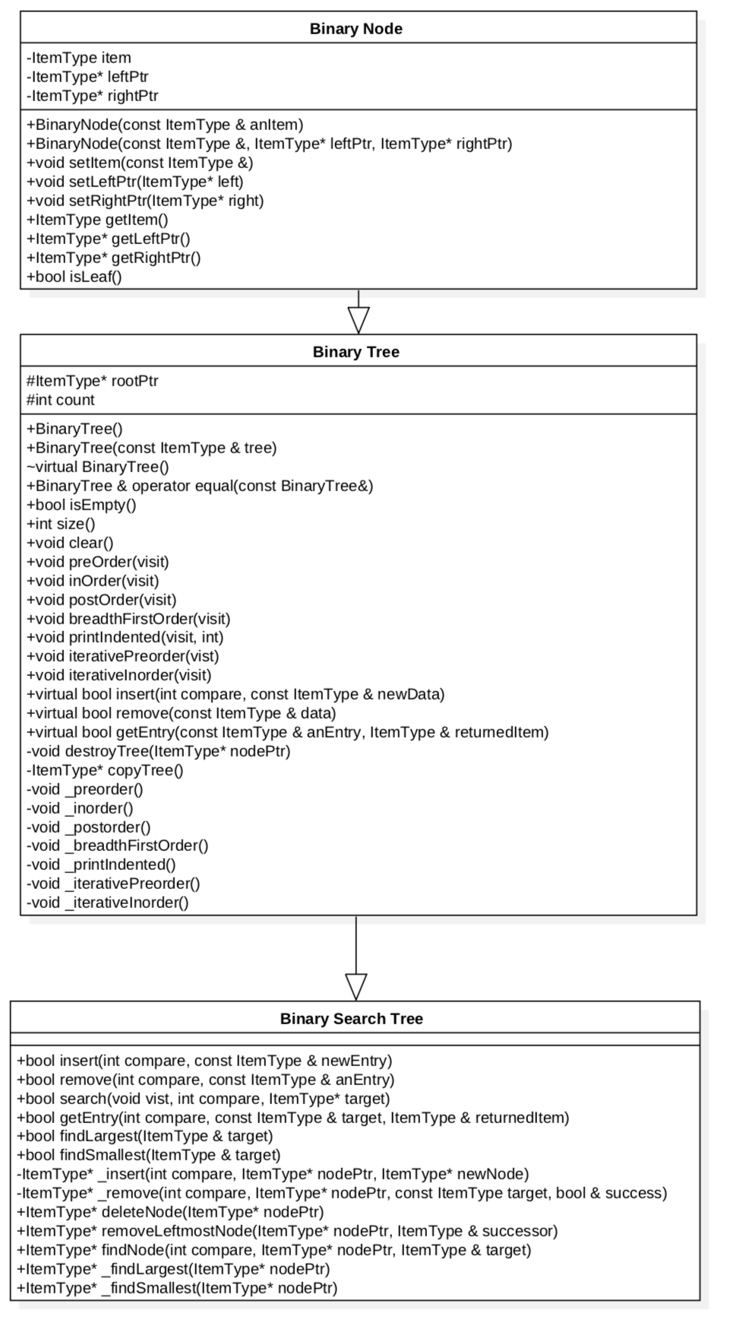
UML

Slide 8
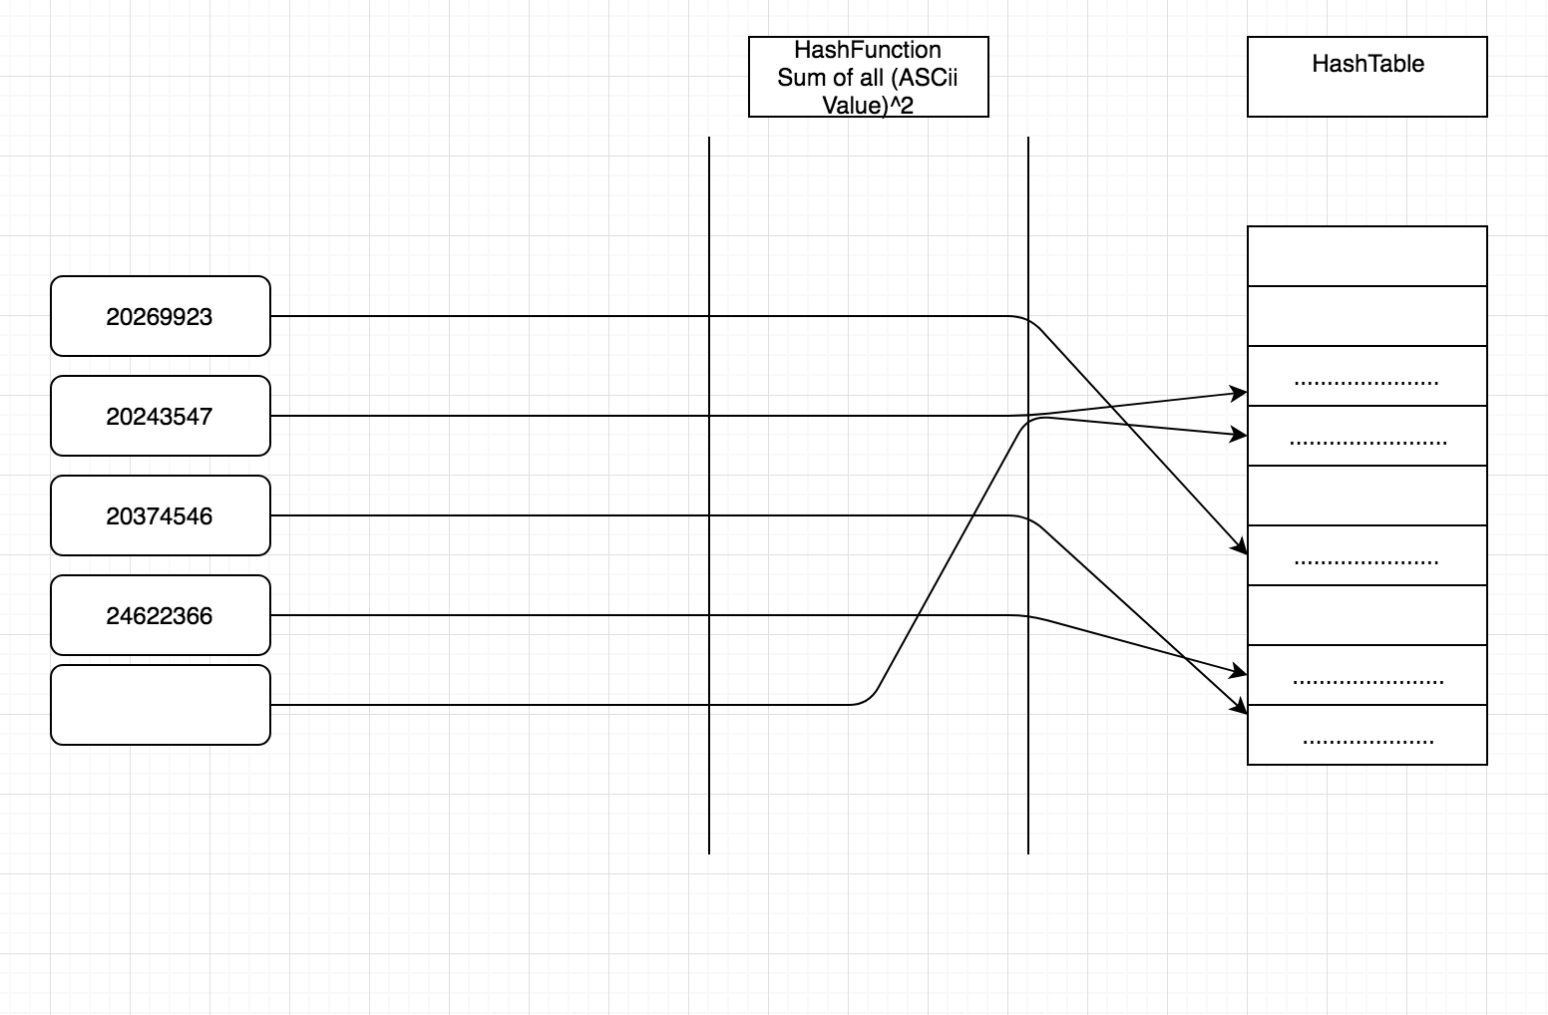
Data Structure

Slide 9
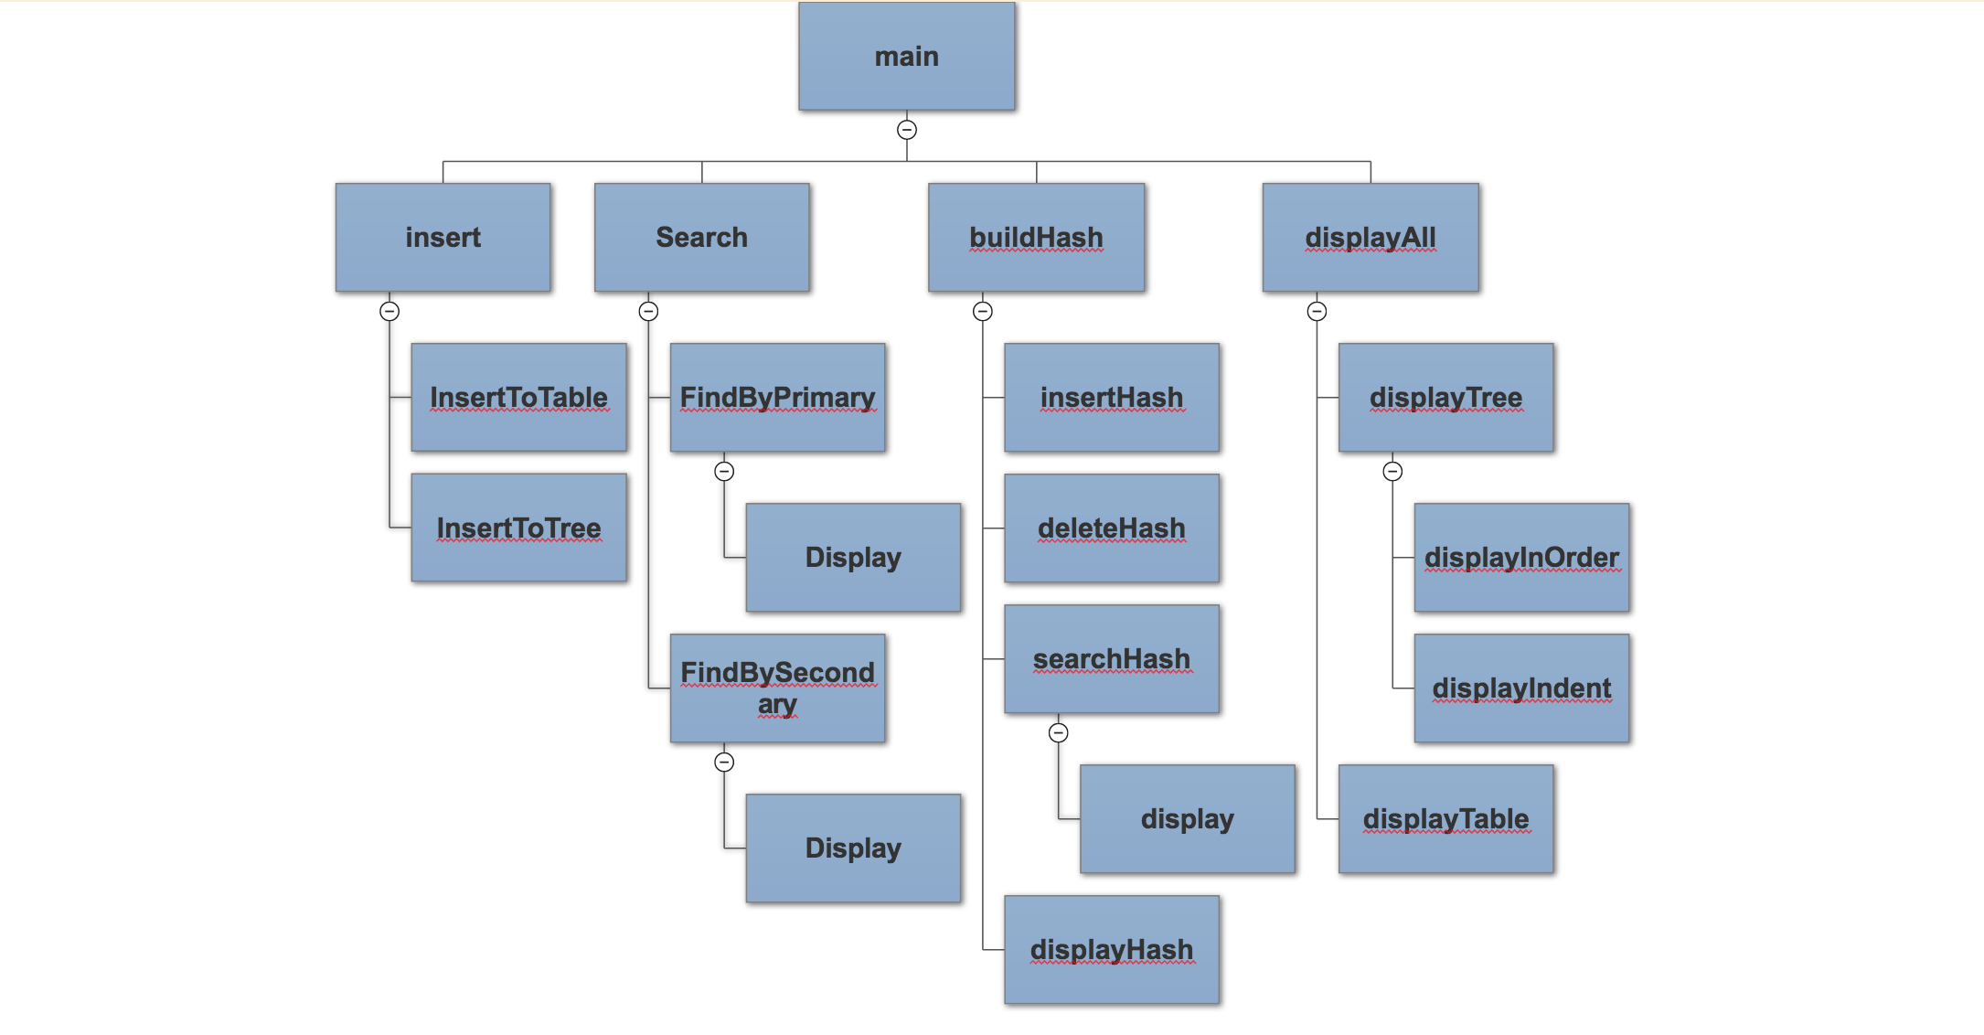
Structure Chart

Slide 10
Code Demonstration

Slide 11
Q & A

