Slide 1
Foundations of AI and ML CS21206
Abir Das and Ayan Chaudhury
Computer Science and Engineering Department
Indian Institute of Technology Kharagpur

Slide 2
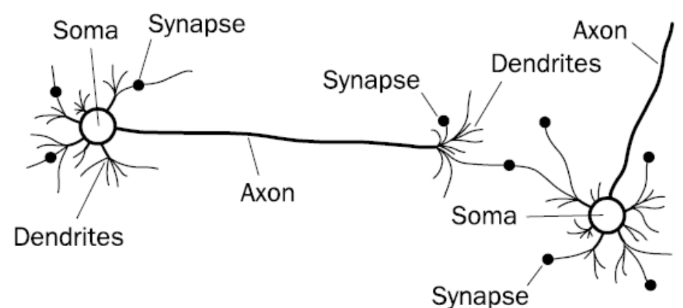
Biological Neural Network
Image courtesy: F. A. Makinde et. al., “Prediction of crude oil viscosity using feed-forward back-propagation neural network (FFBPNN)”." Petroleum & Coal 2012
Notes:
So we are here to familiarize ourselves with the perceptron algorithm. We will see later how a perceptron algorithm leads to one of the most powerful machine learning models of today, i.e., neural network. And to learn about neural networks where else to look for motivation than human beings. Human beings are super complicated machines and arguably the main computing behind each of our decisions are done by a complicated network of neurons present in the brain.
A biological neuron unit consists of several parts - Dendrites carry input stimulation or signal to the cell body or soma. These input stimulations cause protein synthesis inside the soma at different rates depending on the strength of the input signals. Then the axon carries out the signal from the soma (cell body) to other neurons via the branches or the so called dendrites.

Slide 3

Notes:
The early AI researchers have taken the inspiration of this basic building block of the biological neurons - namely its an input-output relation. You get a lot of input signals, you operate on them linearly or non-linearly to get an output signal and then send the output to other connected neurons to feed them with these input signals.
We will see how this "simplified" notion of the working principle of biological neurons is translated to a Mathematical form. But before that, it is worthwhile to mention that it is not only the AI enthusiasts who are getting motivations from neuroscientific works but the reverse is also true. Prof. James DiCarlo the Head of the Department of Brain and Cognitive Sciences at MIT gave a fantastic Keynote speech at CVPR 2017 where he elaborated how advances in deep neural networks are helping explain what happens in the human visual cortex. I would highly encourage you all to listen to the talk which is available in youtube.
And our reference to biological neurons stops here for the purpose of this course. Just the take home message is: To us, a neuron is a computation unit that takes in a bunch of input signals, performs mathematical operations on them and transmit the resulting signal out.

Slide 4










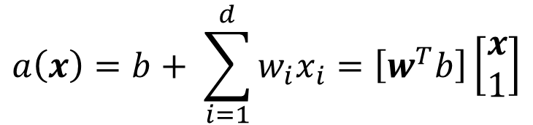

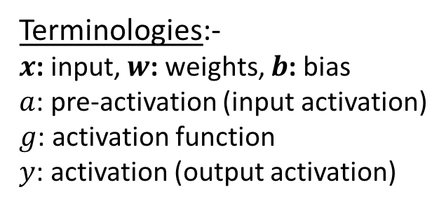



Artificial Neuron
$$w={\left[w_{1} w_{2}…w_{d}\right]}^{T}$$
and
$$x={\left[x_{1} x_{2}…x_{d}\right]}^{T}$$
$$x_{1}$$
$$a\left(x\right)=b+ \sum_{i=1}^{d}{w_{i}x_{i}}=\left[w^{T}b\right]\left[\begin{matrix}x \\ 1\end{matrix}\right]$$
$$w_{1}$$
$$w_{2}$$
$$a(x)$$
$$x_{2}$$
$$g(a)$$
$$y$$
$$y=g(a\left(x\right))$$
$$W_{0}=b$$
$$x_{d}$$
$$w_{d}$$
Terminologies:-
$x$: input, $w$: weights, $b$: bias
$a$: pre-activation (input activation)
$g$: activation function
$y$: activation (output activation)
$$1$$

Slide 5

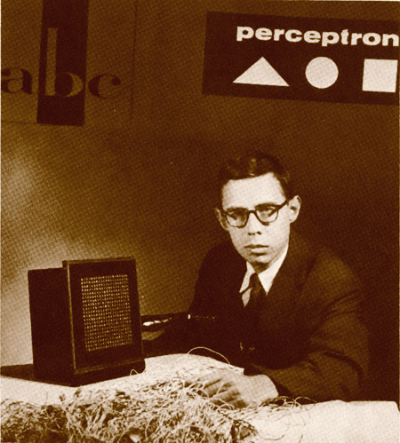
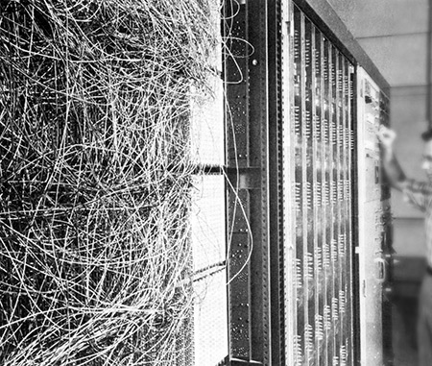
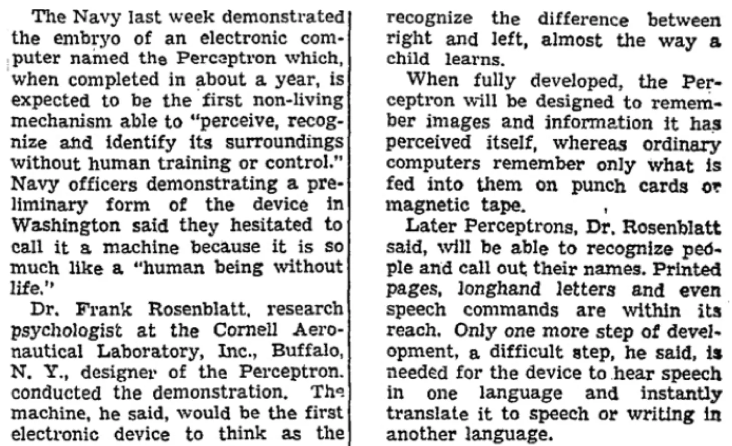
Perceptron
Image courtesy: https://blogs.umass.edu/comphon/2017/06/15/did-frank-rosenblatt-invent-deep-learning-in-1962/

Slide 6
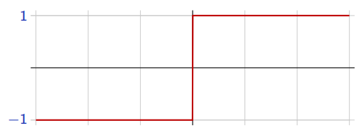
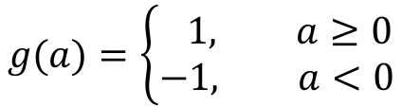

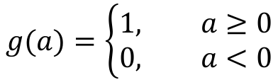



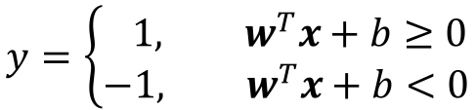
Perceptron
$x∈ℝ^{d}$ and $y∈\{0, 1\}$ – Binary Classification
$$g(a)=\left\{\begin{aligned}1, a≥0 \\ &0, a<0\end{aligned}\right.$$
(Rosenblatt, 1957)
$$x_{1}$$
$$w_{1}$$
$$w_{2}$$
To make things simpler, the response is taken as $y∈\{−1, 1\}$
$$a(x)$$
$$x_{2}$$
$$g(a)$$
$$y$$
$$g(a)=\left\{\begin{aligned} 1, a≥0 \\ &−1, a<0\end{aligned}\right.$$
$$g(a)$$
$$W_{0}=b$$
$$a$$
$$x_{d}$$
$$w_{d}$$
The perceptron classification rule, thus, translates to
$$1$$
$$y=\left\{\begin{aligned} 1, w^{T}x+b≥0 \\ &−1, w^{T}x+b<0\end{aligned}\right.$$
Remember: $w^{T}x+b=0$ represents
a hyperplane.

Slide 7
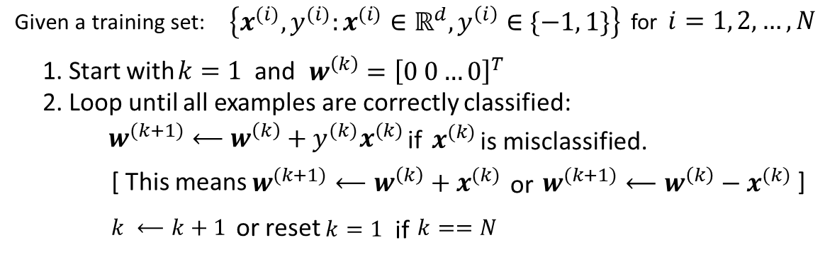
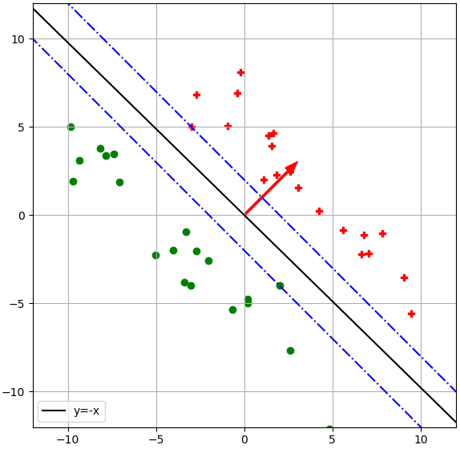
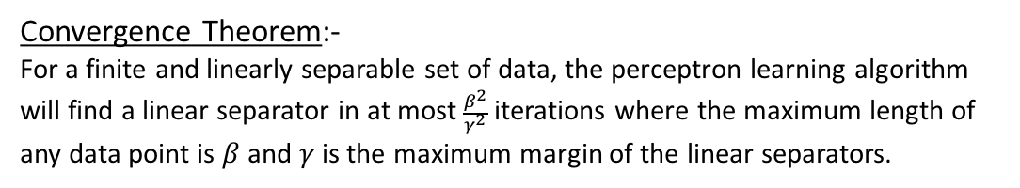


Perceptron Learning Algorithm
$$γ$$
$$β$$
Convergence Theorem:-
For a finite and linearly separable set of data, the perceptron learning algorithm will find a linear separator in at most $\frac{β^{2}}{γ^{2}}$ iterations where the maximum length of any data point is $β$ and $γ$ is the maximum margin of the linear separators.

Slide 8
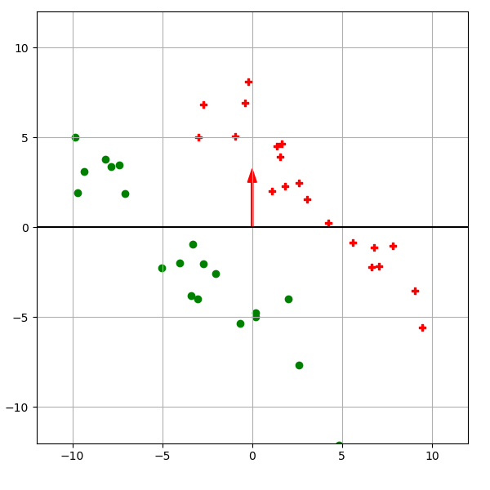
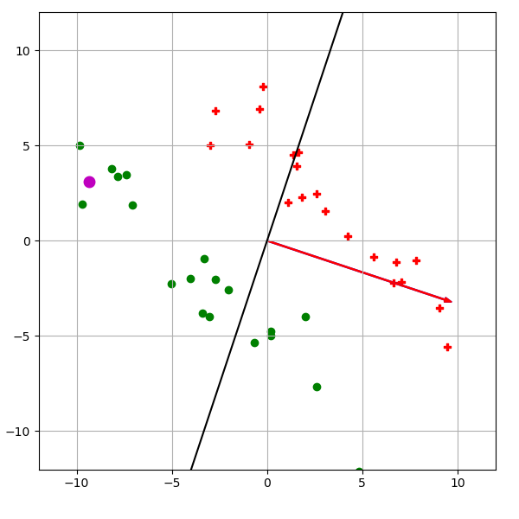
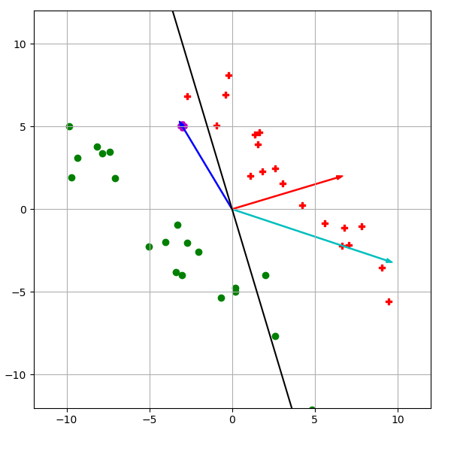
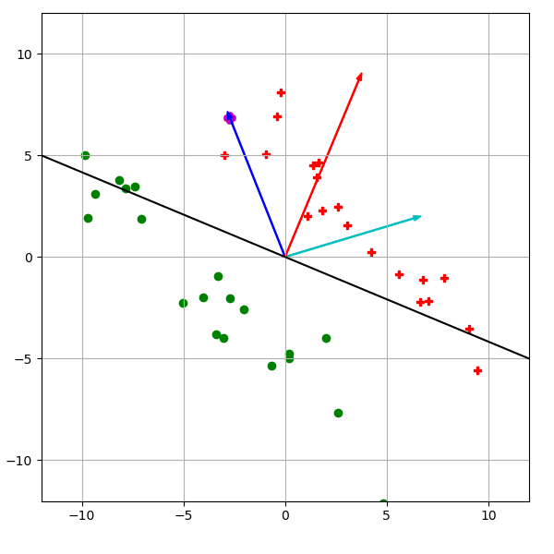
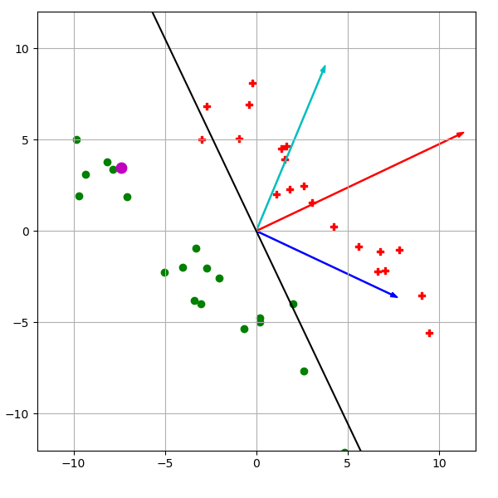
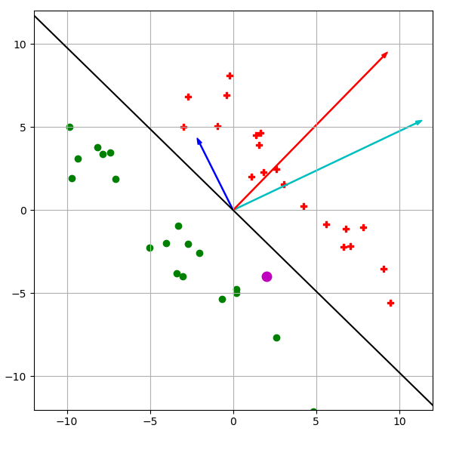

Slide 9














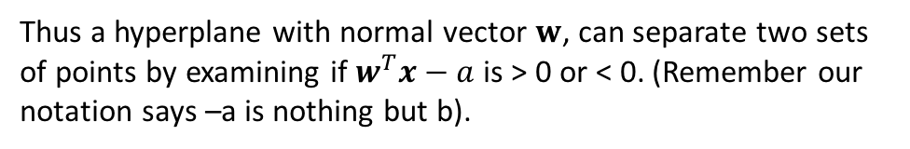
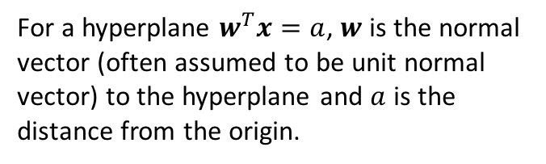





Perceptron Learning Algorithm – Convergence Proof
Some Important Brush-ups:-
$$x^{(1)}$$
$$x^{(1)}$$
$$x^{(1)}$$
$$x^{(2)}$$
$$w$$
$$x^{(2)}$$
$$w$$
$$x^{(2)}$$
$$w$$
$$x^{(3)}$$
$$x^{(3)}$$
$$x^{(3)}$$
$$>a$$
$$a$$
$$<a$$
$$(0,0)$$
$$(0,0)$$
$$(0,0)$$
$$w^{T}x=a$$
$$w^{T}x=a$$
$$w^{T}x=a$$
For a hyperplane $w^{T}x=a$, $w$ is the normal vector (often assumed to be unit normal vector) to the hyperplane and $a$ is the distance from the origin.
Thus a hyperplane with normal vector $w$, can separate two sets of points by examining if $w^{T}x−a$ is > 0 or < 0. (Remember our notation says –a is nothing but b).

Slide 10
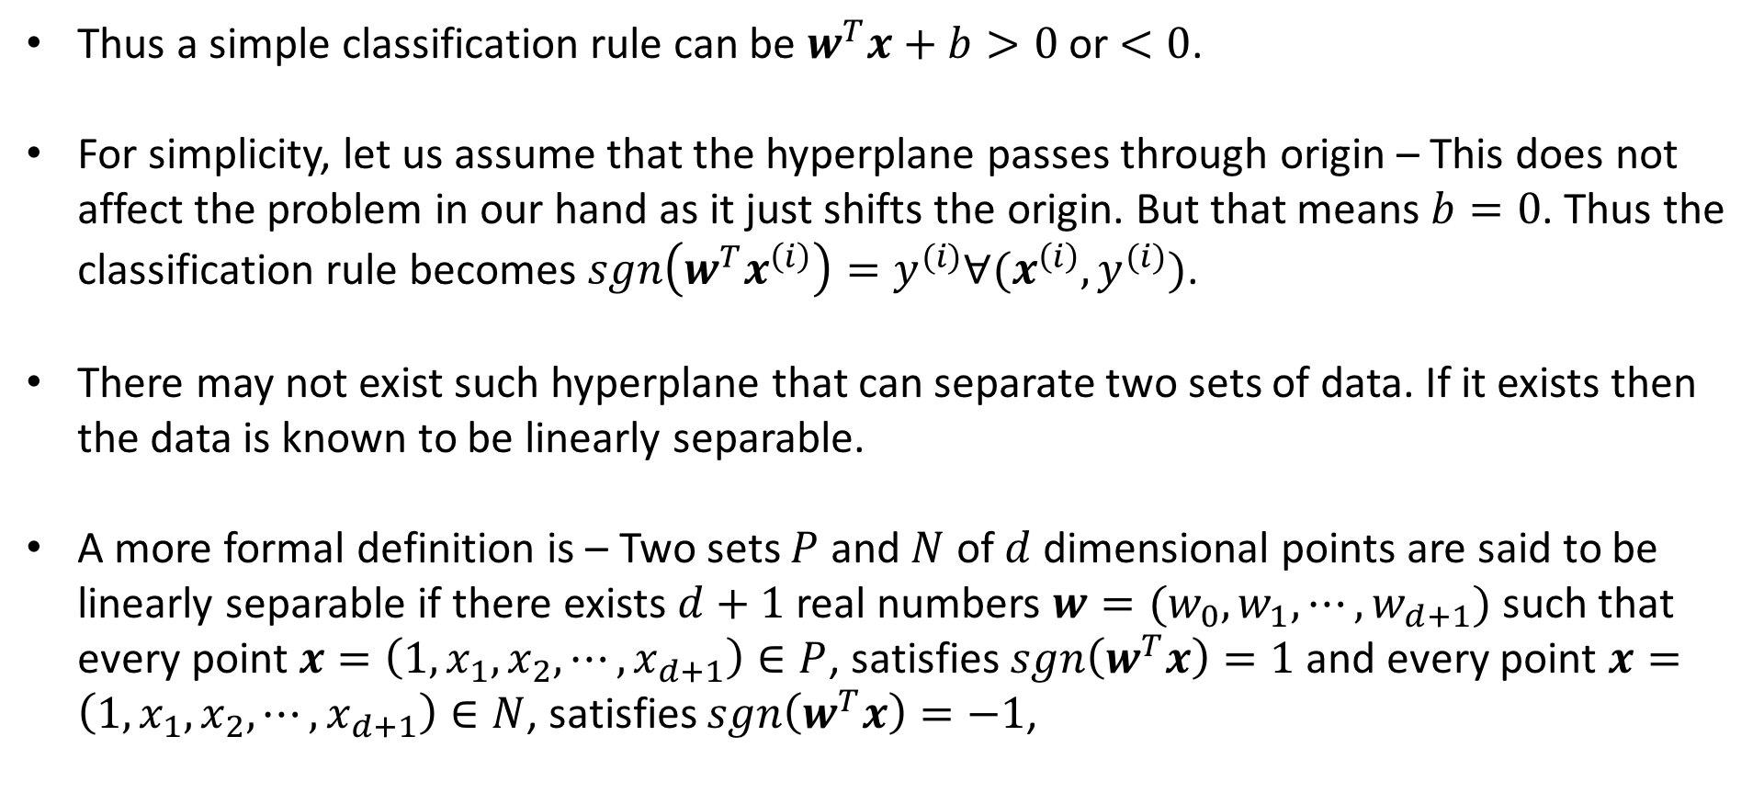
Perceptron Learning Algorithm – Convergence Proof
Thus a simple classification rule can be $w^{T}x+b>0$ or $<0$.
For simplicity, let us assume that the hyperplane passes through origin – This does not affect the problem in our hand as it just shifts the origin. But that means $b=0$. Thus the classification rule becomes $sgn\left(w^{T}x^{\left(i\right)}\right)=y^{(i)}∀(x^{\left(i\right)},y^{(i)})$.
There may not exist such hyperplane that can separate two sets of data. If it exists then the data is known to be linearly separable.
A more formal definition is – Two sets $P$ and $N$ of $d$ dimensional points are said to be linearly separable if there exists $d+1$ real numbers ${w=(w}_{0},w_{1}, ⋯, w_{d+1})$ such that every point $x=\left(1,x_{1}, x_{2},⋯, x_{d+1}\right)∈P$, satisfies $sgn\left(w^{T}x\right)=1$ and every point $x=\left(1,x_{1}, x_{2},⋯, x_{d+1}\right)∈N$, satisfies $sgn\left(w^{T}x\right)=−1$,

Slide 11
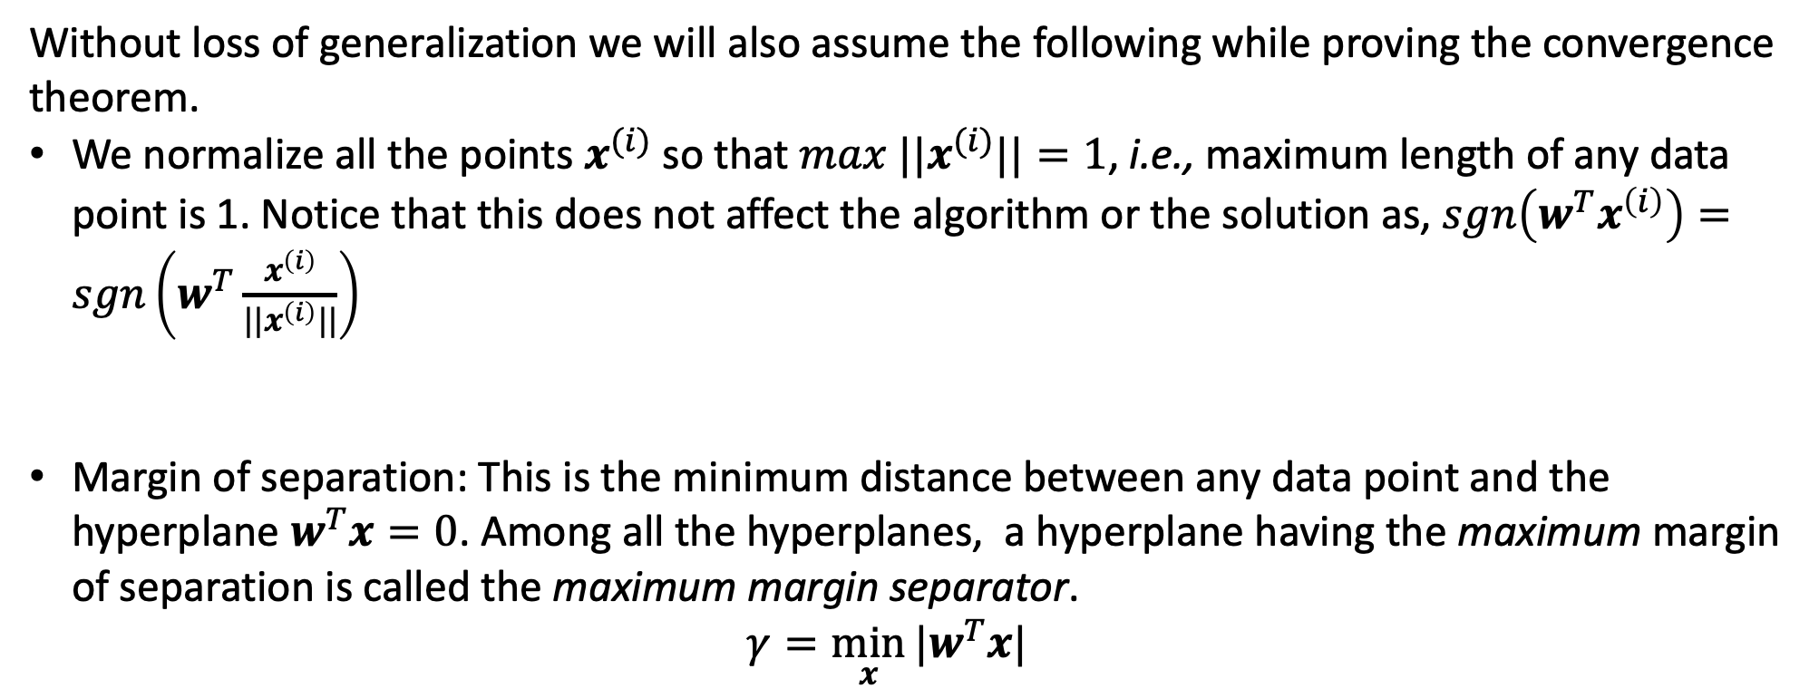
Perceptron Learning Algorithm – Convergence Proof
Without loss of generalization we will also assume the following while proving the convergence theorem.
We normalize all the points $x^{(i)}$ so that ${max ||x}^{(i)}||=1$, i.e., maximum length of any data point is 1. Notice that this does not affect the algorithm or the solution as, $sgn\left(w^{T}x^{\left(i\right)}\right)=sgn\left(w^{T}\frac{x^{\left(i\right)}}{||x^{\left(i\right)}||}\right)$
Margin of separation: This is the minimum distance between any data point and the hyperplane $w^{T}x=0$. Among all the hyperplanes, a hyperplane having the maximum margin of separation is called the maximum margin separator. $γ=\min_{x}{|w^{T}x|}$

Slide 12
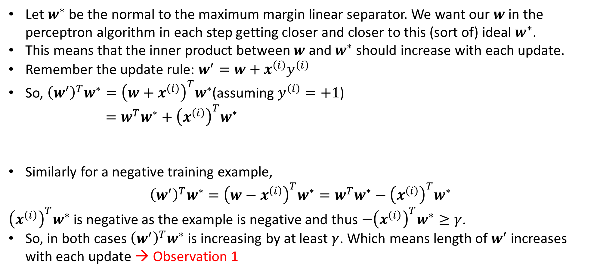


Perceptron Learning Algorithm – Convergence Proof
Let $w^{∗}$ be the normal to the maximum margin linear separator. We want our $w$ in the perceptron algorithm in each step getting closer and closer to this (sort of) ideal $w^{∗}$.
This means that the inner product between $w$ and $w^{∗}$ should increase with each update.
Remember the update rule: $w^{′}=w+x^{\left(i\right)}y^{\left(i\right)}$
So, ${\left(w^{′}\right)}^{T}w^{∗}={\left(w+x^{\left(i\right)}\right)}^{T}w^{∗}$(assuming $y^{\left(i\right)}=+1$) $=w^{T}w^{∗}+{\left(x^{\left(i\right)}\right)}^{T}w^{∗}$
Similarly for a negative training example,
$${\left(w^{′}\right)}^{T}w^{∗}={\left(w−x^{\left(i\right)}\right)}^{T}w^{∗}=w^{T}w^{∗}−{\left(x^{\left(i\right)}\right)}^{T}w^{∗}$$
${\left(x^{\left(i\right)}\right)}^{T}w^{∗}$ is negative as the example is negative and thus $−{\left(x^{\left(i\right)}\right)}^{T}w^{∗}≥γ$.
So, in both cases ${\left(w^{′}\right)}^{T}w^{∗}$ is increasing by at least $γ$. Which means length of $w^{′}$ increases with each update → Observation 1
Previous $w^{T}w^{∗}$
This is at least $γ$

Slide 13
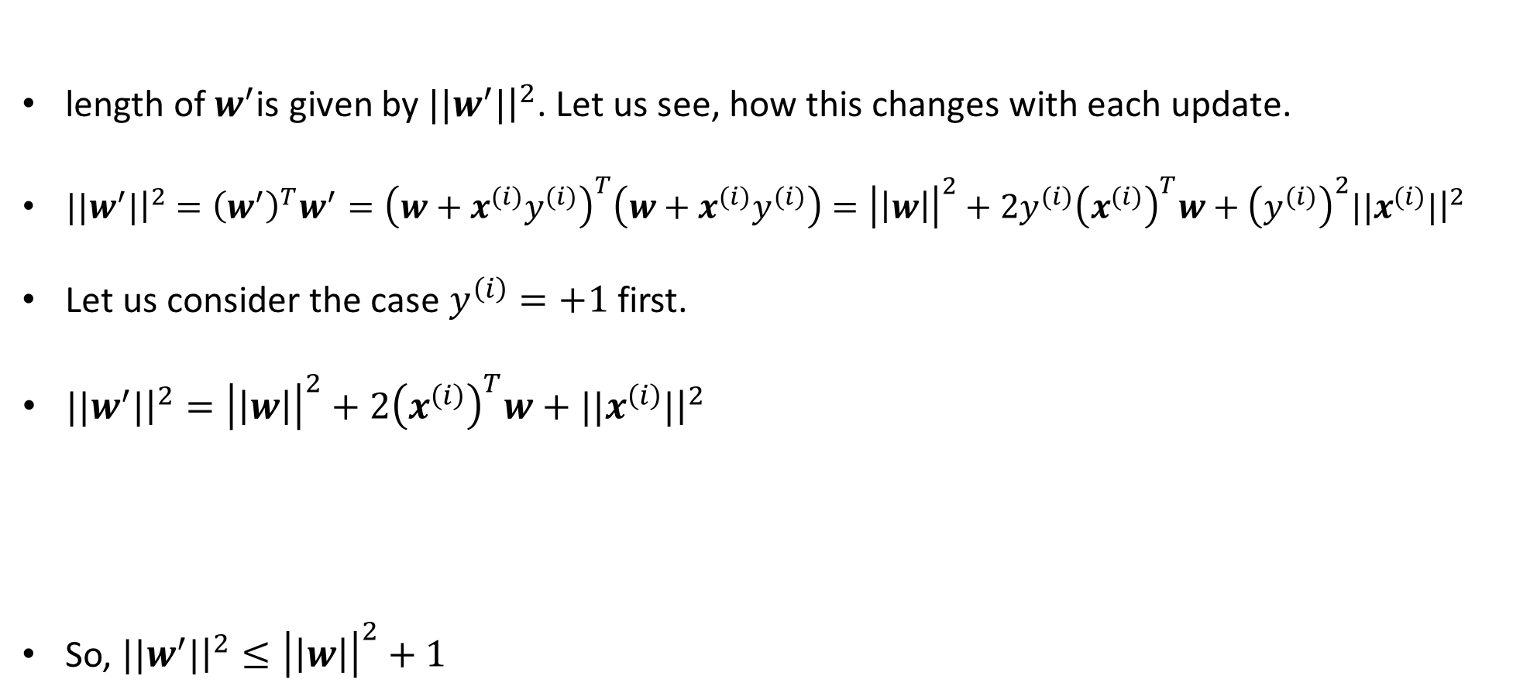
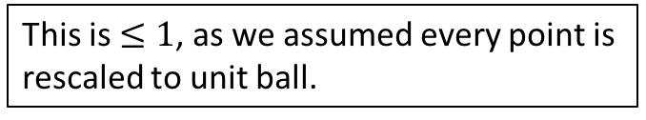
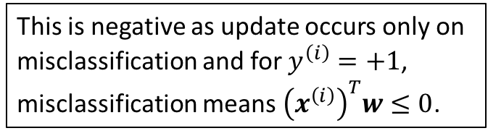
Perceptron Learning Algorithm – Convergence Proof
length of $w^{′}$is given by ${||w}^{′}|{\left.​\right|}^{2}$. Let us see, how this changes with each update.
${||w}^{′}|{\left.​\right|}^{2}={\left(w^{′}\right)}^{T}w^{′}={\left(w+x^{\left(i\right)}y^{\left(i\right)}\right)}^{T}\left(w+x^{\left(i\right)}y^{\left(i\right)}\right)={\left|\left|w\right|\right|}^{2}+2y^{\left(i\right)}{\left(x^{\left(i\right)}\right)}^{T}w+{\left(y^{\left(i\right)}\right)}^{2}{||x}^{\left(i\right)}|{\left.​\right|}^{2}$
Let us consider the case $y^{\left(i\right)}=+1$ first.
${||w}^{′}|{\left.​\right|}^{2}={\left|\left|w\right|\right|}^{2}+2{\left(x^{\left(i\right)}\right)}^{T}w+{||x}^{\left(i\right)}|{\left.​\right|}^{2}$
So, ${||w}^{′}|{\left.​\right|}^{2}≤{\left|\left|w\right|\right|}^{2}+1$
This is negative as update occurs only on misclassification and for $y^{\left(i\right)}=+1$, misclassification means ${\left(x^{\left(i\right)}\right)}^{T}w≤0$.
This is $≤1$, as we assumed every point is rescaled to unit ball.

Slide 14
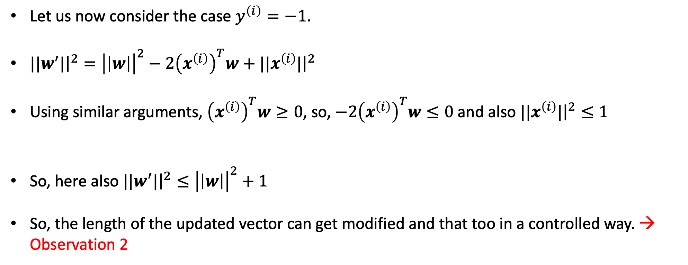
Perceptron Learning Algorithm – Convergence Proof
Let us now consider the case $y^{\left(i\right)}=−1$.
${||w}^{′}|{\left.​\right|}^{2}={\left|\left|w\right|\right|}^{2}−2{\left(x^{\left(i\right)}\right)}^{T}w+{||x}^{\left(i\right)}|{\left.​\right|}^{2}$
Using similar arguments, ${\left(x^{\left(i\right)}\right)}^{T}w≥0$, so, $−2{\left(x^{\left(i\right)}\right)}^{T}w≤0$ and also ${||x}^{\left(i\right)}|{\left.​\right|}^{2}≤1$
So, here also ${||w}^{′}|{\left.​\right|}^{2}≤{\left|\left|w\right|\right|}^{2}+1$
So, the length of the updated vector can get modified and that too in a controlled way. → Observation 2

Slide 15
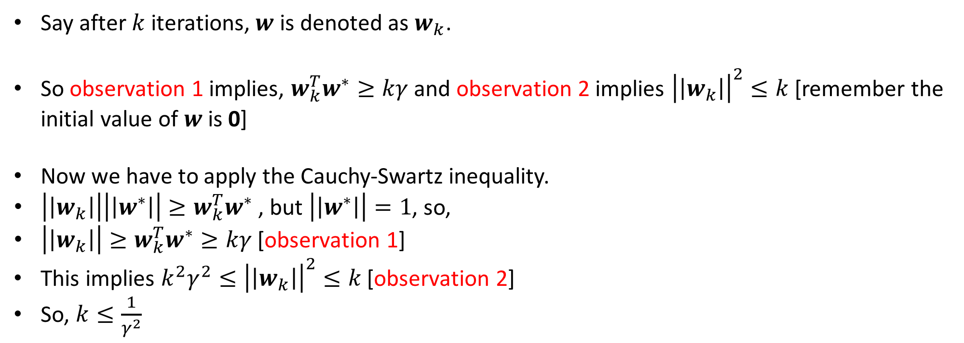
Perceptron Learning Algorithm – Convergence Proof
Say after $k$ iterations, $w$ is denoted as $w_{k}$.
So observation 1 implies, $w_{k}^{T}w^{∗}≥kγ$ and observation 2 implies ${\left|\left|w_{k}\right|\right|}^{2}≤k$ [remember the initial value of $w$ is 0]
Now we have to apply the Cauchy-Swartz inequality.
$\left|\left|w_{k}\right|\right|\left|\left|w^{∗}\right|\right|≥w_{k}^{T}w^{∗}$ , but $\left|\left|w^{∗}\right|\right|=1$, so,
$\left|\left|w_{k}\right|\right|≥w_{k}^{T}w^{∗}≥kγ$ [observation 1]
This implies $k^{2}γ^{2}≤{\left|\left|w_{k}\right|\right|}^{2}≤k$ [observation 2]
So, $k≤\frac{1}{γ^{2}}$
Notes:
What does the last line means -- http://www.cs.columbia.edu/~mcollins/courses/6998-2012/notes/perc.converge.pdf – look at the theorem statement.

Slide 17
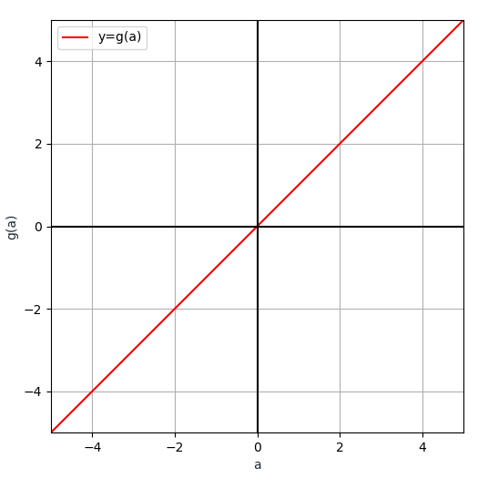
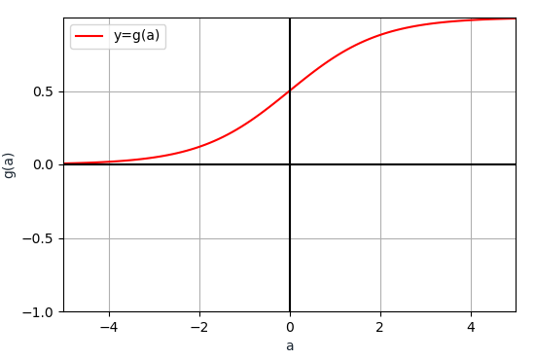
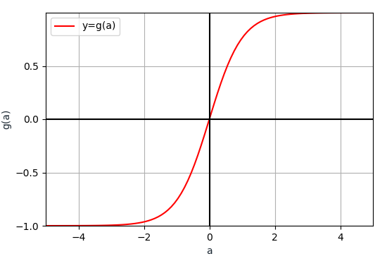
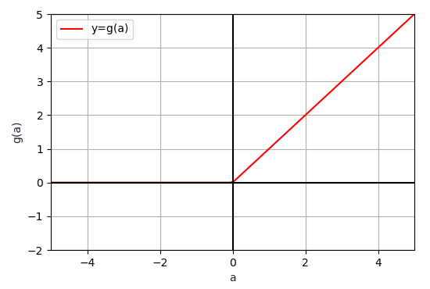
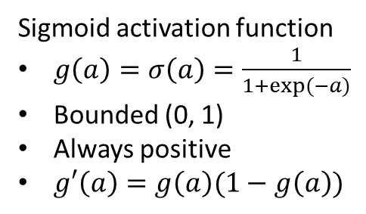
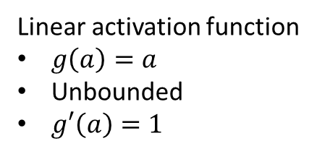
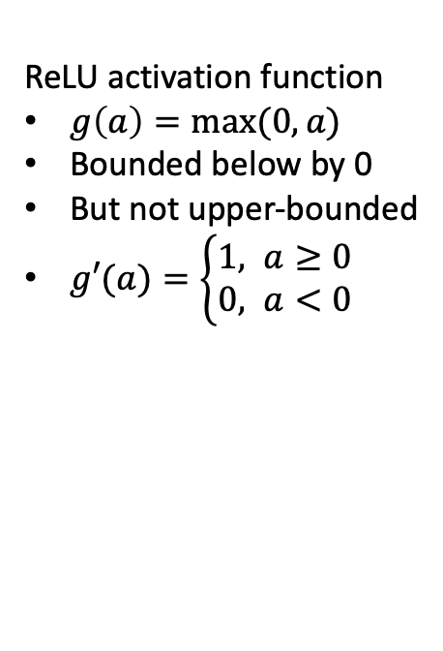
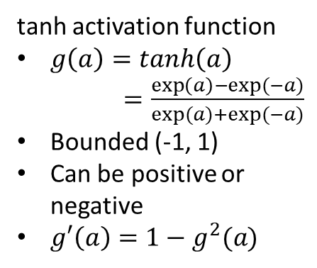
Popular Choices of Activation Functions
Linear activation function
$g\left(a\right)=a$
Unbounded
$g′\left(a\right)=1$
Sigmoid activation function
$g\left(a\right)=σ\left(a\right)=\frac{1}{1+exp⁡(−a)}$
Bounded (0, 1)
Always positive
$g′\left(a\right)=g\left(a\right)(1−g\left(a\right))$
tanh activation function
$g\left(a\right)=tanh\left(a\right)$ $=\frac{\exp\left(a\right)−exp⁡(−a)}{exp⁡(a)+exp⁡(−a)}$
Bounded (-1, 1)
Can be positive or negative
$g′\left(a\right)=1−g^{2}(a)$
ReLU activation function
$g\left(a\right)=max⁡(0,a)$
Bounded below by 0
But not upper-bounded
$g′(a)=\left\{\begin{aligned}1, a≥0 \\ &0, a<0\end{aligned}\right.$

Slide 18






















Multilayer Neural Network
$$x_{1}$$
$$w_{1}$$
$$x_{1}$$
$$w_{1}$$
$$w_{2}$$
$$a(x)$$
$$w_{2}$$
$$x_{2}$$
$$g(a)$$
$$y$$
$$x_{2}$$
$$y$$
$$g(a)$$
$$W_{0}=b$$
$$W_{0}=b$$
$$x_{d}$$
$$w_{d}$$
$$x_{d}$$
$$w_{d}$$
$$1$$
$$1$$
A bit of notation change

Slide 19

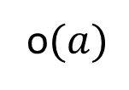









Input Layer
Hidden Layer
Multilayer Neural Network
$$x_{1}$$
$$1$$
$$x_{2}$$
$$g(a)$$
$$1$$
Output Layer
Intuition:-
Hidden Layer: Extracts better representation of the input data
Output layer: Does the classification
$$x_{d}$$
$$y$$
$$g(a)$$
o$(a)$
$$1$$
$$g(a)$$

Slide 20








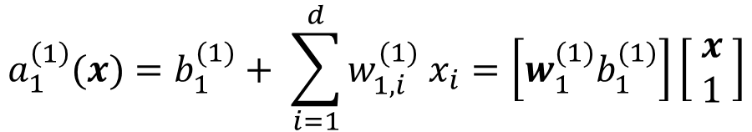
Input Layer
Hidden Layer
Multilayer Neural Network
$$x_{1}$$
$$w_{1,1}^{(1)}$$
$$1$$
$$a_{1}^{\left(1\right)}(x)=b_{1}^{(1)}+ \sum_{i=1}^{d}{w_{1,i}^{(1)} x_{i}}=\left[w_{1}^{(1)}b_{1}^{(1)}\right]\left[\begin{matrix} x \\ 1 \end{matrix}\right]$$
$$w_{1,0}^{(1)}=b_{1}^{(1)}$$
$$x_{2}$$
$$w_{1,2}^{(1)}$$
$$h_{1}^{(1)}$$
$$g(a)$$
Row vector
$$\left[w_{1, 1}^{(1)},w_{1, 2}^{(1)}, ⋯,w_{1, d}^{(1)}\right]$$
Column vector
$${\left[x_{1} x_{2}…x_{d}\right]}^{T}$$
$$h_{1}^{(1)}=g\left(a_{1}^{\left(1\right)}\left(x\right)\right)$$
$$x_{d}$$
$$w_{1,d}^{(1)}$$

Slide 21









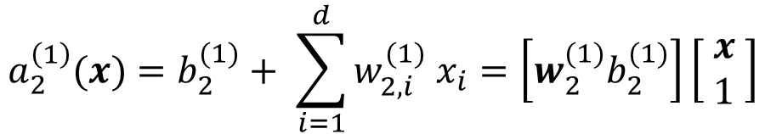





Input Layer
Hidden Layer
Multilayer Neural Network
$$x_{1}$$
$$w_{1,1}^{(1)}$$
$$1$$
$$a_{1}^{\left(1\right)}(x)=b_{1}^{(1)}+ \sum_{i=1}^{d}{w_{1,i}^{(1)} x_{i}}=\left[w_{1}^{(1)}b_{1}^{(1)}\right]\left[\begin{matrix} x \\ 1 \end{matrix}\right]$$
$$w_{1,0}^{(1)}=b_{1}^{(1)}$$
$$w_{1,2}^{(1)}$$
$$x_{2}$$
$$w_{2,1}^{(1)}$$
$$h_{1}^{(1)}$$
$$g(a)$$
$$h_{1}^{(1)}=g\left(a_{1}^{\left(1\right)}\left(x\right)\right)$$
$$w_{2,2}^{(1)}$$
$$1$$
$$a_{2}^{\left(1\right)}(x)=b_{2}^{(1)}+ \sum_{i=1}^{d}{w_{2,i}^{(1)} x_{i}}=\left[w_{2}^{(1)}b_{2}^{(1)}\right]\left[\begin{matrix} x \\ 1 \end{matrix}\right]$$
$$w_{2,0}^{(1)}=b_{2}^{(1)}$$
$$w_{2,3}^{(1)}$$
$$h_{2}^{(1)}$$
$$x_{d}$$
$$w_{1,d}^{(1)}$$
$$g(a)$$
$$h_{2}^{(1)}=g\left(a_{2}^{\left(1\right)}\left(x\right)\right)$$

Slide 22










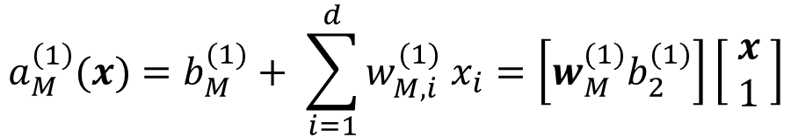



Input Layer
Hidden Layer
Multilayer Neural Network
$$x_{1}$$
$$w_{1,1}^{(1)}$$
$$1$$
$$a_{1}^{\left(1\right)}(x)=b_{1}^{(1)}+ \sum_{i=1}^{d}{w_{1,i}^{(1)} x_{i}}=\left[w_{1}^{(1)}b_{1}^{(1)}\right]\left[\begin{matrix} x \\ 1 \end{matrix}\right]$$
$$w_{1,0}^{(1)}=b_{1}^{(1)}$$
$$w_{1,2}^{(1)}$$
$$x_{2}$$
$$w_{2,1}^{(1)}$$
$$h_{1}^{(1)}$$
$$g(a)$$
$$h_{1}^{(1)}=g\left(a_{1}^{\left(1\right)}\left(x\right)\right)$$
$$w_{2,2}^{(1)}$$
$$1$$
$$a_{2}^{\left(1\right)}(x)=b_{2}^{(1)}+ \sum_{i=1}^{d}{w_{2,i}^{(1)} x_{i}}=\left[w_{2}^{(1)}b_{2}^{(1)}\right]\left[\begin{matrix} x \\ 1 \end{matrix}\right]$$
$$w_{2,0}^{(1)}=b_{2}^{(1)}$$
$$w_{M,2}^{(1)}$$
$$w_{2,3}^{(1)}$$
$$h_{2}^{(1)}$$
$$x_{d}$$
$$w_{1,d}^{(1)}$$
$$g(a)$$
$$h_{2}^{(1)}=g\left(a_{2}^{\left(1\right)}\left(x\right)\right)$$
$$w_{M,1}^{(1)}$$
$$a_{M}^{\left(1\right)}(x)=b_{M}^{(1)}+ \sum_{i=1}^{d}{w_{M,i}^{(1)} x_{i}}=\left[w_{M}^{(1)}b_{2}^{(1)}\right]\left[\begin{matrix} x \\ 1 \end{matrix}\right]$$
$$w_{M,3}^{(1)}$$
$$1$$
$$w_{M,0}^{(1)}=b_{M}^{(1)}$$
$$h_{M}^{(1)}=g\left(a_{M}^{\left(1\right)}\left(x\right)\right)$$
$$h_{M}^{(1)}$$
$$g(a)$$

Slide 23






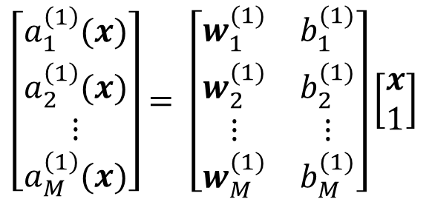
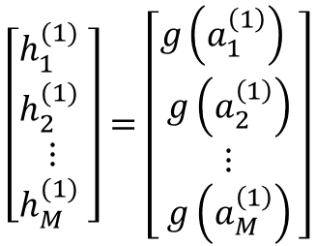
Input Layer
Hidden Layer
Multilayer Neural Network
$$x_{1}$$
$$1$$
$$a_{1}^{\left(1\right)}(x)=\left[w_{1}^{(1)}b_{1}^{(1)}\right]\left[\begin{matrix} x \\ 1 \end{matrix}\right]$$
$$\left[\begin{aligned}\begin{matrix}a_{1}^{\left(1\right)}(x) \\ a_{2}^{\left(1\right)}(x) \\ ⋮\end{matrix} \\ a_{M}^{\left(1\right)}(x)\end{aligned}\right]= \left[\begin{matrix}w_{1}^{(1)} & b_{1}^{(1)} \\ \begin{aligned}w_{2}^{(1)} \\ ⋮\end{aligned} & \begin{aligned}b_{2}^{(1)} \\ ⋮\end{aligned} \\ w_{M}^{(1)} & b_{M}^{(1)}\end{matrix}\right]\left[\begin{matrix}x \\ 1\end{matrix}\right]$$
$$a_{2}^{\left(1\right)}(x)=\left[w_{2}^{(1)}b_{2}^{(1)}\right]\left[\begin{matrix} x \\ 1 \end{matrix}\right]$$
$$x_{2}$$
$$h_{1}^{(1)}$$
$$g(a)$$
$$⋮$$
$$a_{M}^{\left(1\right)}(x)=\left[w_{M}^{(1)}b_{2}^{(1)}\right]\left[\begin{matrix} x \\ 1 \end{matrix}\right]$$
$$1$$
$$a^{\left(1\right)}\left(x\right)=\left[W^{(1)}b^{(1)}\right]\left[\begin{matrix} x \\ 1 \end{matrix}\right]$$
$$x_{d}$$
$$h_{2}^{(1)}$$
$$g(a)$$
Matrix
Column vector
Column vector
Column vector
$$1$$
$$\left[\begin{aligned}\begin{matrix}h_{1}^{(1)} \\ h_{2}^{(1)} \\ ⋮\end{matrix} \\ h_{M}^{(1)} \end{aligned}\right]=\left[\begin{aligned}\begin{matrix}g\left(a_{1}^{\left(1\right)}\right) \\ g\left(a_{2}^{\left(1\right)}\right) \\ ⋮\end{matrix} \\ g\left(a_{M}^{\left(1\right)}\right)\end{aligned}\right]$$
Hidden Layer Activation
$$h^{\left(1\right)}=g\left(a^{(1)}\right)$$
$$h_{M}^{(1)}$$
$$g(a)$$

Slide 24


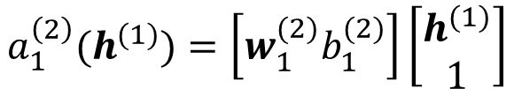





Input Layer
Hidden Layer
Multilayer Neural Network
$$x_{1}$$
$$1$$
Output Layer Pre-activation
$$a_{1}^{\left(2\right)}(h^{(1)})=\left[w_{1}^{(2)}b_{1}^{(2)}\right]\left[\begin{matrix}h^{(1)} \\ 1 \end{matrix}\right]$$
$$x_{2}$$
$$h_{1}^{(1)}$$
$$g(a)$$
$$w_{1,1}^{(2)}$$
Output Layer
Output Layer Activation
$$1$$
$$y=o\left(a_{1}^{\left(2\right)}(h^{(1)})\right)$$
$$h_{2}^{(1)}$$
$$x_{d}$$
$$y$$
$$g(a)$$
o$(a)$
o can have many options
sigmoid
tanh
Relu etc.
$$w_{1,2}^{(2)}$$
$$1$$
$$w_{1,M}^{(2)}$$
One special is softmax function
$$g(a)$$
$$h_{M}^{(1)}$$

Slide 25
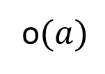

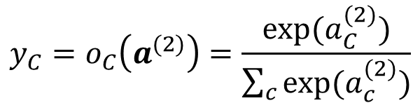


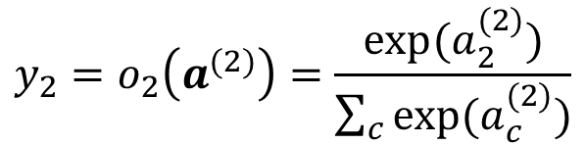
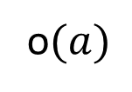
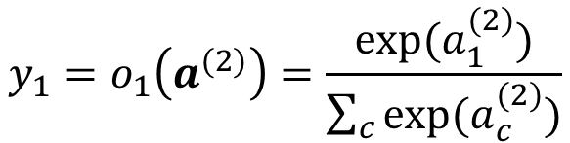
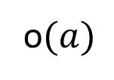
Input Layer
Hidden Layer
Multilayer Neural Network
Output Layer
$$x_{1}$$
$$1$$
$$a_{1}^{(2)}$$
$${y_{1}=o}_{1}\left(a^{(2)}\right)=\frac{exp⁡(a_{1}^{(2)})}{\sum_{c}{exp⁡(a_{c}^{(2)})}}$$
$$x_{2}$$
o$(a)$
$$1$$
Softmax function:
Exponentiate each component of output activation vector and elementwise divide by the sum of the exponentials.
$$a_{2}^{(2)}$$
$${y_{2}=o}_{2}\left(a^{(2)}\right)=\frac{exp⁡(a_{2}^{(2)})}{\sum_{c}{exp⁡(a_{c}^{(2)})}}$$
$$x_{d}$$
o$(a)$
$$1$$
$$a_{C}^{(2)}$$
$${y_{C}=o}_{C}\left(a^{(2)}\right)=\frac{exp⁡(a_{C}^{(2)})}{\sum_{c}{exp⁡(a_{c}^{(2)})}}$$
o$(a)$
Notes:
Note: I have changed to summation symbol.

Slide 26











Training a Neural Network – Loss Function
$$x_{1}$$
$$1$$
$$x_{2}$$
Probability that $x$ belongs to class 1
So we can aim to maximize the probability corresponding to the correct class for any example $x$
$$y_{1}$$
$$g(a)$$
o$(a)$
$$1$$
Probability that $x$ belongs to class 2
$$\max{y_{c}}$$
$$x_{d}$$
$$y_{2}$$
$$g(a)$$
o$(a)$
$$≡max (log{y_{c}})$$
$$≡min (−log{y_{c}})$$
$$1$$
Can be equivalently expressed as $−\sum_{i}{𝕀\left(i=c\right)log⁡(y_{i})}$ known as cross-entropy loss
Probability that $x$ belongs to class C
$$y_{C}$$
$$g(a)$$
o$(a)$
Notes:
We know using softmax activation, each neuron in the output layer provides the probability that the input belongs to the corresponding class. So, y_1 gives the probability that x belongs to class 1, y_2 gives the probability that x belongs to class 2 etc.
so y_c = p(x belongs to class c)
So, what we can aim to do is maximize the probability corresponding to the correct class for any example x.
Now logarithm is a monotonically increasing function that is [See what Hugo says]. So, we can as well maximize log of the probability. Also maximizing something is same as minimizing the negative of it. So, we can aim to minimize the negative log of the probability. Now, in real life we also try to minimize something which causes us some loss. It is ridiculous to minimize something which causes happiness. So, appropriately the Mathematicians call this term as loss and the aim is to minimize loss.
If x denotes the example and c is the class label [c is any number between 1 and C -- the total number of classes], then our loss function is defined as

Slide 27

















Forward Pass in a Nutshell
$θ$ is the collection of all learnable parameters i.e., all $W$ and $b$
$$x$$
$${(h}^{(0)})$$
$$W^{(1)},b^{(1)}$$
$$g(.)$$
$$W^{(2)},b^{(2)}$$
$$g(.)$$
$$W^{(L)},b^{(L)}$$
o$(.)$
$$y=f(x, θ)$$
$$a^{(1)}$$
$$h^{(1)}$$
$$a^{(2)}$$
$$h^{(2)}$$
$$a^{(L)}$$
Hidden layer pre-activation:
For $l=1,…,L; a^{\left(l\right)}=W^{\left(l\right)}h^{\left(l−1\right)}+b^{(l)}$
Hidden layer activation:
For $l=1,…,L−1; h^{\left(l\right)}={g(a}^{\left(l\right)})$
Output layer activation:
For $l=L; h^{\left(L\right)}={o(a}^{\left(L\right)})=f(x, θ)$
Notes:
Let us now turn our attention to a multi-layer neural network where there are not one, but multiple hidden layers. Lets say we have L hidden layers. The input layer can be thought of as the 0th hidden layer. And the output layer is as usual denoted by ’o’ – basically the activation function of the output layer.
Similar to what we have seen in the previous class, the pre-activation of any layer is given by w times h + b. The hidden layer activation is obtained by passing the pre-activation value through the activation function. Only the output layer activation is denoted as ‘o’.
The whole computation from x to y is called the forward pass where in each layer computation of pre-activation and then activation and then again pre-activation, activation, this goes on.
All learnable parameters i.e., all W and b are collectively called theta. In learning, our task is to come up with a proper theta that causes the loss to be minimum – which means we are looking for a theta that causes as many correct classifications as possible.

Slide 28















Backpropagation
$$h^{(l−1)}$$
$$W^{(l)},b^{(l)}$$
$$g(.)$$
$$W^{(l+1)},b^{(l+1)}$$
$$g(.)$$
$$W^{(L)},b^{(L)}$$
o$(.)$
$$y=f(x, θ)$$
$$a^{(l)}$$
$$h^{(l)}$$
$$a^{(l+1)}$$
$$h^{(l+1)}$$
$$a^{(L)}$$
$$J\left(f\left(x, θ\right),c \right)$$
True class of the example
For gradient descent we need to compute $\frac{∂J}{∂W_{i,j}^{(l)}}$ and $\frac{∂J}{∂b_{i}^{(l)}} ∀i,j,l$
Backpropagation consists of intelligent use of the chain rule of differentiation for computation of these gradients
Notes:
The procedure by which we get such thetas is called backpropagation – which is nothing but intelligent use of the chain rule of differentiation for computation of loss function w.r.t. these parameters.
For gradient descent we need to compute [TELL] and let us see how this is done.

Slide 29




Backpropagation
$$h^{(l−1)}$$
$$W^{(l)},b^{(l)}$$
$$g(.)$$
$$W^{(l+1)},b^{(l+1)}$$
$$g(.)$$
$$W^{(L)},b^{(L)}$$
o$(.)$
$$y=f(x, θ)$$
$$a^{(l)}$$
$$h^{(l)}$$
$$a^{(l+1)}$$
$$h^{(l+1)}$$
$$a^{(L)}$$
$$J\left(f\left(x, θ\right),c \right)$$
$W_{i,j}^{(l)}$ influences $J$ through $a_{i}^{(l)}$. That means $J$ is a function of $a_{i}^{(l)}$ and $a_{i}^{(l)}$, in turn, is a function of$W_{i,j}^{(l)}$
$$\frac{∂J}{∂W_{i,j}^{(l)}}=\frac{∂J}{∂a_{i}^{(l)}}\frac{∂a_{i}^{(l)}}{∂W_{i,j}^{(l)}}$$
$$a_{i}^{\left(l\right)}=\sum_{j}{W_{i,j}^{(l)} h_{j}^{(l−1)}}+b_{i}^{(l)}=W_{i,1}^{(l)} h_{1}^{(l−1)}+W_{i,2}^{(l)} h_{2}^{(l−1)}+…+W_{i,j}^{\left(l\right)} h_{j}^{\left(l−1\right)}+…+b_{i}^{(l)}$$
$$⇒\frac{∂J}{∂W_{i,j}^{(l)}}=\frac{∂J}{∂a_{i}^{(l)}}\frac{∂a_{i}^{(l)}}{∂W_{i,j}^{(l)}}=\frac{∂J}{∂a_{i}^{(l)}}h_{j}^{\left(l−1\right)}$$
… (1)
We know $h_{j}^{\left(l−1\right)}$ from forward pass, so we need $\frac{∂J}{∂a_{i}^{(l)}}$
And similarly $\frac{∂J}{∂b_{i}^{(l)}}=\frac{∂J}{∂a_{i}^{(l)}}\frac{∂a_{i}^{(l)}}{∂b_{i}^{(l)}}=\frac{∂J}{∂a_{i}^{(l)}}$
… (2)

Slide 30

Backpropagation
$$h^{(l−1)}$$
$$W^{(l)},b^{(l)}$$
$$g(.)$$
$$W^{(l+1)},b^{(l+1)}$$
$$g(.)$$
$$W^{(L)},b^{(L)}$$
o$(.)$
$$y=f(x, θ)$$
$$a^{(l)}$$
$$h^{(l)}$$
$$a^{(l+1)}$$
$$h^{(l+1)}$$
$$a^{(L)}$$
$$J\left(f\left(x, θ\right),c \right)$$
$a_{i}^{(l)}$ influences $J$ through $h_{i}^{(l)}$. That means $J$ is a function of $h_{i}^{(l)}$ and $h_{i}^{(l)}$, in turn, is a function of$a_{i}^{(l)}$
$$\frac{∂J}{∂a_{i}^{(l)}}=\frac{∂J}{∂h_{i}^{(l)}}\frac{∂h_{i}^{(l)}}{∂a_{i}^{(l)}}=\frac{∂J}{∂h_{i}^{(l)}}g′\left(a_{i}^{(l)}\right)$$
… (3)
We know $g′\left(a_{i}^{(l)}\right)$ from forward pass, so we need $\frac{∂J}{∂h_{i}^{(l)}}$

Slide 31




Backpropagation
$$h^{(l−1)}$$
$$W^{(l)},b^{(l)}$$
$$g(.)$$
$$W^{(l+1)},b^{(l+1)}$$
$$g(.)$$
$$W^{(L)},b^{(L)}$$
o$(.)$
$$y=f(x, θ)$$
$$a^{(l)}$$
$$h^{(l)}$$
$$a^{(l+1)}$$
$$h^{(l+1)}$$
$$a^{(L)}$$
$$J\left(f\left(x, θ\right),c \right)$$
$h_{i}^{(l)}$ influences $J$ through $a_{1:M_{l+1}}^{(l+1)}$ . That means $J$ is a function of${ a}_{1:M_{l+1}}^{(l+1)}$and each of $a_{1:M_{l+1}}^{(l+1)}$, in turn, is a function of$h_{i}^{(l)}$
Number of neurons in hidden layer $(l+1)$
$$\frac{∂J}{∂h_{i}^{(l)}}=\sum_{m=1}^{M_{l+1}}{\frac{∂J}{∂a_{m}^{(l+1)}}}\frac{∂a_{m}^{(l+1)}}{∂h_{i}^{(l)}}$$
Remember I$f, u=f\left(x,y\right), where x=φ\left(t\right), y=ψ\left(t\right), then \frac{∂u}{∂t}=\frac{∂u}{∂x}\frac{∂x}{∂t}+\frac{∂u}{∂y}\frac{∂y}{∂t}$
$$a_{m}^{\left(l+1\right)}=\sum_{j}{W_{m,j}^{(l+1)} h_{j}^{(l)}}+b_{m}^{(l+1)}=W_{m,1}^{(l+1)} h_{1}^{(l)}+W_{m,2}^{(l+1)} h_{2}^{(l)}+…+W_{m,i}^{\left(l+1\right)} h_{i}^{\left(l\right)}+…+b_{m}^{(l+1)}$$
$$⇒\frac{∂J}{∂h_{i}^{(l)}}=\sum_{m=1}^{M_{l+1}}{\frac{∂J}{∂a_{m}^{(l+1)}}}W_{m,i}^{\left(l+1\right)}$$
… (4)
Notes:
The rule is obtained from result 9.8 in Dada’s pass course Math book

Slide 32














Backpropagation
$$\left[W_{m,i}^{(l)} \right]$$
$$b_{i}^{(l)}$$
$$\left[W_{i,j}^{(l)} \right]$$
$$h_{j}^{\left(l−1\right)}$$
$$×$$
$$+$$
$$a_{i}^{(l)}$$
$$g(.)$$
$$h_{i}^{\left(l\right)}$$
$$\frac{∂J}{∂a_{i}^{(l)}}=\frac{∂J}{∂h_{i}^{(l)}}g′\left(a_{i}^{(l)}\right)$$
… (3)
$$g′(.)$$
$$\frac{∂J}{∂a_{i}^{(l)}}$$
$$×$$
$$\frac{∂J}{∂h_{i}^{(l)}}$$

Slide 33


Backpropagation
$$\left[W_{m,i}^{(l)} \right]$$
$$\frac{∂J}{∂b_{i}^{(l)}}$$
$$b_{i}^{(l)}$$
$$\left[W_{i,j}^{(l)} \right]$$
$$h_{j}^{\left(l−1\right)}$$
$$×$$
$$+$$
$$a_{i}^{(l)}$$
$$g(.)$$
$$h_{i}^{\left(l\right)}$$
$$\frac{∂J}{∂a_{i}^{(l)}}=\frac{∂J}{∂h_{i}^{(l)}}g′\left(a_{i}^{(l)}\right)$$
… (3)
$$\frac{∂J}{∂b_{i}^{(l)}}=\frac{∂J}{∂a_{i}^{(l)}}$$
… (2)
$$g′(.)$$
$$\frac{∂J}{∂a_{i}^{(l)}}$$
$$×$$
$$\frac{∂J}{∂h_{i}^{(l)}}$$

Slide 34



Backpropagation
$$\left[W_{m,i}^{(l)} \right]$$
$$\frac{∂J}{∂W_{i,j}^{(l)}}$$
$$\frac{∂J}{∂b_{i}^{(l)}}$$
$$b_{i}^{(l)}$$
$$\left[W_{i,j}^{(l)} \right]$$
$$×$$
$$h_{j}^{\left(l−1\right)}$$
$$×$$
$$+$$
$$a_{i}^{(l)}$$
$$g(.)$$
$$h_{i}^{\left(l\right)}$$
$$\frac{∂J}{∂a_{i}^{(l)}}=\frac{∂J}{∂h_{i}^{(l)}}g′\left(a_{i}^{(l)}\right)$$
… (3)
$$\frac{∂J}{∂b_{i}^{(l)}}=\frac{∂J}{∂a_{i}^{(l)}}$$
… (2)
$$g′(.)$$
$$\frac{∂J}{∂W_{i,j}^{(l)}}=\frac{∂J}{∂a_{i}^{(l)}}h_{j}^{\left(l−1\right)}$$
… (1)
$$\frac{∂J}{∂a_{i}^{(l)}}$$
$$×$$
$$\frac{∂J}{∂h_{i}^{(l)}}$$

Slide 35





Backpropagation
$$\left[W_{m,i}^{(l)} \right]$$
$$\frac{∂J}{∂W_{i,j}^{(l)}}$$
$$\frac{∂J}{∂b_{i}^{(l)}}$$
$$b_{i}^{(l)}$$
$$\left[W_{i,j}^{(l)} \right]$$
$$×$$
$$h_{j}^{\left(l−1\right)}$$
$$×$$
$$+$$
$$a_{i}^{(l)}$$
$$g(.)$$
$$h_{i}^{\left(l\right)}$$
$$\frac{∂J}{∂a_{i}^{(l)}}=\frac{∂J}{∂h_{i}^{(l)}}g′\left(a_{i}^{(l)}\right)$$
… (3)
$$∀i=1:M_{L}$$
$$\frac{∂J}{∂b_{i}^{(l)}}=\frac{∂J}{∂a_{i}^{(l)}}$$
… (2)
$$g′(.)$$
$$\frac{∂J}{∂W_{i,j}^{(l)}}=\frac{∂J}{∂a_{i}^{(l)}}h_{j}^{\left(l−1\right)}$$
… (1)
$$\frac{∂J}{∂h_{i}^{(l−1)}}$$
$$×$$
$$\frac{∂J}{∂a_{i}^{(l)}}$$
$$\frac{∂J}{∂h_{i}^{(l)}}$$
$$\frac{∂J}{∂h_{i}^{(l−1)}}=\sum_{m=1}^{M_{l}}{\frac{∂J}{∂a_{m}^{(l)}}}W_{m,i}^{\left(l\right)}$$
and
$$∀i=1:M_{L}$$
$$×$$
… (4)
$$+$$

Slide 36

Training Multilayer Neural Network for non-linearly Separable Data
Training Data

Slide 37








Learned Decision Boundary with Single Hidden Layer
# of hidden neurons = 2
# of hidden neurons = 4
# of hidden neurons = 8
# of hidden neurons = 16
# of hidden neurons = 32
# of hidden neurons = 64
# of hidden neurons = 128
# of hidden neurons = 256

Slide 38





Learned Decision Boundary with Two Hidden Layers
# of neurons in each hidden layer = 2
# of neurons in each hidden layer = 4
# of neurons in each hidden layer = 8
# of neurons in each hidden layer = 16
# of neurons in each hidden layer = 32

