Slide 1
Foundations of AI and ML CS21206
Abir Das and Ayan Chaudhury
Computer Science and Engineering Department
Indian Institute of Technology Kharagpur

Slide 2
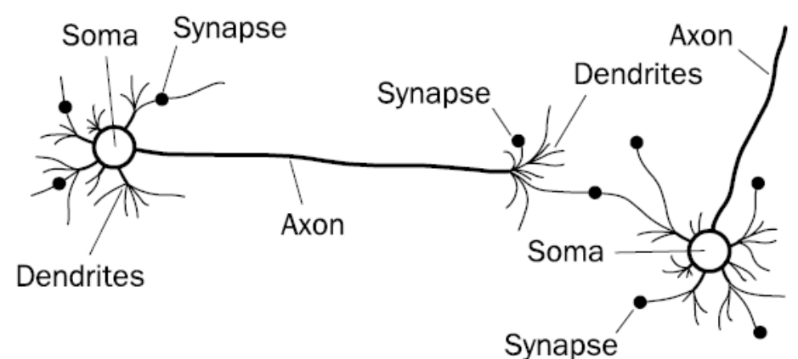
Biological Neural Network
Image courtesy: F. A. Makinde et. al., “Prediction of crude oil viscosity using feed-forward back-propagation neural network (FFBPNN)”." Petroleum & Coal 2012

Slide 3

Notes:
It is worthwhile to mention that it is not only the AI enthusiasts who are getting motivations from neuroscientific works but the reverse is also true. Prof. James DiCarlo the Head of the Department of Brain and Cognitive Sciences at MIT gave a fantastic Keynote speech at CVPR 2017 where he elaborated how advances in deep neural networks are helping explain what happens in the human visual cortex. I would highly encourage you all to listen to the talk which is available in youtube.
And our reference to biological neurons stops here for the purpose of this course. Just the take home message is: To us, a neuron is a computation unit that takes in a bunch of input signals, performs mathematical operations on them and transmit the resulting signal out.

Slide 4










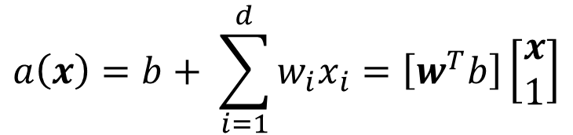

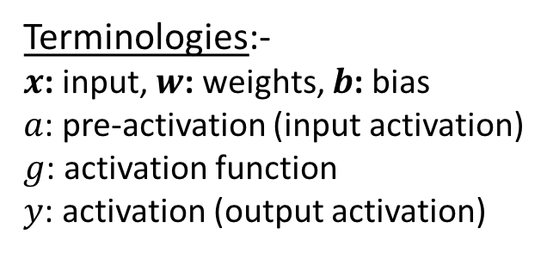



Artificial Neuron
$$w={\left[w_{1} w_{2}…w_{d}\right]}^{T}$$
and
$$x={\left[x_{1} x_{2}…x_{d}\right]}^{T}$$
$$x_{1}$$
$$a\left(x\right)=b+ \sum_{i=1}^{d}{w_{i}x_{i}}=\left[w^{T}b\right]\left[\begin{matrix}x \\ 1\end{matrix}\right]$$
$$w_{1}$$
$$w_{2}$$
$$a(x)$$
$$x_{2}$$
$$g(a)$$
$$y$$
$$y=g(a\left(x\right))$$
$$W_{0}=b$$
$$x_{d}$$
$$w_{d}$$
Terminologies:-
$x$: input, $w$: weights, $b$: bias
$a$: pre-activation (input activation)
$g$: activation function
$y$: activation (output activation)
$$1$$

Slide 5



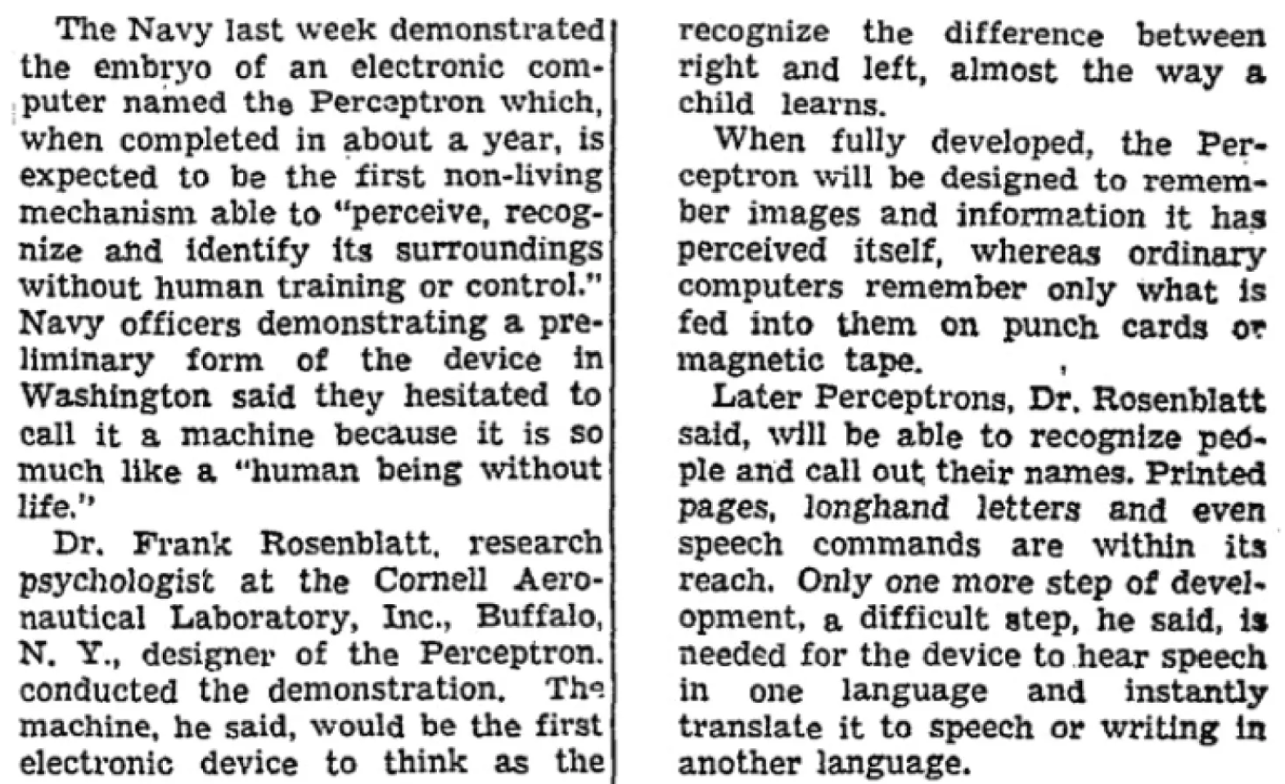
Perceptron
Image courtesy: https://blogs.umass.edu/comphon/2017/06/15/did-frank-rosenblatt-invent-deep-learning-in-1962/

Slide 6
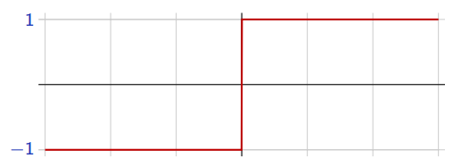
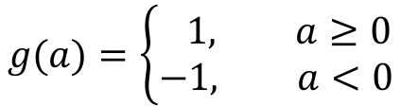

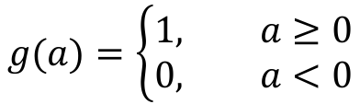



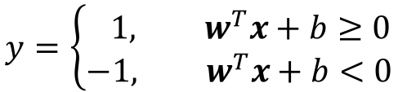
Perceptron
$x∈ℝ^{d}$ and $y∈\{0, 1\}$ – Binary Classification
$$g(a)=\left\{\begin{aligned}1, a≥0 \\ &0, a<0\end{aligned}\right.$$
(Rosenblatt, 1957)
$$x_{1}$$
$$w_{1}$$
$$w_{2}$$
To make things simpler, the response is taken as $y∈\{−1, 1\}$
$$a(x)$$
$$x_{2}$$
$$g(a)$$
$$y$$
$$g(a)=\left\{\begin{aligned} 1, a≥0 \\ &−1, a<0\end{aligned}\right.$$
$$g(a)$$
$$W_{0}=b$$
$$a$$
$$x_{d}$$
$$w_{d}$$
The perceptron classification rule, thus, translates to
$$1$$
$$y=\left\{\begin{aligned} 1, w^{T}x+b≥0 \\ &−1, w^{T}x+b<0\end{aligned}\right.$$
Remember: $w^{T}x+b=0$ represents
a hyperplane.

Slide 7
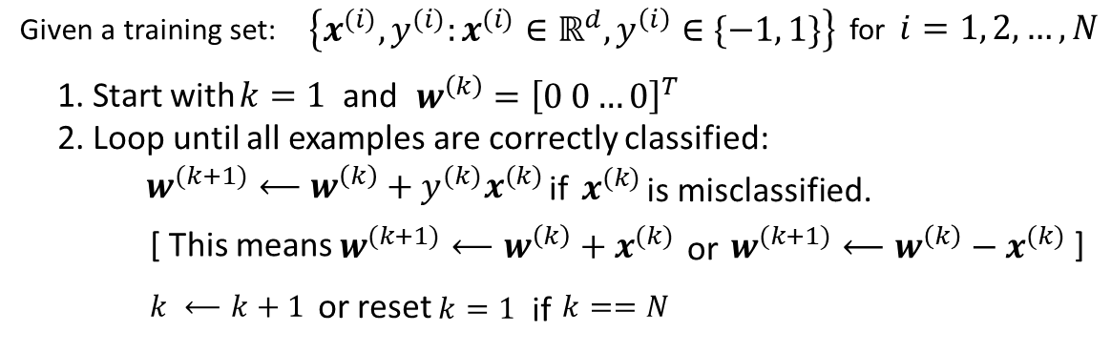
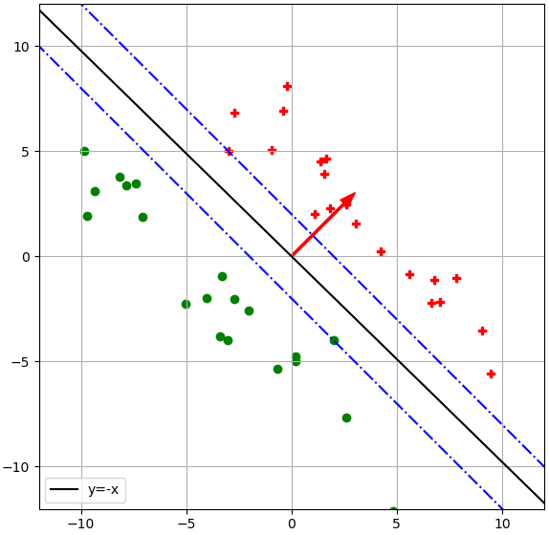
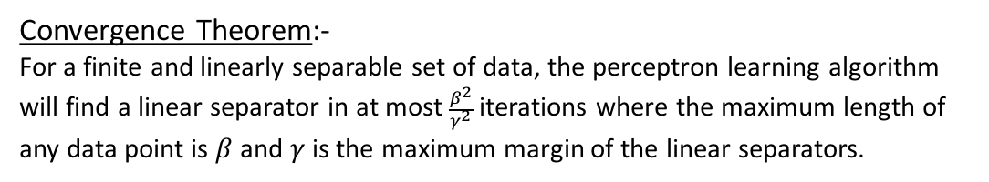


Perceptron Learning Algorithm
$$γ$$
$$β$$
Convergence Theorem:-
For a finite and linearly separable set of data, the perceptron learning algorithm will find a linear separator in at most $\frac{β^{2}}{γ^{2}}$ iterations where the maximum length of any data point is $β$ and $γ$ is the maximum margin of the linear separators.

Slide 8
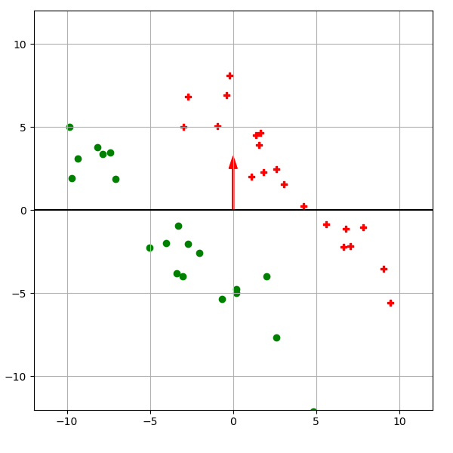
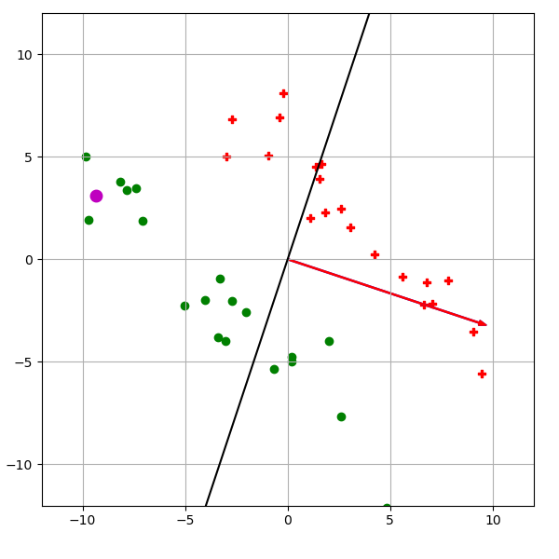
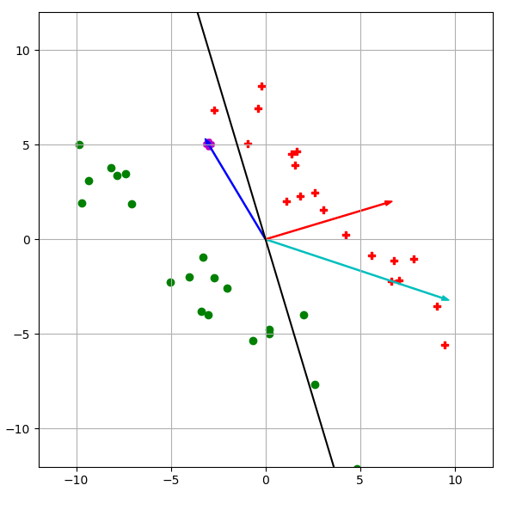
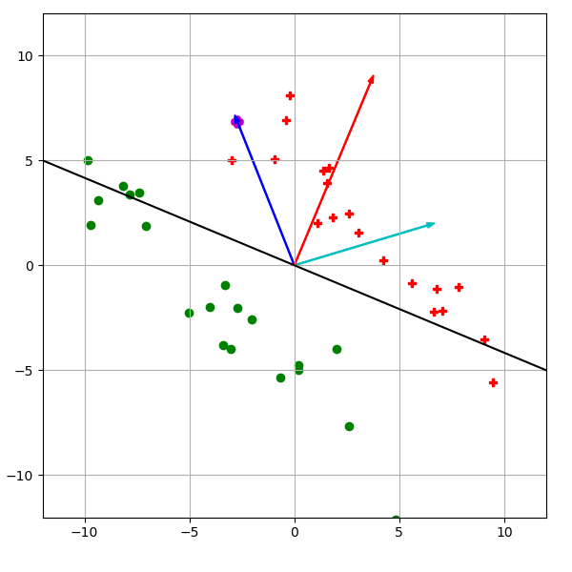
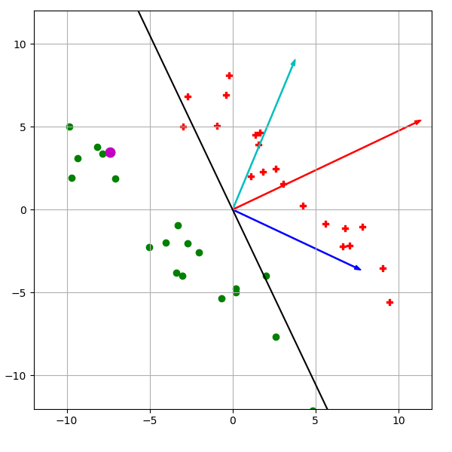
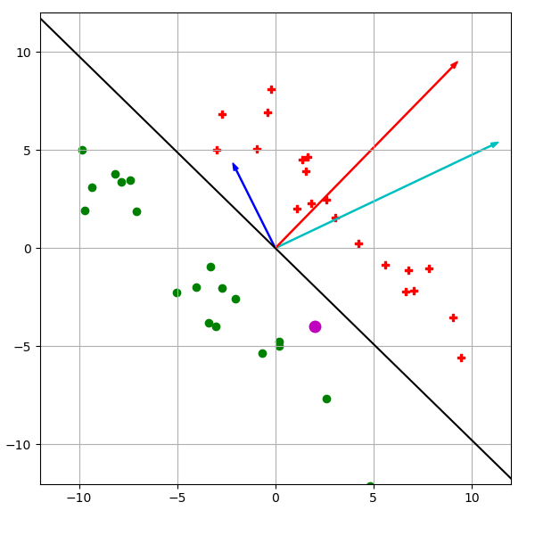

Slide 9














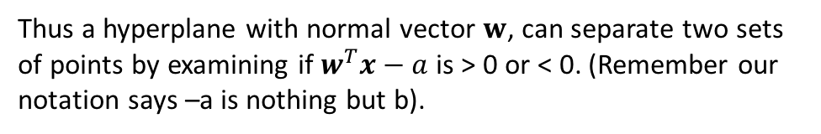
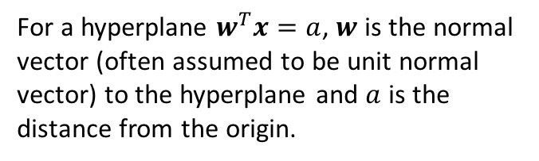





Perceptron Learning Algorithm – Convergence Proof
Some Important Brush-ups:-
$$x^{(1)}$$
$$x^{(1)}$$
$$x^{(1)}$$
$$x^{(2)}$$
$$w$$
$$x^{(2)}$$
$$w$$
$$x^{(2)}$$
$$w$$
$$x^{(3)}$$
$$x^{(3)}$$
$$x^{(3)}$$
$$>a$$
$$a$$
$$<a$$
$$(0,0)$$
$$(0,0)$$
$$(0,0)$$
$$w^{T}x=a$$
$$w^{T}x=a$$
$$w^{T}x=a$$
For a hyperplane $w^{T}x=a$, $w$ is the normal vector (often assumed to be unit normal vector) to the hyperplane and $a$ is the distance from the origin.
Thus a hyperplane with normal vector $w$, can separate two sets of points by examining if $w^{T}x−a$ is > 0 or < 0. (Remember our notation says –a is nothing but b).

Slide 10
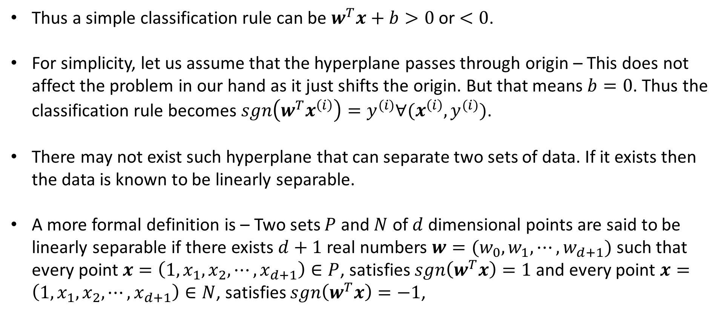
Perceptron Learning Algorithm – Convergence Proof
Thus a simple classification rule can be $w^{T}x+b>0$ or $<0$.
For simplicity, let us assume that the hyperplane passes through origin – This does not affect the problem in our hand as it just shifts the origin. But that means $b=0$. Thus the classification rule becomes $sgn\left(w^{T}x^{\left(i\right)}\right)=y^{(i)}∀(x^{\left(i\right)},y^{(i)})$.
There may not exist such hyperplane that can separate two sets of data. If it exists then the data is known to be linearly separable.
A more formal definition is – Two sets $P$ and $N$ of $d$ dimensional points are said to be linearly separable if there exists $d+1$ real numbers ${w=(w}_{0},w_{1}, ⋯, w_{d+1})$ such that every point $x=\left(1,x_{1}, x_{2},⋯, x_{d+1}\right)∈P$, satisfies $sgn\left(w^{T}x\right)=1$ and every point $x=\left(1,x_{1}, x_{2},⋯, x_{d+1}\right)∈N$, satisfies $sgn\left(w^{T}x\right)=−1$,

Slide 11
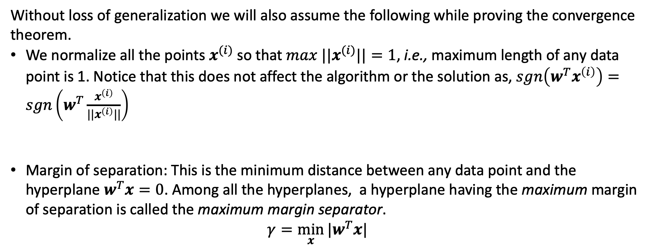
Perceptron Learning Algorithm – Convergence Proof
Without loss of generalization we will also assume the following while proving the convergence theorem.
We normalize all the points $x^{(i)}$ so that ${max ||x}^{(i)}||=1$, i.e., maximum length of any data point is 1. Notice that this does not affect the algorithm or the solution as, $sgn\left(w^{T}x^{\left(i\right)}\right)=sgn\left(w^{T}\frac{x^{\left(i\right)}}{||x^{\left(i\right)}||}\right)$
Margin of separation: This is the minimum distance between any data point and the hyperplane $w^{T}x=0$. Among all the hyperplanes, a hyperplane having the maximum margin of separation is called the maximum margin separator. $γ=\min_{x}{|w^{T}x|}$

Slide 12
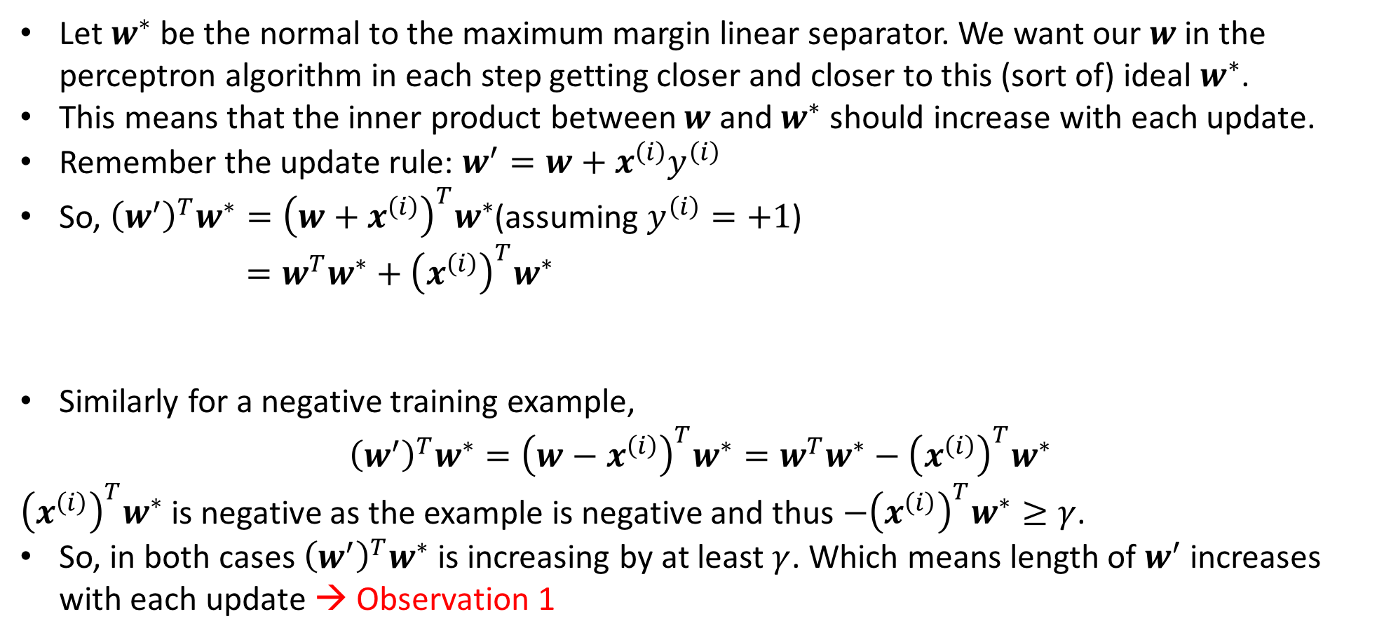


Perceptron Learning Algorithm – Convergence Proof
Let $w^{∗}$ be the normal to the maximum margin linear separator. We want our $w$ in the perceptron algorithm in each step getting closer and closer to this (sort of) ideal $w^{∗}$.
This means that the inner product between $w$ and $w^{∗}$ should increase with each update.
Remember the update rule: $w^{′}=w+x^{\left(i\right)}y^{\left(i\right)}$
So, ${\left(w^{′}\right)}^{T}w^{∗}={\left(w+x^{\left(i\right)}\right)}^{T}w^{∗}$(assuming $y^{\left(i\right)}=+1$) $=w^{T}w^{∗}+{\left(x^{\left(i\right)}\right)}^{T}w^{∗}$
Similarly for a negative training example,
$${\left(w^{′}\right)}^{T}w^{∗}={\left(w−x^{\left(i\right)}\right)}^{T}w^{∗}=w^{T}w^{∗}−{\left(x^{\left(i\right)}\right)}^{T}w^{∗}$$
${\left(x^{\left(i\right)}\right)}^{T}w^{∗}$ is negative as the example is negative and thus $−{\left(x^{\left(i\right)}\right)}^{T}w^{∗}≥γ$.
So, in both cases ${\left(w^{′}\right)}^{T}w^{∗}$ is increasing by at least $γ$. Which means length of $w^{′}$ increases with each update → Observation 1
Previous $w^{T}w^{∗}$
This is at least $γ$

Slide 13
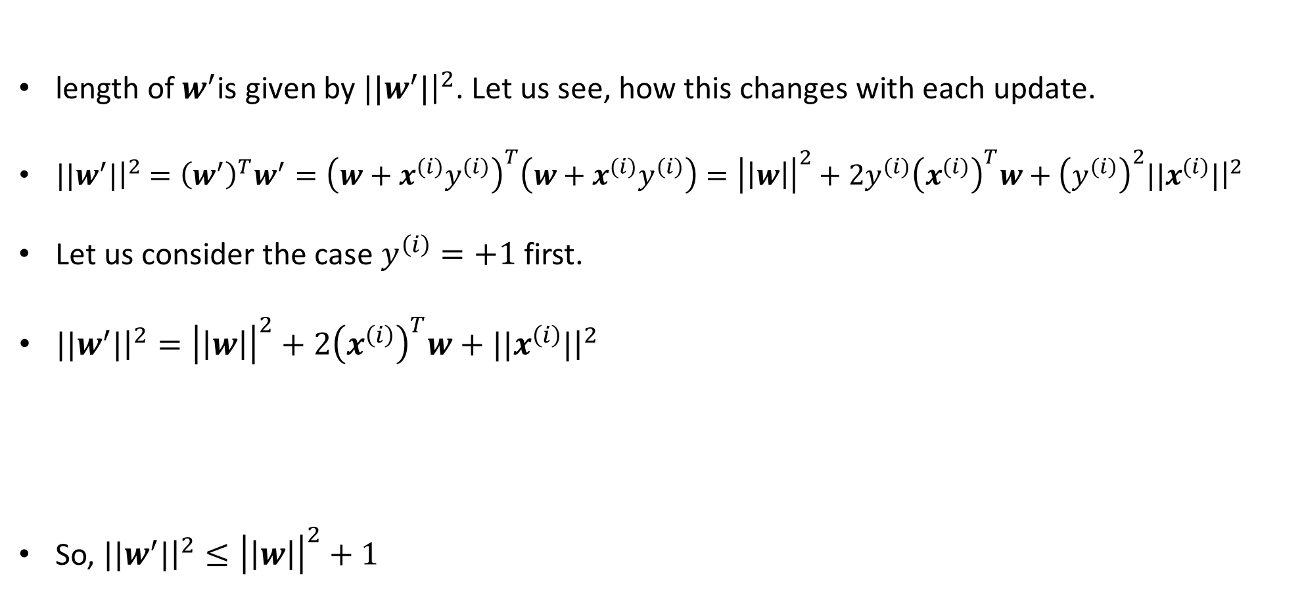
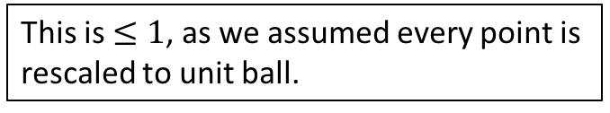
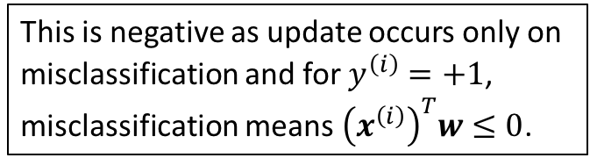
Perceptron Learning Algorithm – Convergence Proof
length of $w^{′}$is given by ${||w}^{′}|{\left.​\right|}^{2}$. Let us see, how this changes with each update.
${||w}^{′}|{\left.​\right|}^{2}={\left(w^{′}\right)}^{T}w^{′}={\left(w+x^{\left(i\right)}y^{\left(i\right)}\right)}^{T}\left(w+x^{\left(i\right)}y^{\left(i\right)}\right)={\left|\left|w\right|\right|}^{2}+2y^{\left(i\right)}{\left(x^{\left(i\right)}\right)}^{T}w+{\left(y^{\left(i\right)}\right)}^{2}{||x}^{\left(i\right)}|{\left.​\right|}^{2}$
Let us consider the case $y^{\left(i\right)}=+1$ first.
${||w}^{′}|{\left.​\right|}^{2}={\left|\left|w\right|\right|}^{2}+2{\left(x^{\left(i\right)}\right)}^{T}w+{||x}^{\left(i\right)}|{\left.​\right|}^{2}$
So, ${||w}^{′}|{\left.​\right|}^{2}≤{\left|\left|w\right|\right|}^{2}+1$
This is negative as update occurs only on misclassification and for $y^{\left(i\right)}=+1$, misclassification means ${\left(x^{\left(i\right)}\right)}^{T}w≤0$.
This is $≤1$, as we assumed every point is rescaled to unit ball.

Slide 14
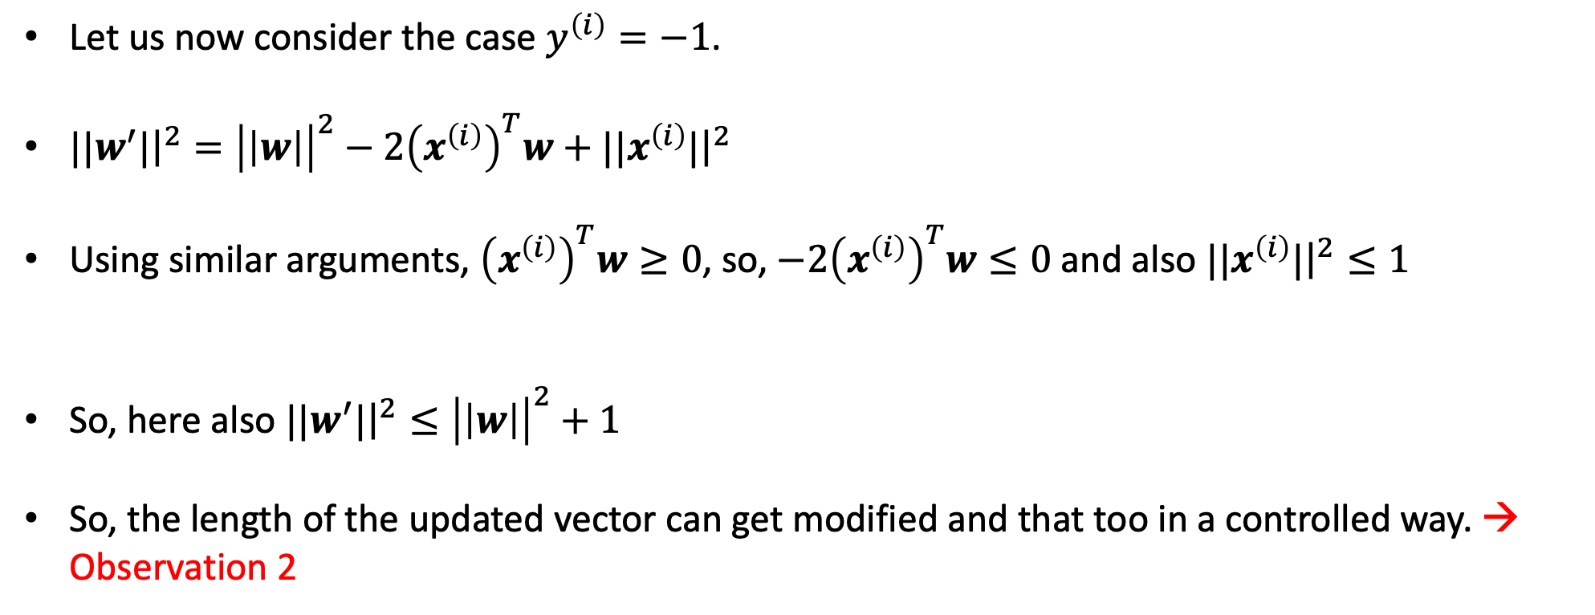
Perceptron Learning Algorithm – Convergence Proof
Let us now consider the case $y^{\left(i\right)}=−1$.
${||w}^{′}|{\left.​\right|}^{2}={\left|\left|w\right|\right|}^{2}−2{\left(x^{\left(i\right)}\right)}^{T}w+{||x}^{\left(i\right)}|{\left.​\right|}^{2}$
Using similar arguments, ${\left(x^{\left(i\right)}\right)}^{T}w≥0$, so, $−2{\left(x^{\left(i\right)}\right)}^{T}w≤0$ and also ${||x}^{\left(i\right)}|{\left.​\right|}^{2}≤1$
So, here also ${||w}^{′}|{\left.​\right|}^{2}≤{\left|\left|w\right|\right|}^{2}+1$
So, the length of the updated vector can get modified and that too in a controlled way. → Observation 2

Slide 15
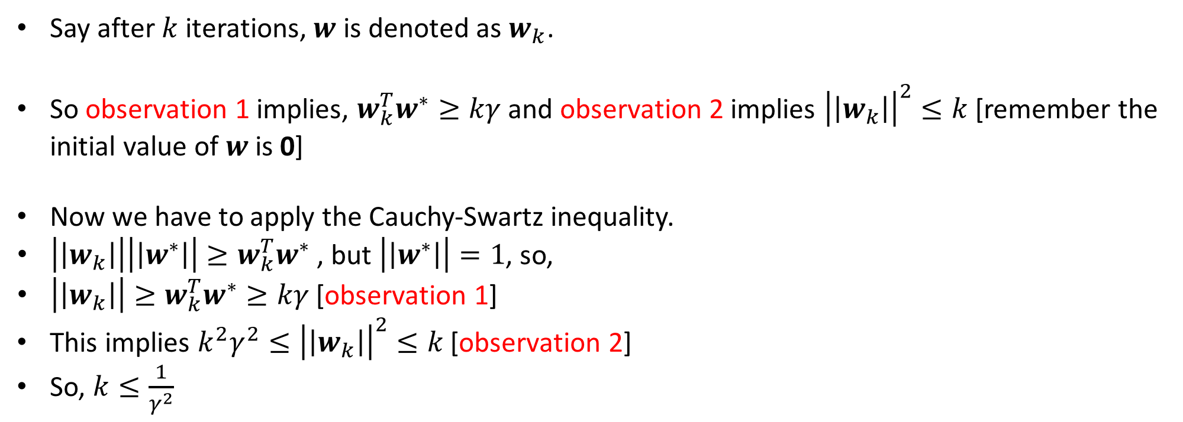
Perceptron Learning Algorithm – Convergence Proof
Say after $k$ iterations, $w$ is denoted as $w_{k}$.
So observation 1 implies, $w_{k}^{T}w^{∗}≥kγ$ and observation 2 implies ${\left|\left|w_{k}\right|\right|}^{2}≤k$ [remember the initial value of $w$ is 0]
Now we have to apply the Cauchy-Swartz inequality.
$\left|\left|w_{k}\right|\right|\left|\left|w^{∗}\right|\right|≥w_{k}^{T}w^{∗}$ , but $\left|\left|w^{∗}\right|\right|=1$, so,
$\left|\left|w_{k}\right|\right|≥w_{k}^{T}w^{∗}≥kγ$ [observation 1]
This implies $k^{2}γ^{2}≤{\left|\left|w_{k}\right|\right|}^{2}≤k$ [observation 2]
So, $k≤\frac{1}{γ^{2}}$
Notes:
What does the last line means -- http://www.cs.columbia.edu/~mcollins/courses/6998-2012/notes/perc.converge.pdf – look at the theorem statement.

Slide 17
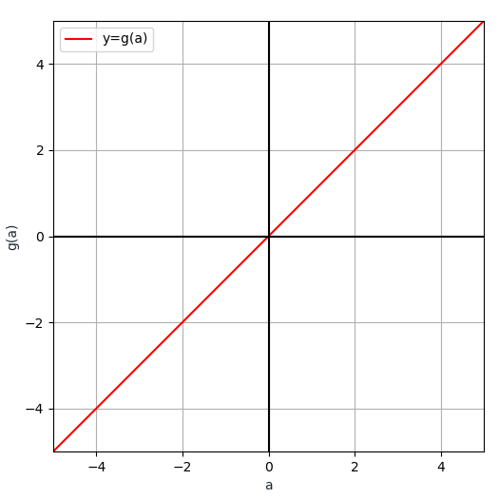
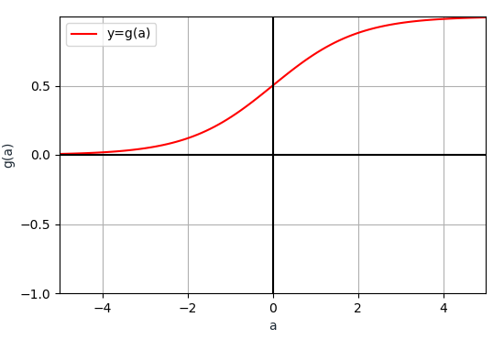
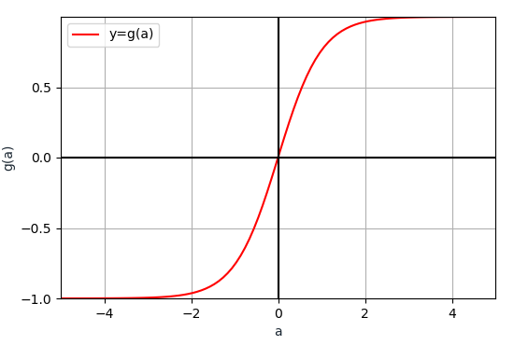
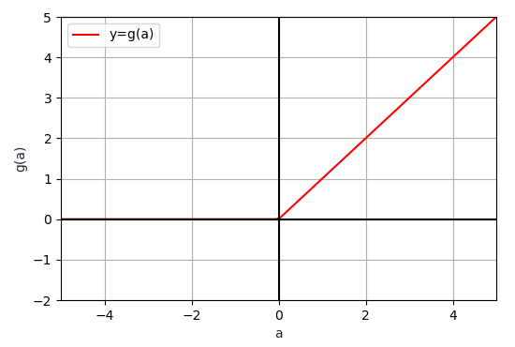
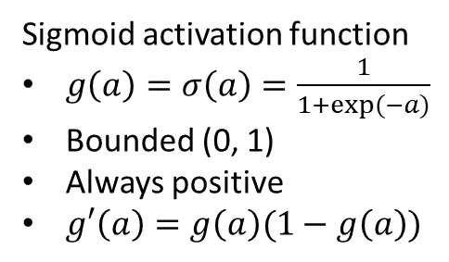
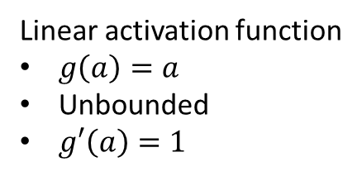
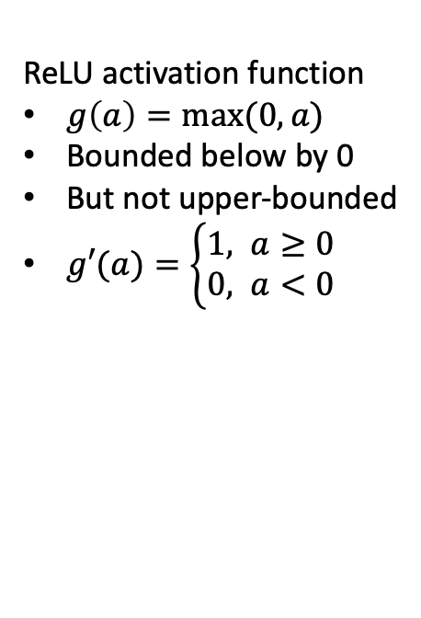
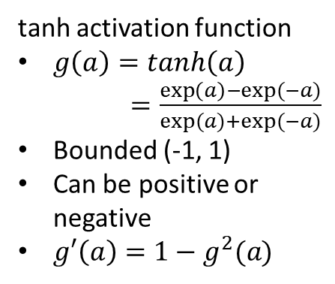
Popular Choices of Activation Functions
Linear activation function
$g\left(a\right)=a$
Unbounded
$g′\left(a\right)=1$
Sigmoid activation function
$g\left(a\right)=σ\left(a\right)=\frac{1}{1+exp⁡(−a)}$
Bounded (0, 1)
Always positive
$g′\left(a\right)=g\left(a\right)(1−g\left(a\right))$
tanh activation function
$g\left(a\right)=tanh\left(a\right)$ $=\frac{\exp\left(a\right)−exp⁡(−a)}{exp⁡(a)+exp⁡(−a)}$
Bounded (-1, 1)
Can be positive or negative
$g′\left(a\right)=1−g^{2}(a)$
ReLU activation function
$g\left(a\right)=max⁡(0,a)$
Bounded below by 0
But not upper-bounded
$g′(a)=\left\{\begin{aligned}1, a≥0 \\ &0, a<0\end{aligned}\right.$

