Slide 1
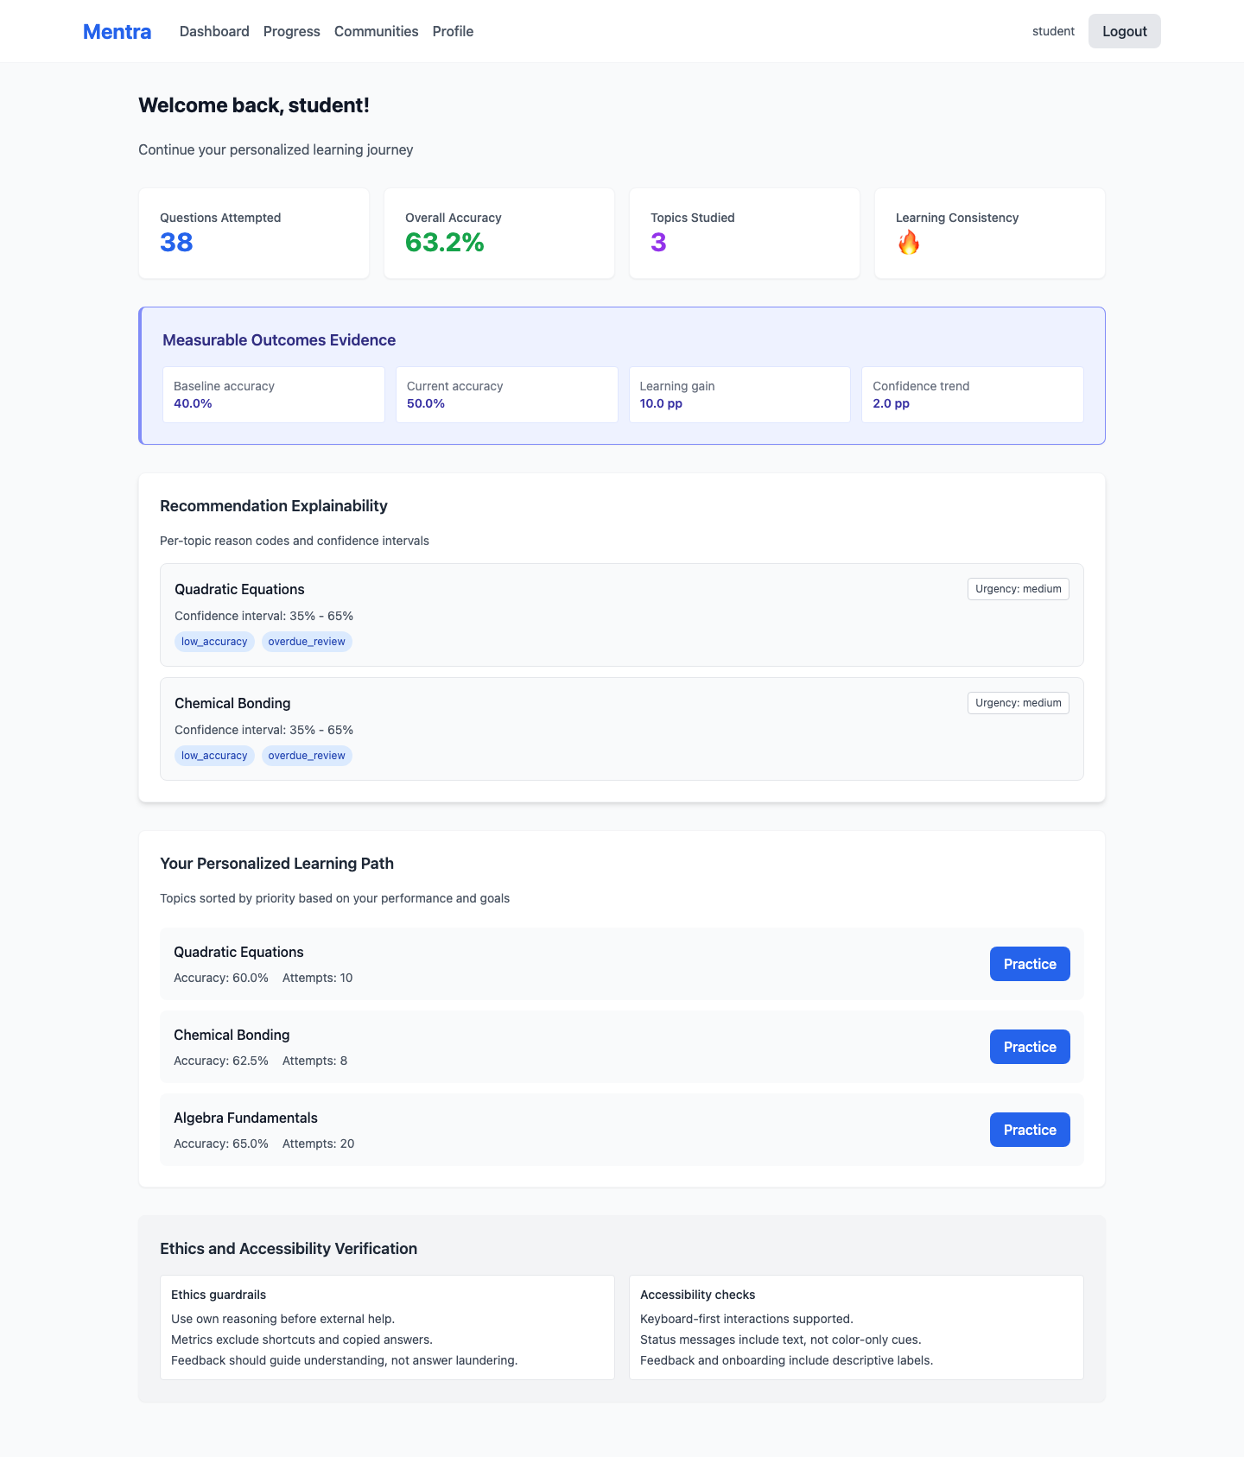
Dissertation Viva
Mentra
AI-driven personal tutor with evidence, explainability, guardrails, and transparent feedback
React + FastAPI + SQLAlchemy + local Ollama-backed feedback
Local demo build
Mentra - viva presentation

Slide 2
Why Mentra Exists
Problem framing and contribution
Traditional e-learning tools give limited feedback after an answer is submitted.
Mentra adds adaptive questioning, immediate explanations, and progress evidence.
The system is designed for a viva-ready dissertation demonstration, not just a static prototype.
Use this slide to frame the problem space.
The emphasis is on personalisation, explanation, and measurable learning impact.
Mentra is a self-contained local demo with seeded data and a local LLM runtime.
Mentra viva presentation

Slide 3
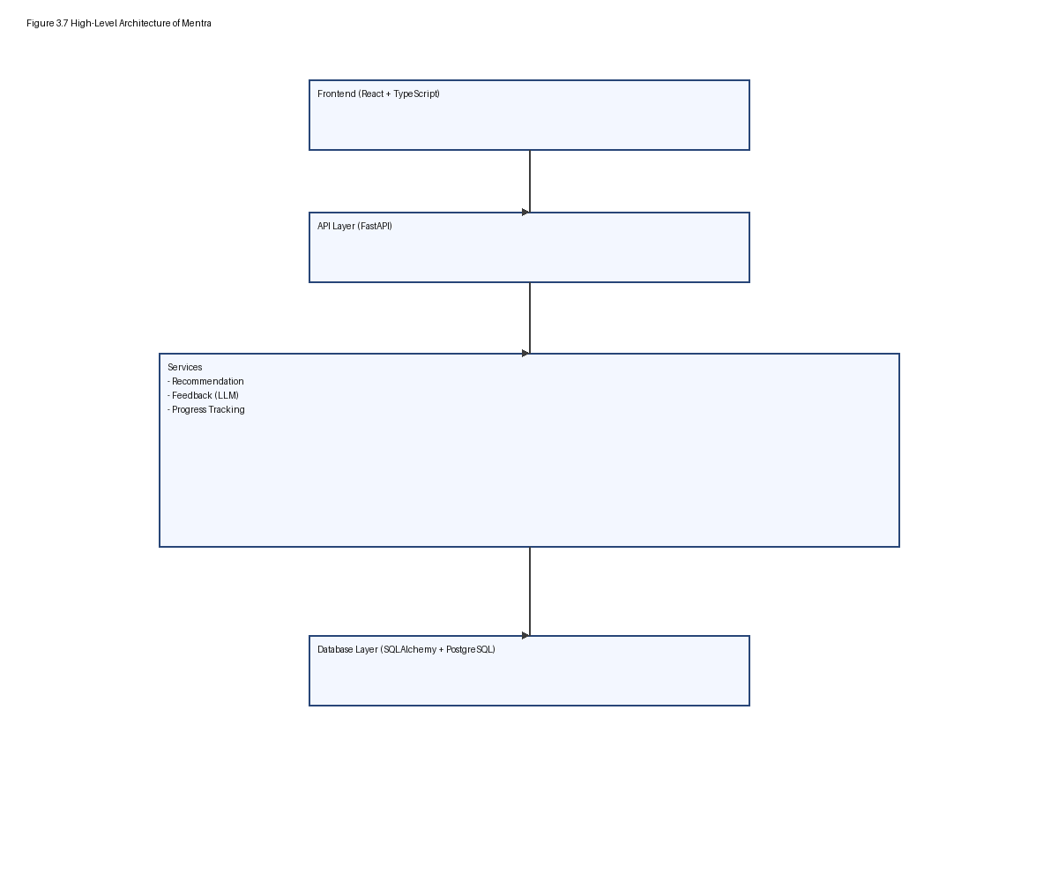
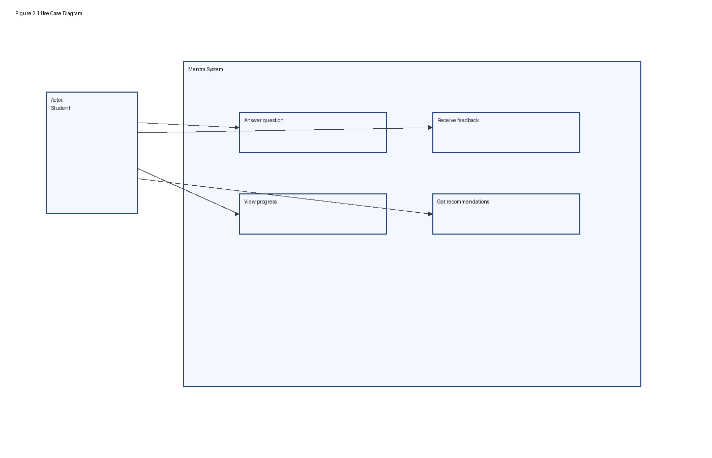
System Architecture
How the app is built
React frontend | FastAPI backend | SQLAlchemy persistence | local Ollama feedback service | seeded demo data
Mentra viva presentation

Slide 4
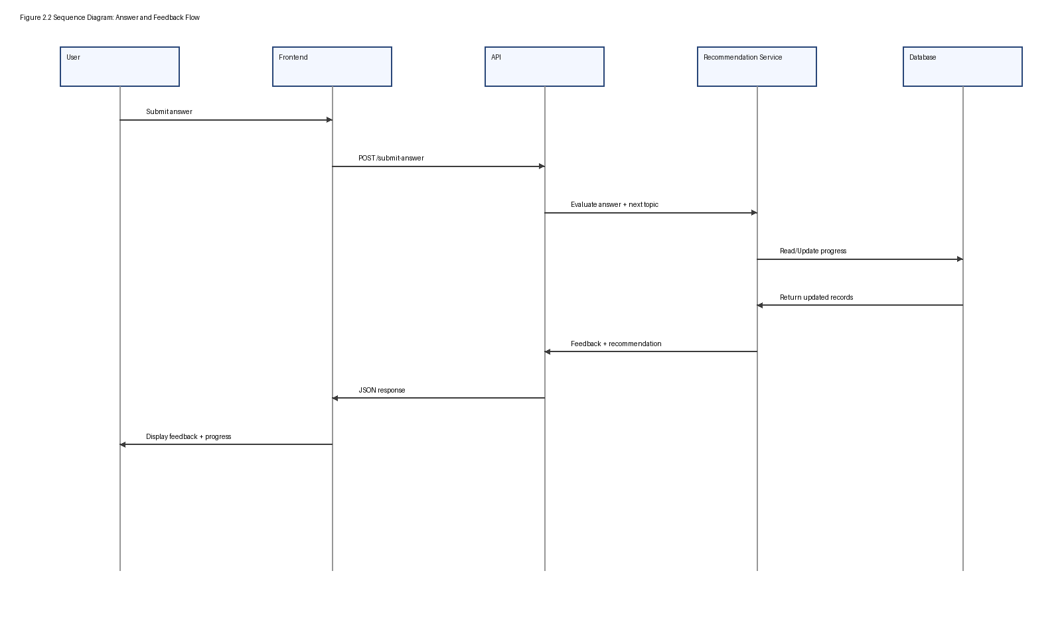
Feedback Flow
Question -> assessment -> explainable output
The learner answers a topic question.
The backend evaluates correctness and stores the answer.
LLM feedback is generated locally through Ollama.
The response includes explanation, key concepts, confidence, and next step.
Progress and evidence endpoints update the dissertation metrics layer.
Mentra viva presentation

Slide 5
Evidence on the Dashboard
Screenshot: dashboard evidence + explainability
Dashboard surfaces measurable outcomes and recommendation explainability.
Baseline vs current accuracy are exposed on the landing dashboard.
Reason codes and confidence intervals make recommendation logic legible.
Mentra viva presentation

Slide 6
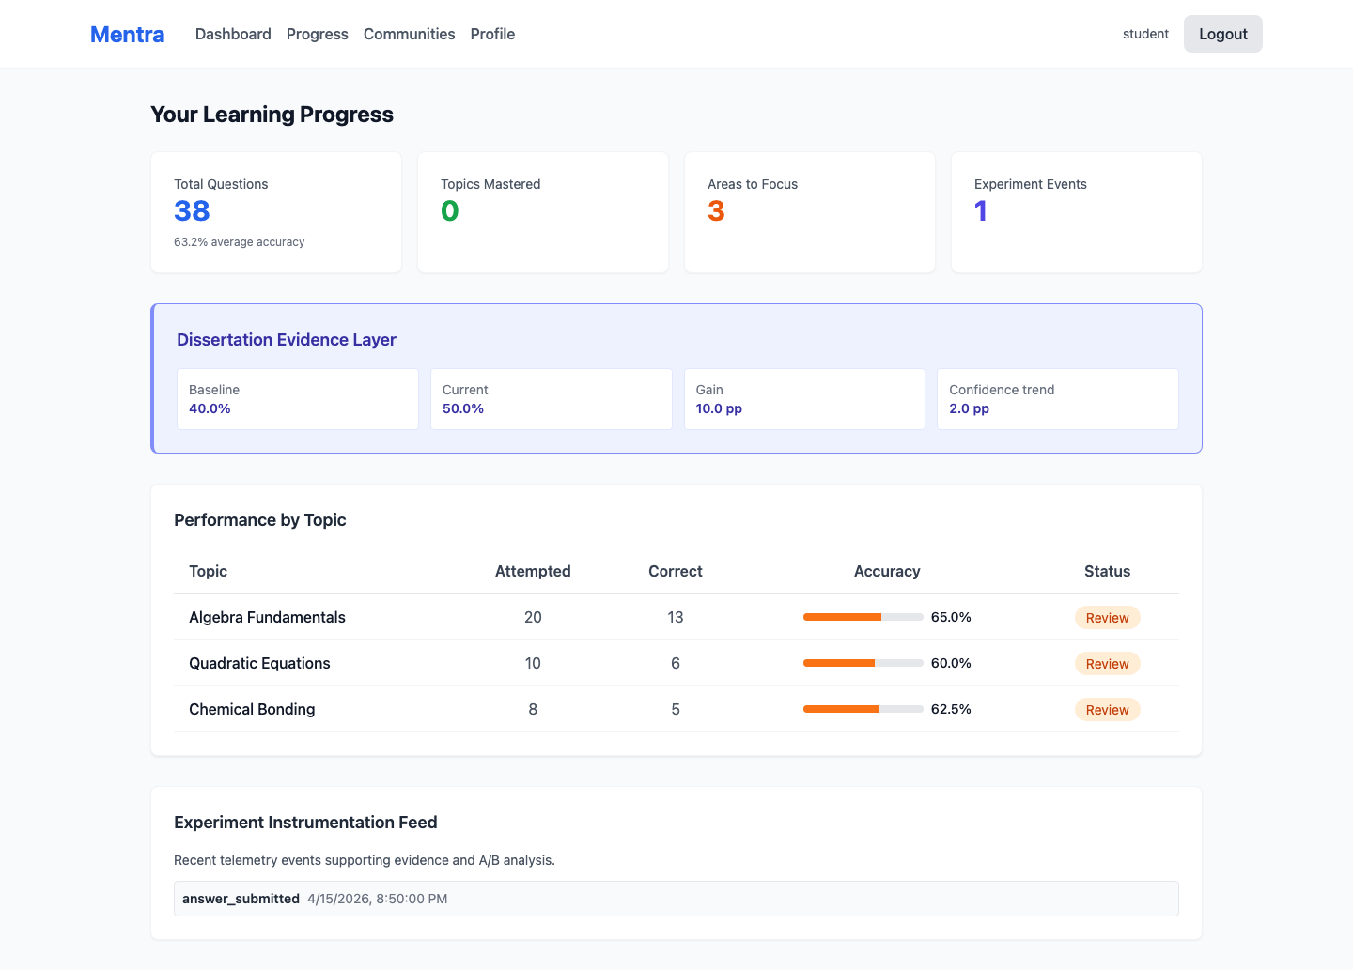
Progress as Evidence
Screenshot: progress analytics and experiment events
Progress page shows learning evidence, topic status, and experiment telemetry.
The evidence layer shows baseline, current accuracy, and confidence trend.
Topic rows summarise attempts, correctness, and mastery status.
Mentra viva presentation

Slide 7
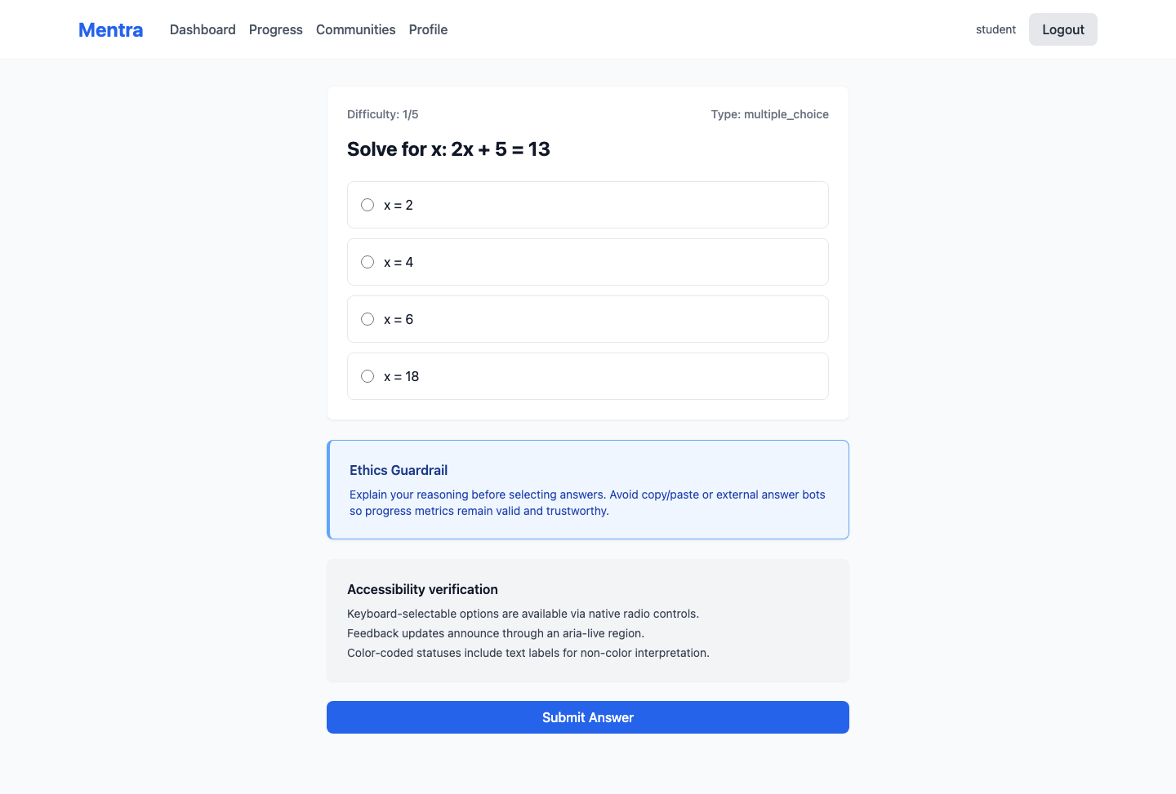
Guardrails and Transparency
Screenshots: safe learning state and explanation rubric
Guardrail state prevents misuse and sets expectations before feedback is generated.
The learning page includes explicit ethical guardrails.
The transparency flow shows rubric-backed feedback after submission.
Mentra viva presentation

Slide 8
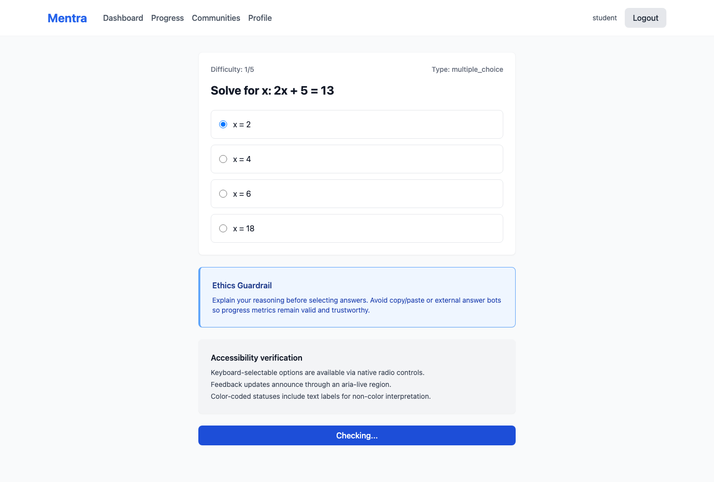
Live Demo Video
Embedded app walkthrough
The embedded demo shows login, dashboard evidence, progress analytics, and the learning feedback transparency flow.
Demo video
Mentra viva presentation

Slide 9
Key Takeaways
Mentra demonstrates adaptive tutoring with explainable feedback.
The dashboard and progress views surface measurable learning evidence.
Guardrails and transparency screens show the system is designed for responsible use.
The local Ollama-backed runtime keeps the demo self-contained for viva delivery.
Questions and discussion

